Slide 1

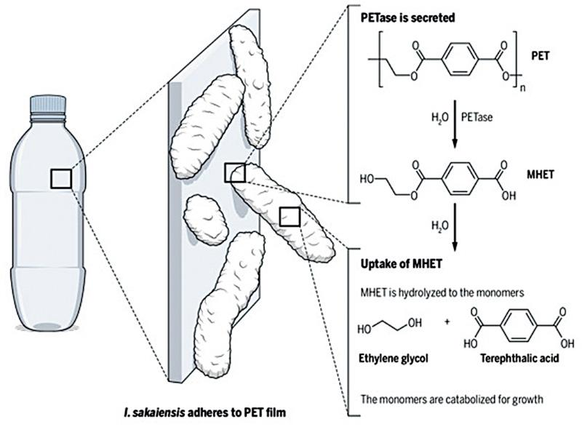
Plastic Degradation System
Authors: Peter Wilson, Kelly Xu, Yuying Fan, Olivia Yang, Bonita Huang, Vaibhav Gupta, Julia Wu, Nitya Aryasomayajula, Emily Liu, Abby Dillon, Apurva Joshi, Riona Chen
Advisor: Aaron Mathieu
Problem: PET plastic buildup has become a major environmental concern and an ecological threat, while the natural breakdown process takes 450-1000 years.
Solution: To genetically engineer yeast, S. cerevisiae, to break down PET by using enzyme PETase derived from Ideonella sakaiensis, which breaks down into MHET(mono-2 hydroxyethyl), an environmental threat as well. MHETase can then be used to catabolize MHET into terephthalate and ethylene glycol.
https://en.wikipedia.org/wiki/File:Image-bacteria-eat-plastic-590x433.jpg
Notes:
The advantage over I. sakaiensis: I sakaiensis is slow - we need to make it faster for large-scale bio-remediation. That means genetic engineering. It's much easier to put the gene into yeast (a very well-characterized system) than muck around in an unknown bacteria.
The big difference our project has with other projects that have used PETase to break down PET is the time-delay kill switch: this means that large-scale release for bioremediation is much less dangerous.

Slide 2
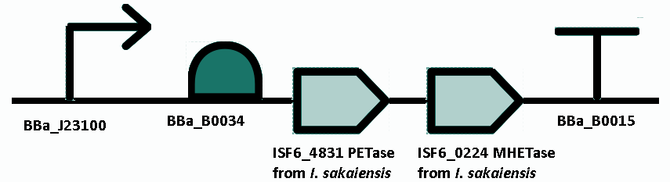
System Parts
IPTG
IPTG
Constitutive promoter
RBS
PETase gene
MHETase gene
Terminator

Slide 3
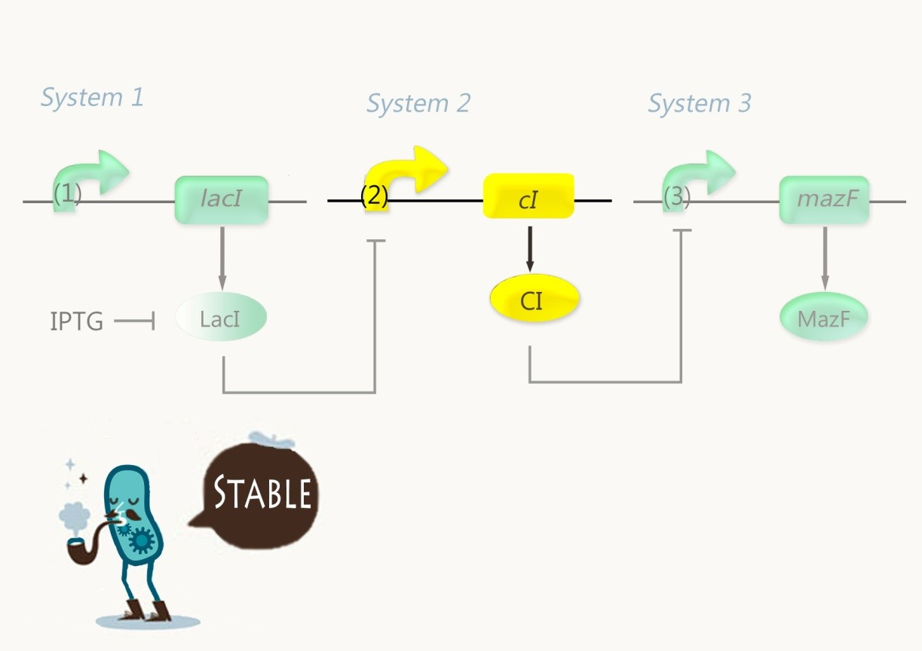
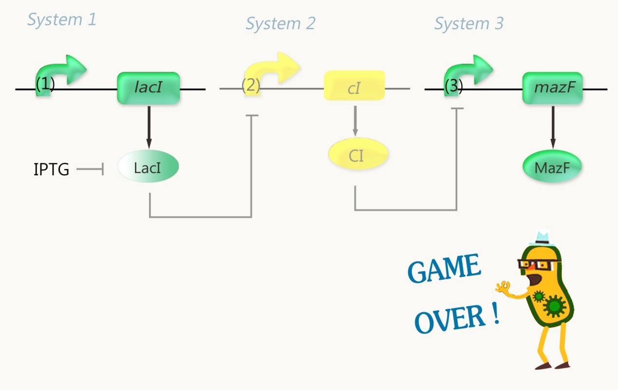
Fail-safe kill switch
System needs to have time to degrade plastic but then die
Solution: Time-delay kill switch
  Biobrick part BBa_K1405008
  After removal of IPTG, dies after time delay
  Delay needs tuning: simulation says 4-5 hours
http://2014.igem.org/wiki/images/1/10/Bnu_safety07.jpg

Slide 4
Future Investigation
Efficacy and Time for PETase and MHETase catabolysis
Kill switch
  How long is the delay?
  How evolutionarily stable is the kill switch?
System performance: saline, pH, and temperature tolerance (pH of PETase function as well as optimal pH and temperature of yeast).
Yeast secretory tags
Acknowledgements
We would like to thank Dr. Natalie Kuldell for her time, expertise, and wonderful lab space.
We would also like to thank our mentor, Anne Burkhardt, for her advice and suggestions.

