Slide 1

SplinterCell: E. coli Splinter Degradation
Problem
Splinters hurt.
They also cause inflammation and heightened risk of infection if left in.
How can we treat splinters minimally invasively?
Possible Solution
Enzymatic cream to dissolve splinters
Two key enzymes
  Endoglucanase
  β-glucosidase
Rapid expression system using E. coli cell lysates (TxTl)
Authors: Caleb Trotz, Lee Dong, Vareesh Balaji, Sid Bhatt, Soumili Dey, Anne Fu, Ramita Kommuru, Zee Kwong, Bernice Mohanadhas. Advisor: Aaron Mathieu

Slide 2
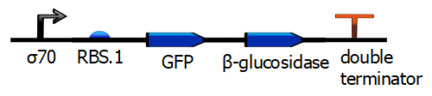
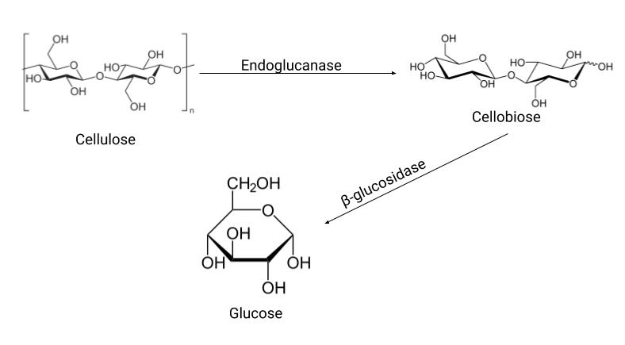
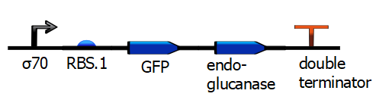
SplinterCell
Model System: Diagram
Biochemical Pathway
Cellulosic material dissolution

Slide 3
SplinterCell
Initial Labs
GFP Transcription-Translation Lab (TxTl)
Plasmid DNA isolation (miniprep)
Plasmid digests
  EcoRI, PstI
Initial Labs: Results
+GFP TxTl sample showed GFP expression
-GFP showed no expression

Slide 4
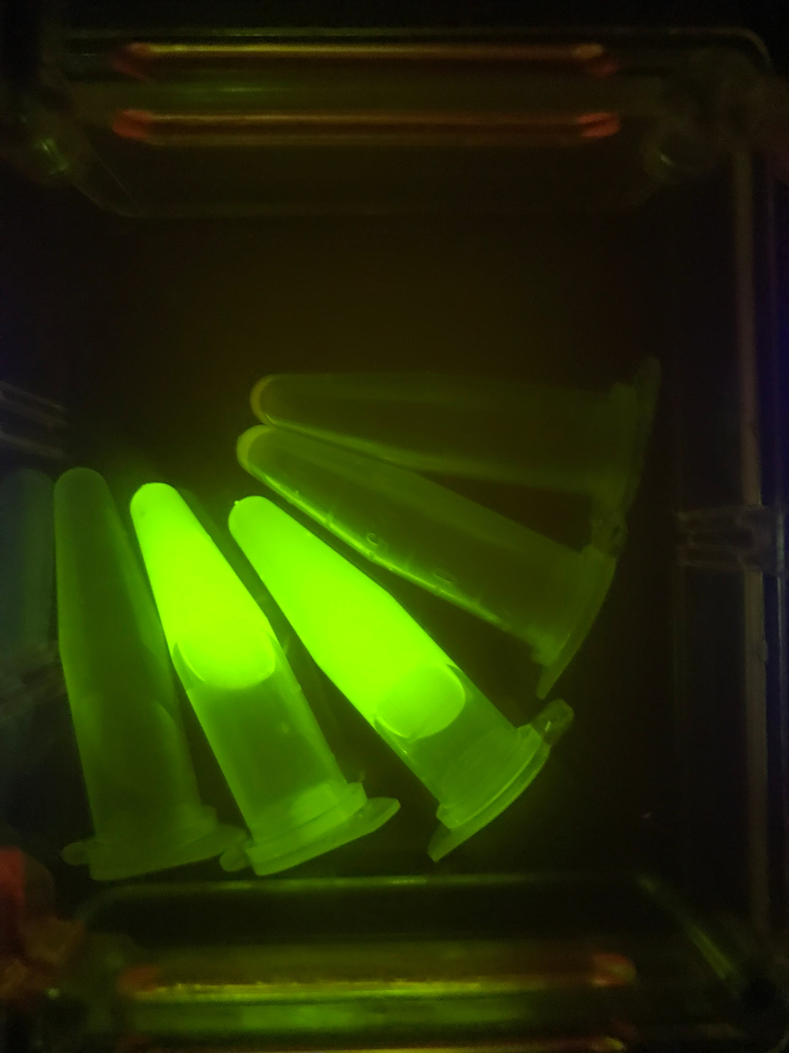
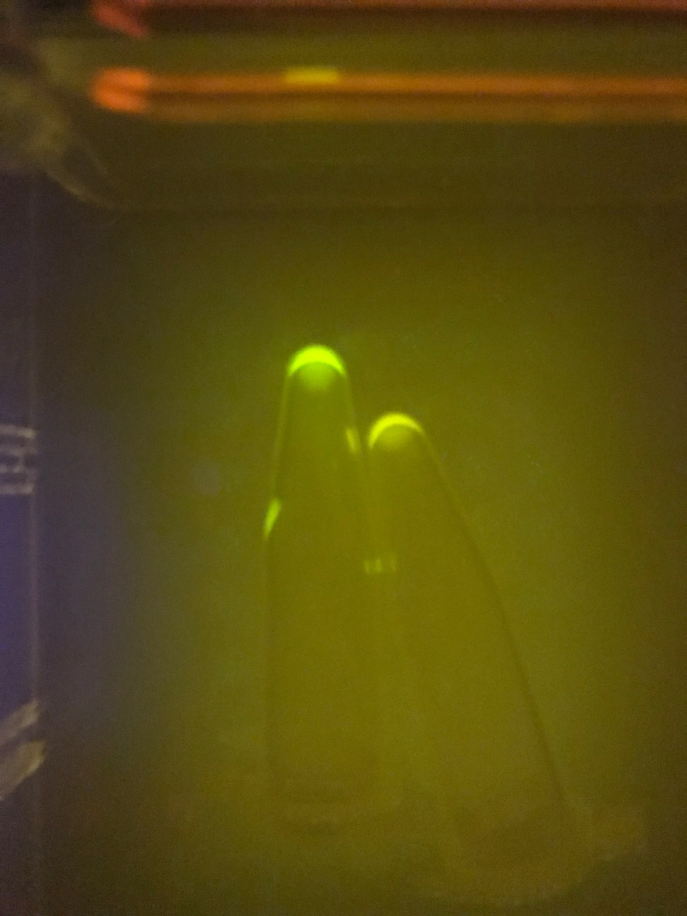
SplinterCell
GFP Lab Results
Clockwise from bottom left: 3 highlighter standards, +GFP, -GFP
Left to Right: +GFP, -GFP

Slide 5
SplinterCell
Labs in Process
GFP constructs
  β-glucosidase assembly
  Endoglucanase assembly
Gel electrophoresis
  Verifies DNA of interest (ORF)
Future Labs
Protein purification
  His-tag and Ni²⁺ column
Enzymatic assays
Product development
  Safety testing
Acknowledgements
We would like to thank Dr. Natalie Kuldell for her time, expertise, and wonderful lab space.
We would also like to thank our mentor, Anne Burkhardt, for her advice and suggestions.

