Slide 1
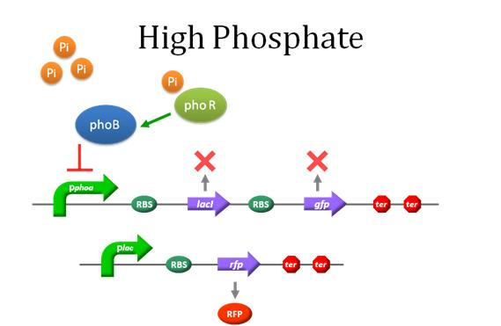
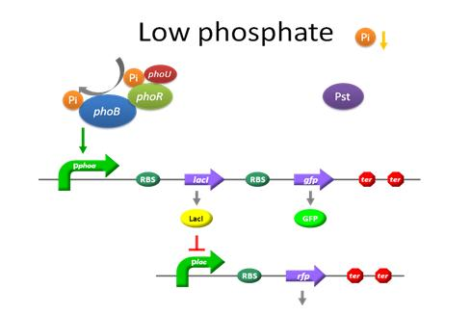

THE EFFECT OF PHOSPHORUS CONCENTRATION ON THE FLOURESCENCE INTENSITY OF E.COLI K12
Anirudh Gadicherla, Luna Li, Tejas Marimuthu, Akshaj Nampelly, Joseph Nguyen, Ansel Sanchez, Ishika Singh, Shivani Singh, and Jonathan Warga
Teacher Mentor: Mrs. Susan Koujak
Briar Woods High School
Interactive!
Click on any of these bubbles to jump to each section
Background
Goals
Phosphorus is essential to the human body, helping with bone mineralization, energy production, cell-signaling, and regulation of acid-base homeostasis. In a healthy individual, phosphorus levels range from 2.5 to 4.5 mg/dL in the bloodstream. While phosphorus is beneficial to the body, high concentrations of phosphorus can contribute to increased rates of cardiovascular disease. Along with that, high concentrations of phosphorus can also cause hyperphosphatemia, a condition where there is an excessive buildup of phosphorus in the blood. Phosphorus is regulated by the kidneys, and in conditions such as CKD (Chronic Kidney Disease), the kidneys are unable to remove sufficient levels of phosphorus from the bloodstream. As the concentration of phosphorus increases in the body, it continues to buildup in the bloodstream, making the blood toxic. An imbalance in the calcium to phosphorus intake ratio can cause osteoporosis.
The main promoters that regulate phosphorus in E.coli are a part of a series called the pho-regulon. The regulon consists of phoA, phoB, phoU, phoR, and other pho genes. PhoA acts as a repressor at high phosphorus concentrations, helping the bacteria regulate the amount phosphorus that enters and remains in the bacteria.
.
Engineer E.coli to detect high concentrations of phosphorus
The goal is to modify the phoA promoter in E.coli bacteria. The phoA promoter acts as a repressor, because it suppresses fluorescent proteins. This experiment is designed to modify a phoA sequence to code for a Green Fluorescent Protein (GFP) gene sequence when the concentration of phosphorus is low and and a Red Fluorescent Protein (RFP) gene sequence when there is a high concentration of phosphorus.
\
Model of our experiment, but with phoB promoter
Adapted from: Team:UAB-Barcelona/Modeling2 Phosphate Biosensor Model
Interactive!
Click here on any slide to return to the title slide
INTRODUCTION
ePosterBoards Template

Slide 2
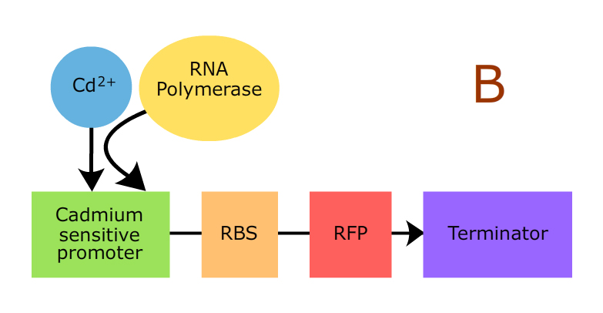
THE EFFECT OF PHOSPHORUS CONCENTRATION ON THE FLOURESCENCE INTENSITY OF E.COLI K12
Anirudh Gadicherla, Luna Li, Tejas Marimuthu, Akshaj Nampelly, Joseph Nguyen, Ansel Sanchez, Ishika Singh, Shivani Singh, and Jonathan Warga
Teacher Mentor: Mrs. Susan Koujak
Briar Woods High School
Interactive!
Click on any of these bubbles to jump to each section
Before Coming up with our experiment, we thought of some methods of phosphorus detection
Method 2: Designing a Phosphorus Sensitive Promoter
This idea was inspired from a BioTreks project in which the group designed a cadmium sensitive promoter to detect the presence of cadmium.
Method 1: Quorum Sensing
Goal: Connect phosphate detection to quorum sensing
Steps:
High Phosphate concentration stimulates autoinducer production
Autoinducers bind to luxR autoinducer receptor
luxR-Autoinducer complex binds to operon
Transcription of lux genes occurs
Transcription of luxA and luxB genes causes Luciferase to be synthesized
Luciferase redox-reaction causes blue-green light to be produced
Bacterium glows
Adapted from: Katherine Hou, Hwiyeon Lim, Manon Miller “Cadmium is Badmium” BioTreks 2017
Interactive!
Click here on any slide to return to the title slide
METHODS
ePosterBoards Template

Slide 3
THE EFFECT OF PHOSPHORUS CONCENTRATION ON THE FLOURESCENCE INTENSITY OF E.COLI K12
Anirudh Gadicherla, Luna Li, Tejas Marimuthu, Akshaj Nampelly, Joseph Nguyen, Ansel Sanchez, Ishika Singh, Shivani Singh, and Jonathan Warga
Teacher Mentor: Mrs. Susan Koujak
Briar Woods High School
Interactive!
Click on any of these bubbles to jump to each section
Future Directions
References
Even though our group hasn’t been able to do the experiment during the season, we plan to do the experiment over the course of the next 3-4 months and possibly continue this on to IGEM
http://2013.igem.org/Team:Tokyo_Tech/Experiment/phoA_Promoter_Assay#3-
1._Before_inducing_by_phosphate_concentration
https://www.merckmanuals.com/home/hormonal-and-metabolic-disorders/electrolyte-balance/hyperphosphatemia-high-level-of-phosphate-in-the-blood
https://www.davita.com/kidney-disease/diet-and-nutrition/diet-basics/high-phosphorus?-investigate-the-cause-when-you-have-kidney-disease/e/8003
http://2009.igem.org/Team:UAB-Barcelona/Project2
Interactive!
Click here on any slide to return to the title slide
DISCUSSION
ePosterBoards Template

