Slide 1
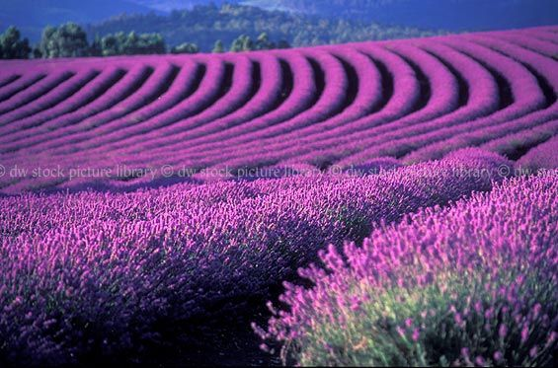
Super Plants to the Rescue
Ayan Chowdhury, TJ Jayasinghe, Aryaman Malliwal, Anuraag Nagaraja

Slide 2

Question
How can we use genetic engineering and the natural world around us to combat the pressing issues of anxiety and depression in our world?

Slide 3
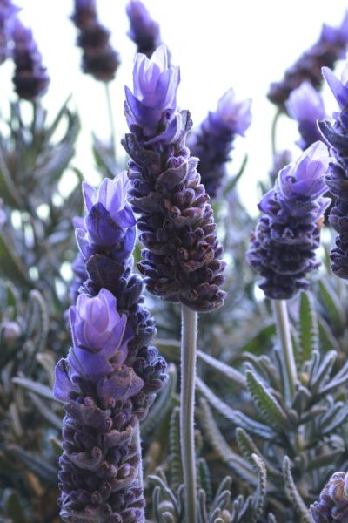
Background
Mental health → Major topic of discussion in our present day
Anxiety disorders
  OCD, PTSD, social anxiety, etc.
Anxiety disorders affect 40 million adults in the US → 18% of the population
25.1% of adolescents aged 13-18 are affected by anxiety disorders
Lavender aroma has been proven to be a successful treatment for anxiety and depression.

Slide 4
Scent Regulation Through Genes
Scent - method of reproduction used to attract pollinators.
A flower's fragrance is made up of volatile chemicals which evaporate in the air and produce scent.
These compounds are called terpenoids are formed through:
* Enzymes (acetyl-CoA) that can be activated through DNA transcriptional activation of SREBP (sterol regulatory element-binding protein-1 and -2).
Activating the genes that code for these proteins would increase the production of lavender scent in the plant
Notes:
I’ll clean this up tonight, but this is the general direction we should go with it

Slide 5


System Level
Lavender Plant
Lavandula
Superplant!

Slide 6
Regulatory Gene (BBa_C0040 → tetracycline repressor from transposon Tn10)
Device/Parts Level
Ribosome Binding Site
(BBa B0034→ Defines binding site efficiency)
Terminator
(BBa_B0015 → double terminator, most commonly used)
Coding Sequence
(BBa_E0040 → green fluorescent protein derived from jellyfish)
Promoter
(BBa_R0040 → TetR repressible promoter)
C-fos gene

Slide 7
Works Cited
Facts & Statistics. (n.d.). Retrieved March 06, 2018, from https://adaa.org/about-adaa/press-room/facts-statistics#
Shaw, D., Norwood, K., & Leslie, J. C. (2011, October 10). Chlordiazepoxide and lavender oil alter unconditioned anxiety-induced c-fos expression in the rat brain. Retrieved March 06, 2018, from https://www.ncbi.nlm.nih.gov/pubmed/21641938
Tholl, D. (2015). Biosynthesis and biological functions of terpenoids in plants. Retrieved March 06, 2018, from https://www.ncbi.nlm.nih.gov/pubmed/25583224
Frequently Used Parts. (n.d.). Retrieved March 06, 2018, from http://parts.igem.org/Frequently_Used_Parts
Lavender Oil for Anxiety and Depression. (2012, February). Retrieved March 06, 2018, from https://www.naturalmedicinejournal.com/journal/2012-02/lavender-oil-anxiety-and-depression-0

