Slide 1
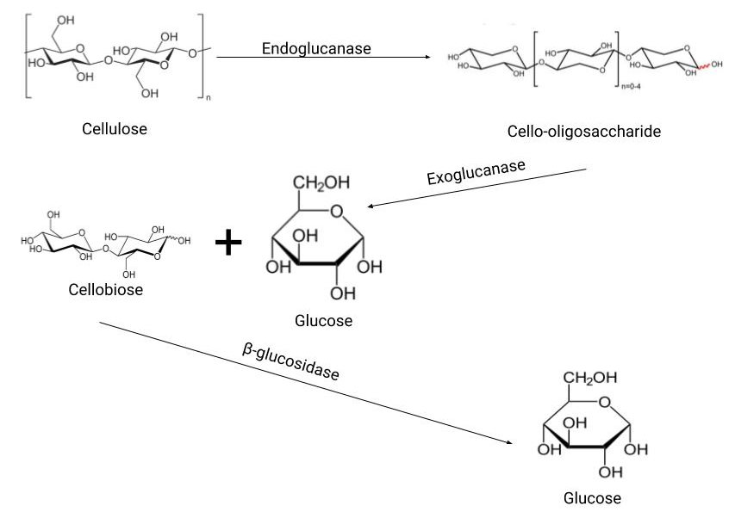
SplintErase
Introduction:
Wood splinters are painful and difficult to remove
Using TxTl, expressed enzymes will degrade lignocellulose into glucose that the body can absorb
Enzymes:
Endoglucanase/Exoglucanase/ Beta-glucosidase: Cellulose degradation
Xylanase: Hemicellulose degradation
Blue Copper Laccase: Lignin degradation
System for Cellulose Degradation:
Authors: Nitya Aryasomyajula, Vareesh Balaji, Abby Dillon, Anne Fu, Rohit Kommuru, Zeeyong Kwong Advisor: Aaron Mathieu

Slide 2
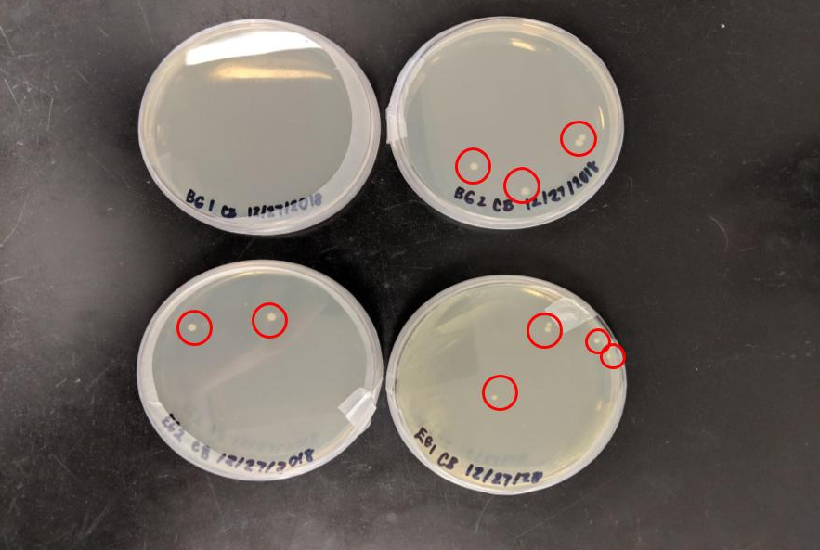
SplintErase
Lab 1: Transformation Lab
Endoglucanase and beta-glucosidase expression in competent cells
Transformed cells were plucked and grown up in LB media
Results:
Image of transformed E.coli grown on LB media. Each plate either shows endoglucanase or beta glucosidase

Slide 3
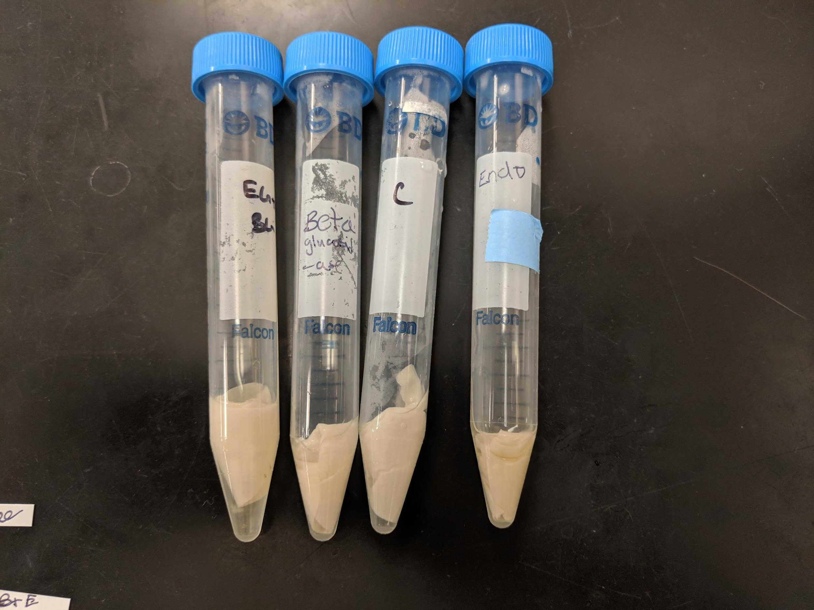
SplintErase
Lab 2: Filter Paper Assay
Used to test whether the endoglucanase and beta-glucosidase degrade cellulose
Observed the decomposition of filter paper and detected the presence of glucose
Image of Endoglucanase, Beta-glucosidase, Endoglucanase + Beta-glucosidase, Negative Control in falcon tubes with filter paper respectively

Slide 4
SplintErase
LAB 2: Filter Paper Assay (Results)
Positive and Negative controls yielded expected results
Endoglucanase, Beta-glucosidase, Endoglucanase + Beta-glucosidase, all lacked glucose
Conclusion
Filter paper was not degraded
Need to add other enzymes for full degradation
Image of the Endoglucanase, Beta-glucosidase, Endoglucanase+Beta-glucosidase, Negative Control and Positive Control of the Glucose test strips

Slide 5
SplintErase
Future Research and Experimentation:
Lignin Degradation: Blue Copper Laccases derived from white rot fungi Degrades into CO₂ and H₂O
Laccases aided with mediators →chemical compounds acting as a carrier between enzyme and substrate
Incorporate exoglucanase and TxTI system in future experiments

