Slide 1
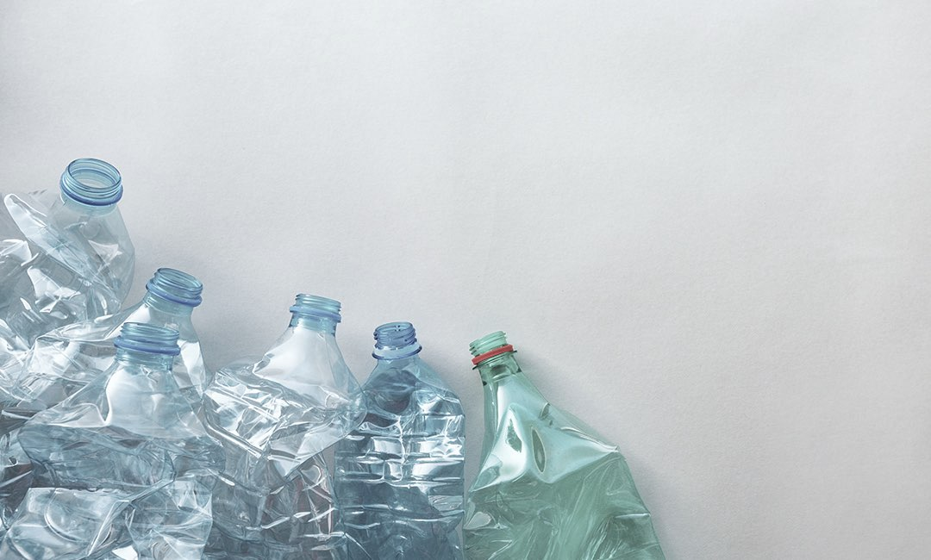
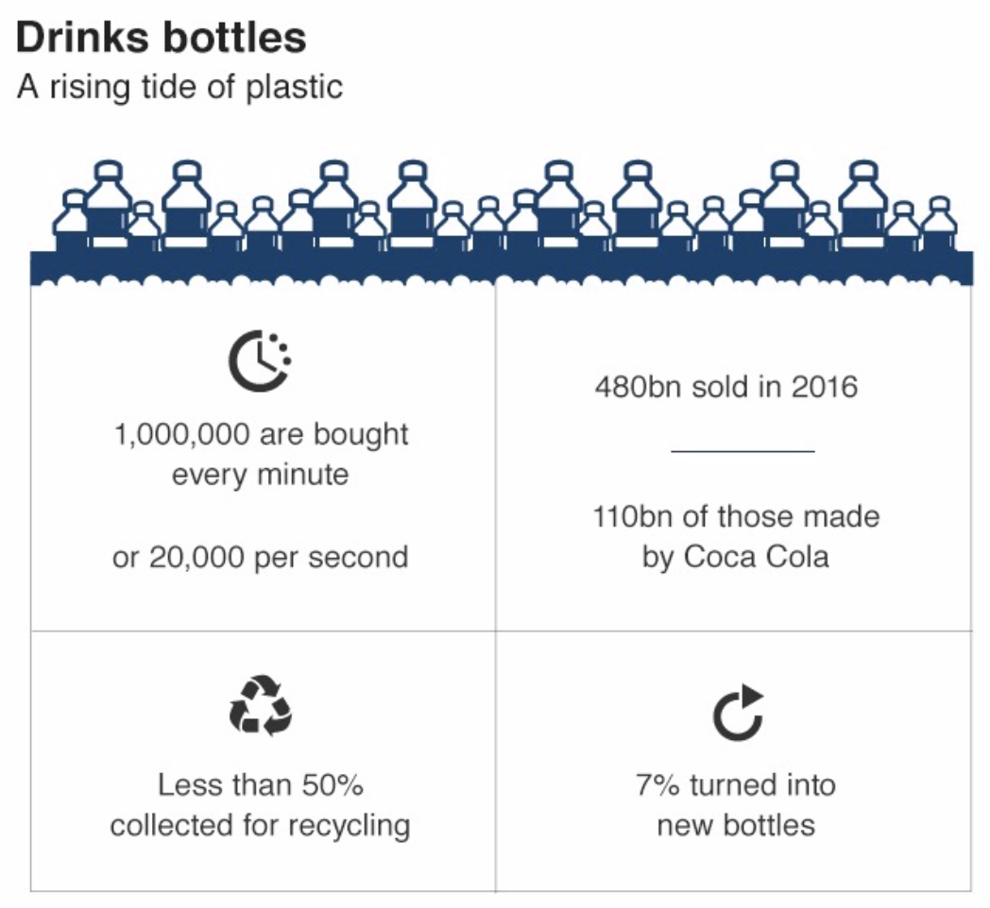
Bottles Be Gone
Problem:
Idea:
To synthetically engineer bacteria that will be placed on the inside of full-length plastic water bottle labels and, in the presence of salt water, produce enzymes to break down the bottles into environmentally benign monomers
Veni Dole, Yashvi Gosalia, Sydney Tran, Puloma Bishnu Teacher: Mrs. L’Ecuyer Mentor: Patrick Holec

Slide 2
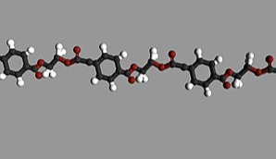
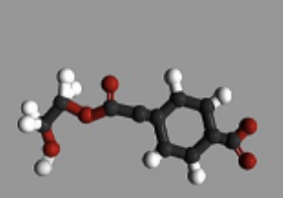
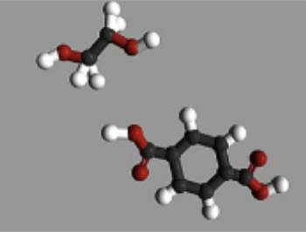
Bottles Be Gone
PET: Plastic in plastic water bottles
MHET: The monomer of PET
Chassis: Bacillus tianshenii
Spore-forming
Marine Isolate
PET
PETase enzyme
MHET
Ethylene Glycol
MHETase enzyme
Terephthalic Acid
Veni Dole, Yashvi Gosalia, Sydney Tran, Puloma Bishnu Teacher: Mrs. L’Ecuyer Mentor: Patrick Holec

Slide 3
Bottles Be Gone
Veni Dole, Yashvi Gosalia, Sydney Tran, Puloma Bishnu Teacher: Mrs. L’Ecuyer Mentor: Patrick Holec

Slide 4
Bottles Be Gone
Polyethylene Terephthalate (PET), the plastic that water bottles are made of, is not naturally biodegradable and accumulates in oceans around the world, causing pollution and environmental damage. Our project, Bottles Be Gone, utilizes genetically engineered halophilic bacteria, Bacillus tianshenii, that can break down PET when in salt water. The bacteria, in their inactive spore form, are placed between the full-length label and the bottle. When they come in contact with salt water, the spores germinate. The growing bacteria then express the two genes coding for the enzymes required for breaking down PET to MHET, and then further to environmentally benign compounds ethylene glycol and terephthalic acid. These compounds can be utilized by the engineered bacteria, as well as other ocean-living bacteria as a carbon source. The two genes coding to break down the bottle are PETase and MHETase, originating from bacterium Ideonella sakaiensis, and are expressed in our Bacillus tianshenii chassis. The gene coding sequences are codon optimized for expression in Bacillus and are engineered for activity in salt water. They are driven by two constitutive Bacillus subtilis promoters (BBa_K143012 and BBa_K143013). Two strong ribosome binding sites for Bacillus subtilis (BBa_K780001 and BBa_K090505) and two terminators (BBa_K780000 and BBa_B0010) that would be codon optimized for Bacillus subtilis are also used. A Bacillus bacteriophage phi29 is part of the design as a kill switch to control the population in the environment if needed. The DNA sequences were sourced from the iGEM Foundation, the National Center for Biotechnology Information, and advice from our mentors.
Veni Dole, Yashvi Gosalia, Sydney Tran, Puloma Bishnu Teacher: Mrs. L’Ecuyer Mentor: Patrick Holec

