Slide 1
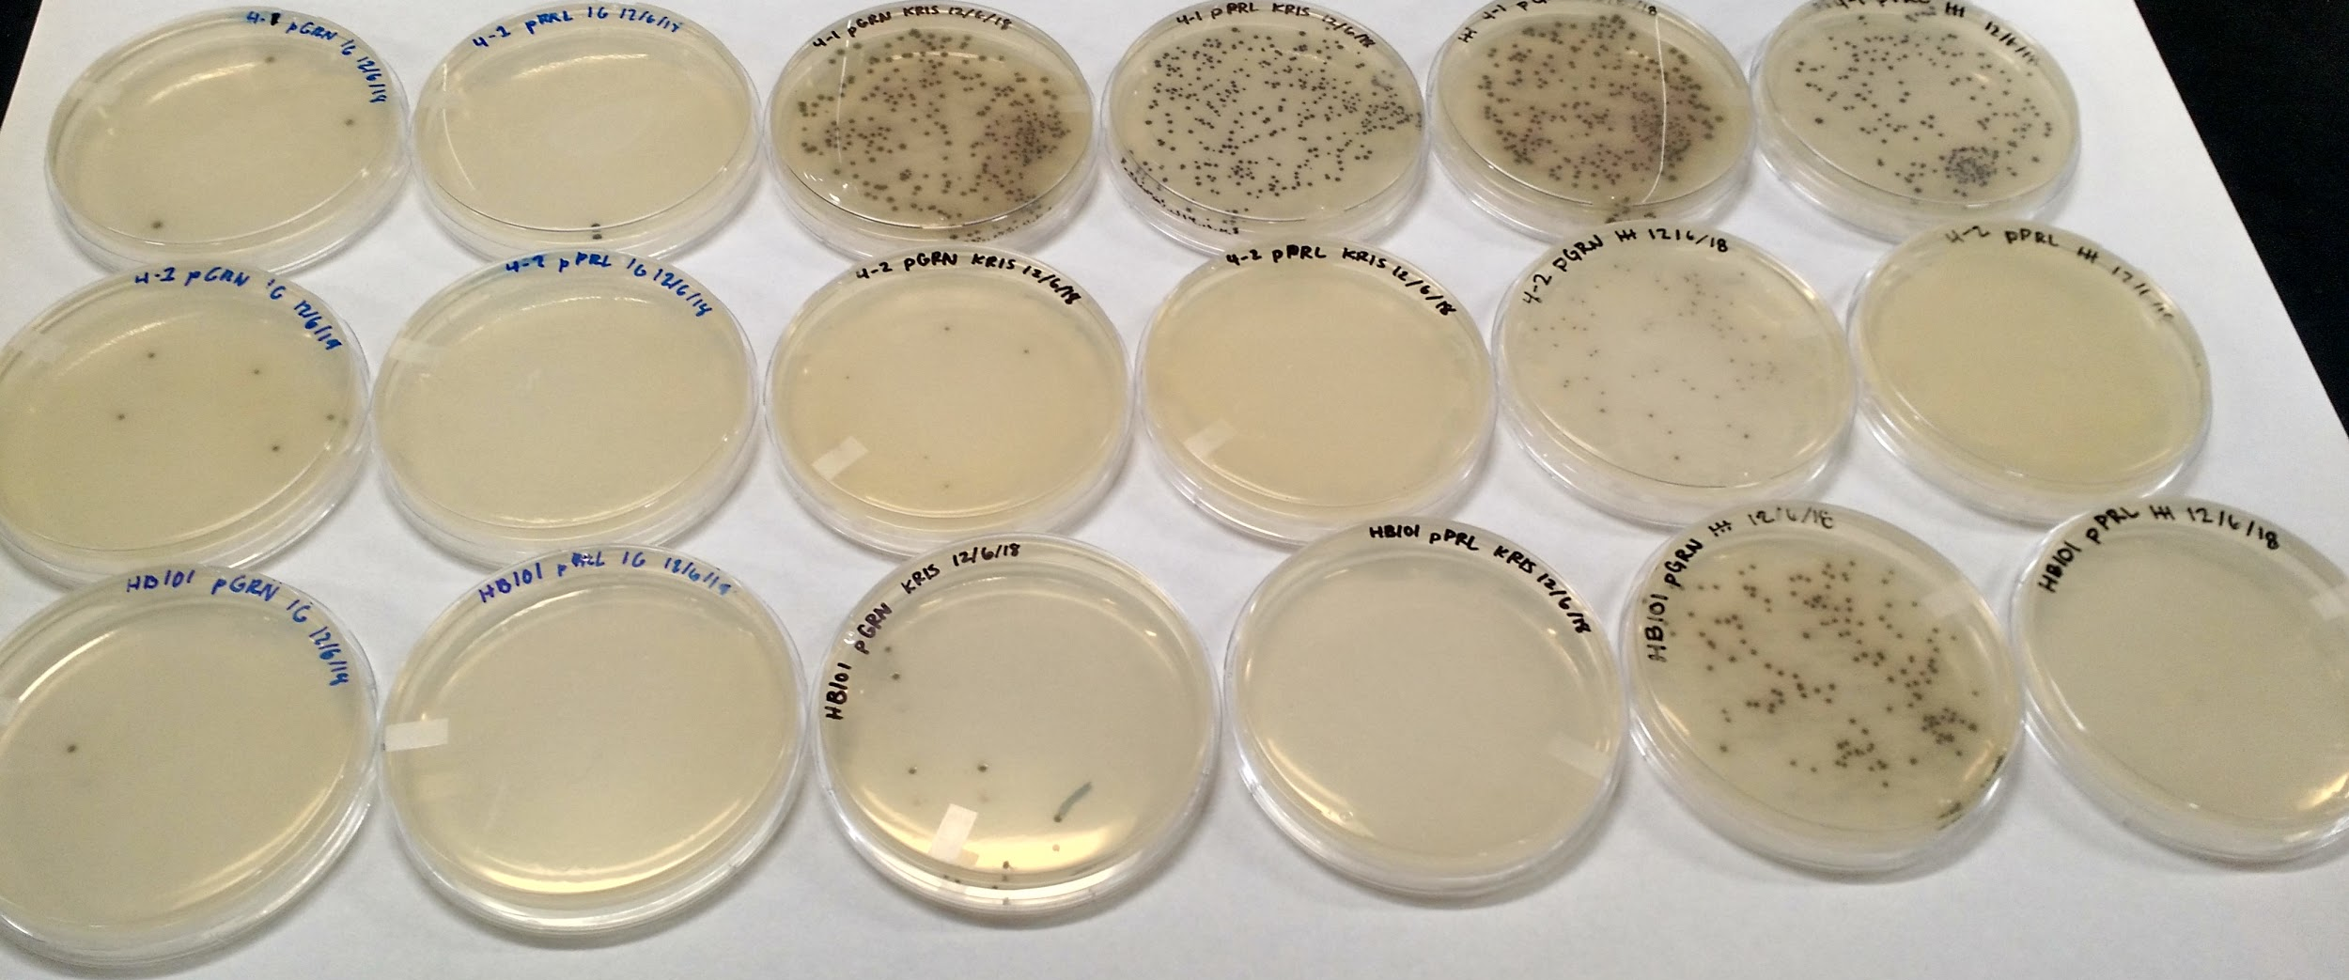
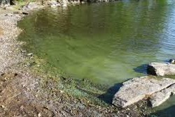
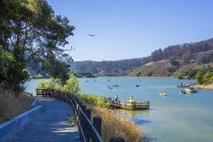
DETECTING TOXIC ALGAE
Holly Henrich, Kristy Chan, Kristi Tu, Molly Brennan, Isabella Stuewe,
Isa Guevara-Longree, Yasmin Alrawi, Melinda Joe, Rohit Sinha
Laura O’Brien and Chris Bing (Advisors), Grace Vezeau (Mentor)
Castro Valley High School
THE PROBLEM
DESIGN/METHODS
RESULTS
toxic algae is an ongoing problem in many communities, including ours
Our local Lake Chobot had an outbreak of blue-green algae due to the drought in 2014
the outbreak killed multiple dogs and lead to our idea
during our research into possible solutions, we have encountered some probkems
In a high school laboratory, we can not experiment with actual toxins
`
A twist on the Colorful World Experiment
indicator of toxic Blue-Green Algae
RFP
Inducible promoter
Ribosome Binding site
rfp gene
terminator
B
Figure 2: Schematic of general design for biosensor of toxic blue-green algae
Figure 3: Results from “Colorful World” transformation, with the addition of one additional chassis
The heat-shock transformation was performed with two plasmids (pGRN and pPRL, which code for green and purple
pigments, respectively) into three different strains of E. coli (4-1, 4-2 and HB101- from BioRad kit for pGLO transformation) as "chassis."
pGRN transformations were successful for all three types of bacteria, but the colonies for 4-1 were larger than in the other two types.
The pPRL transformation only worked in the 4-1 E. coli.
A
Plan:
link an inducible promoter sensitive to a component of blue-green toxic algae to a reporter gene, like RFP
possibly a low oxygen sensor
transform into bacterial chassis (biosensor)
grow biosensor in varying low-oxygen conditions, observe if there are varying degrees of RFP output
modify design as necessary to achieve quick, clear positive result in the presence of harmful levels of toxic blue-green algae
possibly move to cell-free expression
design a portable device that contains our biosensor
https://www.bbc.com/news/uk-england-cumbria-44730910
http://www.redwoodhikes.com/EastBay/Chabot.html
Figure 1: Lake Chabot in Castro valley, CA [A] and a lake blue-green toxic algae bloom [B]
Notes:
Single sided poster!

Slide 2
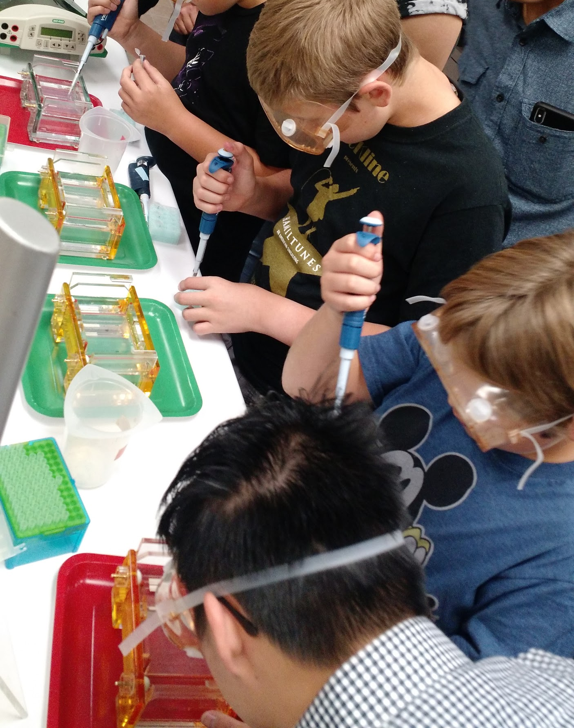
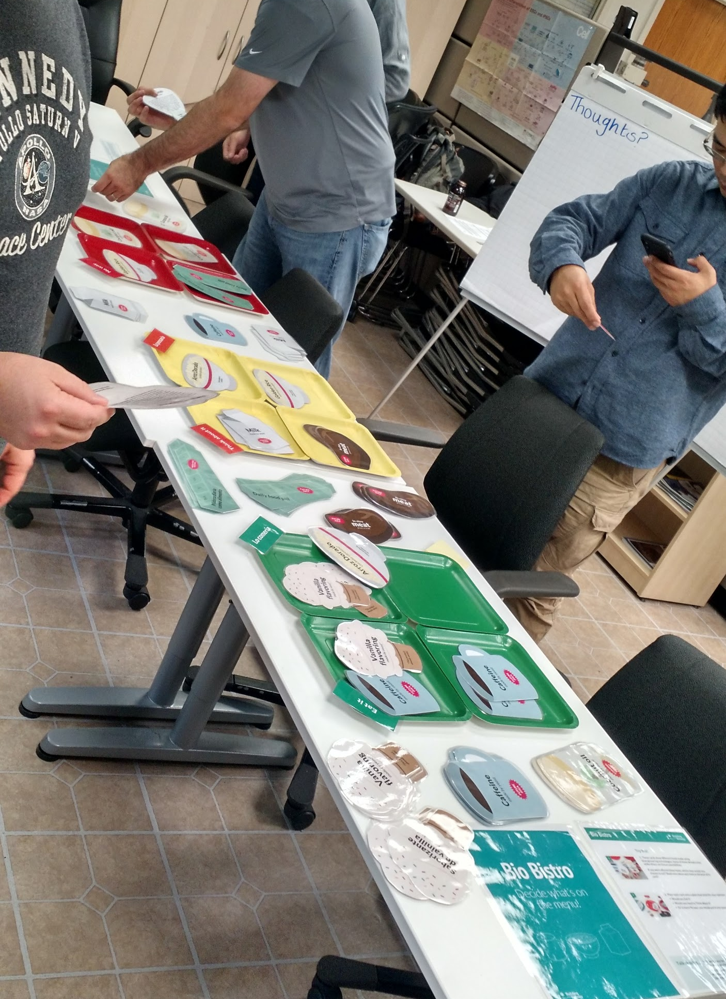
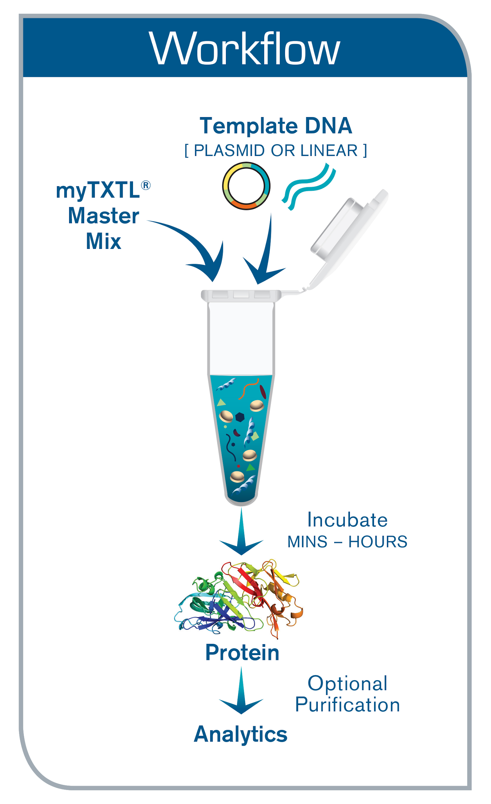
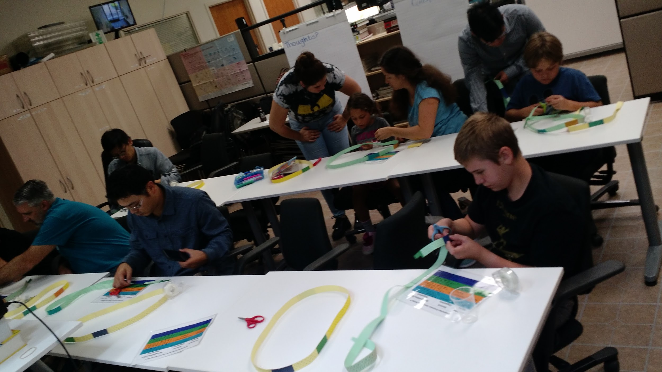
The Future is Now
a workshop presented as part of Synthetic Biology Week
Dye Electrophoresis
Paper Plasmid Engineering
Cell-Free Expression
BioBistro: Decide what’s on the menu!

