Slide 1
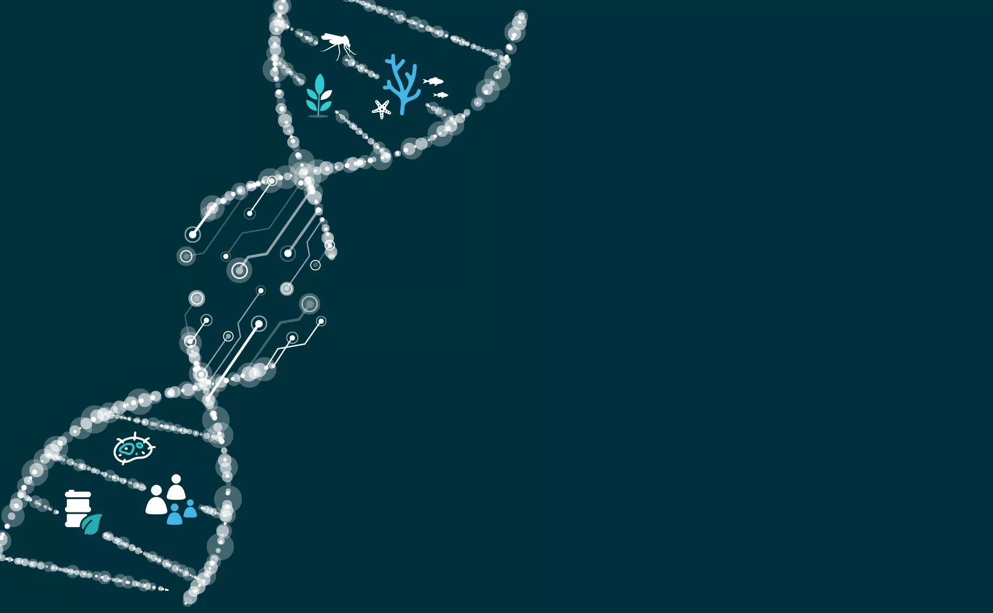
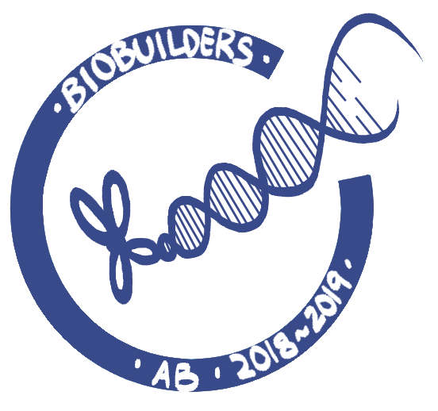

Eutrophication System
Acton Boxborough Regional High School
Problem
Eutrophication - excess nutrients causes toxic algal blooms → less oxygen in air and water, dead organisms, poor air and water quality
Solutions
Extract P from water
Detection, absorption, adhesion
Proposed system: Chassis (E.coli) will absorb P, regulated by “kill switches”
Authors: Julia Wu, Yuying Fan, Annabella Chen, Ramita Kommuru, Bernice Mohanadhas, Soumili Dey, Bonita Huang, Apurva Joshi, Cindy Lu, Dalia Kaghashvili
Advisor: Aaron Mathieu

Slide 2
System Parts
Adhesion:
  Bacterial adhesion appendages
  Mica supported phospholipid bilayer
  Polystyrene particles in buoy
Inducible promoter
  PH089, a phosphate-response gene
Kill switch: Type II toxin-antitoxin system
Addiction: Substance V

Slide 3
Further Details
Adhesion To A Buoy
Purpose: regulate bacteria by keeping them attached
Metal oxides:
  charged bacteria may stick to charged surfaces
Glass:
  Bacterial polarity
Kill Switches
Purpose: regulate bacteria through cell death
Repressible operon:
  Apoptosis is induced in absence of phosphorus
Substance V:
  Synthetic substance needed for E. coli survival

Slide 4
Further Research
Next year aim to run miniprep
  Build system
  Attain local water for testing
Refine kill switch flow
  Further investigate substance V+ repressible operon
Quorum sensing
Acknowledgements: We would like to thank our wonderful teacher Mr. Mathieu for guiding and advising us throughout the project. We would also like to thank our mentor Tatiana Netterfield for helping us refine our ideas and assisting with research.

