Slide 1



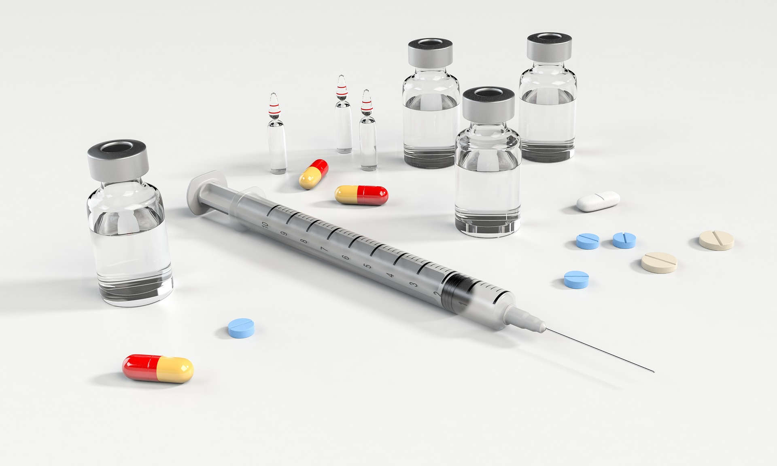
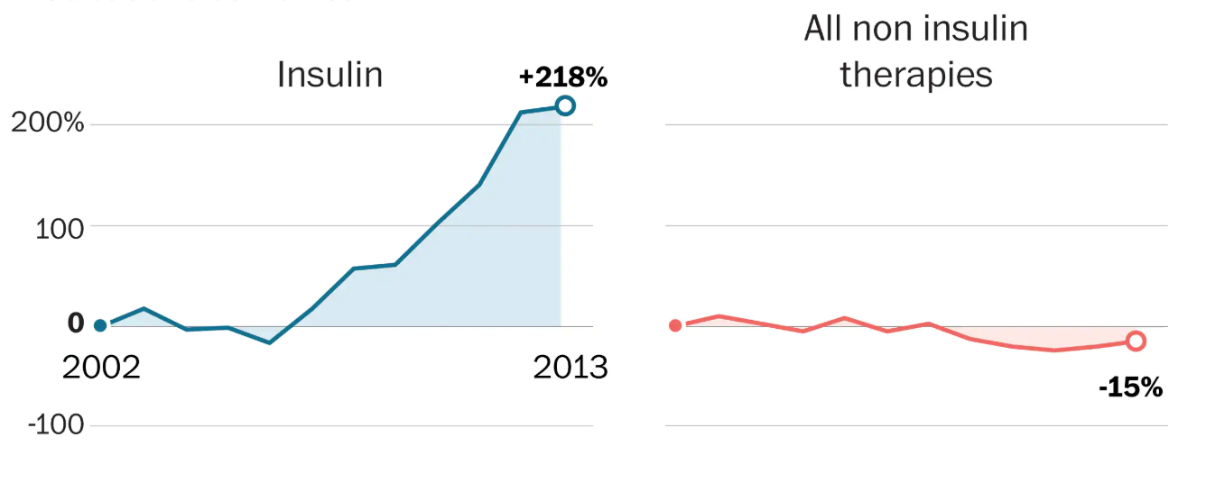
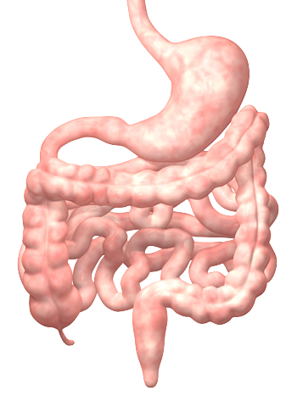
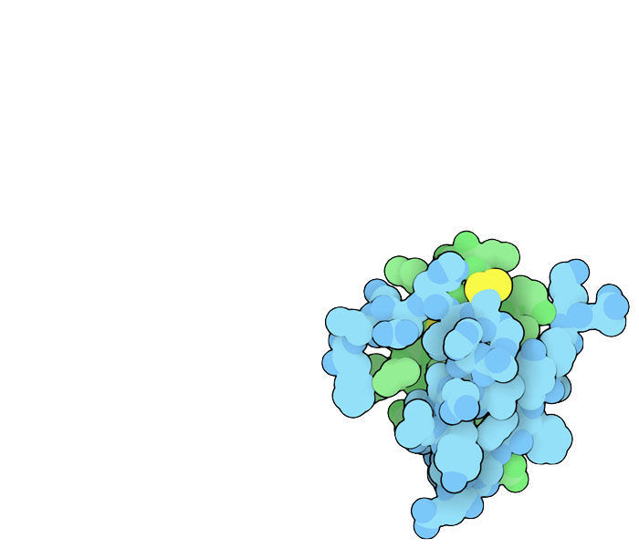
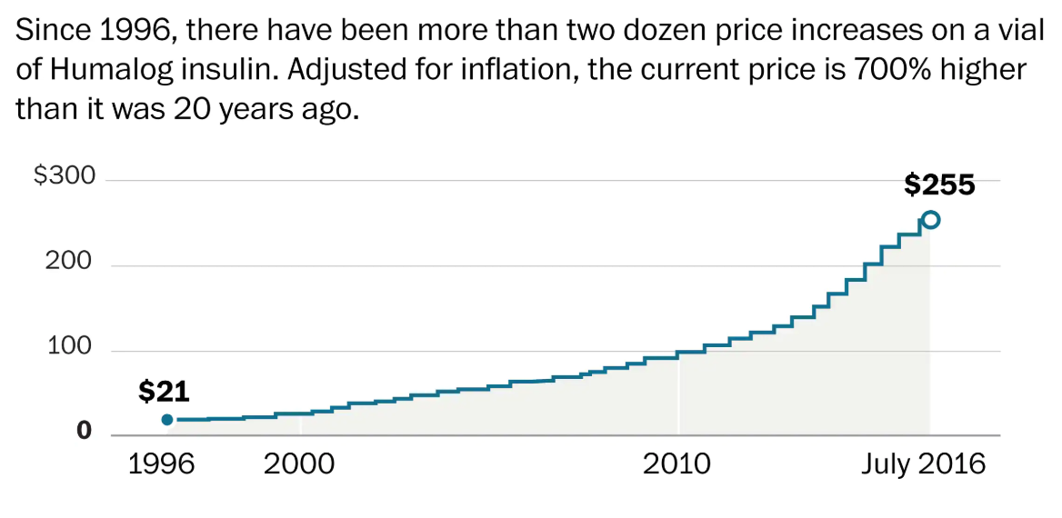
Insulin Producing Probiotics for Type I Diabetics
SWA Bio2M Club: Hyun Seo Park
Hendry Jonathan, Vanessa Lunardi, Enrico Suliarta, Audrey Gandakusuma, Ye Eun Kim (Students)
Eryney Marrogi & David Lips (Mentors), Chris Hayden (Teacher Supervisor)
Abstract
Type I diabetics in many parts of the world do not have access to medical grade insulin due to its high cost and limited production in some countries. A synthetic biology approach to regulated insulin production by probiotic bacteria is described that responds to the presence of both nutritional elements such as cellulose and glucose as well as growth phase properties of the probiotic bacteria themselves. These inducer signals are designed to ensure that insulin is produced when food from a meal enters the small intestines and continues into the colon. Insulin production from proinsulin is facilitated by the presence of membrane bound basic carboxypeptidase and membrane-bound trypsin found on the surface of the probiotic bacteria themselves. Proinsulin secretion is facilitated by the use of a Type 2 Tat Secretion system composed of both inner and outer membrane transport protein complexes from Gram Negative bacteria. Three cellulose inducible devices are constructed to ensure that E. coli chassis produce insulin, membrane bound proteases for proinsulin processing and secretion system proteins for production, processing and release of insulin from bacterial chassis in response to environmental cues from food when entering the intestines.
Introduction
The limitless possibility of therapeutic probiotics
What is Diabetes Melitus?
Diabetes Mellitus is a chronic disease that can be caused by inherited or acquired deficiency in the production of insulin by beta cells in the pancreas. The main problem with treating DM type 1 is that treatments can help but there is no cure. Malfunction of beta cells if often caused by an autoimmune response where the patient's immune system attacks the Beta cells. Thus preventing insulin to be produced.
What is the problem ?
For diabetic patients, insulin is a necessity. Diabetic patient without insulin will only be able to survive for 7 to 10 days maximum eventually dying from a painfully. Often people thinkahat a hormone this essential is probably inexpensive and easily available. However, the reality in some country is far from what we think. The Average price for one vial of insulin in the U.S is around $285. One vial of insulin contains 10ml, 1000 unit of insulin. Diabetic patients need 2~4 vials per month. The price of insulin increased so dramatically over the past few years. Altough the patent for insulin have expired for a long time the price of this medication kept increasing when there is no development or change in Insulin.
If insulin can be produced by a gut bacteria, the bacteria will be able to replace the Beta cells. It will produce insulin for the patient to regulate blood sugar.
This way patients do not need to have a regular insulin shot which will be able to lessen the economic burden. Moreover, the patient will be able to live freely without constantly worrying about availability of insulin.
Interactive!
Click here on any slide to return to the title slide
Johnson, Carolyn Y. “Why Treating Diabetes Keeps Getting More Expensive.” The Washington Post, WP Company, 31 Oct. 2016, www.washingtonpost.com/news/wonk/wp/2016/10/31/why-insulin-prices-have-kept-rising-for-95-years/?noredirect=on&utm_term=.bb808ea45220.
Abstract / Intro

Slide 2
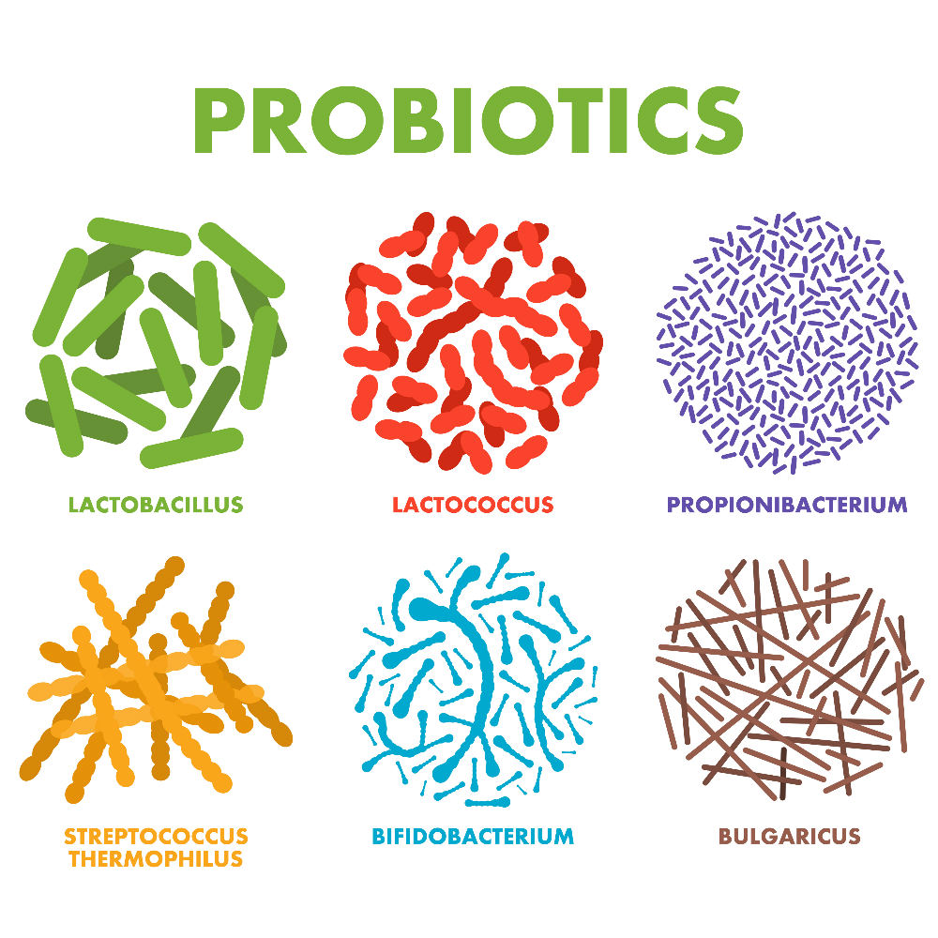
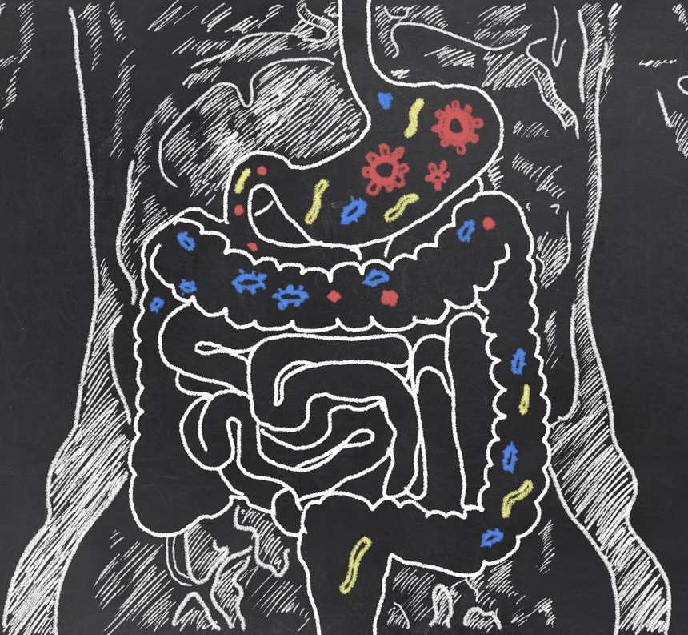
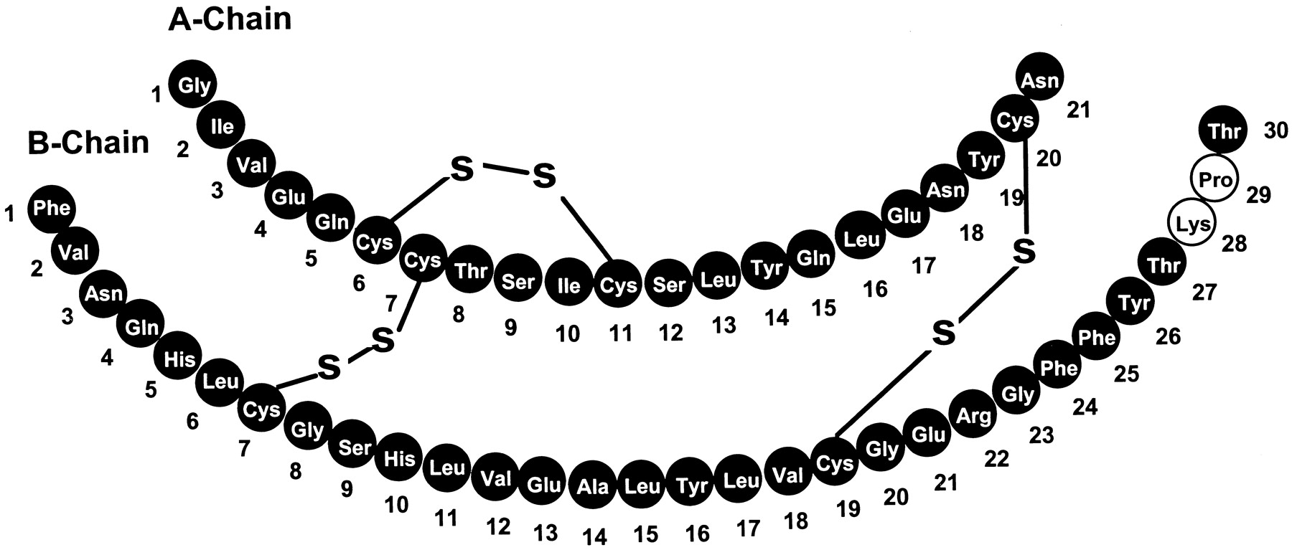

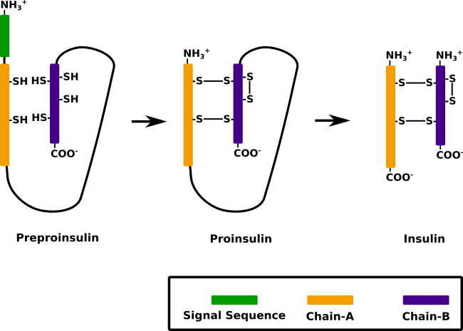
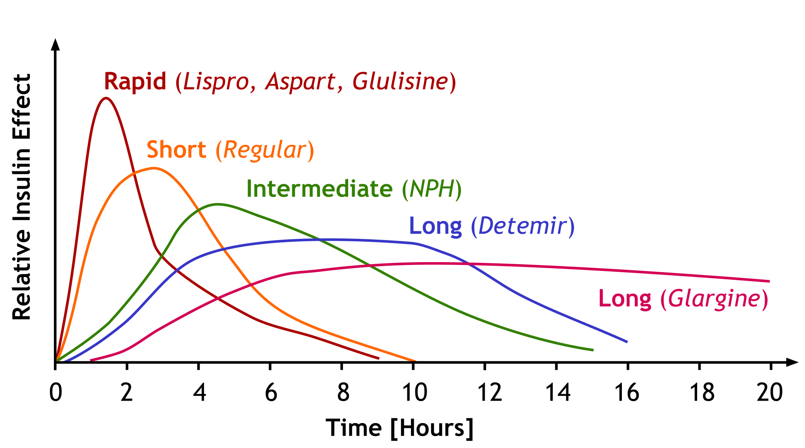
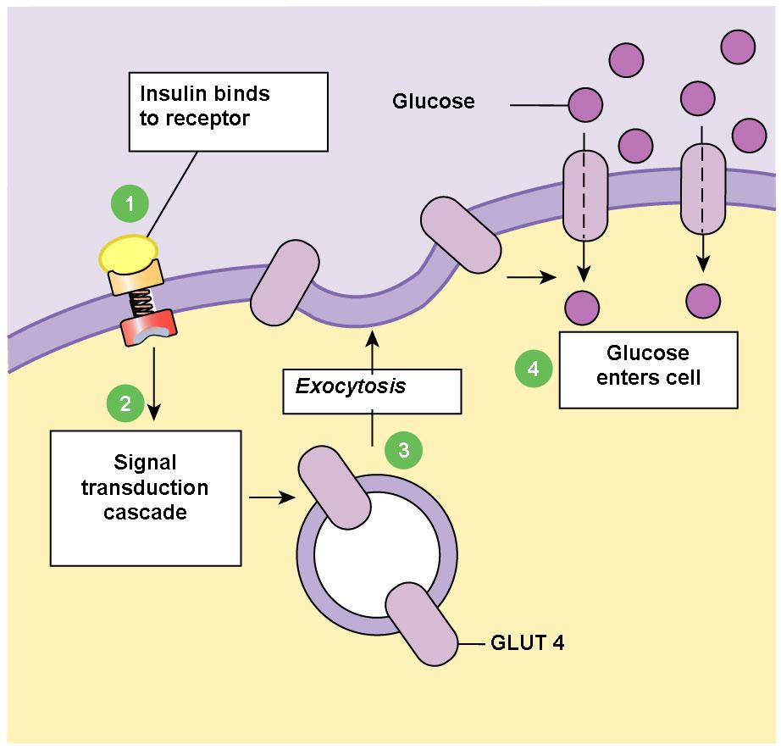
Insulin Producing Probiotics for Type I Diabetics
SWA Bio2M Club: Hyun Seo Park
Hendry Jonathan, Vanessa Lunardi, Enrico Suliarta, Audrey Gandakusuma, Ye Eun Kim (Students)
Eryney Marrogi & David Lips (Mentors), Chris Hayden (Teacher Supervisor)
About Probiotics
About Insulin
Probiotics refer to live microorganisms such as bacteria and yeasts that are beneficial to the host, specifically the digestive system when consumed in healthy amounts. Most common ones include Lactobacillus and bifidobacteria, found in functional foods and dietary supplements. Not only do they demonstrate significant potential for therapeutic purposes but because their mechanisms have yet to be fully explored, the possibilities of using these mechanisms to promote appropriate probiotic strain selection under specific circumstances can lead to the uncovering of new functions.
Examples of important mechanisms underlying the antagonistic effects of probiotics on various microorganisms include the following: modification of the gut microbiota, competitive adherence to the mucosa and epithelium, strengthening of the gut epithelial barrier and modulation of the immune system to convey an advantage to the host. Furthermore, accumulating evidence demonstrates the ability of probiotics to communicate with the host by pattern recognition receptors. This includes Toll-like receptors, nucleotide-binding oligomerization domain-containing protein-like receptors, which modulate key signaling pathways, such as nuclear factor-ĸB and mitogen-activated protein kinase, in order to enhance or suppress activation and affect downstream pathways. Such recognition is vital to elicit antimicrobial responses while minimizing inflammatory tissue damage. Suppression of diarrhea, alleviation of lactose intolerance and postoperative complications, prevention of colorectal and microbial cancer activities, reduction of irritable bowels.
When selecting the appropriate probiotics, bacteria must be able to survive under gastrointestinal conditions, with exposure to bile and gastric acid, having to adhere to the mucosa and competitive exclusion of pathogens.
Mechanism-wise, probiotics play a huge role in the enhancement of the epithelial barrier. The intestinal barrier, composed of the mucous layer, antimicrobial peptides, and secretion of IgA as well as epithelial junction adhesion complex, is a primary defense mechanism used for maintaining epithelial integrity and protection. However, once this barrier function is distorted, antigens can penetrate the submucosa and induce inflammatory responses, resulting in intestinal disorders, such as inflammatory bowel disease.
Role of insulin
Insulin is a hormone produced by the Beta cells in the pancrea which is used to control blood sugar level. Cells needs glucose for cellular respiration, without it, it won't be able to make energy. Insulin binds to the insulin receptor of the cells, then a vesicle containing Glucose transporter type 4 (GLUT4) is released, then these membrane proteins are placed in the cell membrane allowing glucose to get in the cells to be used in cellular respiration. Simply, insulin is a key used to open a channel for Glucose to enter. It is one of the essential hormone used to regulate the blood sugar level to maintain homeostasis.
When the INS gene is transcribed and translated, it produces preproinsulin. Preproinsulin just has a signal sequence used in the maturing of the protein in our cells. However, our project does not need this signal sequence therefore the 24 base pair were removed. This means that when our INS gene without the signal sequence is transcribed, Proinsulin is made directly. Proinsulin just have a C-peptide chain that is used in protein folding, which is later removed by trypsin and carboxypeptidase B to be turned into Insulin.
Chaw, Elly. “What Are Probiotics And What Should You Know Before Taking Them?” Men's Health Singapore, 7 Sept. 2018, www.menshealth.com.sg/health/what-are-probiotics-gut-health/.
By introducing the Human insulin gene, the bacteria is able to produce a hormone crucial for diabetic patients. This does not come in a form of injection but it becomes part of the patients body, replacing the Beta cells.
There are multiple types of insulin. They all have the same functionality but their time of actions are all different. Some act faster and some act slower the half-life of the insulin will also depend on the type of insulin. In our project we plan to produce one of the rapid acting insulin, Insulin Aspart.
The different types of insulin can be easily made by changing some of the base pair in the INS gene sequence.
“Intestines Sketch with Guts Bacteria.” Focus for Health, www.focusforhealth.org/biomedical-treatment-of-autism/intestines-sketch-with-guts-bacteria/.
INTRODUCTION

Slide 3
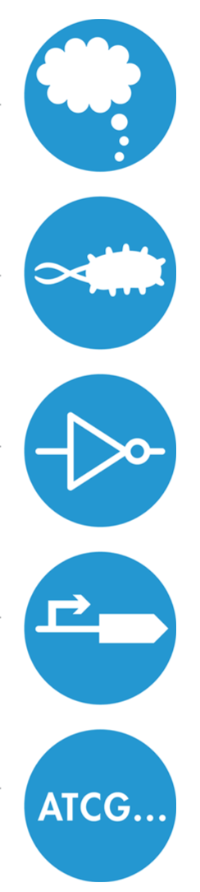
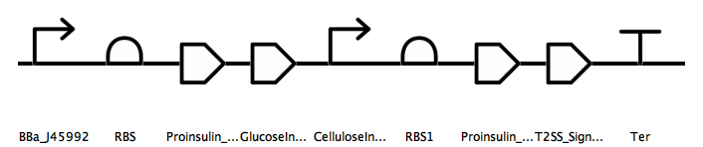
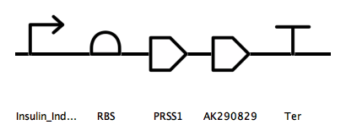
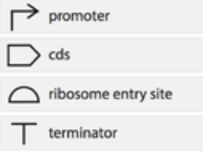
Insulin Producing Probiotics for Type I Diabetics
SWA Bio2M Club: Hyun Seo Park
Hendry Jonathan, Vanessa Lunardi, Enrico Suliarta, Audrey Gandakusuma, Ye Eun Kim (Students)
Eryney Marrogi & David Lips (Mentors), Chris Hayden (Teacher Supervisor)
Design
Regulation of Insulin production is crucial since under or over production of them could be fatal for the patient. Since rapid acting insulin was used, insulin had to be quickly made then secreted out of the bacteria.
To prevent insulin from being produced continuously, osmY promoter and , Glucose induced cellulose promoser was chosen. This allows the bacteria to unly start producing insulin when it is going through a lag phase and with the presence of both glucose and cellulose in the gut.
This is purposely made to target the diet of the patient, the insulin will only be produced when the patients starts to eat their meal. This allows a regular production of rapid acting insulin which will in turn help the patients cells get the glucose they need to survive.
Our main design idea was to create a therapeutic gut bacteria that diabetic patients will regularly(once per week) take which will produce insulin in the patients gut. Our main design goals was producing and regulating insulin. Production of insulin is simple, we just have to express the INS gene. Which makes 51 amino acids arranged in two chains, an A chain (21 amino acids) and B chain (30 amino acids) that are linked by two disulfide bonds. Some of these amino acids can be changed to produce different types of insulin that react in different speed. We plan to implement a insulin expression system so that bacteria do not need to die to expose the insulin in our gut but they can just secrete it. For this, we plan to use either the T2SS or flagellin fliC.
Regulating insulin production is crucial since too much or too little can affect the patient. If too little insulin is produced it wouldn’t be effective at helping the diabetic patient but if too much of insulin was produced then it would cause Hyperinsulinemia which may lead to hypoglycemia. We didn’t want to create harmful bacteria for the diabetic patients so we needed a complex regulatory system. We plan to use the osmY promoter and cellulose induced promoter. This means that insulin will only be produced when the bacteria is going through the log phase and with the presence of cellulose. This way we can make sure that insulin is only produced after patients meal.
Device 1
Device 1
osmY promoter only allows the gene to be expressed during the log phase. Then proinsulin is produced with the T2SS signal sequence. If Glucose and cellulose is present the rest of the gene turns on producing more insulin. When the bacteria goes on to the stationary phase, the system will shut down preventing more insulin to be produced.
Device 2
It is used to produce necessary enzymes and membrane protein used for insulin secretion and turning proinsulin into insulin. Trypsin and Carboxypeptidase B are produced to turn proinsulin into insulin.
Device 2
Interactive!
Click here on any slide to return to the title slide
Methods

Slide 4
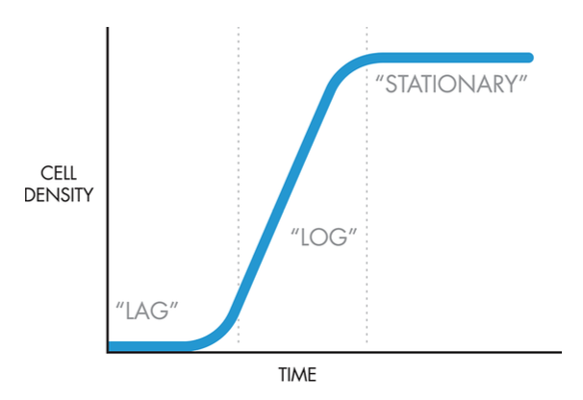
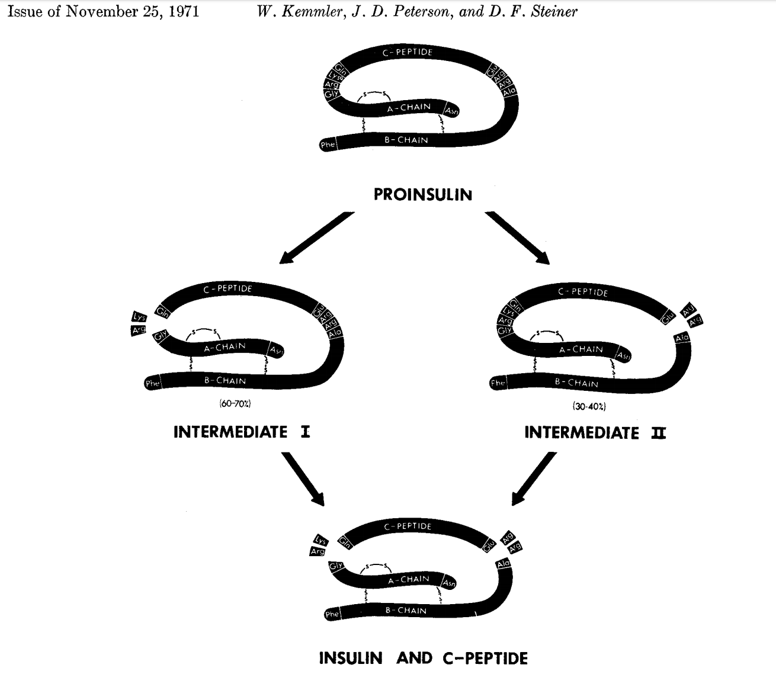
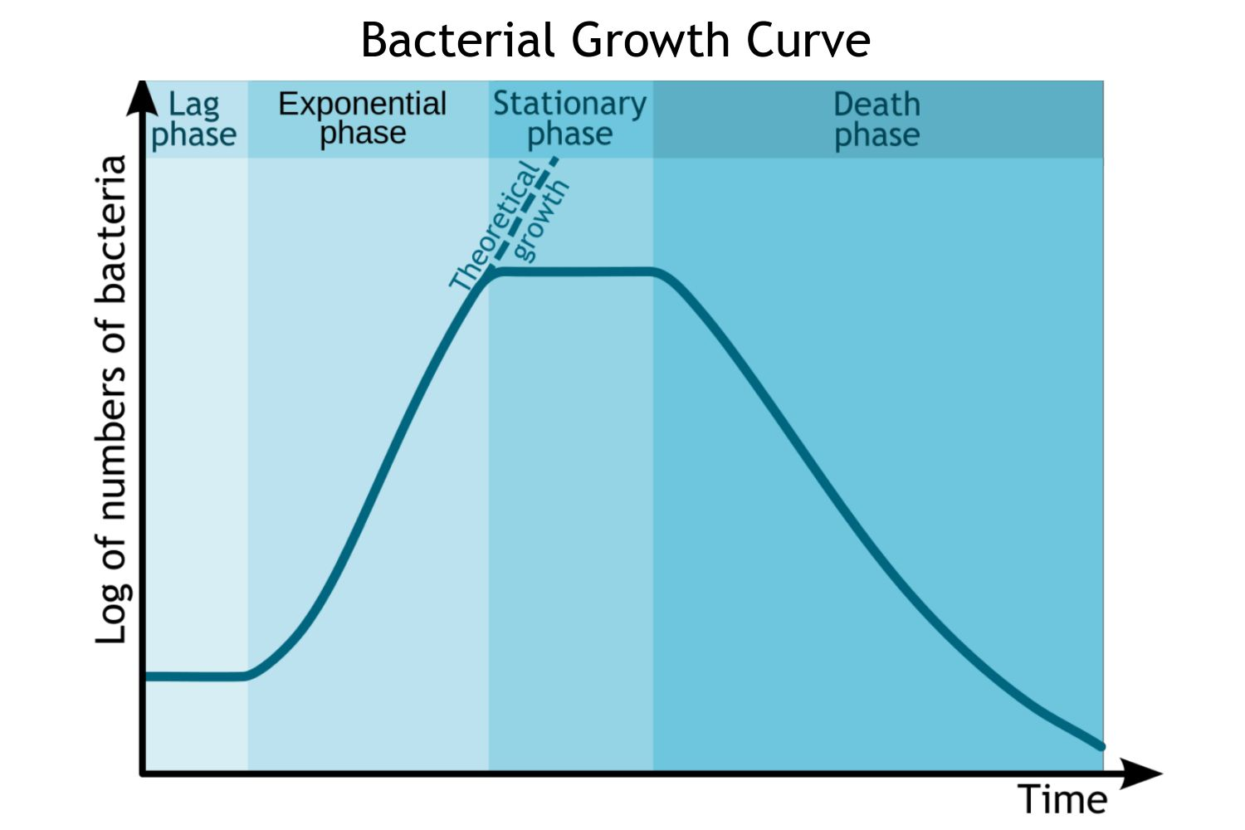
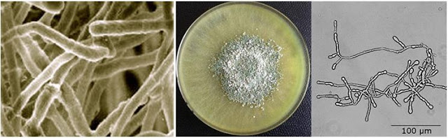
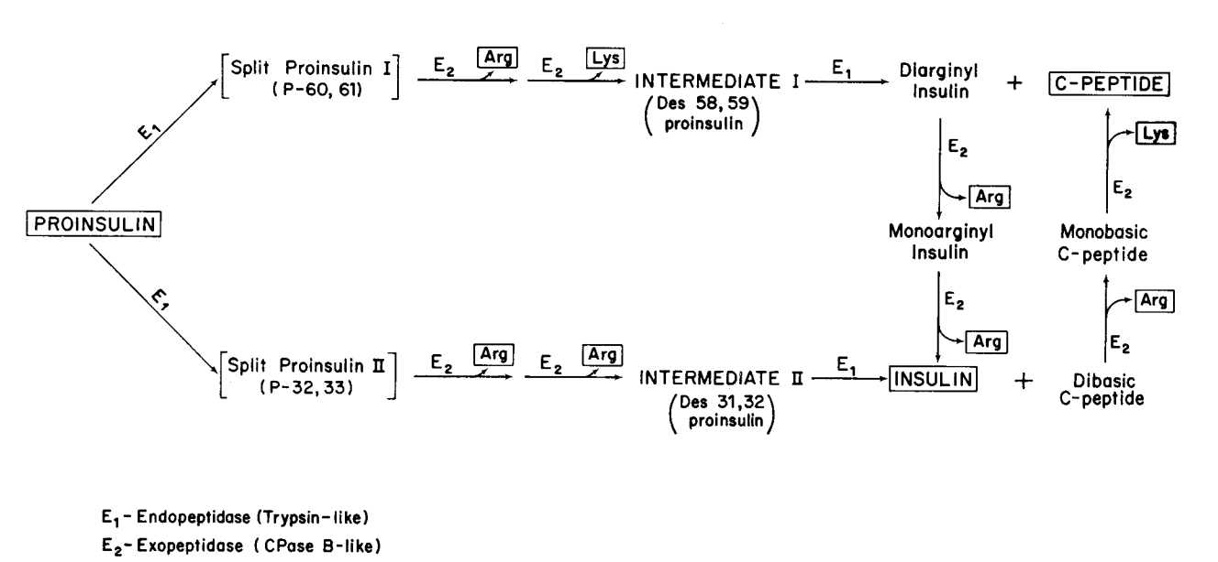
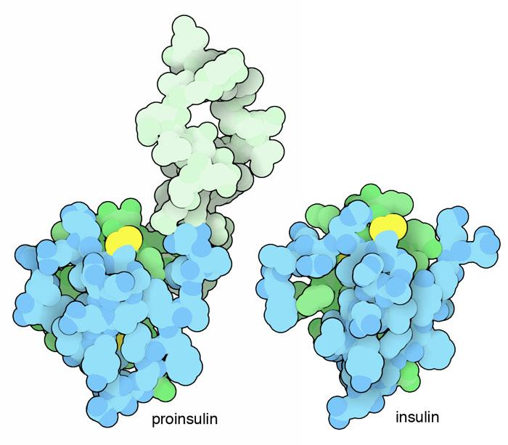
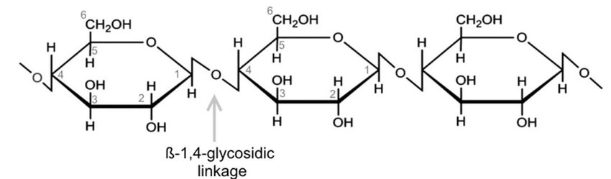
Insulin Producing Probiotics for Type I Diabetics
SWA Bio2M Club: Hyun Seo Park
Hendry Jonathan, Vanessa Lunardi, Enrico Suliarta, Audrey Gandakusuma, Ye Eun Kim (Students)
Eryney Marrogi & David Lips (Mentors), Chris Hayden (Teacher Supervisor)
Promoters and Coding Sequences
osmY promoter
INS gene
Cellulose promoter
Trypsin-1 gene
Carboxypeptidase B2
The fungus Trichoderma reesei hase a special promoter that activated by the presence several saccharides. cbh1 promoter is an inducible promoter which is induced by cellulose, lactose, sophorose,etc and regulated by catabolic repression. When the cbh1 promoter is used for protein expression, an inducer (or inducers) has to be added to trigger the expression of the target genes.
This promoter is especially useful to regulate the expression of gene. As the production of insulin have to be easily and heavily regulated. the cbh1 promoter was add together with the osmY promoter so that insulin won't be able to be produced without the right condition. , In this case, for insulin to be produced, it has to be in the log phase and any of cellulose or other saccharides must be present. These conditions are only met when the the diabetic patient eats. As these patients will have regulated diets with different type of nutrients, cellulose will be usually present as it exists in plants. This way the patient will be encouraged to consistently consume healthier diet in order to maintain their blood sugar level.
Both Trypsin and Carboxypeptidase is usd for transforming the proinsulin into insulin. Trypsin is a serine protease that is formed in the small intestine. It is used to hydrolyze proteins. Trypsin alone can still change proinsulin to insulin. However, studies shows that when Carboxypeptidase B2 is added, the transformation gets much faster. It was observed that the Arg-Gly and Arg-Glu bonds in the carboxyl and amino terminal regions split very rapidly by trypsin, whereas further cleavage of insulin between Lys-Als and at other sites, proceeds much more slowly.
Proinsulin must be turned into insulin in order to have any effect. since both of these enzymes can speed up the process and it is essential to transform proinsulin into insulin they must be present inside the bacteria.This is why
it is present in the second device that is triggered by the presence of proinsulin. So when proinsulin is created in the first device, it then triggers the second device to start producing trypsin and carboxypeptidase.
CPB2 gene was used for the production of carboxypeptidase and PRSS1 gene was used to produce Trypsin-1.
One issue with this method is that if trypsin is produced in the cytoplasm of the cell, it might react with other molecule resuling in the death of the bacteria. That is why our team is still trying to find a better way to transform proinsulin to insulin. For example, using the periplasmic space or having a membrane bound protein which can do the same job.
From BioBuilder textbook
osmY promoter is used for regulation insulin production. When the cells are in log phase there is a promoter that will 'turn on' transcription and there is another for stationary phase.
When the bacteria enters the stationary phase 'inverter' can be used with the osmY promoter to turn off production- hopefully resulting in a 'burst' of insulin production.
BBa_K1819009 can be used to only produce during the ‘log’ phase but BBa_j45992 can replace it if production of insulin in stationary phase is more desirable. As the bacteria moves from each phase the insulin production will switch on or off. When the bacteria dies more should be added through consumption.
The INS gene codes for the proinsulin. By removing the signal sequence that preproinsulin have we are able to directly produce the INS gene. The INS gene can be easily altered to suit patients preference. Although the gene sequence used for the initial design code for rapid acting Aspart Insulin, it is possible to change the gene sequence of the INS gene to produce a different type of insulin. The INS gene still produces proinsulin because it is nearly impossible to make insulin directly since insulin is made up of two chains. Proinsulin basically just has a C_peptide chain that joins the a and b chains that makes insulin. The proinsulin however, cannot work like insulin so eventually the proinsulin must be changed into insulin with the help of some enzymes.
M.D., Arsyad. “Trichoderma Reesei.” Trichoderma Reesei ~, arsyadmd.blogspot.com/2017/11/trichoderma-reesei.html.
Proinsulin = Insulin + C-peptide
Interactive!
Click here on any slide to return to the title slide
KEMMLER, WOLFGANG, et al. “Studies on the Conversion of Proinsulin to Insulin .” I. COXVERSION IN VITRO WITH TRYPSIN AND CARBOXYPEPTIDASE B” , 21 June 1971, www.jbc.org/content/246/22/6786.full.pdf.
Parts

Slide 5
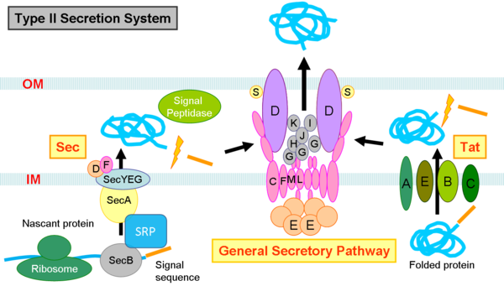
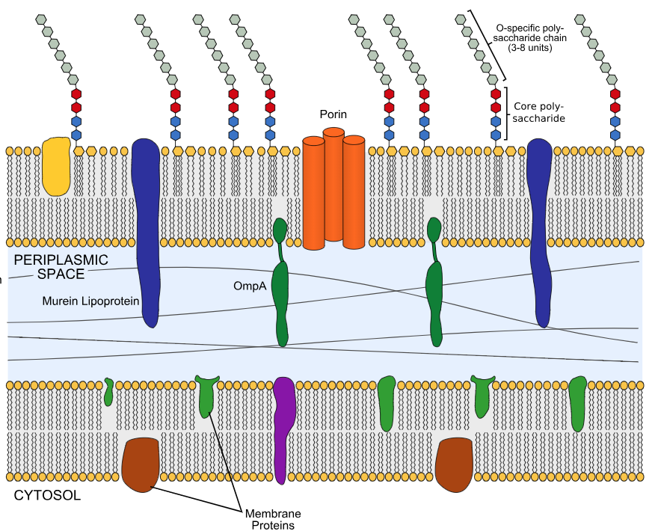
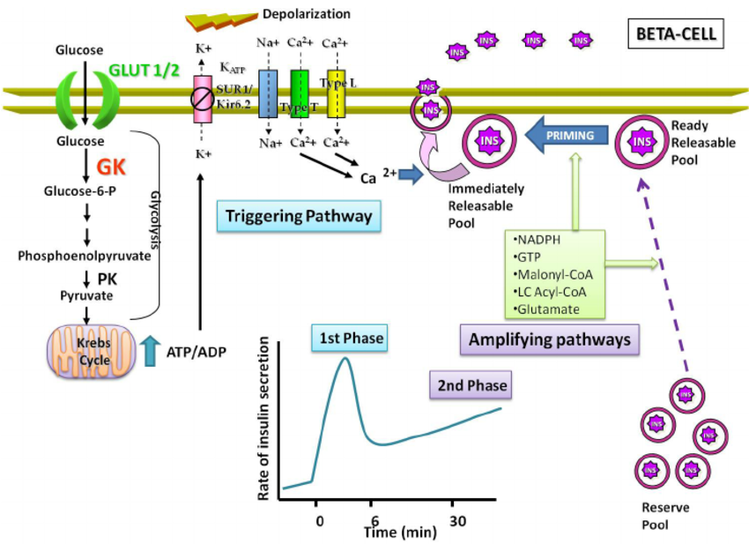
Insulin Producing Probiotics for Type I Diabetics
SWA Bio2M Club: Hyun Seo Park
Hendry Jonathan, Vanessa Lunardi, Enrico Suliarta, Audrey Gandakusuma, Ye Eun Kim (Students)
Eryney Marrogi & David Lips (Mentors), Chris Hayden (Teacher Supervisor)
Insulin Secretion System
When insulin is harvested from the recombinant bacterium. It often requires the bacteria to be broken apart to expose the insulin in the cytoplasm of the bacteria. The main reason for this is that E.coli doesn’t have a naturally built in insulin secretion system.
Needing to burst open the bacteria is not idea for the diabetic patient because it can be difficult to control how much or when the insulin is produced. Also once the bacteria burst it will die.
When insulin is produced in our Beta cell, they are secreted through Glucose-stimulated insulin secretion (GSIS) system. This process is a multistep process which include multiple proteins. This process requires multiple proteins to be present to work which is difficult to stimulate in a bacteria.
Although some gram negative bacteria have the T2SS on their membrane, the E.coli strand living in our gut does not have this. That is why all the protein used to make this system must be made. This will be added in the second device that is triggered by the production of insulin. The secretion method might be changed in the future into a much simpler version which does not require multiple proteins. However, currently this might be the safest method to make sure that the secretion of insulin occurs when needed. The secretion system is not controlled however the production of insulin is. Thus there is no need to have a regulatory system for secretion of insulin.
“Type 2 Secretion System.” Back to IGEM, 2012, 2012.igem.org/Team:NTU-Taida/Project/Effector.
The type 2 secretion system (T2SS) was used to secret insulin into the guts. There are two most common way to transport a protein using a T2SS. Using the hemolysin transport system (Hly)or using a twin-arginine translocation (Tat) to transport the polypeptide to the periplasm, then using the general secretory pathway (GSP) to secrete the protein out of the bacteria.
For both Hly and Tat transport system it requires a signal sequence to be attached in the end so that the membrane protein can recognise it. This signal sequence is attached right after the insulin gene as shown in Device 1. This sequence is then removed from the INS gene as it makes its way into the periplasm. When the INS gene is first translated in the cytoplasm it will be sent to the periplasm without it maturing. This means that protein folding must take place ether outside the bacterium or in the periplasmic space. chaperone proteins exists in the periplasmic space to help with protein folding.
The General secretory pathway is used to secrete the proteins out of the periplasm. The GSP consists of 4 distinguished subassemblies: inner membrane platform, outer membrane complex, pseudopilus, and secretion ATPase. Small proteins such as insulin are able leak from the periplasmic space into the environment, the GSP was added to make sure that the secretion is going to occur.
M.V. Sánchez-Lira, Nancy & Morales-Miranda, Angélica & Garcia de la Mora, Gustavo & León-Contreras, Juan & González-Sánchez, Ignacio & Valencia, Norma & Cerbón, Marco & Morimoto, Sumiko. (2017). Orcinol derivative compound with antioxidant properties protects Langerhans islets against streptozotocin damage. The Journal of pharmacy and pharmacology. 69. 10.1111/jphp.12696.
Interactive!
Click here on any slide to return to the title slide
Whitwam, Ryan. “Scientists Find Molecular 'Key' to Killing Hearty Bacteria.” ExtremeTech, 27 June 2017, www.extremetech.com/extreme/249127-scientists-find-molecular-key-killing-hearty-bacteria.
Design

Slide 6
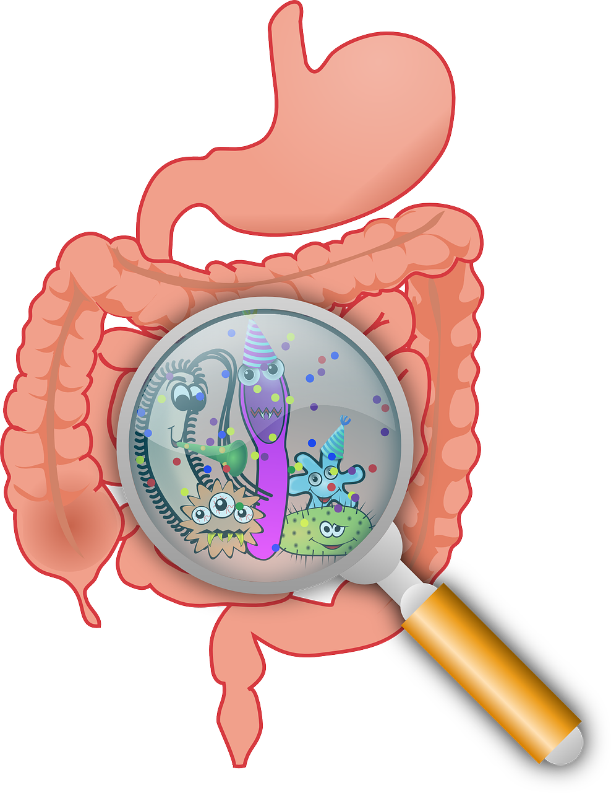
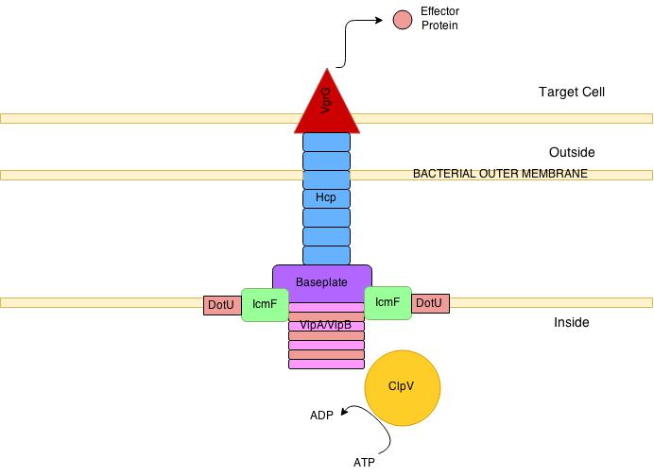
Insulin Producing Probiotics for Type I Diabetics
SWA Bio2M Club: Hyun Seo Park
Hendry Jonathan, Vanessa Lunardi, Enrico Suliarta, Audrey Gandakusuma, Ye Eun Kim (Students)
Eryney Marrogi & David Lips (Mentors), Chris Hayden (Teacher Supervisor)
Current Stage
Future Directions
The project is still undeniably at its early stage. The planning and exploration of idea was done. However, due to limited knowledge in the field of biotechnology several mistakes were made in the planning stage.
The idea of therapeutic bacteria to treat diabetes could’ve been executed better. The design flaws still exists about how protein folding will occur and how the matured protein will go out of the GSP. All these mistakes could've been avoided with more research and planning. However, as a fairly new project some of the logic behind the regulation and production of insulin might be useful when understood since it could be implemented in other biotechnology projects.
The regulation method of the insulin production could be improved. At the current stage some parts might not work together such as the osmY promoter together with the cellulose promoter. Further research must be conducted on this topic.
If possible, finding out a way to directly interact with the blood glucose level would be great since then the bacteria can produce insulin as soon as it notices that the blood sugar level is rising.
Improvements must be made in the following area.
Understanding of Insulin Folding
Insulin folding might not be a huge problem, because it can be produced by bacteria in labs. However, those bacteria have to be opened or killed so that the insulin can come out of the cell membrane. Our team plans to have the insulin to be excreted from the bacteria rather than needing to kill the bacteria so that it could be used for long term. The problem arises when we introduce the type ii secretion system. The T2SS
Further understanding of bacterial secretory system
After the protein goes in the periplasm, it will meet with the chaperone protein that will help in the protein folding. The problem is that if Proinsulin is transported out to the periplasm. The C-peptide might not be able to be disconnected. This is a major problem since the proinsulin will not be able to be turned into insulin. If this is the case, one possible way to produce the insulin is to separate the a and b chain and find a way to assemble them together in the periplasm. BUT the chaperone protein only accepts 1 protein chain.
“Type VI Secretion System.” Wikiwand, www.wikiwand.com/en/Type_VI_secretion_system.
Exploration of other secretory system can give alternative solutions to the problem that this project faces.
For example, Type VI secretion system is able to directly inject a protein into the cells. This can be used to possibly treat insulin resistance and also give more understanding of how proteins are transported from bacterias to cells
Interactive!
Click here on any slide to return to the title slide
Conclusion

Slide 7
Insulin Producing Probiotics for Type I Diabetics
SWA Bio2M Club: Hyun Seo Park
Hendry Jonathan, Vanessa Lunardi, Enrico Suliarta, Audrey Gandakusuma, Ye Eun Kim (Students)
Eryney Marrogi & David Lips (Mentors), Chris Hayden (Teacher Supervisor)
Limitations
References
The Design was never tested. While we have been able to identify genetic pathways in the production of insulin such as the changes that are made from preproinsulin to insulin and how this will be done and secreted by the bacteria. We have yet to test whether or not the designed devices will work in cells of E. coli.
Some of the products that the E.coli has to produce might affect the biological pathways of e.coli. For example, Trypsin is a used for digestion and it might have negative affect in the survival of E.coli.
Assumptions were made throughout the project. Which makes the project unrealistic to a certain extent. Since human body, especially the gut have such a complex system. The project did not focus on other factors in the gut such as interaction of the gut bacteria such as the quorum sensing signals. Theoretically the bacteria could produce insulin but how the bacteria will react in the gut might be a totally different story.
“Glucose Regulation.” Austin Community College - Start Here. Get There., www.austincc.edu/apreview/EmphasisItems/Glucose_regulation.html.
Goodsell, David. “PDB101: Molecule of the Month: Insulin.” PDB-101: Acetylcholine Receptor, 2002, pdb101.rcsb.org/motm/14.
Johnson, Carolyn Y. “Why Treating Diabetes Keeps Getting More Expensive.” The Washington Post, WP Company, 31 Oct. 2016, www.washingtonpost.com/news/wonk/wp/2016/10/31/why-insulin-prices-have-kept-rising-for-95-years/?noredirect=on&utm_term=.bb808ea45220.
Ward, Colin, and Mike Lawrence. “Insulin Binding and Activation of the Insulin Receptor.” Type 2 Diabetes Mellitus - Diapedia, The Living Textbook of Diabetes, www.diapedia.org/metabolism-and-hormones/51040851468/insulin-binding-and-activation-of-the-insulin-receptor.
THE JOURNAL OF BIOLOGICAL CIIEMISTRY Vol. 246, No. 22,Issue of November 25, pp. 6786-6791, 1971 Studies on the Conversion of Proinsulin to Insulin Received for publication, June 21, 1971
The membrane-bound basic carboxypeptidase from hog intestinal mucosa Biochimica et Biophysica Acta 1421 (1999) 234^248 Received 21 April 1999; received in revised form 12 July 1999; accepted 15 July 1999
“What is type VI secretion doing in all those bugs?” Sandra Schwar, Rachel D. Hood, Joseph D. Mougous .2010.09.001
https://www.cell.com/trends/microbiology/fulltext/S0966-842X(10)00165-4#%20
Interactive!
Click here on any slide to return to the title slide
Conclusion

