Slide 1


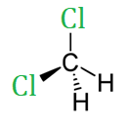

Detection of Dichloromethane in Superfund Sites
Alexander Popescu, Monica German
Homeschool Team
Interactive!
Click bubbles to jump to each section
Abstract
Background
Superfund sites pose an immediate danger to humans because of the toxic waste they contain and the likelihood of this toxic waste spreading into the environment. Many Superfund sites are located near neighborhoods or in areas prone to earthquakes, flooding, or erosion of the container walls.
The EPA’s Superfund Program identified more than 1300 Superfund sites in the United States.¹ These sites, which contain toxic waste from dangerous metals to harmful organic compounds, are prone to earthquakes or flooding. Thousands of sites with contaminated soil and groundwater exist nationally due to hazardous waste being dumped, left out in the open, or otherwise improperly managed.
Our team decided to focus on the detection of dichloromethane (DCM) because we found that this is the main constituent in a local Superfund site that is very close to our school. DCM is a widely-used synthetic haloalkane which is a neurotoxin and possibly a carcinogen.
In 2017, approximately 15 million people were living within 1 mile of Superfund sites (roughly 5% of the U.S. population), which includes 5% of children less than 5.² As changes in climate result in sea-level rise and greater chances of flooding, more communities will be at serious health risk due to contamination of their drinking water and soil by noxious substances from Superfund sites.³
We designed a biological system that has DCM as the input and red fluorescence as the output. In the absence of DCM, there will be no color present, and in the presence of DCM, a red color will be formed. We added a tuner which will report how much DCM is in the environment as the color output will vary with the concentration of DCM.
Our system uses E. Coli as a chassis and is composed of two connected devices: a DCM sensor and a DCM reporter. We used the dcmR gene as our sensor; this gene was first identified in the genome of Methylobacterium extorquens, an extremophile bacterium capable of degrading DCM. The constitutive promoter produces a regulatory protein, dcmR, which binds with DCM and triggers visible red fluorescence.
Dichloromethane (DCM), also known as methylene chloride, is a volatile organic compound (VOC) used widely as a paint remover and industrial solvent. In addition to being highly volatile, DCM is also water-soluble and can be present in aquifers, groundwater, or soil.
DCM is a widespread contaminant in the environment; from 1987 to 1993, according to EPA's Toxic Chemical Release Inventory, the amount of DCM on land and in water totaled over 2.1 million pounds.⁴ DCM is rated as potentially carcinogenic for humans and can cause neurological symptoms after significant exposures.⁵ It can be lethal in high doses. Additionally, DCM contributes significantly to the amount of chlorine in the atmosphere, having a similar effect as hydrochlorofluorocarbons (HCFCs).
Ultimately, our goal is to provide an inexpensive and easy to use DCM biosensor for testing water and soil samples from locations close to Superfund sites.
INTRODUCTION
Return to Title Slide

Slide 2
Detection of Dichloromethane in Superfund Sites
Alexander Popescu, Monica German
Homeschool Team
Interactive!
Click bubbles to jump to each section
Methylobacterium extorquens
System Level Design
An important part of our design system is the dcmR gene, which was discovered in Methylobacterium extorquens, an extremophile bacterium. Methylobacterium strain DM4 has been isolated from industrial wastewater sludge in Switzerland, as part of efforts to characterize microorganisms able to degrade the organohalogenated pollutant dichloromethane (DCM).⁶
The biological system has DCM as input and red fluorescence as output. In the absence of DCM, there will be no color formed, and in the presence of DCM, the cells will turn red.
Black Box
Function
Methylobacterium extorquens is a methylotroph with the ability to grow on one or several reduced one carbon (C1) compounds⁷ and able to metabolize formaldehyde, a toxic product. There are two genes responsible for metabolizing DCM: dcmA which codes for the enzyme DCM dehalogenase and dcmR.
The dcmR gene is induced by the presence of DCM in the environment, and it codes for the regulatory protein DcmR. The DcmR protein binds DCM and serves as a repressor for both the dcmR and dcmA gene.
DCM
Red
Fluorescence
Chassis Selection
Device Level Design
We decided to use Escherichia coli (E. coli), a standard chassis, for the following reasons: E. coli is simple compared to other bacteria, is easily engineered, is commonly used in bioengineering, and provides better standardization.
The DCM detector or sensor device is connected to the reporter sensor device which generates color.
DCM
DCM Detector
Reporter
Red
Fluorescence
SYSTEM LEVEL DESIGN
Return to Title Slide

Slide 3
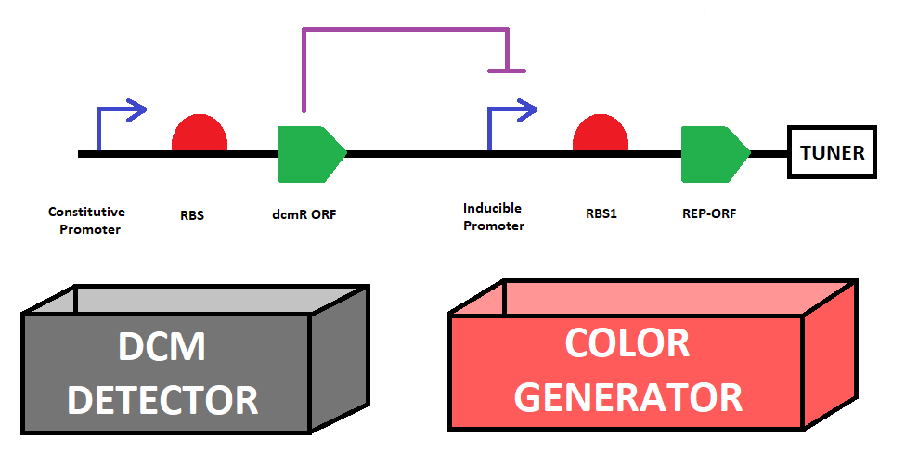
Detection of Dichloromethane in Superfund Sites
Alexander Popescu, Monica German
Homeschool Team
Interactive!
Click bubbles to jump to each section
Parts Level Design
The output of the first device will be DcmR protein, a transcriptional repressor, which turns off the reporter. When DCM is present in the environment will bind the DcmR protein, (causing its conformation to change) and as a consequence will remove the repressor protein from the DNA, allowing the RFP to be expressed.
Truth Table:
DCM CONCENTRATION | REPORTER 1 | REPORTER 2
0 | 0 | 0
LOW | 1 | 0
HIGH | 1 | 1
The first device, the DCM detector device, is composed of a constitutive promoter, a RBS, dcmR ORF and a forward terminator.
The second device, the Color generator is composed of a promoter, RBS, RFP ORF and a tuner.
A low DCM concentration will turn on just the first reporter, while a high DCM concentration will also turn on the second reporter which will create a stronger red signal.
We added a tuner to report how much DCM is in the environment, the color output will vary with concentration of DCM. For the tuner we added a second reporter which is the second copy of the PdcmR-RFP with a stronger RBS and a “novel “version of promoter. This copy will be sensitive to a higher concentration, potentially more dangerous, of DCM which will be reported with an intense red color. The stronger RBS will ensure a higher amount of RFP protein when the promoter is expressed. The “novel” promoter will have two binding sites for the DcmR protein.
PARTS LEVEL DESIGN
Return to Title Slide

Slide 4
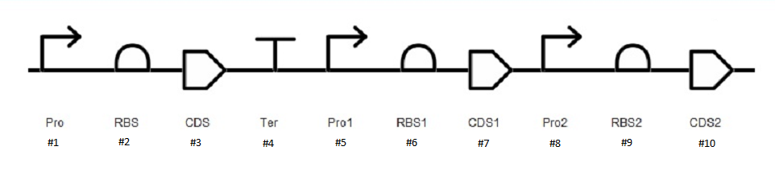
Detection of Dichloromethane in Superfund Sites
Alexander Popescu, Monica German
Homeschool Team
Interactive!
Click bubbles to jump to each section
DNA – BioBrick Parts
References
https://www.epa.gov/superfund
https://www.epa.gov/sites/production/files/2015-09/documents/webpopulationrsuperfundsites9.28.15.pdf
https://grist.org/briefly/superfund-sites-are-in-danger-of-flooding-putting-millions-of-americans-at-risk/
https://www.freedrinkingwater.com/water-contamination/dichloromethane-contaminants-removal-water.htm
https://toxnet.nlm.nih.gov/cgi-bin/sis/search2/f?./temp/~fNgU7g:3
Gälli R, Leisinger T. Specialized bacterial strains for the removal of dichloromethane from industrial waste. Conservation and Recycling.
https://www.ncbi.nlm.nih.gov/pmc/articles/PMC2680597/#pone.0005584-Galbally1
https://jb.asm.org/content/jb/173/21/6714.full.pdf
http://2014.igem.org/Team:Oxford
https://www.ncbi.nlm.nih.gov/pubmed/7765835
https://www.uniprot.org/uniprot/P45876
http://www.bioinformatics.org/sms2/rev_trans.html
Design Diagram Number | Part
1 | Constitutive Promoter (Part:BBa_K1443002)
2 | RBS (Part: BBa_B0032)
3 | dcmR ORF We couldn’t find this part in the Registry, but we can get the sequence of the dcmR ORF through reverse-translating the protein sequence from https://www.uniprot.org/uniprot/P45876 using the following web site: http://www.bioinformatics.org/sms2/rev_trans.html
4 | Forward Terminator (Part: BBa_B0010)
5 | Inducible Promoter: PdcmR
6 | RBS (medium RBS) (Part: BBa_B0032)
7 | RFP ORF (Part: BBa_K1399003)
8 | “Novel” Promoter, with two binding sites for the DcmR protein
9 | RBS (strong RBS) (Part: BBa_B0034)
10 | RFP ORF (Part: BBa_K1399003)
We are grateful to Dr. Natalie Kuldell for her mentorship and all the help she has provided to our team.
DNA – BioBrick PARTS
Return to Title Slide

