Slide 1


Biobuilders Skunk Smell Project
Needham High School Biobuilders

Slide 2
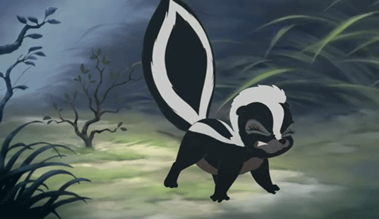
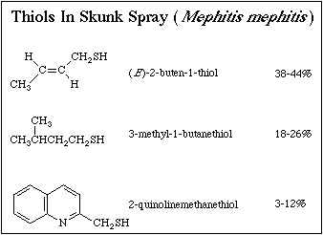
Exploration on Reducing Unpleasant Skunk Odor
Background:
-Compounds known as thiols are responsible for the unpleasant odor of skunk spray; more specifically, the disulfide bonds between these thiols
-One method of reducing skunk spray odors is to oxidize the thiol compounds
The Problem:
-Skunk spray is an inconvenience to many individuals, especially if they own pets
-Most household remedies, such as tomato juice, are insufficient at eliminating the smell and mask it instead
-Solutions which utilize hydrogen peroxide are also a potential threat to the individual or pet that is being cleansed
System:
Skunk Spray Thiols
E.coli with Specialized Genes
Thioredoxin
Final Result
A non smellable molecule.
Change to a pleasant smelling molecule (Grapefruit).
In response to the detection of thiols, the E.coli will produce Thioredoxin, a protein that will break apart the disulfide bonds responsible for the scent.
E.coli, through the utilization of *various genes*, will detect the presence of thiols.
Needham High School BioBuilder Club
Notes:
First slide should be about the entire project
Go into detail in later slides

Slide 3
Index
Introduction
What We Did This Year
How We Started
Research: Skunk Smell Makeup
What Are Thiols?
Solutions
Current Research

Slide 4
Exploration on Reducing Unpleasant Skunk Odor
Background:
-Compounds known as thiols are responsible for the unpleasant odor of skunk spray; more specifically, the disulfide bonds between these thiols
-One method of reducing skunk spray odors is to oxidize the thiol compounds
The Problem:
-Skunk spray is an inconvenience to many individuals, especially if they own pets
-Most household remedies, such as tomato juice, are insufficient at eliminating the smell and mask it instead
-Solutions which utilize hydrogen peroxide are also a potential threat to the individual
Needham High School BioBuilder Club
Notes:
First slide should be about the entire project
Go into detail in later slides

Slide 5
What We Did This Year
Attempted a lab to explore gene modification
Brainstormed ideas for a main project
Travelled to the MIT Launch Lab to explore gene testing to see which combinations of bacterial strains are best at producing a specific enzyme
Researched skunk spray
Communicated with a variety of resources to achieve a greater understanding of the biology and chemistry of the project

Slide 6
How We Started
Understanding of gene modification
CRISPR-CAS9
Plasmids
Promoters, Terminators, etc.
Translation/Transcription (RNA)
Brainstorming of ideas

Slide 7
Research: Skunk Smell Makeup
3 Major Thiols
(E)-2-buten-1-thiol
3-methyl-1-butanethiol
2-quinolinemethanthiol

Slide 8
What Are Thiols?
S
H
Thiols are organic compounds that are similar to alcohols
Have Sulfur in place of the Oxygen
Contains a sulfhydryl group (-SH)
Produces an extremely unpleasant smell when bonded together

Slide 9
Solutions
Chemistry Research:
Thiol = Sulfur + Alcohol (OH Group)
Solution: Change the S-H group
Substitute new group (methyl iodide)
Ex: Thioether (CH₃ I)
Oxidation (Disulfide)
What kind of catalyst/enzyme can do this? (Oxidize)
Biology Research:
Promoters:
Constitutive Promoter
Inducible Promoter
Enzymes:
Redox Enzyme:
Oxidate Enzyme
Thiol Oxidase
Thioredoxin

Slide 10
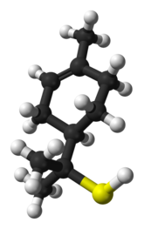
Current Research
After contacting and consulting multiple researchers we began our research:
Currently we are…
Looking at databases to map out the steps of the reaction:
BRENDA and Registry of Standard Biological Parts
“Oxidate Enzymes”, “Thiol Oxidase”
“Constitutive Promoters”, “Inducible Promoter”
Debating oxidation verse modification of thiols into other smells (to grapefruit or other good smells with sulfur)

Slide 11
Future Plans
Research Enzymes more in-depth
Research Promoters
Create Procedure
Test Enzyme and Promoter combinations
Test different processes for gene modification for this project
Different cell species or types (E.coli)

Slide 12
Citations:
http://users.humboldt.edu/wfwood/chemofskunkspray.html
https://giphy.com/gifs/bambi-2-G3UNkhLPsojZe
http://webiconspng.com/icon/13200
http://moziru.com/explore/Wind%20clipart%20transparent%20background/
More citations can be found in our research sheet:
https://tinyurl.com/yaxnogxe

