Slide 1

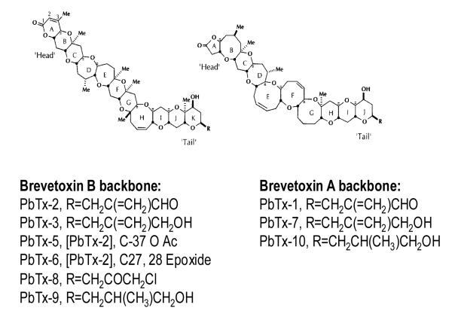
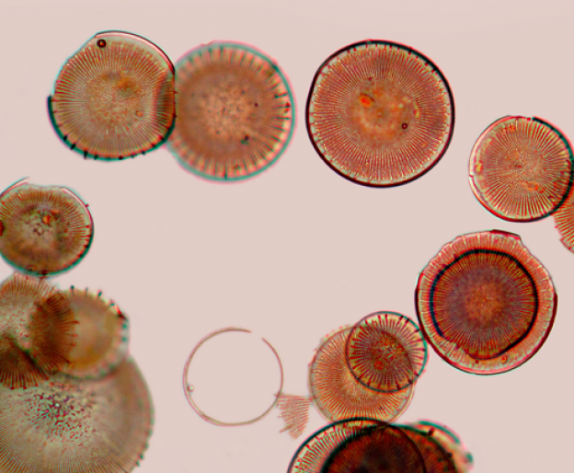
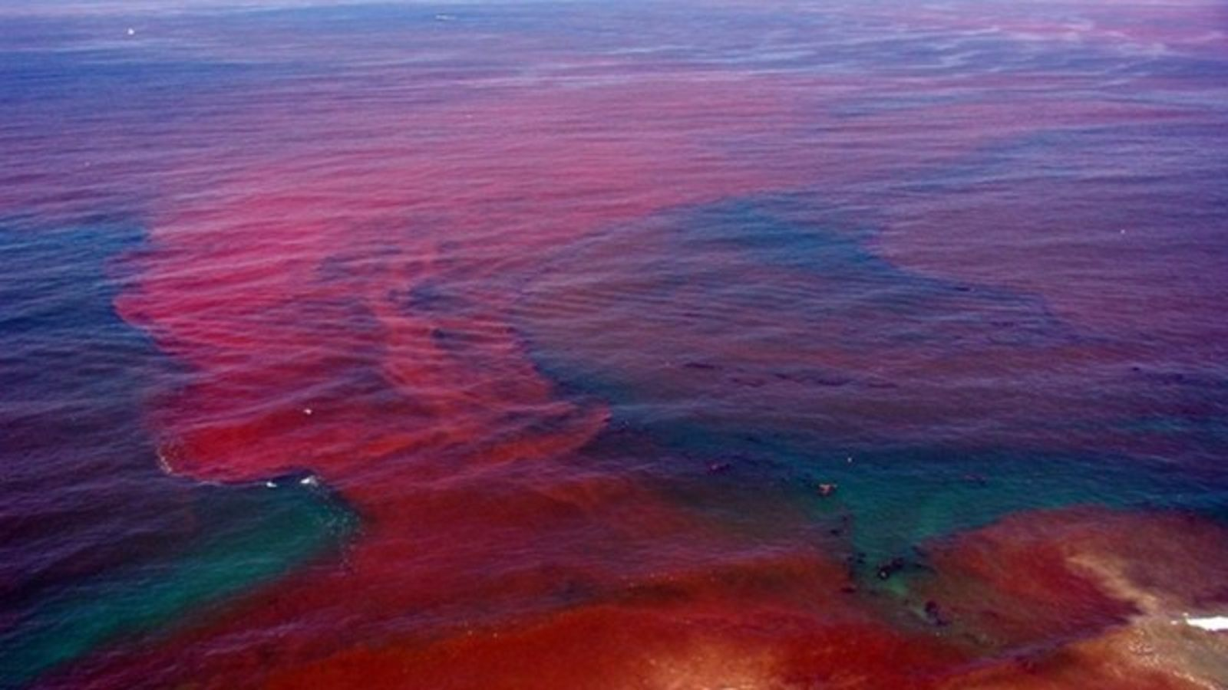
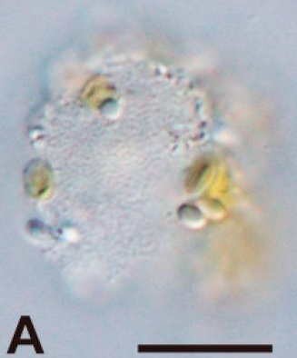
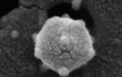
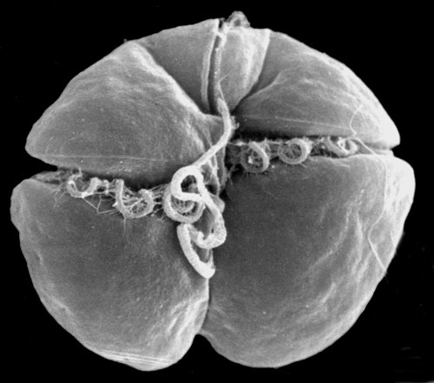
Eliminating the Neurotoxic Effects of Red Tide Algae
Renaissance School
2019
Introduction:
Red tide algae blooms are high-density algae blooms that secrete neurotoxins called brevetoxins. They occur around the Gulf coastline, most noticeably around Florida.
The exact cause of the harmful algae blooms is unknown, but they are postulated to be triggered by a mix of environmental factors such as light exposure, water salinity, and water temperature.
Brevetoxins are absorbed by and kill oceanic wildlife by attacking the neurosystem.
When brevetoxin-infected fish and aerosolized brevetoxins are consumed/inhaled by humans, neurotoxic shellfish poisoning and various respiratory problems occur.
Brevetoxins are theorized to be secondary metabolites produced by enzyme complexes called polyketide synthases (PKS), Therefore
eliminating the gene regulating polyketide synthase production could halt or disrupt brevetoxin production. The functional use of brevetoxins within red tide algae species like K. brevis (Dinophyceae) is unknown.
Methods:
Brevetoxins are not proteins and cannot themselves be genetically manipulated to regulate their production.
An engineered gene that shuts down PKS synthesis could be introduced to red tide algae via an algae-infecting phage as a gene drive facsimile,
The dinophyceae-infecting virus strain HcDNAV could be a potential phage; studies would need to be completed to determine its effectiveness in infecting K. brevis.
An algae-specific virus strain from the family Phycodnaviridae could be used as a phage
The location and nature of PKS genes remains largely unresearched; more research would be required to determine the specific Biobricks necessary for development of a knockout gene and viral infiltration of the algae.
Conclusions:
The potential environmental repercussions of releasing a phage like HcDNAV must be hypothesized and studied further.
Research on PKS synthesis in algae is limited; however, the exact pathways of brevetoxin synthesis in relation to PKS need to be ascertained.
Should the use of HcDNAV prove ineffectual, more studies would be necessary to find a suitable phage to replace it.
Algae species like K. brevis are difficult to cultivate in laboratory conditions due to unknown environmental triggers causing blooms.
A better general understanding of the function of brevetoxins in algae is necessary to explore this pathway further.
References:
Baden, D. G., Bourdelais, A. J., Jacocks, H.,
Michelliza, S., & Naar, J. (2005). Natural and
Derivative Brevetoxins: Historical Background, Multiplicity, and Effects. Environmental Health Perspectives, 113(5), 621-625. doi:10.1289/ehp.7499
Erdner, D. L., Dyble, J., Parsons, M. L., Stevens,
R. C., Hubbard, K. A., Wrabel, M. L., . . .
Trainer, V. L. (2008, November 07). Centers for Oceans and Human Health: A unified approach
to the challenge of harmful algal blooms. Retrieved January 24, 2019, from https://www.ncbi.nlm.nih.gov/pubmed/19025673
Kellmann, R., Stüken, A., Orr, R. J., Svendsen, H. M.,
& Jakobsen, K. S. (2010). Biosynthesis and Molecular Genetics of Polyketides in Marine Dinoflagellates. Marine Drugs, 8(4), 1011-1048. doi:10.3390/md8041011
Michelliza, S., Abraham, W. M., Jacocks, H. M.,
Schuster, T., & Baden, D. G. (2007). Synthesis,
Modeling, and Biological Evaluation of Analogues of the Semisynthetic Brevetoxin Antagonist β-Naphthoyl-Brevetoxin. ChemBioChem, 8(18), 2233-2239. doi:10.1002/cbic.200700317
Schumann, K. (2019, February 11). [Photo of red tide
bloom off the coast of Florida]. Retrieved March 7, 2019, from https://wbhsbullseye.com/695/news/murder-at-the-beach/
Thompson, Natalie. “Brevetoxin: How Is It Made
and Why?” Texas A&M University, 2012, pp.
1–77.
Takano, Y., Tomaru, Y., & Nagasaki, K. (2018). Visualization of a Dinoflagellate-Infecting Virus HcDNAV and Its Infection Process. Viruses, 10(10), 554. doi:10.3390/v10100554
Figure 1:
Distinctly red brevetoxin-
secreting algae
Figure 3: Brevetoxin backbone structure
B
A) HcDNAV- infected algae; B) A HcDNAV particle
Figure 2:
A photograph of K. brevis, a brevetoxin producing algae
Figure 4:
A red tide algae bloom off the coast of Florida, easily identifiable by its reddish or pinkish hue
Notes:
Single sided poster!

