Slide 1
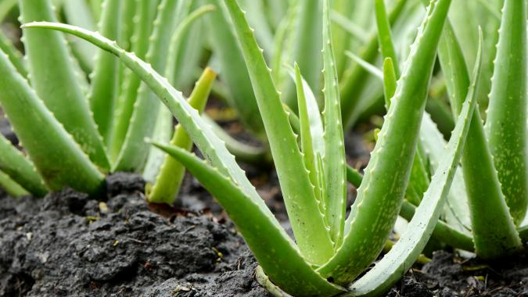
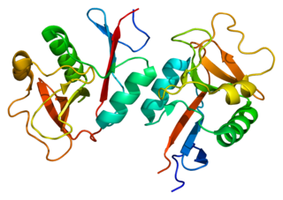
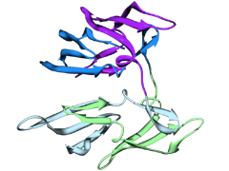
HIV Disinfectant
Affordable and Available Worldwide
PROSPECT HILL ACADEMY BIO BUILDERS: Wiener Douyon, Adriana Alcindor, Ishivita Bali, Yassmine Benmimoun, Cassie Calixte, Isabelle Coimbra, Lavanya Goel, Mia Gutarra, Vaishali Kaushal, Gianna Martinez, Daniel Opara.
Can anti-HIV proteins be mass-produced in Aloe Vera plants and made into a hand sanitizer?
Griffithsin
(red algae
protein)
Cyanovirin-N
(cyanobacteria
protein)
Acknowledgements to our mentor, Patrick Holec, MIT
Notes:
Based our research off of 2018 research from Spain – scientists engineered rice with 1 antibody and 2 lectin proteins that can be ground into a paste and applied as an HIV-disinfecting topical cream.
We want to explore how we can engineer aloe vera plants (or something else) with the two lectin proteins, Griffithsin and Cyanovirin-N. Aloe vera grows naturally on continents where HIV is prevalent and this could be an affordable way to prevent the spread of the virus.
More info:
Griffithsin, lectin protein from red algae. 121 amino acids long.
Cyanovirin-N, lectin protein from cyanobacteria. 101 amino acids long.

