Slide 1
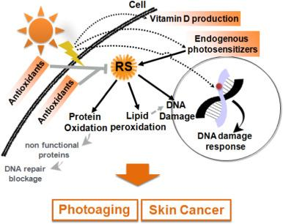
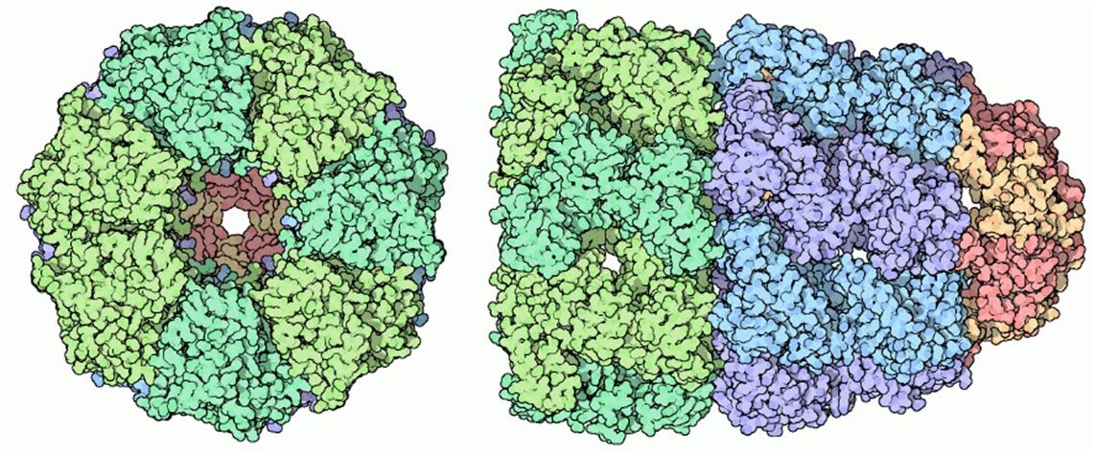
UV-Activated Enhanced Chaperonin Expression
Overall objective: protect organisms in space from protein damage from excess radiation by implementing a UV-activated promoter and added chaperonin genes to enhance protein repair mechanisms.
  Current objective: We want to test out which UV-activated promoter has a wider range of sensitivity and whether GFP or ZsGreen is better for our experiments.
We will be using PCR (and primer design), cloning, bacterial transformation, and microarrays (to measure expression)
Ithaca High School BioBuilders
Chaperonin capsule structure with isolation cavity to aid protein refolding

