Slide 1



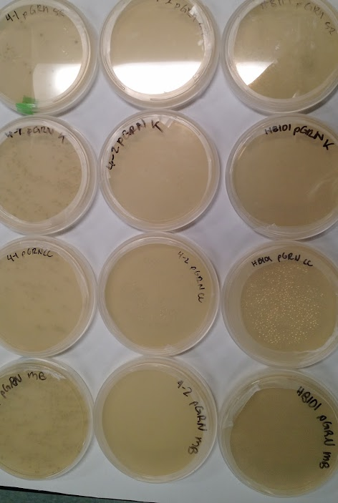
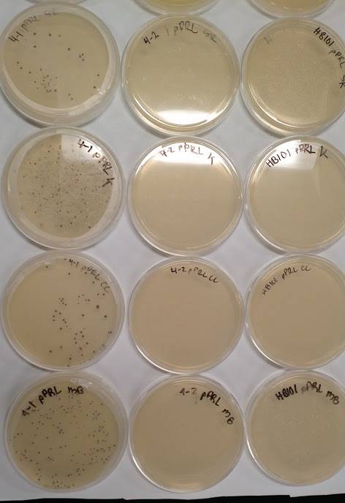
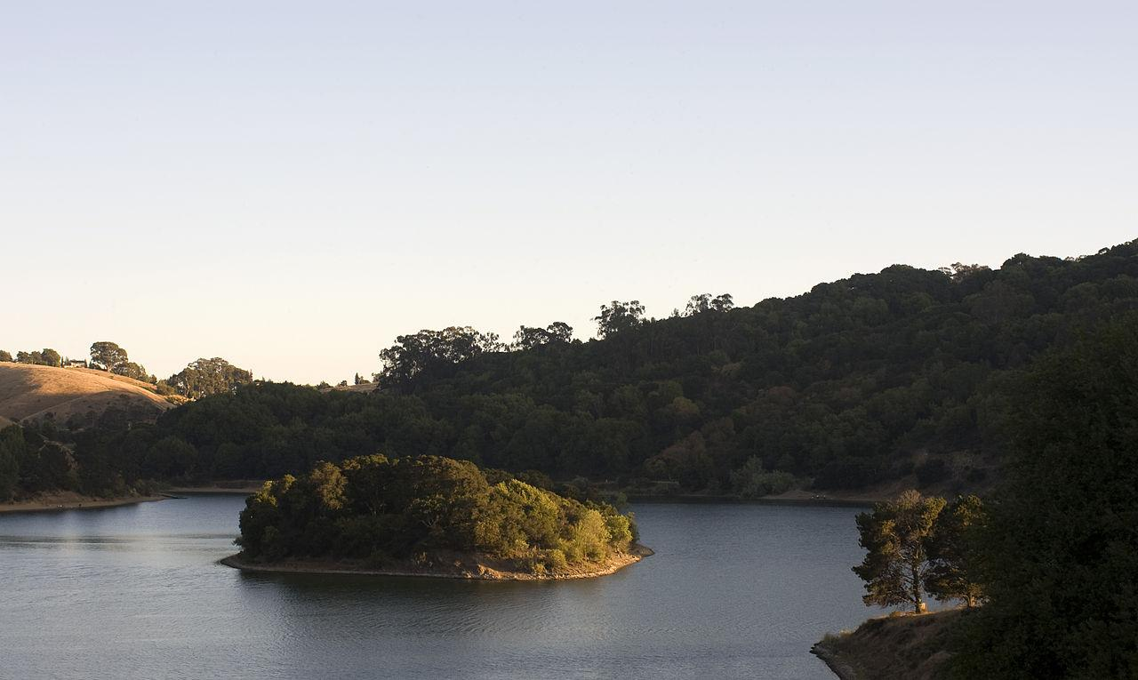
Toxic Algae? In Our Lake Chabot? More Likely Than You Think!
Molly Brown, Caitlyn Carden, Kelly Chen, Holly Heinrich, Toby Hung, Marcella Ku, Conor Mora,
Kenneth Richey, Sara Roderick, Alyssa Tivey, Mei Yi You
Teacher/Advisor: Laura O’Brien Mentor: Cameron Williams
Introduction:
Blue-Green Algae ( Anabaena Circinalis ) that produces the neurotoxins which causes liver damage has been found in our local lake, Lake Chabot, along with other lakes in the area. California’s drought has contributed to conditions favoring growth of blue-green algae. Consumption of this algae has led to the deaths of multiple dogs after visits to Lake Chabot. This algae bloom is particularly concerning because Lake Chabot serves as an emergency drinking water source.
Design:
We plan to build a bacterial system that gives a color change (rfp) output in the presence of toxic algae.
Methods/Results: transformation
Heat-shock transformed two plasmids (pGRN and pPRL, which code for green and purple pigments, respectively) into three different strains of E. coli (4-1, 4-2 and HB101) as "chassis"
pGRN transformations successful for all three types of bacteria, but colonies for 4-1 were larger than in the other two types.
pPRL transformation only worked in the 4-1 E. coli.
Methods/Results: inducible promoter testing
We tested copper (from CuSO4) concentrations ranging from to in bacteria containing a copper-inducible promoter (iGEM part BBa_M11077) linked to rfp. None of the cultures had a visible red/pink color.
Further Studies:
restriction digest plasmid with copper-inducible promoter to ensure that the rfp gene is present
testing bacteria with a plasmid with arabinose-induced promoter linked to rfp, using different concentrations of arabinose
iTunes Lab
identify target molecule(s) in toxic algae; find or design a promoter that responds to presence of molecule(s)
References:
Cuff, Denis. “Toxic Algae Troubles Many California Lakes and Waterways.” East Bay Times, East Bay Times, 20 Sept. 2016, www.eastbaytimes.com/2016/09/17/toxic-algae-troubles-many-california-lakes-and-waterways/.
“For Research on Cyanobacteria.” Cyanosite For Cyanobacteria, The Blue-Green Algae, www-cyanosite.bio.purdue.edu/.
Acknowledgements:
We would like to thank Natalie Kuldell and Cameron Williams for their invaluable input for research and lab ideas. We are also grateful to Chris Bing, Blaine Torpey and the CVUSD School Board for making our trip to participate in the Final Assembly in person possible.
Blue-Green Algae Toxin
RFP
Figure 3: Petri plates after incubating at 37℃ overnight
Inducible promoter
Ribosome Binding site
rfp gene
terminator
Figure 2: Device Diagram
Blue-green algae toxin (or a non-toxic molecule only present in blue-green algae) activates a promoter for the rfp gene, leading to a color change from white to red/pink in bacterial culture.
Once the DNA parts are assembled, we would transform E. coli bacteria that would floresce red in the presence of toxins or other desired compounds to be detected.
Figure 1: Lake Chabot in Castro Valley, CA
Notes:
Single sided poster!

