Slide 1

NEEDHAM BIOBUILDERS: Sustainable Switchgrass

Slide 2
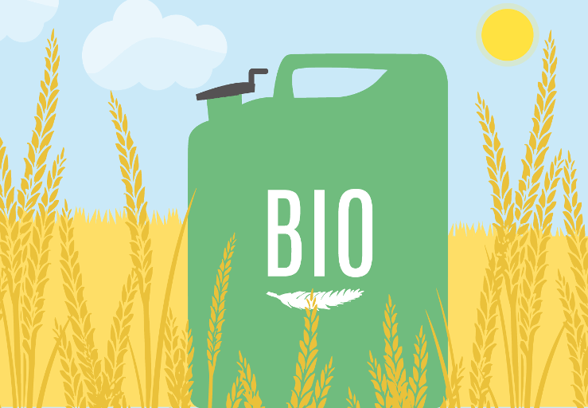
Introduction
1
What is Biofuel? Why is biofuel effective?

Slide 3
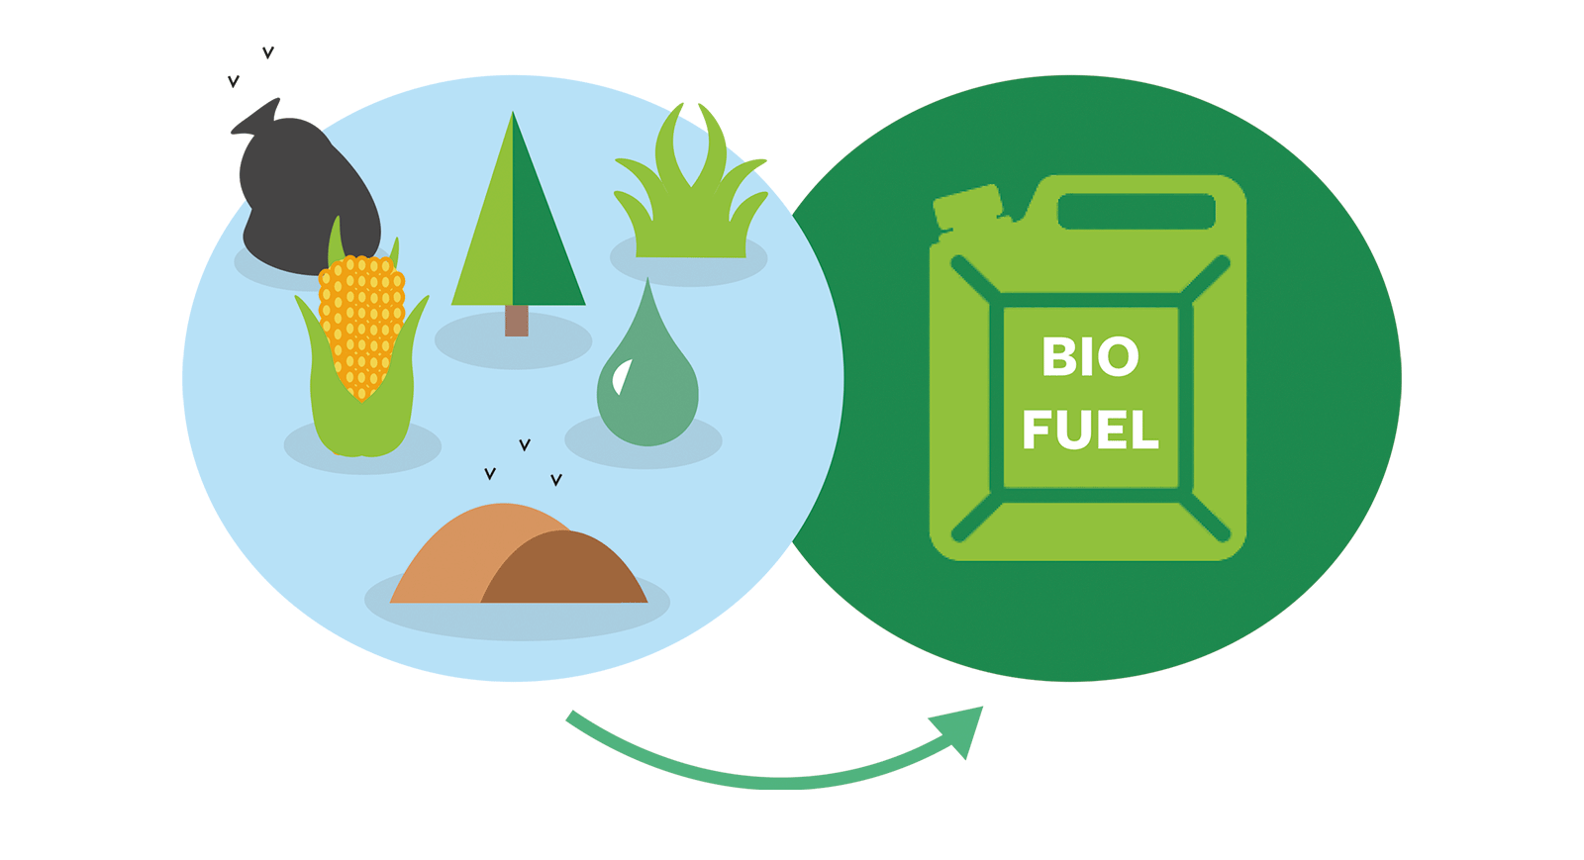
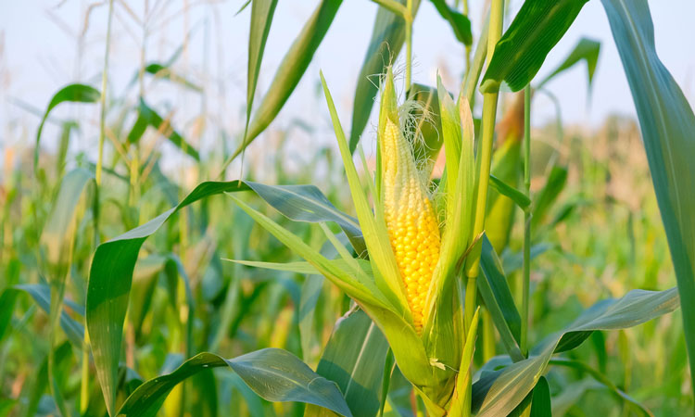
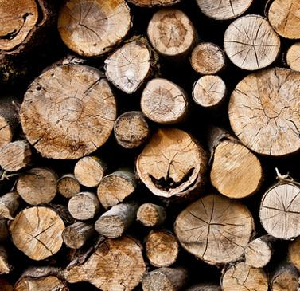
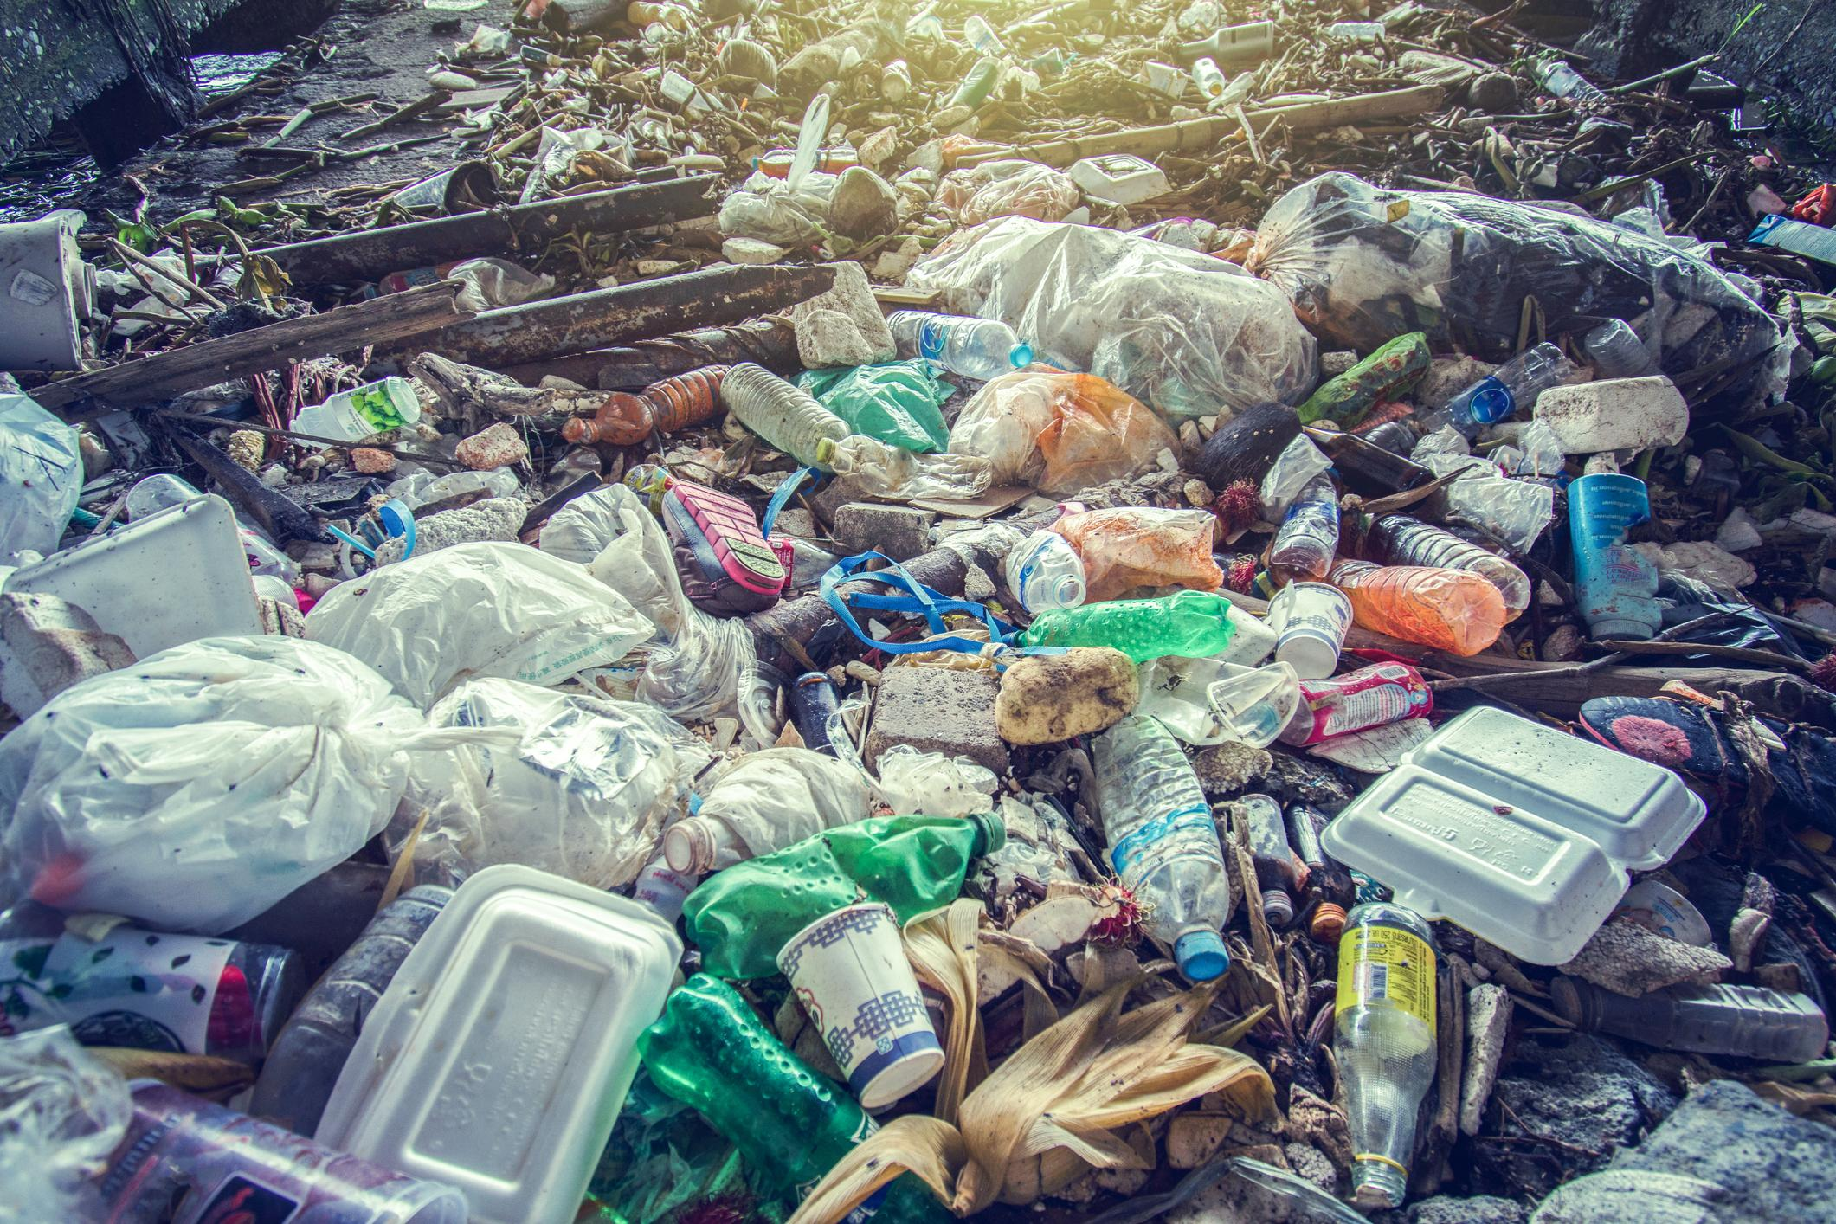
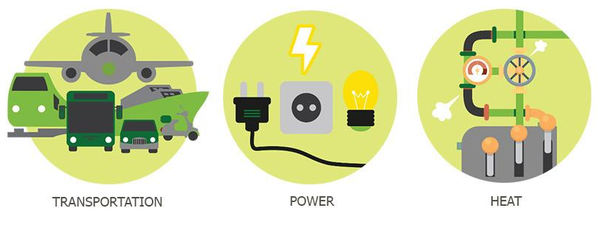
What is Biofuel?
A fuel derived directly from
living matter
Derived from biomass: plant or algae material or animal waste
Notes:
Since such feedstock material can be replenished readily, biofuel is considered to be a source of renewable energy, unlike fossil fuels such as petroleum, coal, and natural gas
Conventional ethanol production makes ethanol by fermenting sugars and starches from plants such as corn, sorghum, and sugarcane - similar to making alcoholic beverages

Slide 4
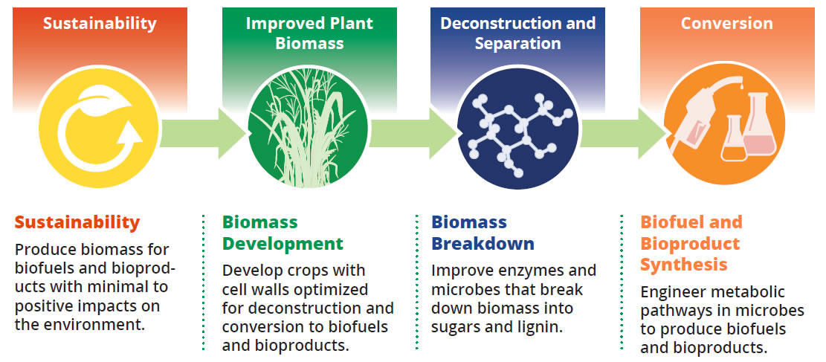
Biofuel Process:

Slide 5
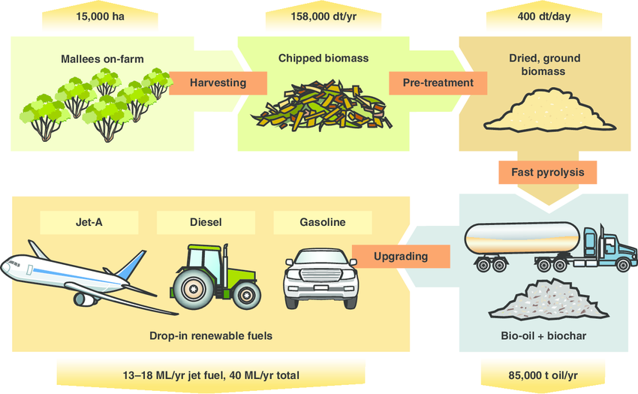
Biofuel Process:

Slide 6
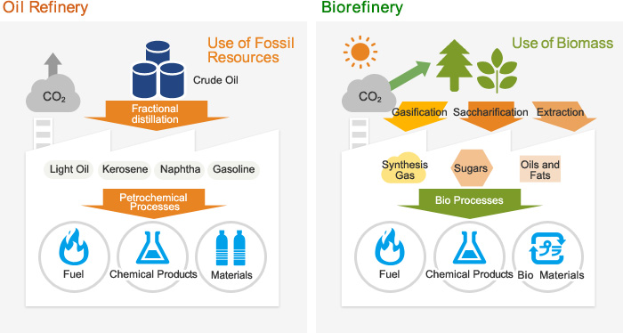
Biofuel Process:
vs

Slide 7
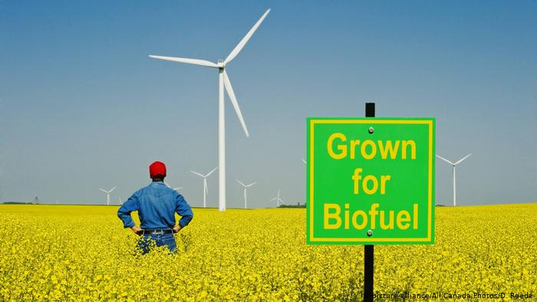
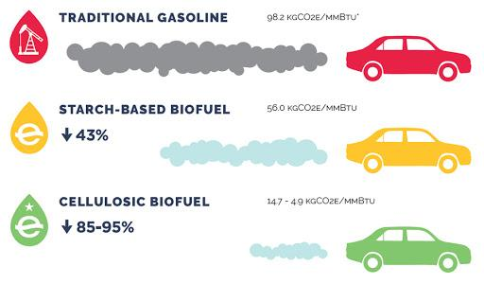
Why Biofuel?
Sustainable energy
Feedstock material replenished readily
Renewable energy
Better for environment
Unlike fossil fuels such as petroleum, coal, and natural gas
Combats alternatives that contribute to global warming
Notes:
Sustainable energy
Feedstock material can be replenished readily
Source of renewable energy
Better for environment
Unlike fossil fuels such as petroleum, coal, and natural gas
Combats alternatives that contribute to global warming

Slide 8
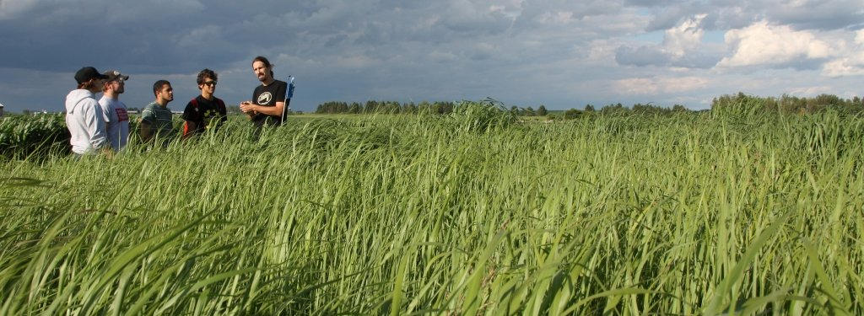
The Problem with Switchgrass...
“We reviewed over 100 articles on switchgrass, which found that this crop has a considerable ability to accumulate carbon in the soil compared to several other grasses, and especially row crops”
- Dr. Andrea Monti (research Scientist, Univ. Bologna, Italy)
Notes:
Switchgrass:
What is it?
Warm season bunchgrass native to North America prairie
Begins growth in late spring, can grow up to 8ft high
Ethanol (biofuel made from corn and other plant materials) is the main liquid in biofuel (usually 70-85% ethanol) and can be produced from the breakdown of switchgrass
Reproduces fast, releases a ton of carbon into the air

Slide 9
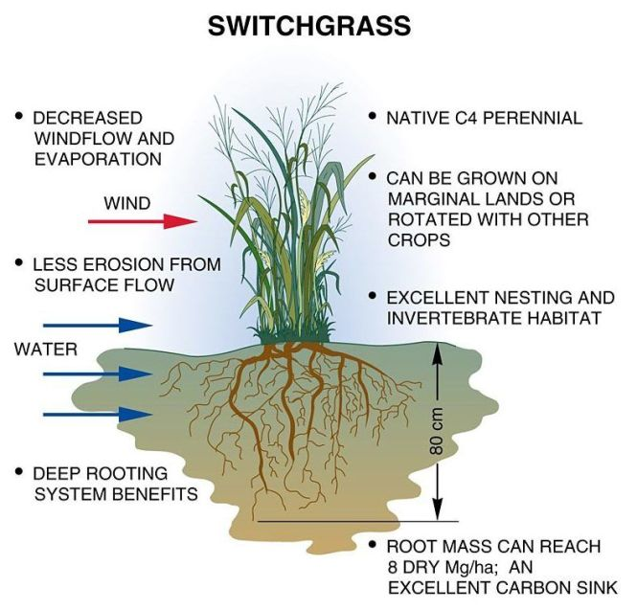

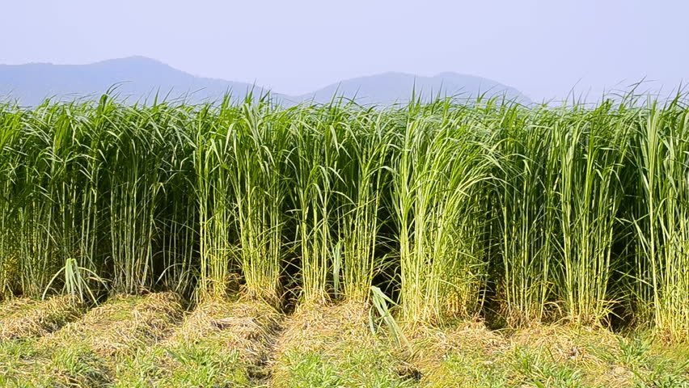
Switchgrass Biosynthetic Production
Ethanol can also be produced from cellulose, the stringy fibre that is a major component of stems of leaves
Prodigious producer of cellulose, producing higher biofuel yields than food crops
Grows higher than 2.7 meters and grows in large amounts

Slide 10
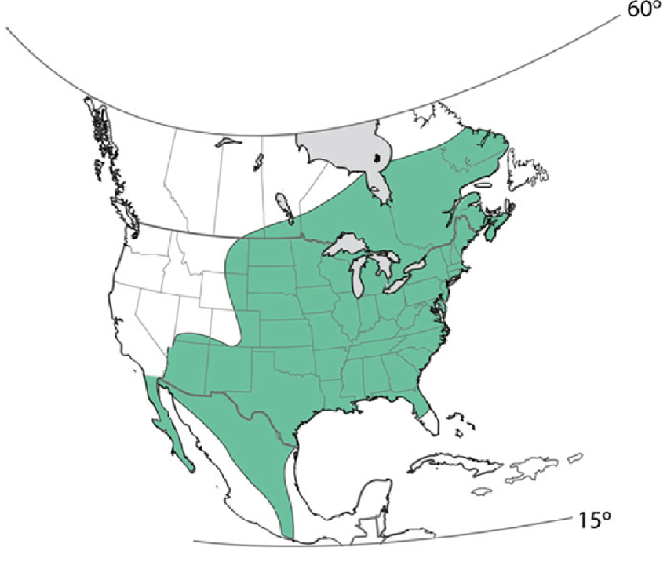
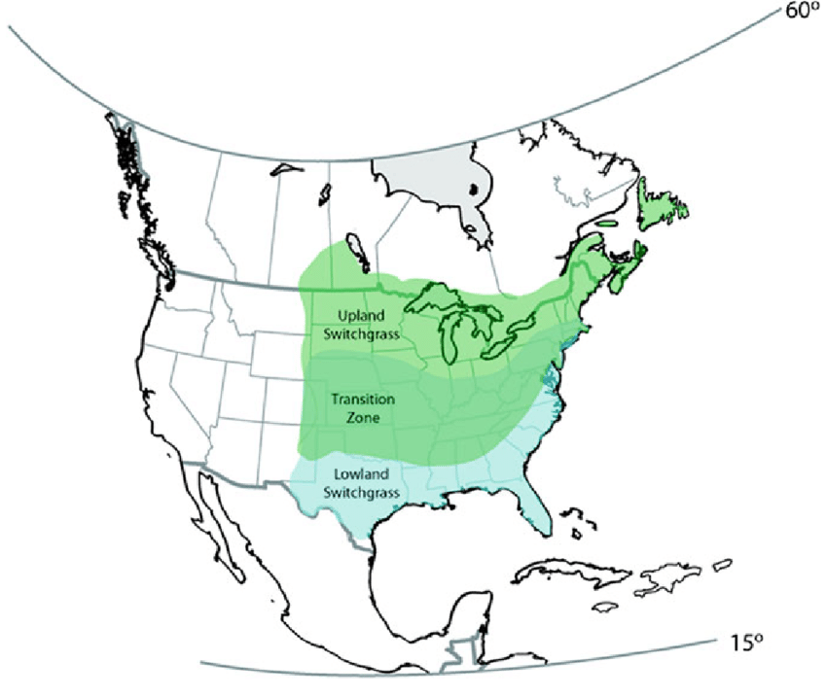
Switchgrass Range

Slide 11
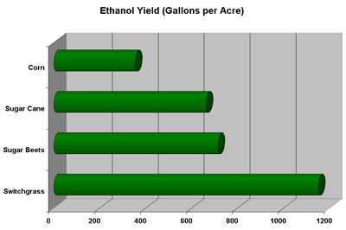
Switchgrass Surpasses Biocrops in Ethanol Production
Notes:
Switchgrass significantly surpasses biocrops in ethanol production

Slide 12
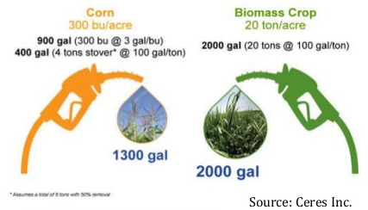
Switchgrass Surpasses Corn in Ethanol Production

Slide 13
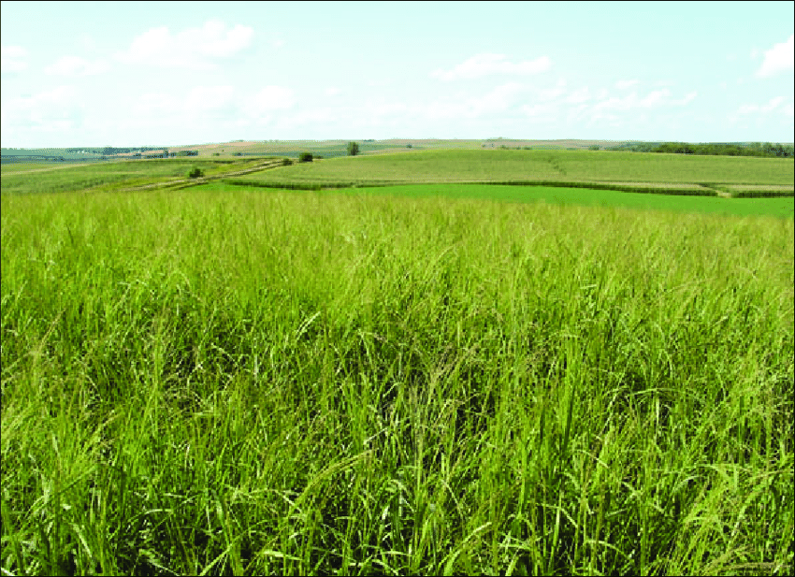
OUR PLAN:
COMBINING AND INSERTING DNA FROM MULTIPLE BACTERIA INTO E.COLI TO CARRY OUT THE PROCESS OF CONVERTING CELLULOSE INTO BIOFUEL

Slide 14
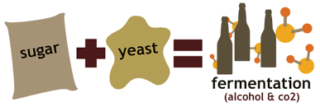
Research
2
Ethanol Fermentation

Slide 15
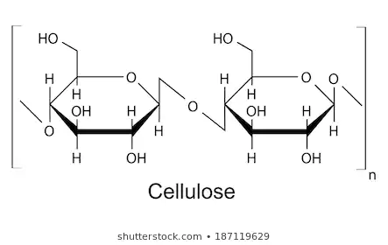
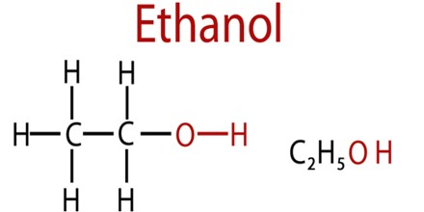
Our Plan

Slide 16
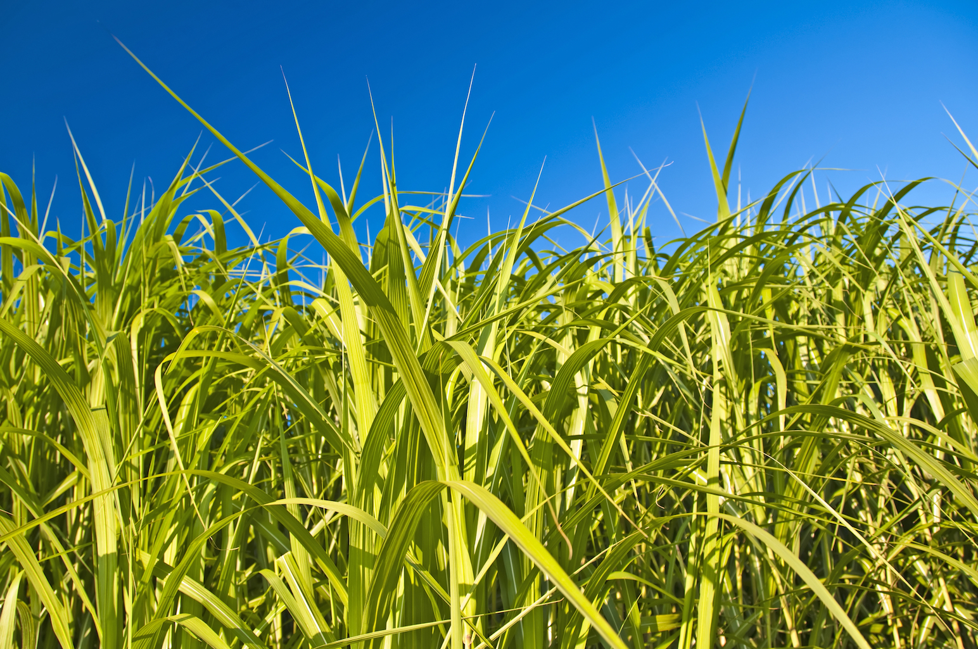
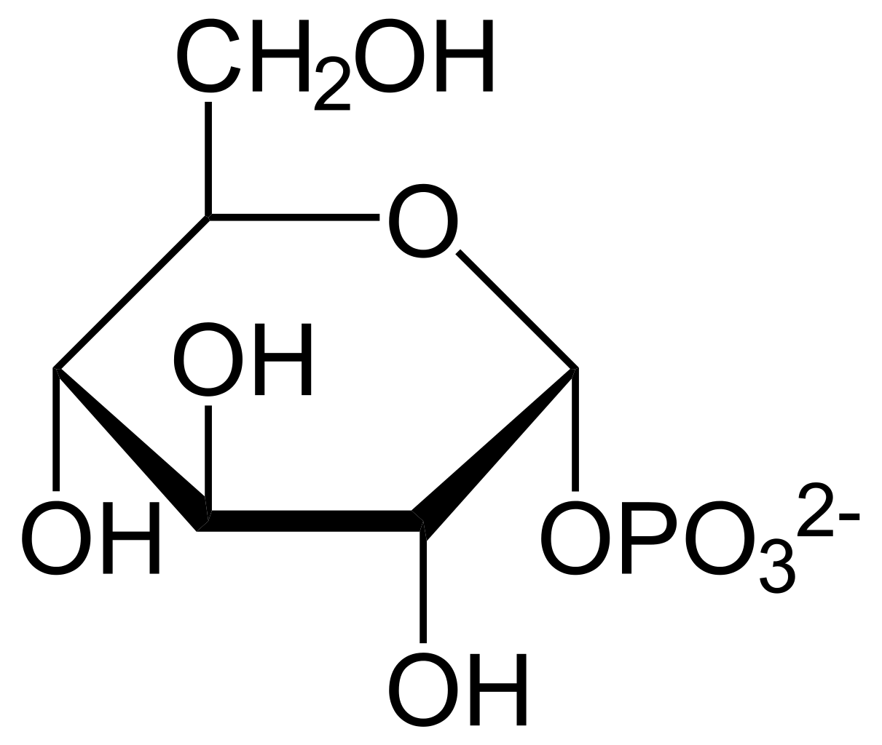
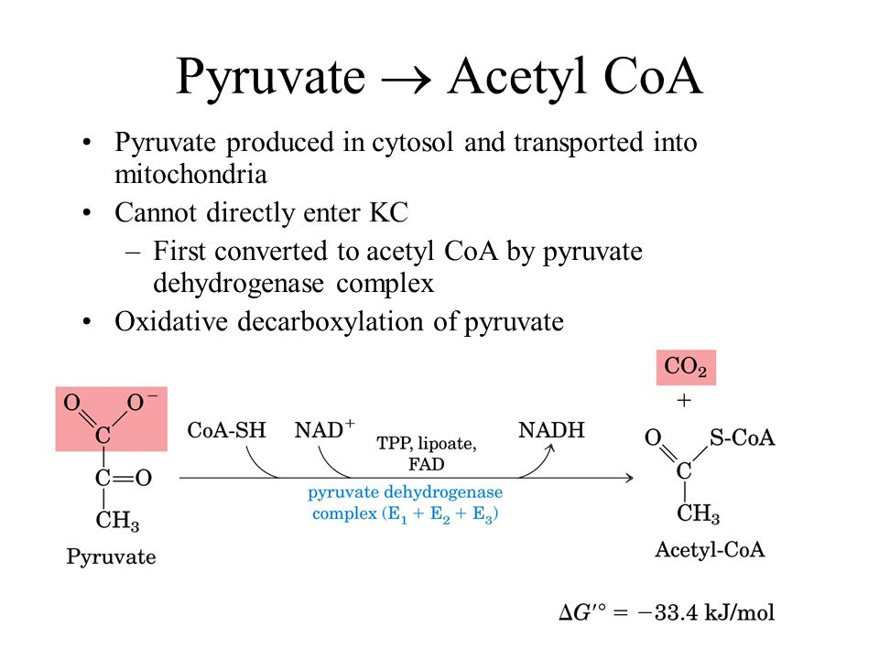
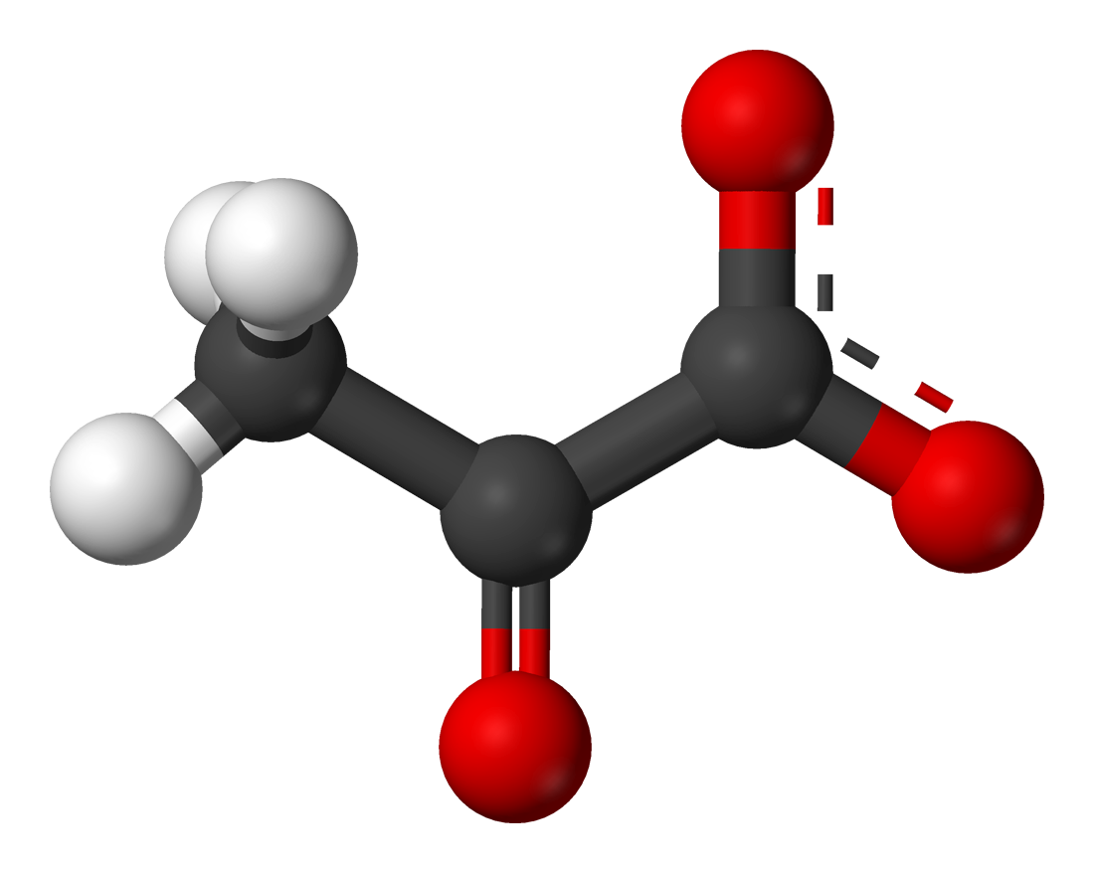


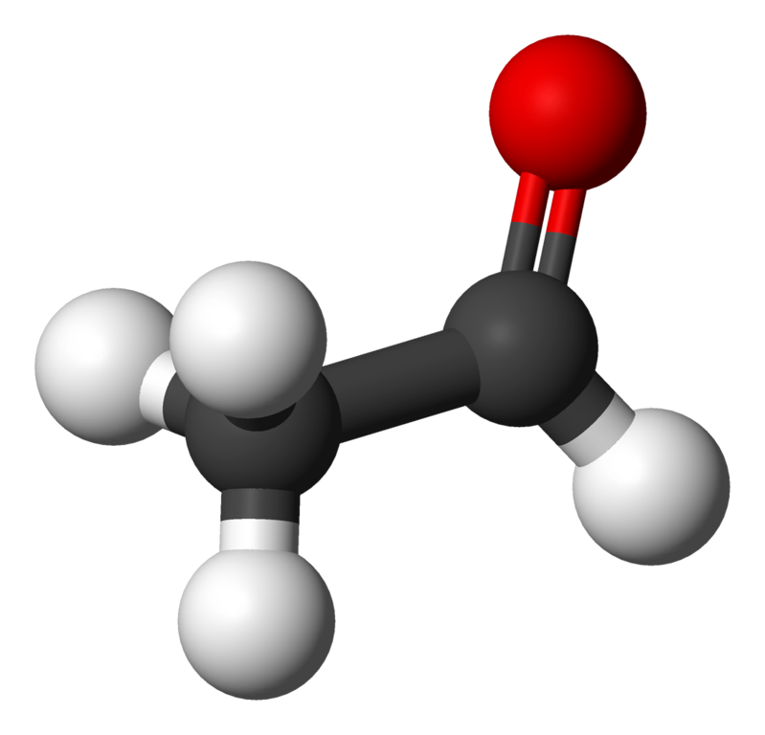
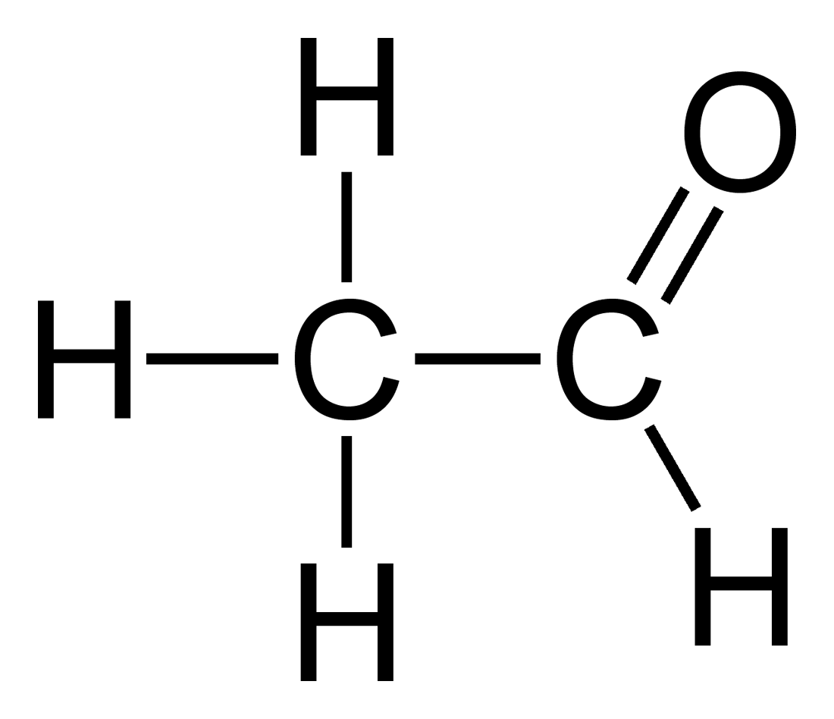
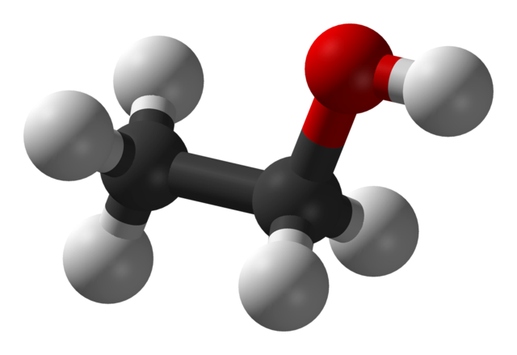

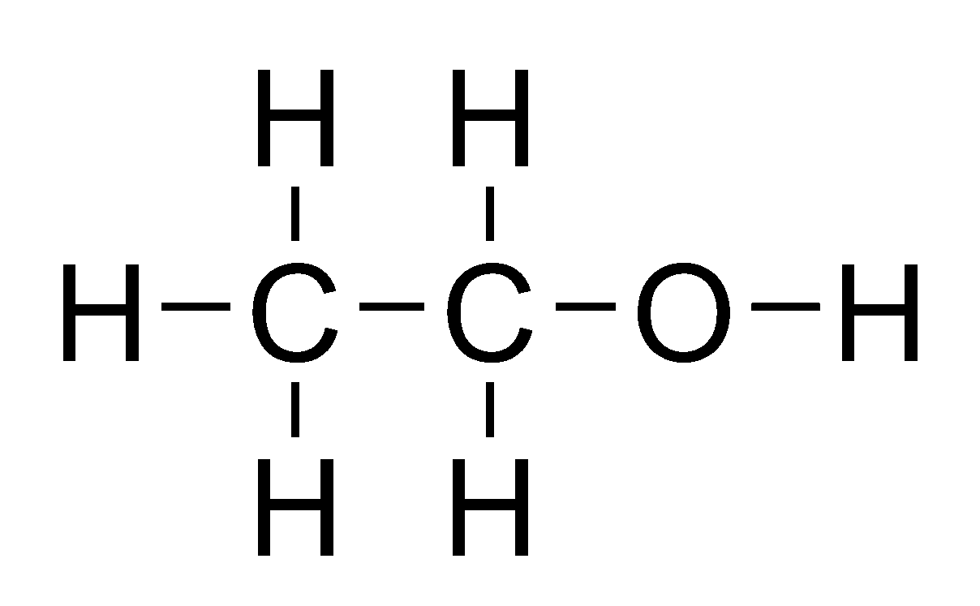
Diagram of Process
Cellulose: Switchgrass
E.coli:
Hexokinase, Phosphofructokinase, Pyruvate Kinase
Glycolysis breaks down glucose and forms pyruvate with the production of two molecules of ATP
Pyruvate
Glucose
E.coli:
Pyruvate Decarboxylase
In response to glucose, the enzyme pdh converts glucose into Pyruvate, which is converted to the compound Acetyl-CoA.
Acetyl-CoA
Acetaldehyde
Ethanol
E.coli:
Alcohol Dehydrogenase
In response to Acetyl-CoA, the enzyme adhB converts Acetyl-CoA into Acetaldehyde, which is converted to ethanol.

Slide 17
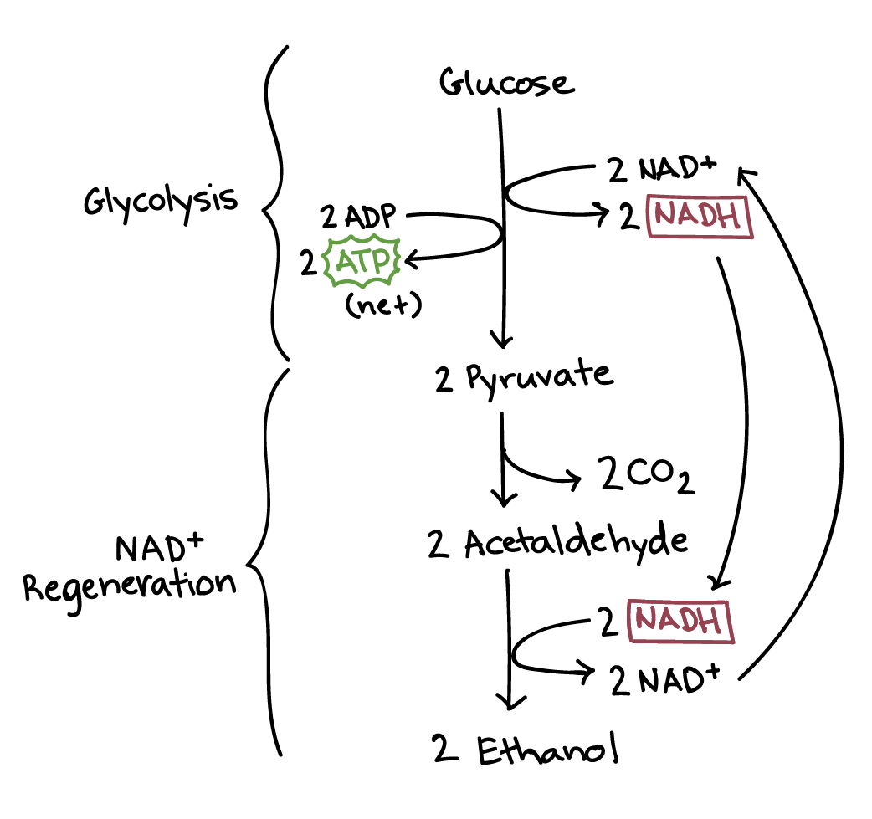
Steps:
Step (1): a carboxyl group is removed from pyruvate and released in as carbon dioxide, producing a two-carbon molecule called acetaldehyde
Step (2): NADH passes its electrons to acetaldehyde, regenerating NAD⁺ and forming ethanol

Slide 18
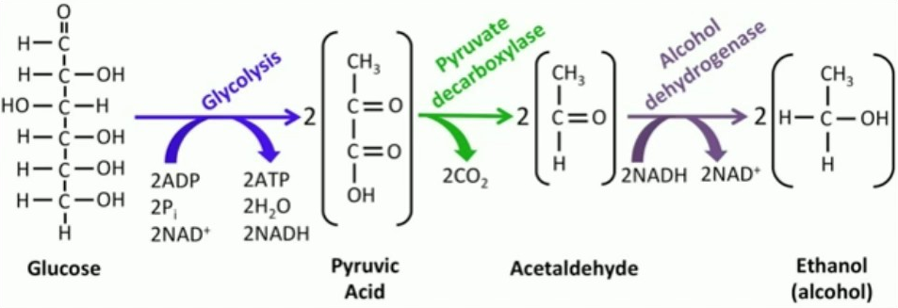
Ethanol Fermentation

Slide 19
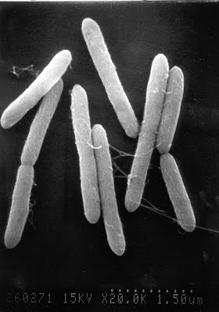
Research: Bacteria
Bacteria that perform steps in
Glycolysis & Ethanol Fermentation
Notes:
Bacteria pic: thermocellum

Slide 20
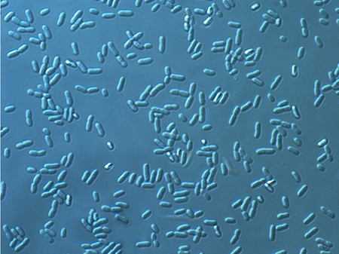
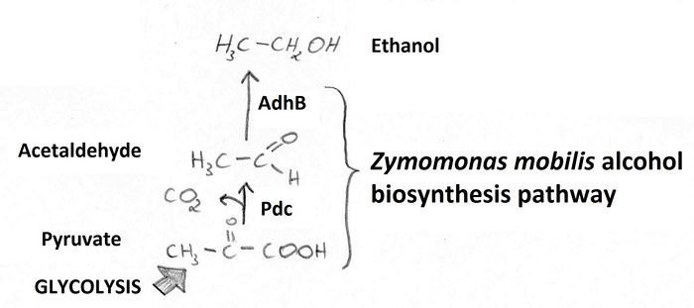
Zymomona Mobilis
Steps: turns pyruvate into ethanol and carbon dioxide
Beneficial Traits: high-ethanol productivity, high alcohol tolerance, broad pH range
Processes:
  Entner-Doudoroff Pathway: a metabolic pathway that starts with
Glucose and through a series of enzyme assisted chemical reactions is catabolized into pyruvate
  Homoethanol pathway: to metabolize pyruvate to ethanol (pdc, adh)
Genes/Enzymes:
  Pyruvate Decarboxylase: turns pyruvic acid to acetaldehyde and CO2
  Alcohol Dehydrogenase II (adhB gene): turns acetaldehyde and a
ubiquinon → ethanol

Slide 21
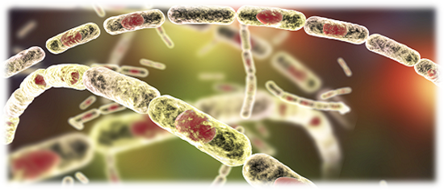
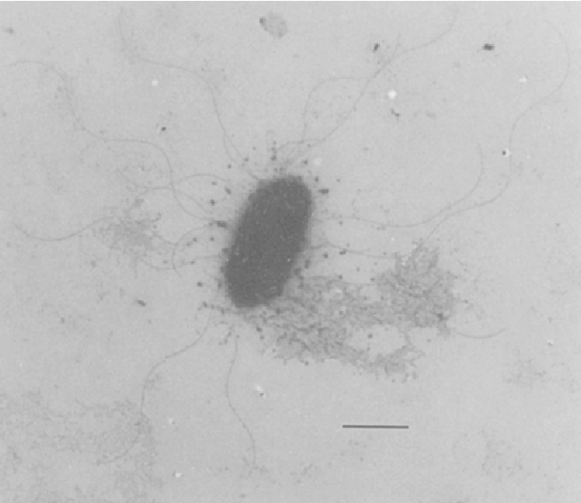
(3) Zymobacter Palmae
(2) (Geo)Bacillus Stearothermophilus
Steps: turns pyruvic acid into ethanol
Beneficial Traits: high-ethanol productivity, high alcohol tolerance, broad pH range
Genes/Enzymes:
  Pyruvate Decarboxylase: turns pyruvic acid to acetaldehyde and CO2
  Alcohol dehydrogenase II (adhB gene): turns acetaldehyde and a ubiquinon → ethanol
Steps: turns acetalhyde into ethanol
Beneficial Traits: high growth rate, high ethanol production from glucose
Genes/Enzymes:
  Alcohol Dehydrogenase (NAD+ dependent): turns acetaldehyde and a ubiquinon → ethanol and NADH

Slide 22
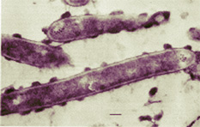
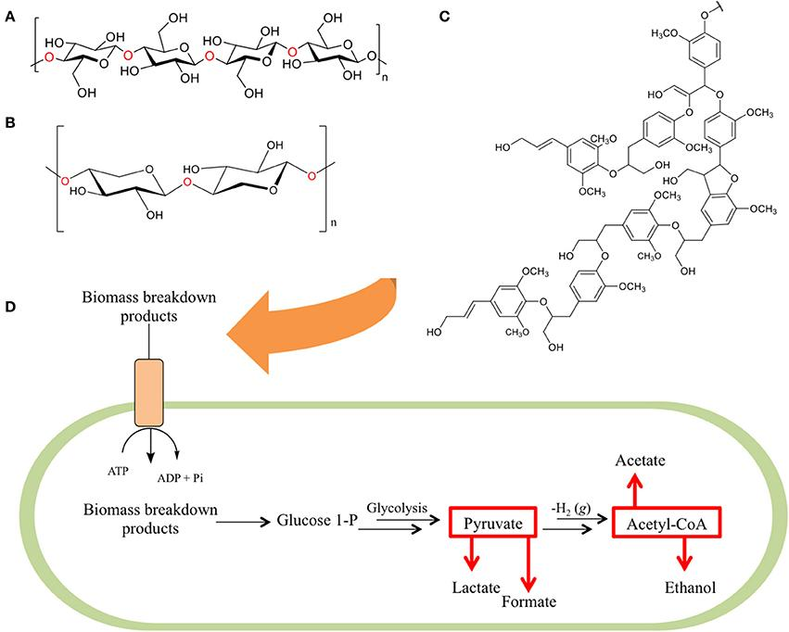
(4) Clostridium Thermocellum
Steps: turns pyruvate into ethanol and carbon dioxide
Beneficial Traits: rapidly ferments cellulose, produces ethanol at a high yield
Processes:
  Glycolysis: the process in which one glucose molecule is broken down to form two molecules of pyruvic acid (also called pyruvate)
Genes/Enzymes:
  Pyruvate Decarboxylase: turns pyruvic acid to acetaldehyde and CO2
  Alcohol Dehydrogenase II (adhB gene): turns acetaldehyde and a ubiquinon → ethanol

Slide 23

Research: Problems
Issues concerning leftover CO₂

Slide 24
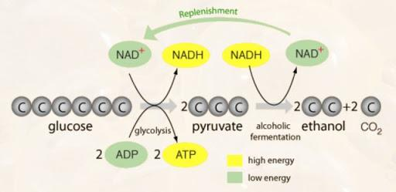
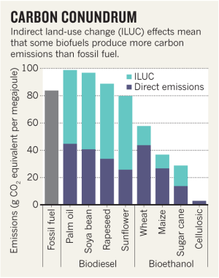
Issues in Research
Problem: Ethanol Fermentation produces CO₂ as by-product
Need to get rid of CO₂ as well or it’s pointless?
Original idea: fix carbon into energy (biofuel)
Use of biofuel decreases major CO₂ emission
  Less combustion emission in production process
  Replacing production of CO₂ in combustion rxns > CO₂ produced through ethanol production
Negligible CO₂ emission: we don’t need to deal with it
Overall: Production of CO2 in this bacteria will pale in comparison to the CO₂ produced by a car/plane/other vehicle that uses traditional fuels)
Notes:
Revisit the original idea

Slide 25
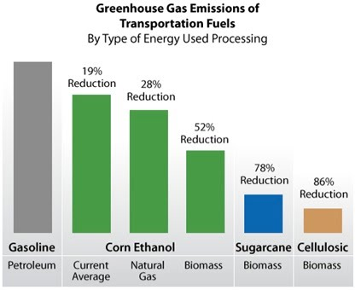
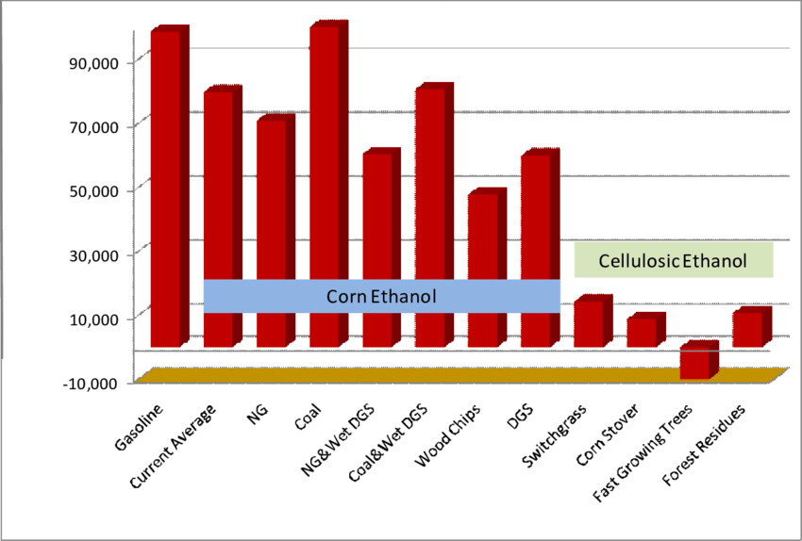
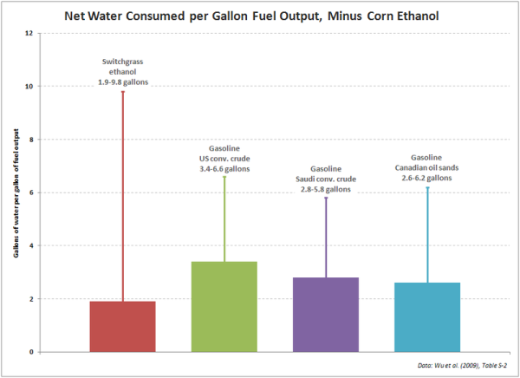
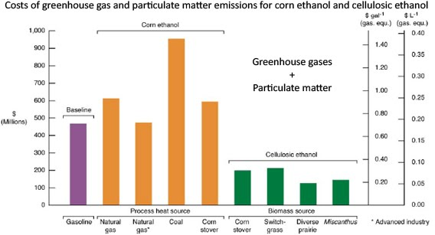
Notes:
So many pros that overshadow the cons of a few extra CO₂: cost, water usage

Slide 26
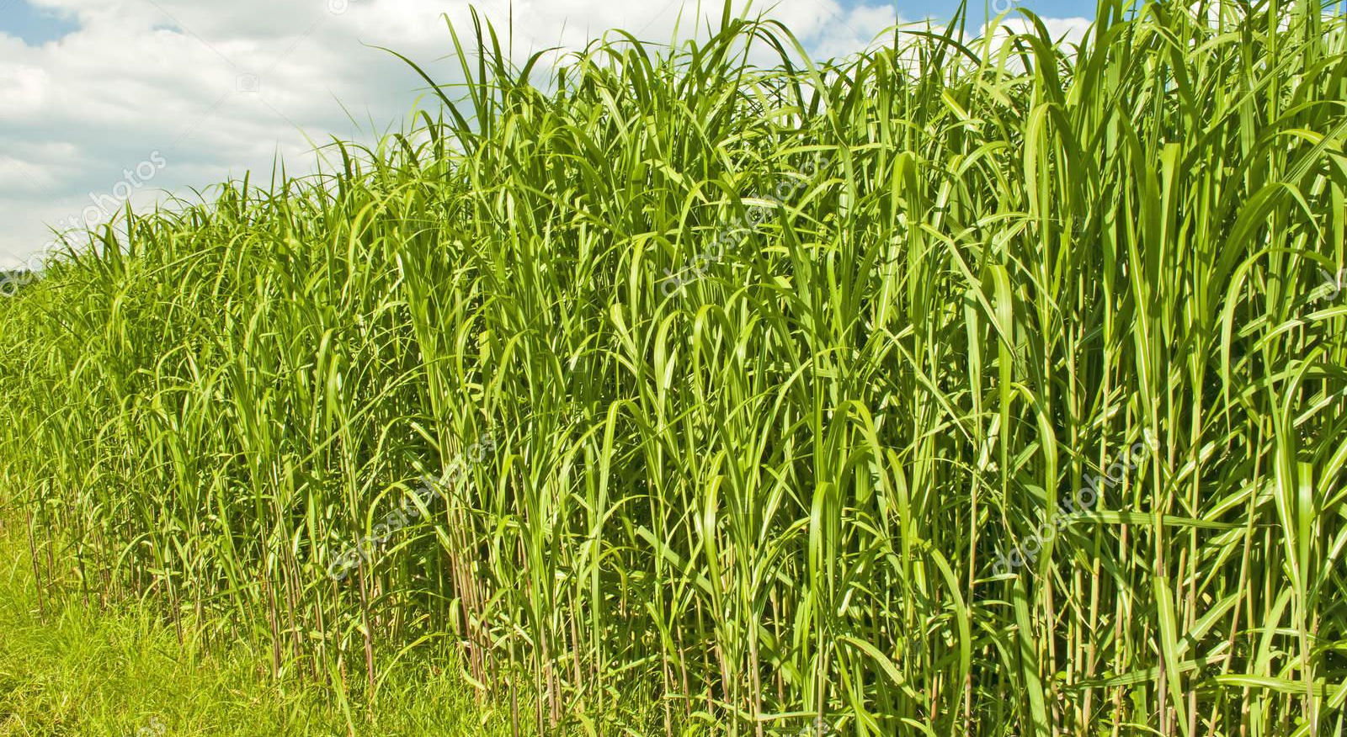
Future Research
4
Let’s start with the first set of slides

Slide 27
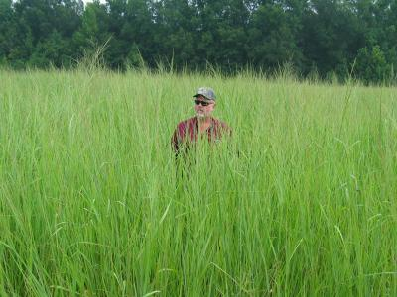

Future Research
Find specific genes of target bacteria
Choose two bacteria to work with
Design gene plasmid for E.coli chassis bacteria
Participate in competition
Reach out to local biotech companies

Slide 28
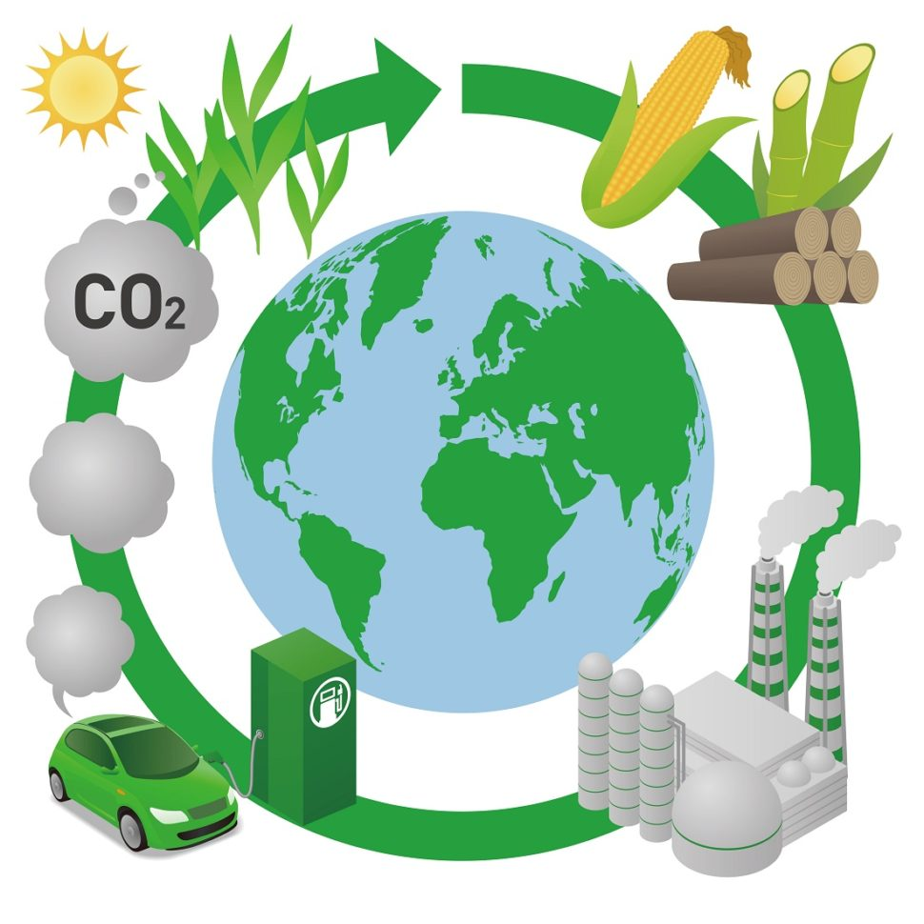
Resources Used
iGEM Database
BRENDA Database
BioCyc Database
Uniprot Database
QuickGo Database
MicrobeWiki

Slide 29
Citations
Akinosho, Hannah, et al. “The Emergence of Clostridium Thermocellum as a High Utility Candidate for Consolidated Bioprocessing Applications.” Frontiers in Chemistry, vol. 2, 2014, doi:10.3389/fchem.2014.00066.
Tian, Liang, et al. “Enhanced Ethanol Formation by Clostridium Thermocellum via Pyruvate Decarboxylase.” Microbial Cell Factories, vol. 16, no. 1, 2017, doi:10.1186/s12934-017-0783-9.
Zarubin, Bobby. “Cellulosic Ethanol: Environmentally Friendly, But Costly.” Cellulosic Ethanol: Environmentally Friendly, But Costly, 16 Nov. 2014, large.stanford.edu/courses/2014/ph240/zarubin1/.
Badger, P. C. “Ethanol From Cellulose: A General Review.” Ethanol From Cellulose: A General Review, 2002, hort.purdue.edu/newcrop/ncnu02/v5-017.html.
Xiong, Wei, et al. “CO2-Fixing One-Carbon Metabolism in a Cellulose-Degrading Bacterium Clostridium Thermocellum.” Proceedings of the National Academy of Sciences, vol. 113, no. 46, 2016, pp. 13180–13185., doi:10.1073/pnas.1605482113.
“Geobacillus Stearothermophilus.” Microbewiki, microbewiki.kenyon.edu/index.php/Geobacillus_stearothermophilus.
Mohamed Rizwan Haroon Al Rasheed and Carmencita G. Senseng (2016) Sarcina ventriculi: Review of the Literature. Archives of Pathology & Laboratory Medicine: December 2016, Vol. 140, No. 12, pp. 1441-1445.
Singh, Kevin. “Emphysematous Gastritis Associated with Sarcina Ventriculi.” Case Reports in Gastroenterology, vol. 13, no. 1, 2019, pp. 207–213., doi:10.1159/000499446.
Okamoto, Tomoyuki, et al. “Zymobacter Palmae Gen. Nov., Sp. Nov., a New Ethanol-Fermenting Peritrichous Bacterium Isolated from Palm Sap.” Archives of Microbiology, vol. 160, no. 5, 1993, doi:10.1007/bf00252218.
Lee, Jae Sun, et al. “Bioethanol Production by Heterologous Expression of Pdc and AdhII in Streptomyces Lividans.” Applied Microbiology and Biotechnology, vol. 97, no. 13, 2013, pp. 6089–6097., doi:10.1007/s00253-013-4951-5.
“Alcohol Dehydrogenase II .” MetaCyc AdhB, SRI International, 2020, biocyc.org/gene?orgid=META&id=G-14634.
UniProt ConsortiumEuropean Bioinformatics InstituteProtein Information ResourceSIB Swiss Institute of Bioinformatics. “Alcohol Dehydrogenase II.” UniProt ConsortiumEuropean Bioinformatics InstituteProtein Information ResourceSIB Swiss Institute of Bioinformatics, 11 Dec. 2019, www.uniprot.org/uniprot/O31150.
Kirmair, Ludwig, et al. “Stability Engineering of the Geobacillus Stearothermophilus Alcohol Dehydrogenase and Application for the Synthesis of a Polyamide 12 Precursor.” Applied Microbiology and Biotechnology, vol. 99, no. 24, 2015, pp. 10501–10513., doi:10.1007/s00253-015-6930-5.

Slide 30

THANKS!
Any questions?

