Slide 1


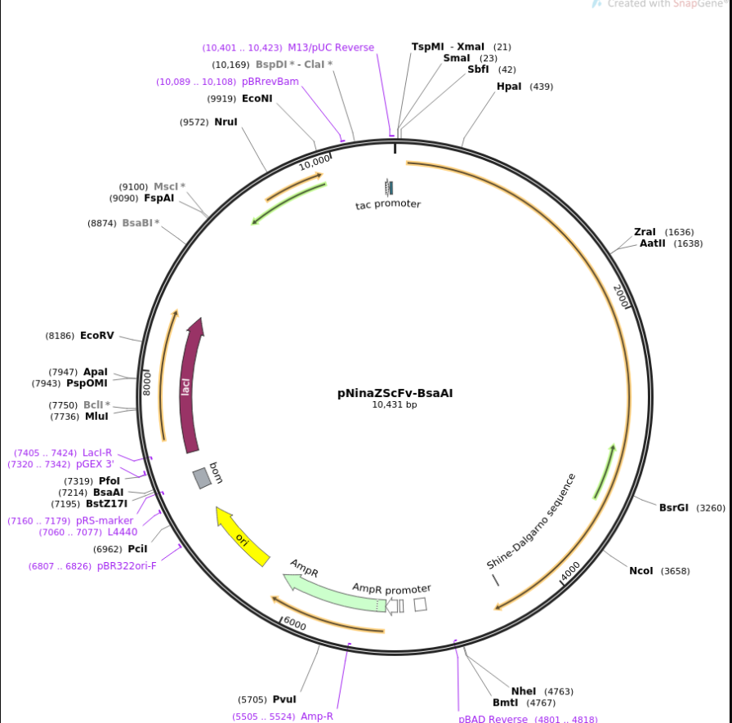
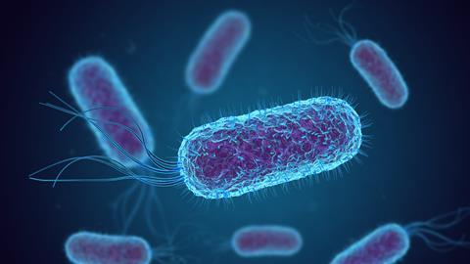
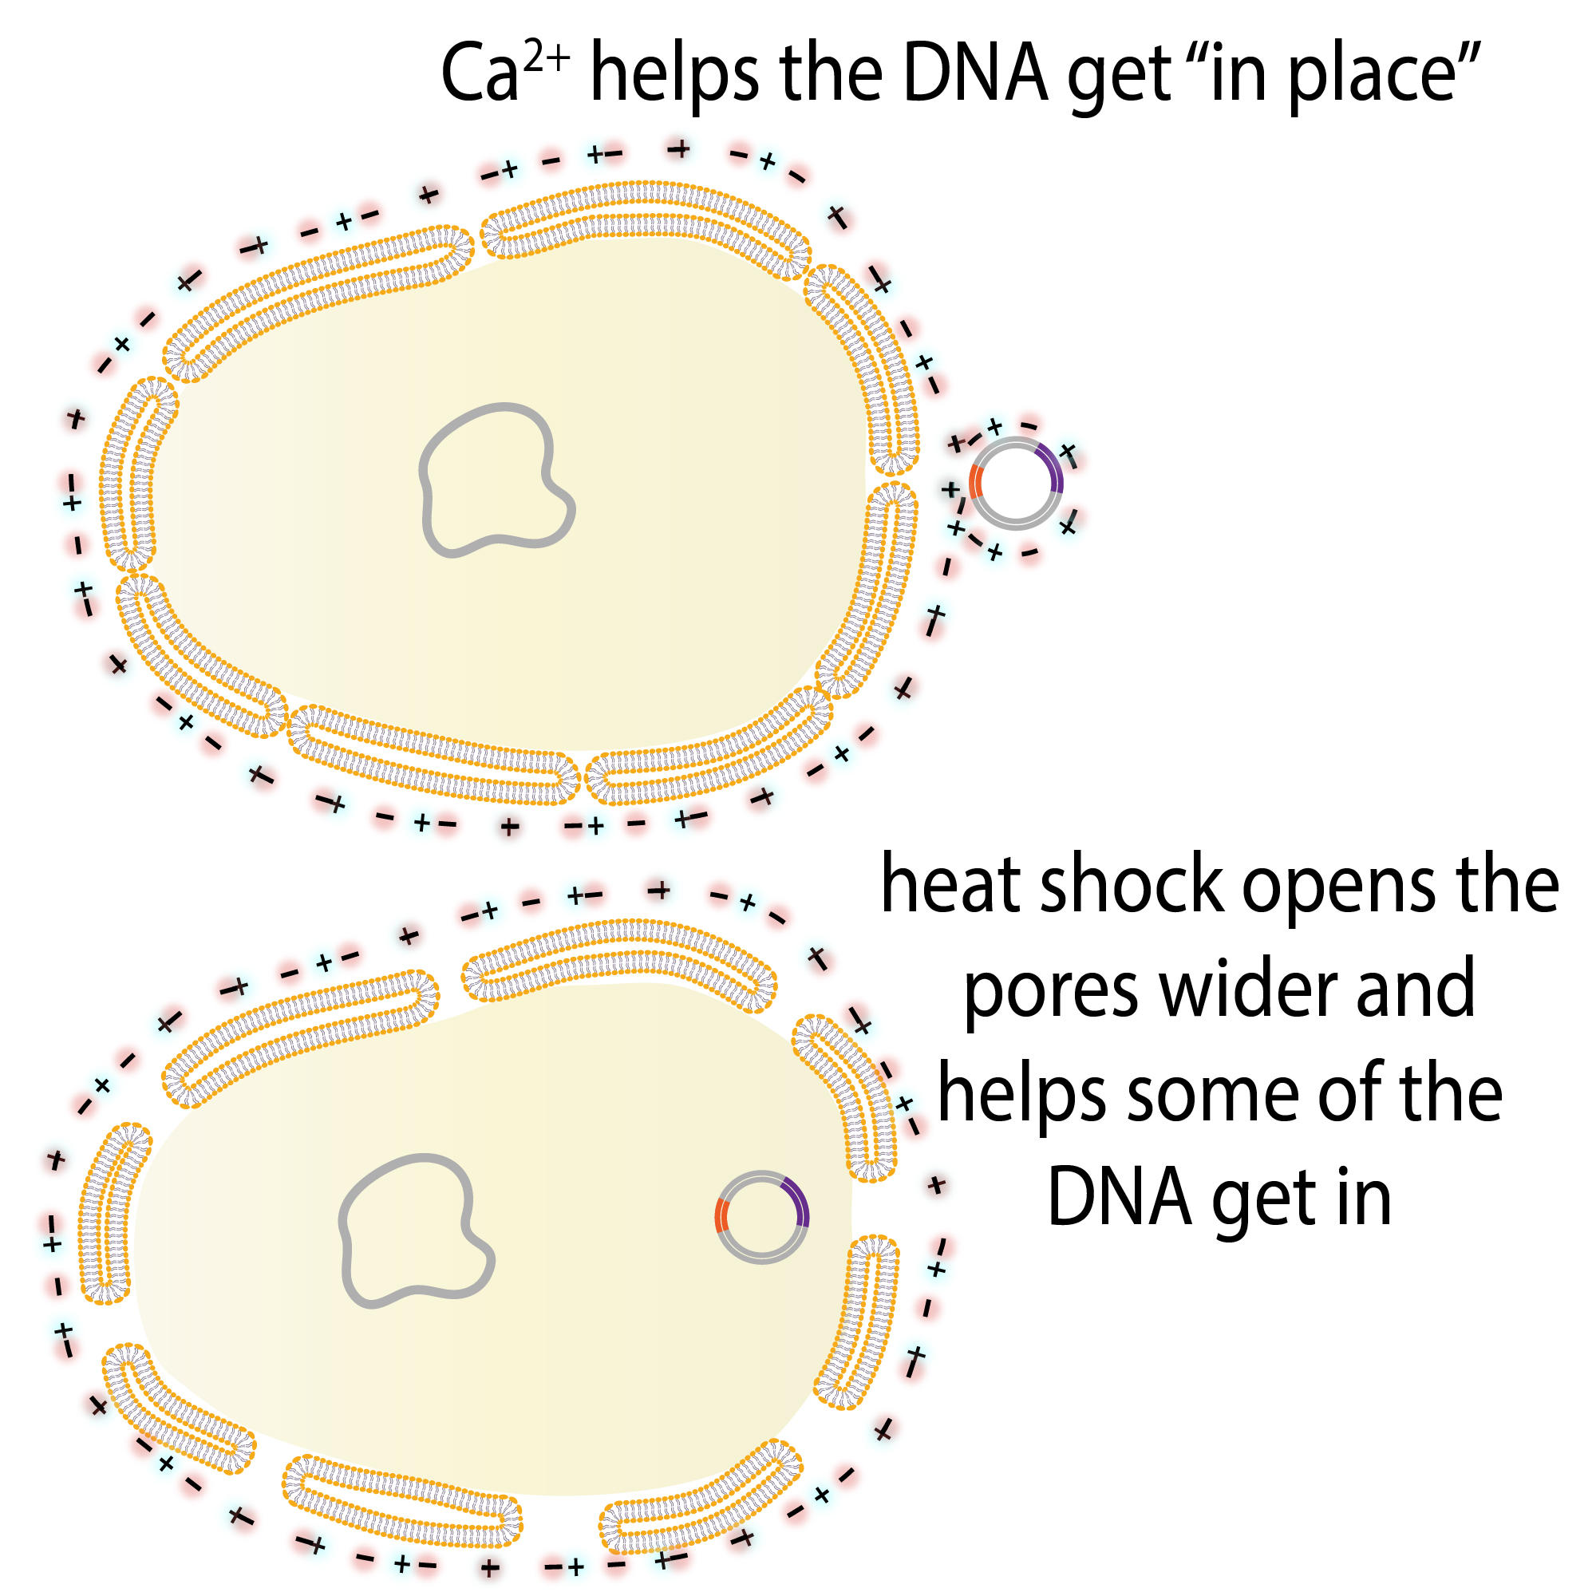
Bacterial Ice Creation
Adriana A, Lavanya G, Pranita O, Daniel O, Tsega W
Prospect Hill Academy Charter School, Cambridge, MA
Introduction & Project Details
Experiments We Planned
Problem: Global warming is causing ice to melt in the arctic.
Solution: Bioengineer bacteria to produce ice.
Project Design: We’re going to use bacterial transformation to insert ice nucleating proteins into E. Coli.
Ice nucleating proteins turn water into ice at higher temperatures than normal
Chose E. Coli because it duplicates quickly and is a commonly used model organism
Order Materials:
-Plasmid (#26759)
- BL21 cells (E. Coli)
Bacterial Transformation: inserting plasmid into the bacteria
Heat shock
  High temp = Little pores open up in bacteria membrane → Allows plasmids in surrounding area to be sucked into bacteria
Testing
  Compare bacteria with the Ice Nucleating gene vs bacteria without the gene and see whether our null hypothesis is supported
            Control Bacteria: Proteins don't produce ice when exposed to water
            Altered Bacteria: Proteins produce ice when exposed to water

Slide 2

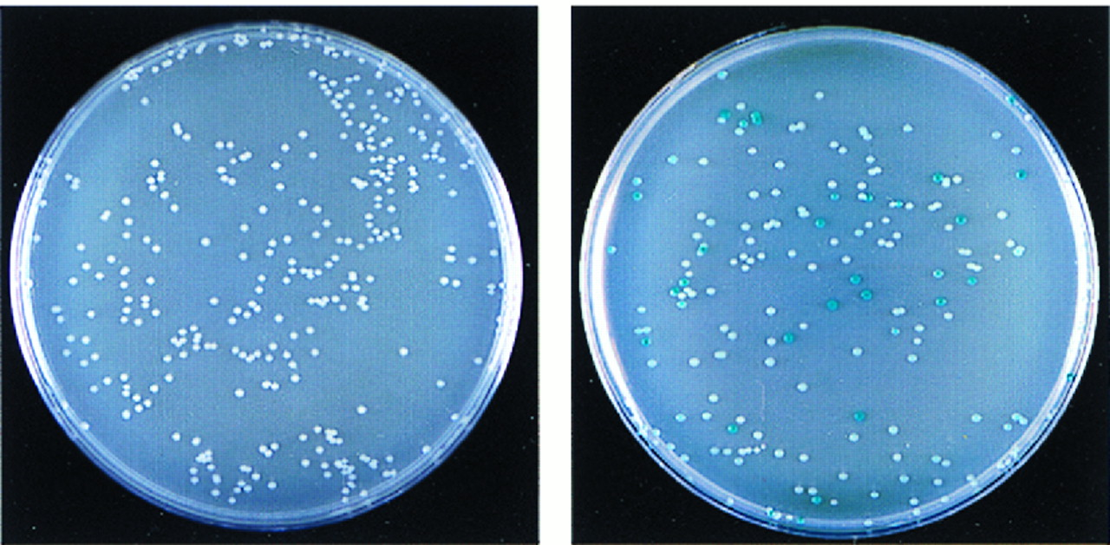
Bacterial Ice Creation
Adriana A, Lavanya G, Pranita O, Daniel O, Tsega W
Prospect Hill Academy Charter School, Cambridge, MA
Challenge for Next Year’s Team
About This Year’s Team
Next steps:
Ordering materials and conducting bacterial transformation in lab
Testing in lab
Testing in the real world
Daniel, Drin, Pranita, Lavanya, Tsega, Ms.Benson, Patrick
References & Acknowledgements
Thanks to whomever should be acknowledged in this research.
Plasmid: https://www.addgene.org/26759/
Amino Acid Sequence: https://www.uniprot.org/uniprot/S3MD81
Heat Shock Protocol: https://www.addgene.org/protocols/bacterial-transformation/#:~:text=Incubate%20the%20competent%20cell%2FDNA,on%20ice%20for%202%20min.

