Slide 1



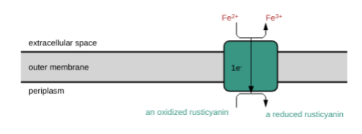
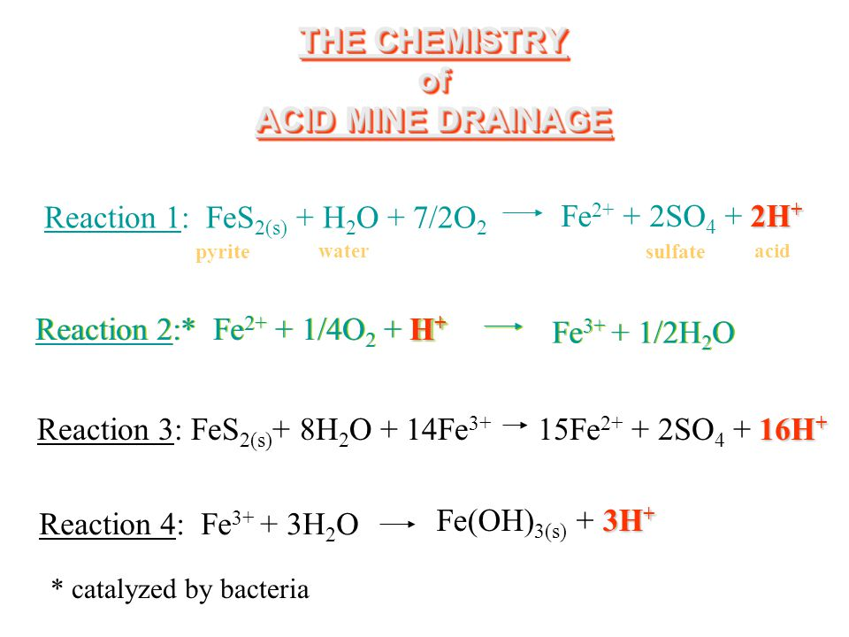
Combating Acid Mine Drainage
Kaitlyn Ramesh, Phil Shraybman, Phoebe Shubin, Yasu Patel, Brady Chin
Needham High School, Needham, MA
Introduction & Project Details
Experiments We Did &/or Planned
About Acid Mine Drainage (AMD)
Ore in metal mines often contains a high level of sulfide minerals. When these sulfides are exposed to water and air, their reaction creates sulfuric acid (H₂SO₄).
  Acid mine drainage can pollute nearby water supplies and cause them to have high metal concentrations and low pH. These issues can corrode infrastructure and damage nearby aquatic life, as some organisms cannot survive in polluted waters. In the Bingham Canyon Mine, acid mine drainage has severely polluted nearby rivers, damaging local wildlife.
Acidithiobacillus ferrooxidans is an acidophile that thrives in acidic environments, and is prevalent in abandoned metal mines; it plays a major role in producing sulfuric acid
Common treatments for acid mine drainage have been through the addition of chemicals
  We propose using existing mechanisms in A. ferrooxidans to counteract acid mine drainage as a form of bioremediation
The iGEM Registry of Biological Parts was used to understand the specific genetic and metabolic characteristics of A. ferrooxidans that contribute to acid mine drainage
The specific alterations needed in the genome of A. ferrooxidans were investigated using the UniProt database of protein sequences
A possibility for future experimentation is the potential to disable (via knockout method) the specific gene of the A. ferrooxidans genome that contributes to acid mine drainage
  The effectiveness of the genome knockout could be tested by measuring sulfuric acid levels in AMD
Our Design
We researched a method to introduce genetically-engineered Acidithiobacillus ferrooxidans, lacking the enzymes that increase H₂SO₄ production, into bodies of water affected by AMD
  A. ferrooxidans oxidizes Fe2+ (ferrous ions) to Fe3+ (ferric ions)
One enzyme involved in A. ferrooxidans’ iron-oxidizing mechanism (iron-oxidizing/O2 reducing supercomplex) is is iron-rusticyanin reductase, which catalyzes the oxidation of Fe2+
  Removing the cyc2 gene that encodes iron-rusticyanin reductase can be carried out with the knockout method (as done for E.coli)

Slide 2
Combating Acid Mine Drainage
Kaitlyn Ramesh, Phil Shraybman, Phoebe Shubin, Yasu Patel, Brady Chin
Needham High School, Needham, MA
Challenge for Next Year’s Team
About This Year’s Team
Key Points and Takeaways
We have identified the iron-rusticyanin reductase enzyme, along with several other enzymes composing a supercomplex, as being important in the creation of ferric ions by Acidithiobacillus ferrooxidans, which play a crucial role in the mass production of sulfuric acid. This enzyme is coded by the cyc2 gene, but we need to identify how to alter this gene in order to disable the enzyme supercomplex.
Our Recommended Experiment for Other School’s Teams
If this project were to be picked up be another team, it would be beneficial to conduct an experiment altering or removing the cyc2 gene of Acidithiobacillus ferrooxidans to see how the supercomplex was effected, and whether or not sulfuric acid was still produced by the bacteria.
Although we intend to remove the gene through the knockout method, we are unsure of how to transform DNA into this particular bacteria. Furthermore, A. ferrooxidans may die without the gene, or the supercomplex could continue creating ferric ions even without the gene.
It would also be worth investigating how the altered Acidithiobacillus ferrooxidans would compete with the wild-type bacteria. If the altered bacteria died out, it would not be helpful in preventing acid mine drainage. Instead, the bacteria should be equipped with advantageous genes so that the wild-type is replaced, to lessen the damage of acid mine drainage.
However, if this process of knocking out the gene did not reduce the concentration of sulfuric acid, a different possible strategy could be altering the gene to catalyze the reverse reaction of the enzyme, returning the sulfuric acid to sulfide minerals.
Members of Our Team:
Phil Shraybman: 12th grade; NHS BioBuilders Co-captain, 2nd year in BioBuilders
Kaitlyn Ramesh: 12th grade; NHS BioBuilders Co-captain, 2nd year in BioBuilders
Phoebe Shubin: 12th grade; 3rd year in BioBuilders
Yasu Patel: 9th grade; 1st year in BioBuilders
Brady Chin: 9th grade; 1st year in BioBuilders
Acknowledgements
A special thank you to Katherine Warfel and Jennifer Regrut for the opportunity to pursue this research.
Valdés, J., Pedroso, I., Quatrini, R. et al. Acidithiobacillus ferrooxidans metabolism: from genome sequence to industrial applications. BMC Genomics 9, 597 (2008). https://doi.org/10.1186/1471-2164-9-597
"iron-rusticyanin reductase." MetaCyc, biocyc.org/gene?orgid=META&id=MONOMER-16162#tab=RXNS.
Datsenko, K A, and B L Wanner. “One-step inactivation of chromosomal genes in Escherichia coli K-12 using PCR products.” Proceedings of the National Academy of Sciences of the United States of America vol. 97,12 (2000): 6640-5. doi:10.1073/pnas.120163297

