Slide 1

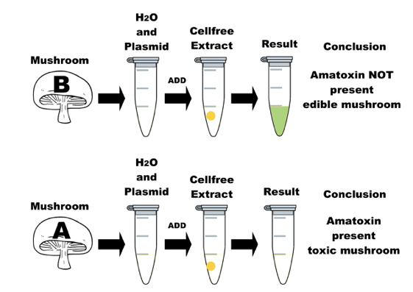
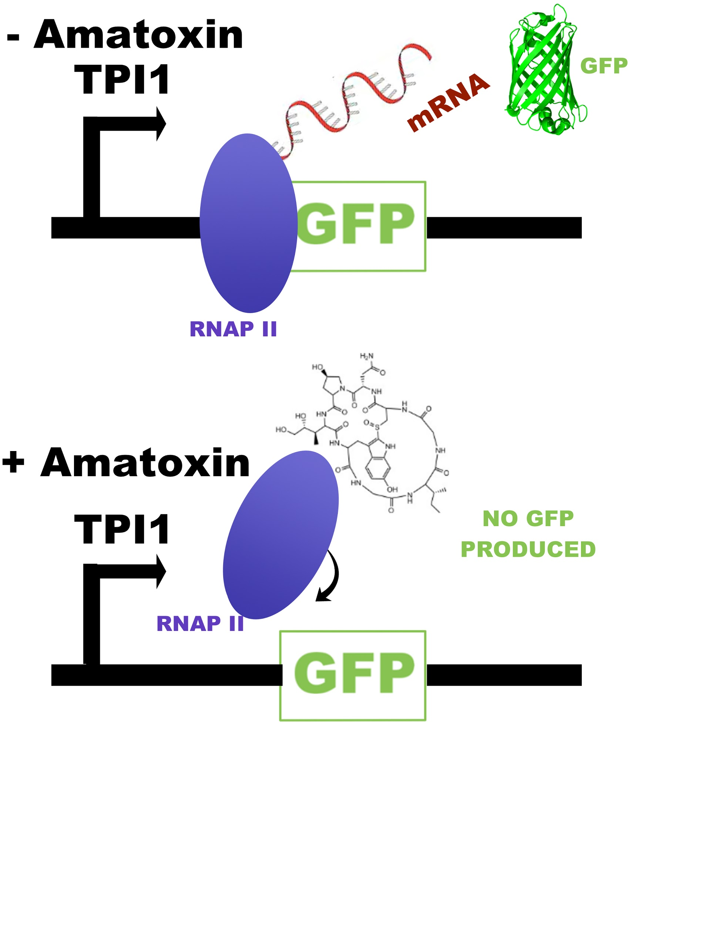
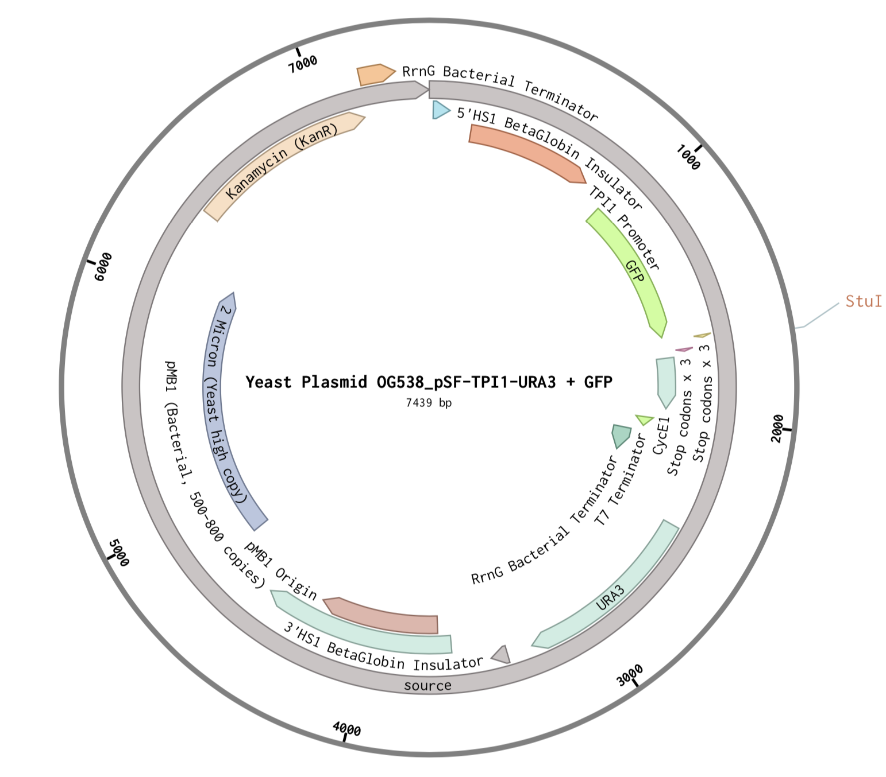
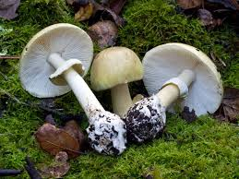
Amatoxin Biosensor
Alverno Heights Academy
The objective of our project is to create a biosensor that detects whether a collected mushroom is a member of the deadly amatoxin-containing Amanita mushrooms.
Our biosensor consists of a yeast cell-free extract and a GFP yeast plasmid, which, in the presence of the alpha-amanita toxin, negates production of GFP by disabling RNA polymerase II.
Fig.1 Amanita phalloides, Death Cap Mushroom, often confused with common edible mushrooms.
Fig.2 Yeast Plasmid [GFP]
Fig. 3 Amatoxin inhibits RNAP II -->
No GFP produced

