Slide 1
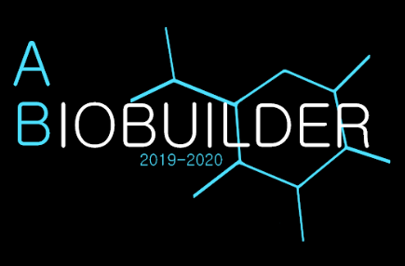
Acton-Boxborough Regional High School
Eutrophication System: Engineer E. coli to absorb excess phosphorus in water using ppk gene with several safety components
Hemophilia System: Engineer E. coli, K12 strain, to produce Factors VIII, IX, and X to hasten blood coagulation in order to benefit hemophiliacs, who suffer from a lack of blood-clotting proteins
Glial Scars System: Use siRNA to slow down the production of GFAP and CX-30 when elevated levels are detected during the formation of glial scars, since they can inhibit regeneration in the CNS
Eutrophication System Authors: Annabella Chen, Abigail Dillon, Yuying Fan, Song Leav, Amanda Zhang
Hemophilia System Authors: Nitya Aryasomayajula, Soumili Dey, Sam Dillon, Anne Fu, Apurva Joshi, Paul Kim, Rohit Kommuru, Alex Russell, Julia Wu
Glial Scars System Authors: Will Klatte, Mariana Maranga, Anya Mittal, Arjun Saulnier, Hannah Tandang, Grace Xu
Advisor. Mr. Mathieu

