Slide 1
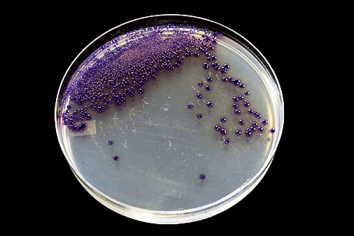

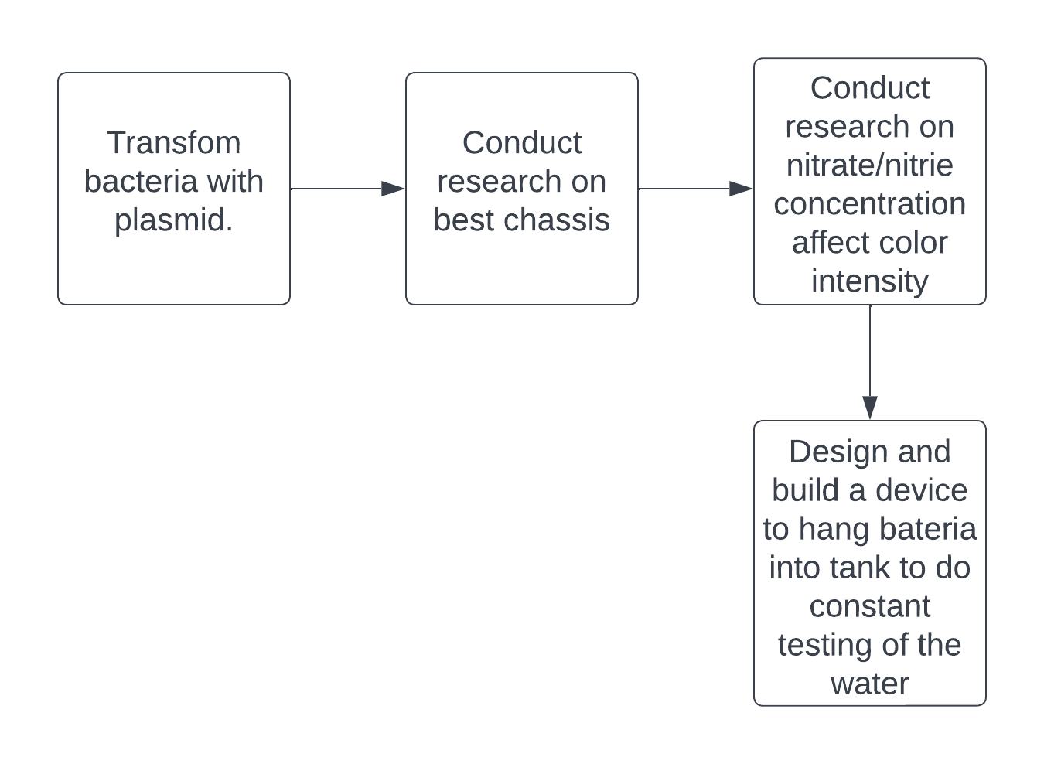
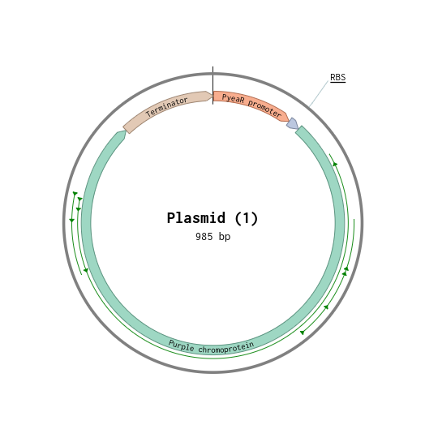
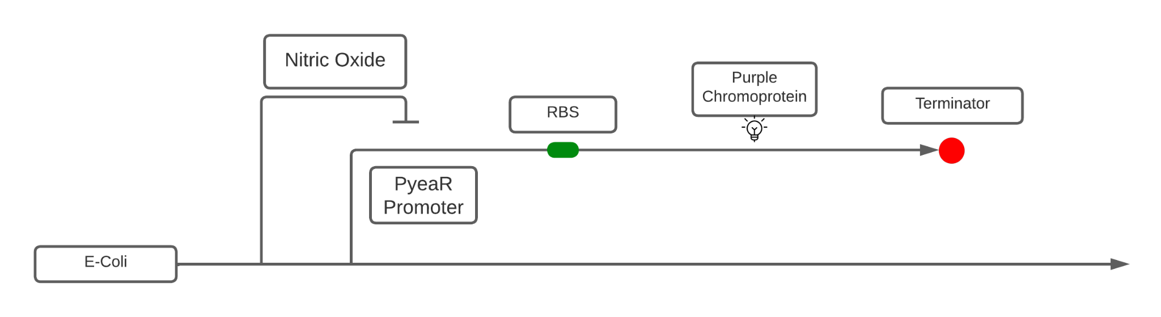






Nitrogen Compound Detector
Rylee Adams, Chase Howard, Eric Thomas, Tomidylan Klepper Amanda Dunham, Scott Gaines (Ph.d candidate at Boston University)
Dobyns Bennett Excel, Kingsport, Tennessee, USA
Abstract
Our solution is targeted towards efficiency in checking water quality for aquatic life. With some alterations, we plan to use bacteria to check for nitrogen compounds in a more time and cost efficient way. To implement our solution, we plan to initially test it within a controlled fish tank environment.
Science Content
1.) After configuration of our design, we have sequenced a plasmid and modeled in benchling
2.) We ordered our plasmid from Twist.com
3) We will grow two cultures of E.Coli K12 and BL21 overnight and inscrapth cells into centrifuge tube
4.) Utilizing the process of transformation, through a CaCl2 solution to bring cells to a “competent” state.
5.) We will introduce the plasmid into the cells by spiking the tube with DNA
6.) We will heat shock the E. Coli by incubating tubes in ice for 5 minutes and then submerging in 42 degree water bath
7.) We will grow cultures on media that has ampicillin present in the media which will ensure only the growth of the color-generating device.
8.) We will grow four petri dishes, two will receive the liquid nitrogen compound and two will not
Team Content
We are a new team consisting of members and seeks to grow. We are sourced at DBE, a STEM oriented/designated school. We call ourselves the Bio-Buds. We meet every Monday and Wednesday from 2:45- 3:45 pm after school.
And maybe some next steps:
Conduct research on how the concentration of nitrate and nitrite levels affects color intensity and building a device to hold the altered bacteria into the tank to allow constant testing
An experiment that would need to be done is testing different concentrations of nitrates and nitrites to see if the colors intensity differs.
Introduction/Background
With this synthetic biology project, we aim to transform Escherichia coli to be a detection system for nitrates and nitrites.
Our end goal is to maintain aquatic life in a more cost effective and convenient way.
To do this, we plan to transform bacteria to produce purple pigment in the presence of nitrogen compounds (Nitrates and Nitrites).
The sensor, PyeaR is highly sensitive to the presence of Nitrites and Nitrates.
The promoter protein, NsrR binds with Nitric Oxide, which prevents PyeaR from transcribing downstream DNA.
This causes the activation of a reporter protein, chromoprotein.
This reporter is a purple chromoprotein based in E-coli. When the PyeaR sensor is enabled, a purple pigment will be released by the bacteria.
References and acknowledgements
Liljeruhm, J., Funk, S. K., Tietscher, S., Edlund, A. D., Jamal, S., Wistrand-Yuen, P., Dyrhage, K., Gynnå, A., Ivermark, K., Lövgren, J., Törnblom, V., Virtanen, A., Lundin, E. R., Wistrand-Yuen, E., &amp; Forster, A. C. (2018, May 10). Engineering a palette of eukaryotic chromoproteins for bacterial synthetic biology. Journal of biological engineering. Retrieved March 6, 2023, from https://www.ncbi.nlm.nih.gov/pmc/articles/PMC5946454/
(Purple Chromoprotein) Jamal, S. (2013, August 25). BBA_K1033906. Part. Retrieved March 6, 2023, from http://parts.igem.org/Part:BBa_K1033906
(PyeaR)IGem. (2009, September 25). BBa_K216005. Part. Retrieved March 6, 2023, from http://parts.igem.org/Part:BBa_K216005
(Terminator) Shetty, R. (2003, July 17). BBa_B0015. Part. Retrieved March 6, 2023, from http://parts.igem.org/Part:BBa_B0015

