Slide 1


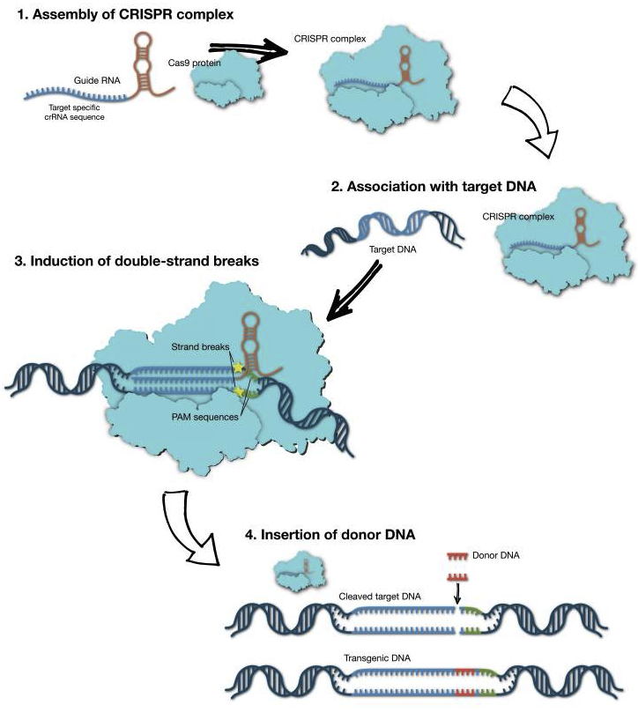
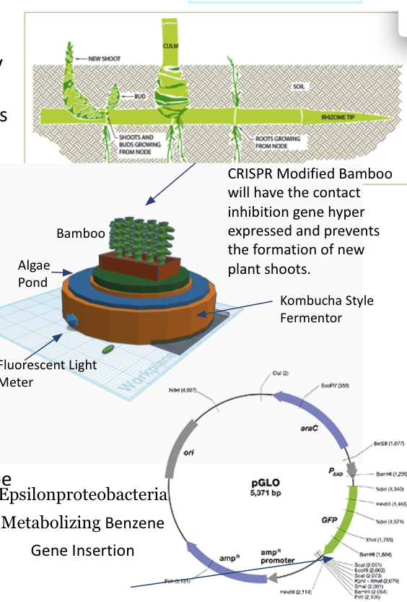
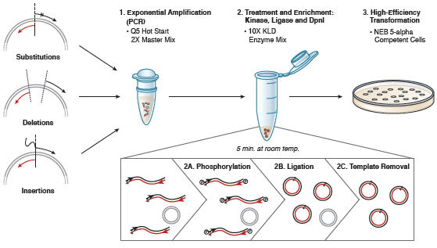
Bamboo Water Filtration System with Air Toxin Detection and Purification
Christian T.,Bryce B.J. McKenzie B.,Samuel S.,Anaya H.,Jonna R., J.W Eljen M., & Jaxon T.
Crosstown High Memphis, TN
Introduction & Project Details
Experiments We Did &/or Planned
The purpose of this project is to create a filter system that will notify you that there are harmful substances in the air and convert them into a neutral substance. The system will also purify rain water, serve as a carbon sink, and create ethanol for fuel. In order to change the genetic makeup of Bamboo and bacteria, two different techniques are suggested for use, CRISPR and mutagenesis. The CRISPR system will be used to insert a gene that will prevent the overgrowth of the bamboo through turning on contact inhibition genes similar to those found in eukaryotic cells. This will prevent the budding of new shoots that will overcrowd the system. CRISPR is more effective for eukaryotic cells. Mutagenesis will be used on a class of epsilonproteobacteria to insert the GFP gene that will generate fluorescence if the bacteria is actively metabolizing benzene which is a toxin produced from gasoline consumption into nitrite and will be detected by a Fluorescent Camera. This bacteria will be added to a Kombucha style fermentor that will produce ethanol that will be harvested for fuel. The Kombucha fermenter will consist of a symbiotic colony of bacteria and yeast that will have the biosensors added to the colony. The colony will feed off the bamboo as a source of sugar along with an initial spiking with sugar infused tea.
CRISPR/Cas9 genome editing system uses a single guide (sg) RNA that that causes the Cas9 endonuclease to cut a specific region of the double stranded genomic DNA, resulting in a double strand break. New DNA can be inserted creating a transgenic DNA.
Fig1
Mutagenesis and Transformation
Fig2.

Slide 2
Bamboo Water Filtration System with Air Toxin Detection and Purification
Christian T.,Bryce B.J. McKenzie B.,Samuel S.,Anaya H.,Jonna R., J.W Eljen M., & Jaxon T.
Crosstown High Memphis, TN
Challenge for Next Year’s Team
About This Year’s Team
More research is needed about which genes specifically should be inserted and if they can function in certain epsilonproteobacteria strains.
If our team doesn’t continue the project next year, and was picked up by another school’s team we would like them to look up the laws that would possibly prevent this from being used and advocate for change.
Limitations: Cost, time, and ethical dilemmas.
Our team consist of 8 new members.
7 Freshman
1 Sophomore
References & Acknowledgements
Thanks to whomever should be acknowledged in this research.
Costa JR, Bejcek BE, McGee JE, et al. Genome Editing Using Engineered Nucleases and Their Use in Genomic Screening. 2017 Nov 20. In: Markossian S, Sittampalam GS, Grossman A, et al., editors. Assay Guidance Manual [Internet]. Bethesda (MD): Eli Lilly & Company and the National Center for Advancing Translational Sciences; 2004-. Figure 2: [Mechanism of CRISPR/Cas9 genome editing...]. Available from: https://www.ncbi.nlm.nih.gov/books/NBK464635/figure/gen_edit.F2/
https://www.sciencedirect.com/topics/medicine-and-dentistry/epsilonproteobacteria
https://www.bamboobotanicals.ca/html/bamboo-care/controlling-bamboo-spread.html
https://chem.libretexts.org/Bookshelves/Organic_Chemistry/Supplemental_Modules_(Organic_Chemistry)/Arenes/Reactivity_of_Arenes/Nitration_of_Benzene_and_Methylbenzene
https://link.springer.com/article/10.1007/s10874-005-5304-2
https://link.springer.com/article/10.1007/s10874-005-5304-2
https://international.neb.com/applications/cloning-and-synthetic-biology/site-directed-mutagenesis

