Slide 1

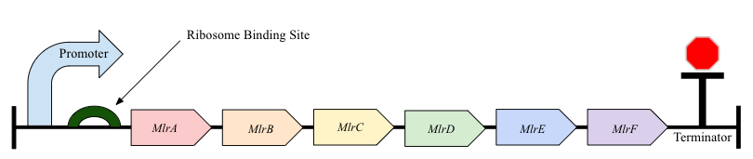
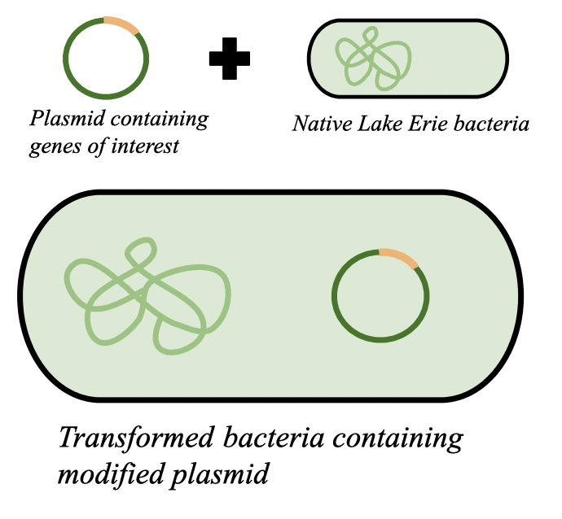
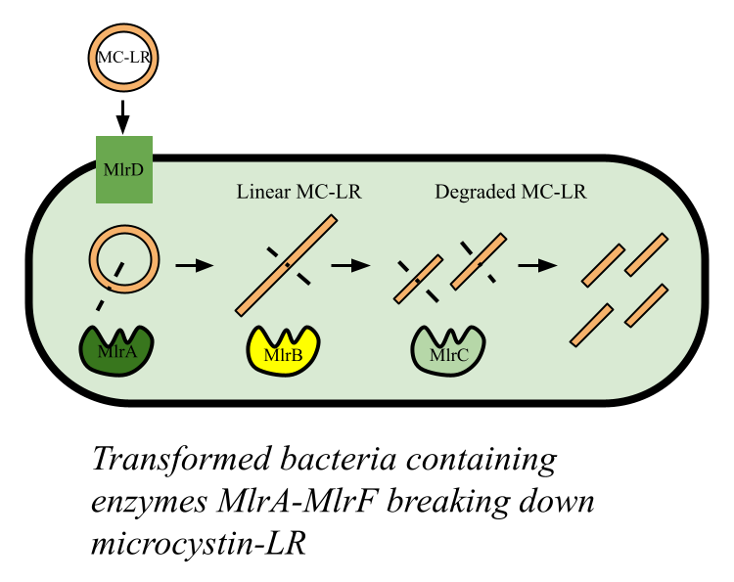

Harmful Algal Blooms in Lake Erie
Logan Amos, Angela Benzigar, Ella Bump, Erika Frohring, Natalie Ham, Isabella Haslinger-Johnson, Cynthia Li, Jessica Li, Lucy Li, Katya Luchette, Sheilla Muligande, Annie Nguyen, Adam Osman, Cavin Xue, Elena Yang, Mira Zamarro, Vivian Zhou
Western Reserve Academy, Hudson, Ohio
Microcystin-LR is a toxin produced by harmful algal blooms. These growths harm surrounding organisms and surrounding habitats. The enzymes MlrA, MlrB, MlrC, MlrD, MlrE, and MlrF have been found to break down microcystin-LR into harmless amino acids.
Transformation of genetic construct into plasmid.
Our objective is to break down microcystin-LR produced by Microcystis aeruginosa in Lake Erie. We plan to transform a ubiquitous Lake Erie bacteria with the MlrA-MlrF enzymes. If the transformation is successful, the transformed organisms will be able to break down microcystin-LR produced in Lake Erie.

