Slide 1

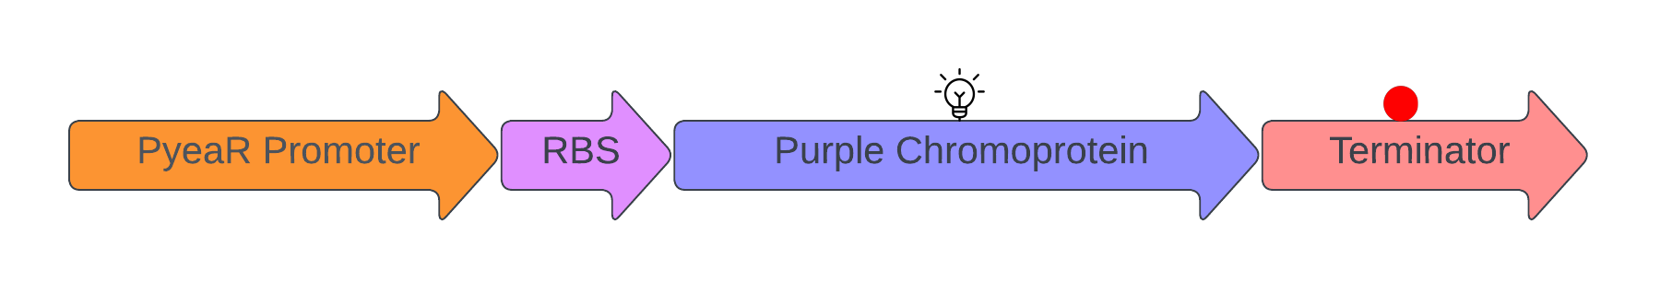
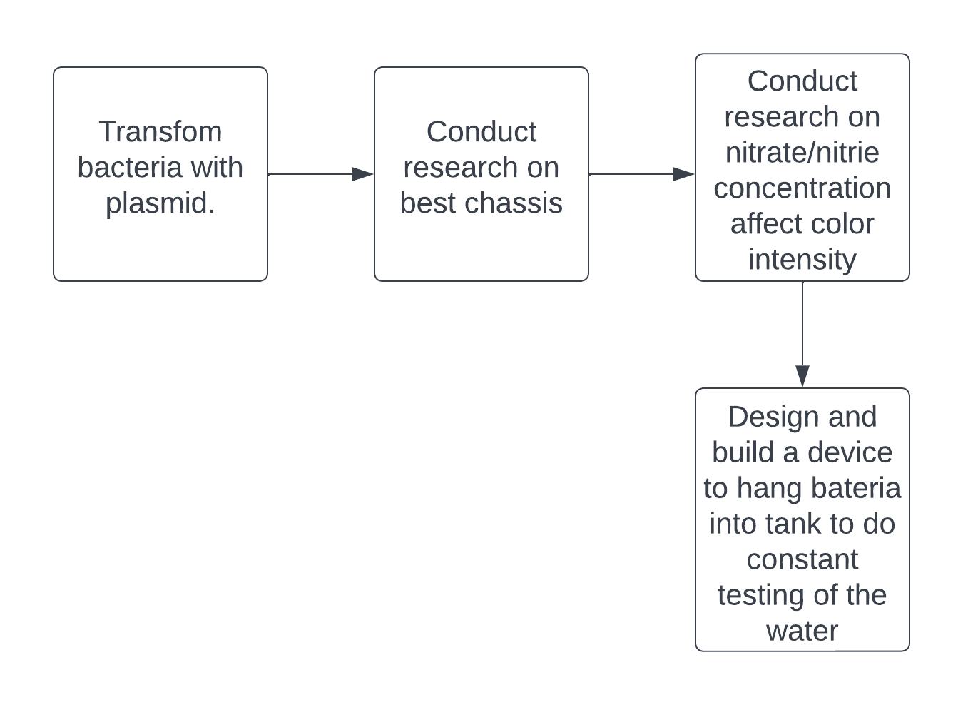
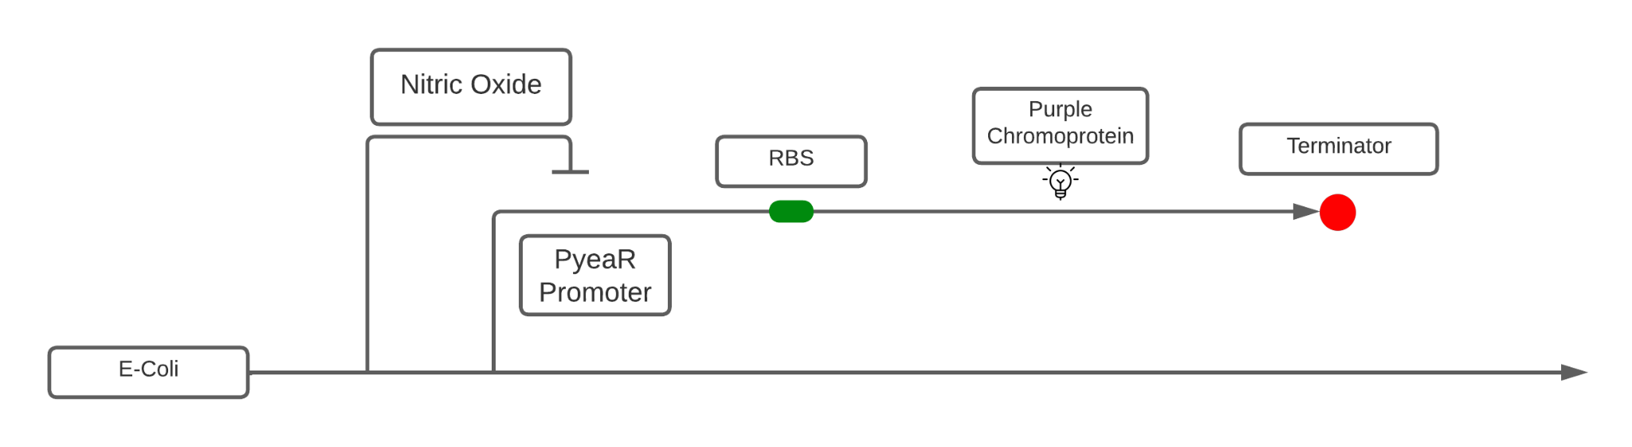
Nitrate/Nitrite Fish Tank Detector
Dobyns Bennett EXCEL Kingsport, TN
Chase Howard, Tomidylan Klepper, Eric Thomas, Rylee Adams, Amanda Dunham and mentor, Scott Gains (Ph.d Student at Boston University)
To create a modified Escherichia Coli that will turn purple in the presence of nitrates and nitrites
We plan to use transformation to allow the cells to process the plasmid
A technical need is requiring a spectrophotometer to measure the intensity of the purple pigment in different concentrations of nitrate and nitrites
Future steps

