Slide 1


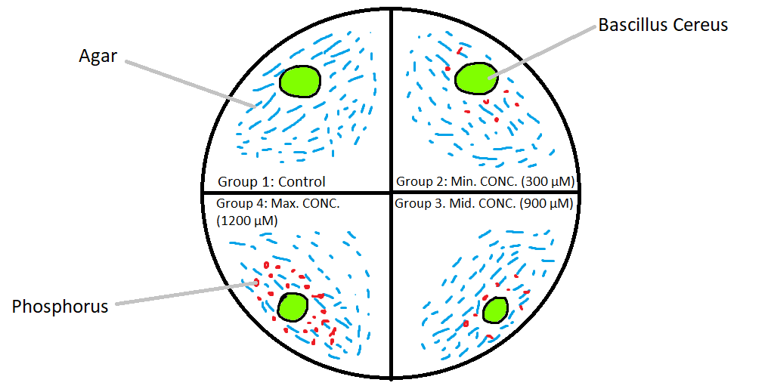
Phosphorus and Bacteria
Martin Saenz, Xialing Solis, Vu Hao Nguyen Phan
Blanson CTE HS, 311 West Road, Houston, TX 77038
Introduction & Project Details
Experiments We Did &/or Planned
Our team is working on creating a bacteria that glows to help farmers determine the appropriate quantity to resupply their soil with phosphorus.
  However, we decided to do a separate experiment to help us prepare for creating the bacteria
Now, we plan to observe the bacterial growth of Bacillus cereus, influenced by different concentrations of phosphorus atop Agar plates.
  Afterwards, the results will help us understand and create our genetically modified bacteria capable of absorbing phosphorus to carry out its tasks.
Our experiment plan is to use the BioBuilder Kit given to us and use a marker to divide an Agar plate into 4 sections and figuratively named Group 1: Control, Group 2, Group 3, and Group 4, in a clockwise rotation.
  Group 1: Control, 0 concentrations of phosphorus
  Group 2: 300 micromolar phosphorus solution
  Group 3: 900 micromolar phosphorus solution
  Group 4: 1200 micromolar phosphorus solution
Solutions will be created separately into sterilized pipettes and drops will be absorbed by agar for 10 seconds
Bacteria will be placed in each section and left to grow for 2-3 days
Observations on the bacteria’s growth will be made either by weight or by the size of the colonies.
Optionally, an antibiotic disk can be added in the agar plate to observe the bacteria’s reaction to antibiotics

Slide 2
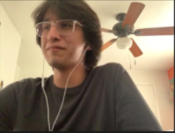
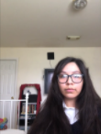
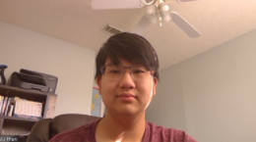
Phosphorus and Bacteria
Martin Saenz, Xialing Solis, Vu Hao Nguyen Phan
Blanson CTE HS, 311 West Road, Houston, TX 77038
Challenge for Next Year’s Team
About This Year’s Team
Our challenge for next year’s team is to test how B. cereus reacts to concentrations of nitrogen (nitrates) and or potassium. They can use the same method as us and use concentrations found here for nitrogen and here for potassium.
A bigger challenge would be creating an NPK sensor that is used in water rather than soil. This bacteria will hopefully help detect runoffs of fertilizers and prevent further water pollution. Sadly, we have no suggestions for this experiment.
Here is some advice we have from our experiences:
  Be wary of miscommunication
  Divide time fairly for research and development
  Use studies/process that have already been test before attempting to create our own process
  Do not be afraid to ask questions or speak out, it will make the whole designing process much easier.
For this year, we are a new team of 3 members. We’ve been able to come up with a plan and some highlights about the process include not knowing what to do for a day, researching using sources from Rice University, and discussing our plans with a BioBuilder advisor.
References & Acknowledgements
Thanks to whomever should be acknowledged in this research:
Laura Alberici Da Barbiano
Natasha Turyasingura
Vu Hao Nguyen Phan (Research Member/Student at Blanson CTE HS)
Martin Saenz (Research Member/Student at Blanson CTE HS)
Xialing Solis (Research Member/Student at Blanson CTE HS)
H. (2015). Phosphate Sensor - PphoA , PphoBR. Retrieved February 24, 2021, from http://2015.igem.org/Team:HKUST-Rice/Phosphate_Sensor
Suzuki, S., Saito, K., Wakabayashi, Y., Hatanaka, E., Watarai, N., Masanori, M., . . . Shi, Y. (2013, October 29). PhoA Promoter Assay. Retrieved February 25, 2021, from http://2013.igem.org/Team:Tokyo_Tech/Experiment/phoA_Promoter_Assay

