Slide 1


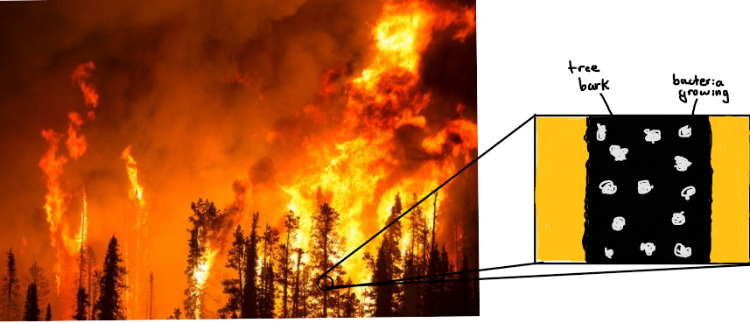
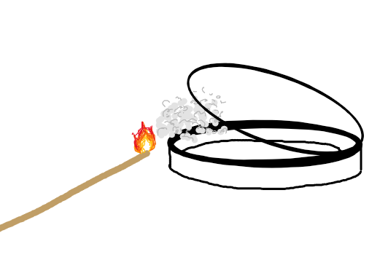
Fire Gel Biofilm
Juan Gurrusquieta, Alexander Guel
Blanson CTE High School, Houston, TX
Introduction & Project Details
Experiments We Planned
Our topic focuses on a way to aid firefighters in slowing the progression of wildfires towards residential and populated areas. Although they are part of natural cycles, wildfires can cause extensive damage to life and property, and our biofilm could be used to slow the fires from reaching them.
To address this, we have decided to work on a biofilm that:
  Will be placed on trees surrounding populated areas
  Consist of bacterial cells that produce and release a fire-resistant gel-like substance
  When heat is detected, they will begin to reproduce rapidly and spread across the surface of the tree, creating and releasing more of the gel-like substance.
  Overall, the biofilm should be able to slow down the spread of the fire and gain firefighters more time.
We were not able to conduct any experiments, as our spring break coincided with the Project Development Studio.
However, we came up with a preliminary experiment to start off our project. Since the cells were going to be exposed for prolonged periods to smoke in our intended environment, we planned to test the effects of smoke on cell growth.
Our planned experiment:
  Treatments replicated 3 times: 10 seconds, 30 seconds, 1 minute of smoke exposure and a control (no exposure)
Steps:
  Add bacteria to plates and allow to grow for about a week.
  After this, count the number of living colonies.
  Then, hold a lighted incense stick for the designated exposure time over the center of the plate, and immediately close it.
  Count the number of living colonies a day to a week after.
tree bark
bacteria growing
3 replicates for each treatment
Sketch of the experiment process
Control
(no exposure)
10 seconds of smoke exposure
30 seconds of smoke exposure
1
minute of smoke exposure
30 seconds
Unscented incense sticks

Slide 2
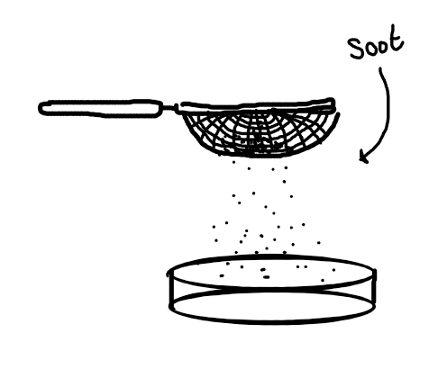
Fire Gel Biofilm
Juan Gurrusquieta, Alexander Guel
Blanson CTE High School, Houston, TX
Challenge for Next Year’s Team
About This Year’s Team
From this experience, we will have gained more knowledge about the effects of smoke produced by fire on cell growth.
If another team decided to continue the project next year, then we would want them to test the effects of soot on cell growth. Soot is a major byproduct of fire and is just as important to test on growth.
In order for them to try this, they could set up an experiment such as:
  Treatments replicated 3 times: 5 grams, 10 grams, 15 grams of soot and a control (no soot)
Steps:
  Add bacteria to plates and allow to grow for about a week.
  After this, count the number of living colonies.
  Then, using a strainer, add the respective amount of soot to its plate, spreading it throughout the entire plate.
  Count the number of living colonies a day to a week after.
This would be a good indicator as to how soot directly affects bacterial cell growth.
New team
2 members
Previous participants in district and regional level science fair competitions.
References & Acknowledgements
Thanks to:
Laura Alberici da Barbiano
Natasha Turyasingura
Control
(no soot)
5 grams of
soot
10 grams of soot
15 grams of soot
3 replicates for each treatment
Strainer
Scale

