Slide 1

Microplastics in Water
Bayview Glen BioBuilders Team
Notes:
Hello, we are the BVG BioBuilders team. This year, we are researching microplastics.

Slide 2
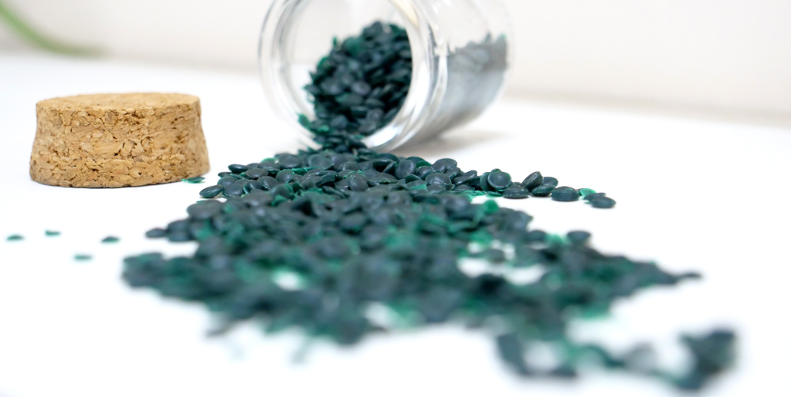
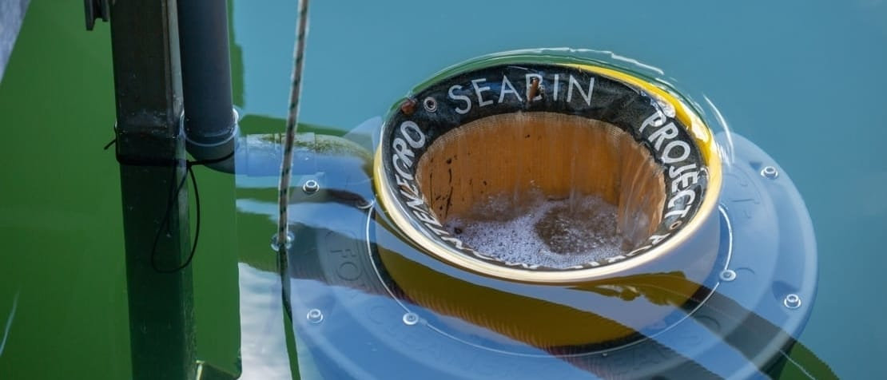
A current solution
Can catch all surrounding debris (microplastics, microfibers)
The bag holds up to 20 kg of waste and can catch up to 1.5 kg of plastics per day
Notes:
One solution is the SeaBin. The SeaBin is a barrel used in coastal areas, that when submerged under water, collects floating trash such as plastics through electric pump suction. While this can make considerable impacts on oceans, the SeaBin is limited to only collecting debris in its path.

Slide 3

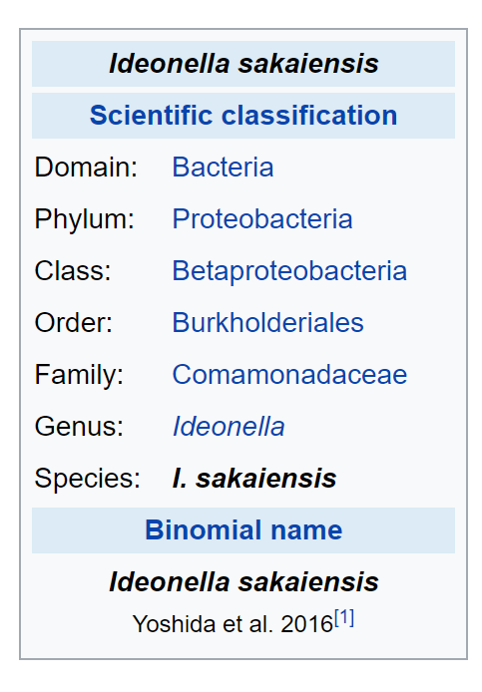
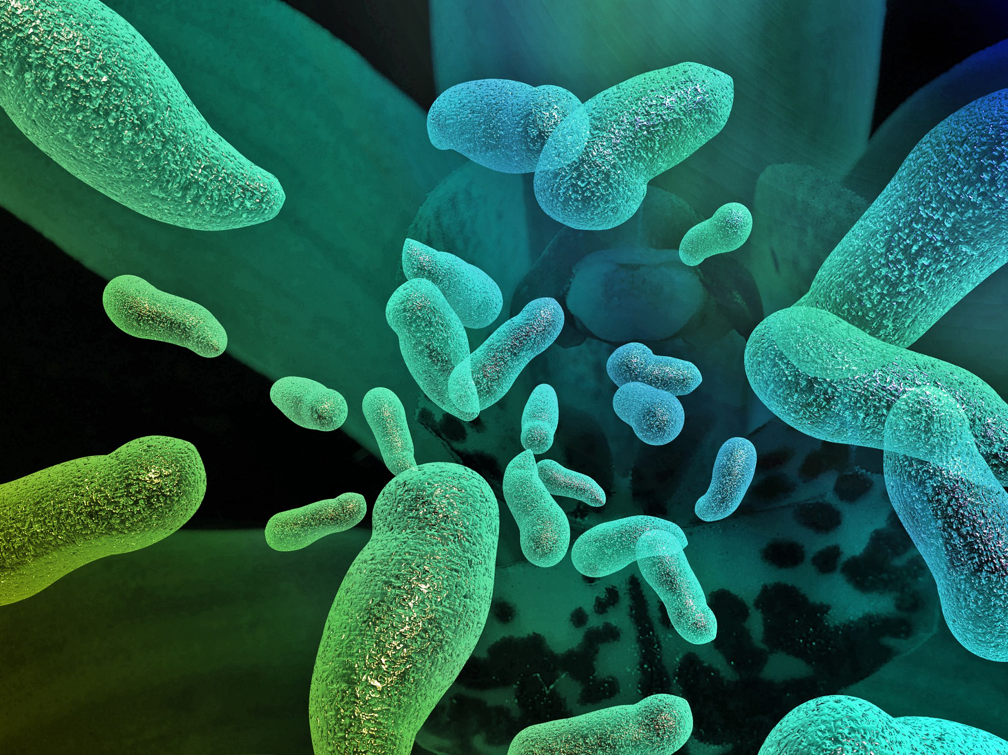
Notes:
This is where we come in, with this proposed solution based off of a recent discovery.
In 2016 researchers in Japan discovered a bacteria called Ideonella Sakaiensis that has a very interesting ability: it can break down plastics.
Our proposed, hypothetical solution for microplastics in aquatic ecosystems would involve using the process of transformation to incorporate the gene responsible for microplastic degradation from Ideonella Sakaiensis into some existing microorganism species common to aquatic ecosystems. It is important to pick an existing microorganism to ensure no invasive species are introduced. This will involve some lab testing on simulated aquatic environments, and through trials, we will determine the efficacy of the solution and any changes needed.

Slide 4
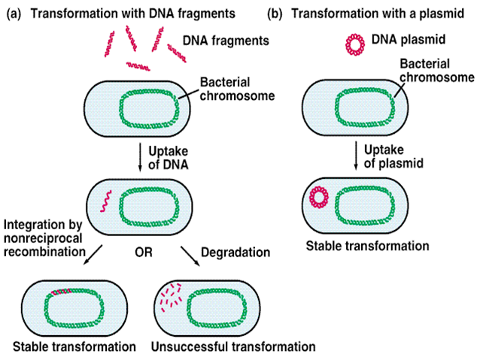
Notes:
This is where we come in, with this proposed solution based off of a recent discovery.
In 2016 researchers in Japan discovered a bacteria called Ideonella Sakaiensis that has a very interesting ability: it can break down plastics.
Our proposed, hypothetical solution for microplastics in aquatic ecosystems would involve using the process of transformation to incorporate the gene responsible for microplastic degradation from Ideonella Sakaiensis into some existing microorganism species common to aquatic ecosystems. It is important to pick an existing microorganism to ensure no invasive species are introduced. This will involve some lab testing on simulated aquatic environments, and through trials, we will determine the efficacy of the solution and any changes needed.

Slide 5
Notes:
This is where we come in, with this proposed solution based off of a recent discovery.
In 2016 researchers in Japan discovered a bacteria called Ideonella Sakaiensis that has a very interesting ability: it can break down plastics.
Our proposed, hypothetical solution for microplastics in aquatic ecosystems would involve using the process of transformation to incorporate the gene responsible for microplastic degradation from Ideonella Sakaiensis into some existing microorganism species common to aquatic ecosystems. It is important to pick an existing microorganism to ensure no invasive species are introduced. This will involve some lab testing on simulated aquatic environments, and through trials, we will determine the efficacy of the solution and any changes needed.

Slide 6
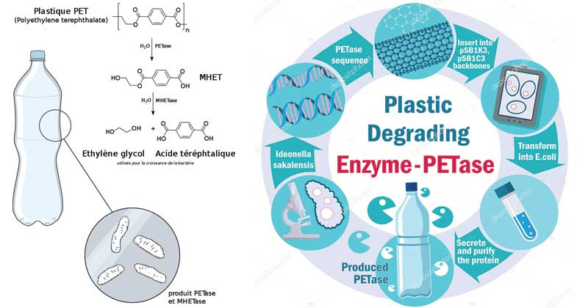
Notes:
Concerns
Byproducts
Carbon

Slide 7
Bibliography
https://oceanservice.noaa.gov/facts/microplastics.html
https://link.springer.com/article/10.1007/s11356-020-08688-2#:~:text=Microplastics%20are%20becoming%20a%20universal,or%20chemical%20additives%20to%20biota.
https://www.nottingham.ac.uk/connectonline/research/2018/the-big-problem-of-microplastics.aspx
https://www.sas.org.uk/our-work/plastic-pollution/plastic-pollution-facts-figures/#:~:text=Every%20day%20approximately%208%20million,of%20all%20marine%20debris%20studied.
https://i.pinimg.com/originals/87/03/26/870326814f689e0664f20c3532cb5e1e.jpg
https://en.wikipedia.org/wiki/Ideonella_sakaiensis#:~:text=Ideonella%20sakaiensis%20is%20a%20bacterium,sole%20carbon%20and%20energy%20source.
https://www.dtu.dk/english/news/2019/09/eng-bakterier-har-faaet-appetit-paa-plast??id=afa835a7-eb08-4f05-a5ee-9212464dcf26

