Slide 1


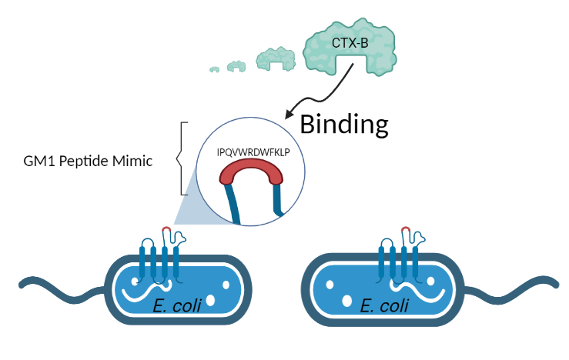


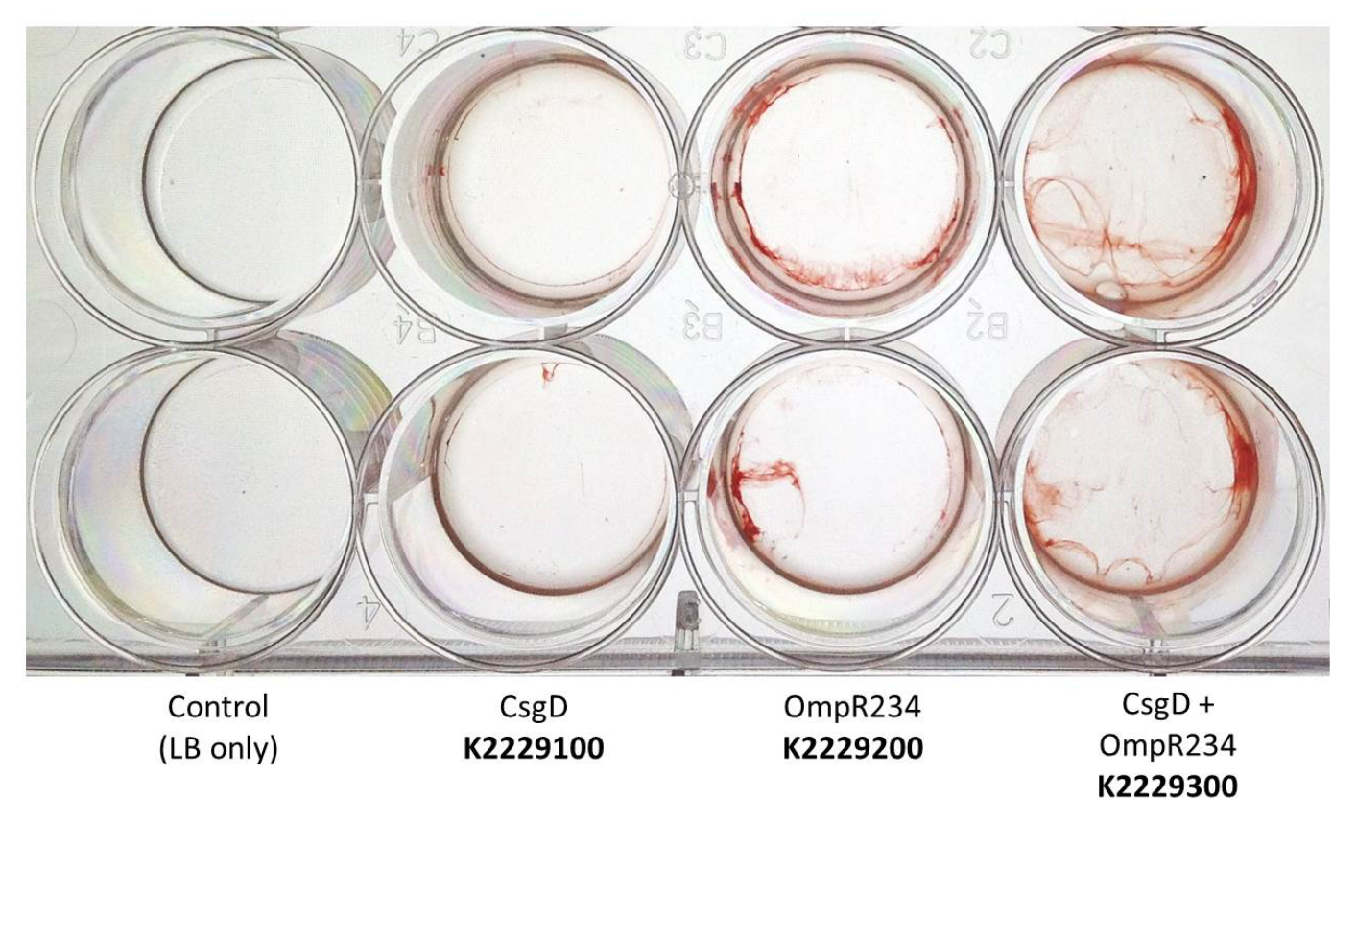
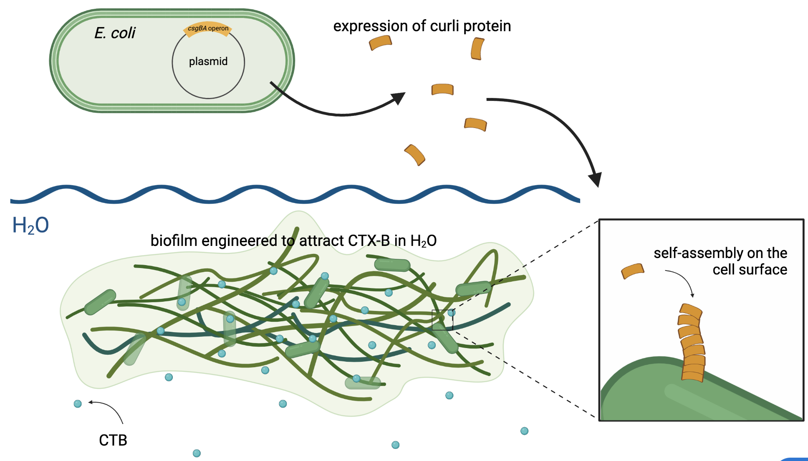






CTox-DTox
A novel method for the removal of cholera toxins
Austin Lo, Andrew Lee, James Kuo, Emma Shih, Ariel Lan, Yunho Chun, Josh Shih, Zoe Shong, Dr. Jonathan Hsu, Alex Barutis, Aya Kassem, Jarn Anowak
Taipei American School, Taipei, Taiwan
OUR PROJECT
CLICK FOR AUDIO!
GOAL:
Create a method of removing cholera toxin from contaminated water through engineered E. coli
TECHNIQUES:
Produce biofilm through overexpression of csgD and OmpR234
Clone GM1-mimic receptor in biofilm production strain and test binding to CTX-B
Figure 1: Binding process of CTX-B to GM1 receptors using E.coli.
Figure 2: Formation of CTX-B-binding biofilm
Figure 3: Congo red assay stains biofilms induced by CsgD and OmpR234. BBa_K2229300 increases adhesion (TAS Taipei, 2017).

