Slide 1
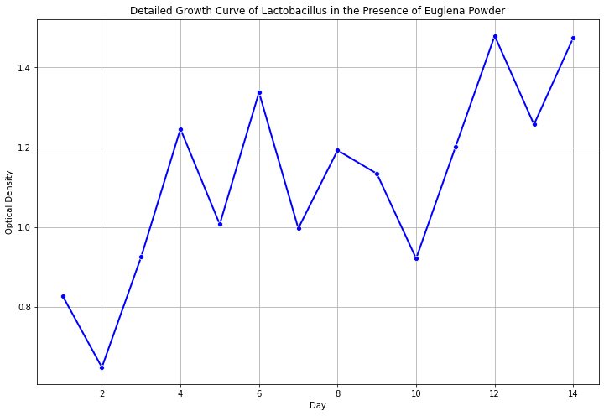
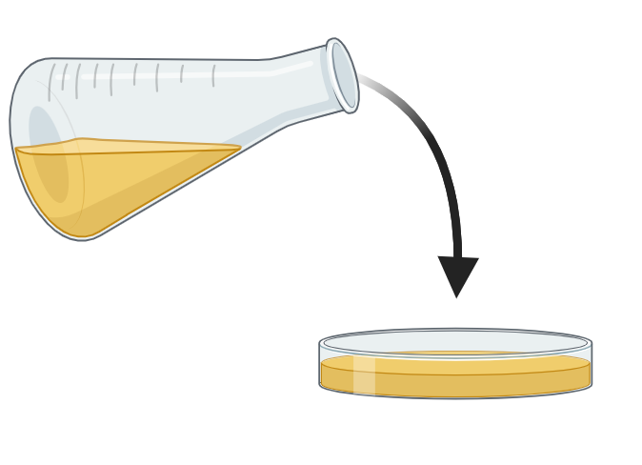
Prebiotics in Lactobacillus E. Coli Cocultures
Makayla Dunn, Ty Heinlen, Amanda Barrett, Benjamin Steele PhD
Marietta High School, Marietta, Georgia, Cobb
Objective: To observe how affective the prebiotic, euglena powder, is in promoting the growth of Lactobacillus.
Techniques/Skills used: Growth curve to measure optic density of the cultures, Serial Dilution, Plate counting, Use of fluorescent dyes to identify Lactobacillus bacteria under a microscope, PCR to express long term change, Fermentation monitoring to measure change (Ph, Biomass, Metabolite production).
Expectations: We predict that higher concentrations of euglena powder would stimulate Lactobacillus growth. Additionally, in cocultures it is expected that the number of E. coli CFU’s will decrease as euglena concentrations increase. This would be applicable to Lactobacilli’s use as a probiotic in conjunction with prebiotics like euglena as a method of inhibiting pathogenic bacterial growth.

