Slide 1
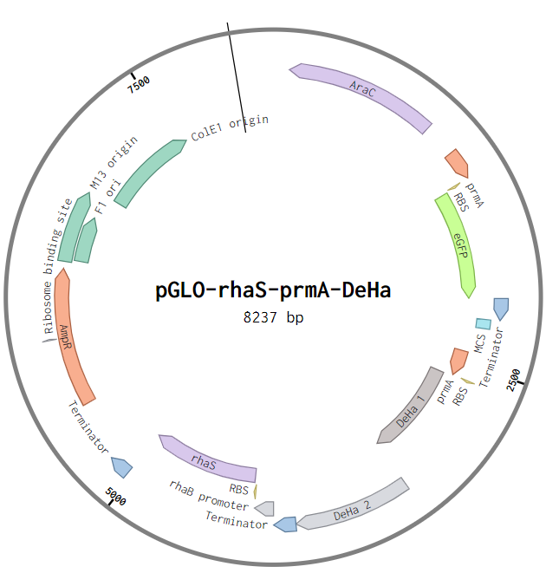
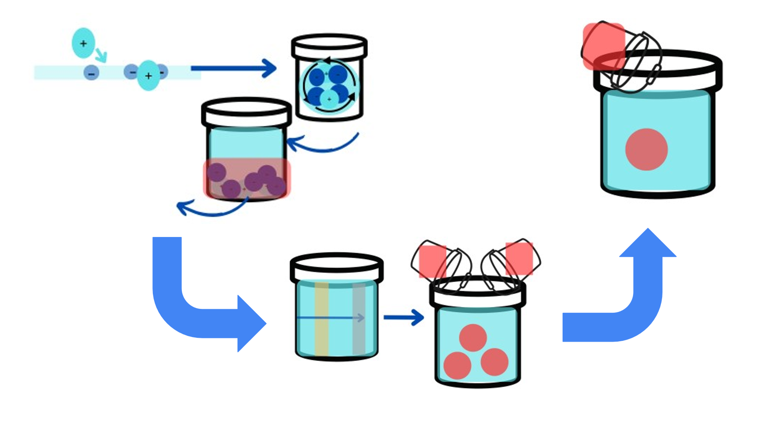
Water Treatment Degradation of Pfas
Exahel Castamdeda, JoAnna Chaclan, Floricela Bravo, Juan Mendoza, Carolina Torres,
Camillo Samano, Brandon Gonzales, Kevin Cruz Ana White, and Michael Sheets.
Cross Keys High School, Atlanta, Georgia, United States of America
BBC_LT_Cross Keys_2024
Problem: PFAS, a type of microplastic that is ubiquitously found in our environment and detrimental to our health.
Objective: Get rid of PFAS in the water supply.
Project Design | Project Design
Step1 | Test Activity of the Pfas promoter prmA + GFP
Step 2 | Test ability of enzymes DeHa 1/2 in PFAS degradation
Step 3 | Test the kill-switch gene (rhaS) under the arabinose promoter
Step 4 | Integrating our system in the water processing system
1. Coagulation
2. Flocculation
PFAS
Both genes are under the prmA promoter
eGFP
DeHa 1/2
3. Sedimentation
6. Corrosion Control
Arabinose
Under the pBAD promoter
Kill switch gene
4. Filtration
5. Disinfection

