Slide 1
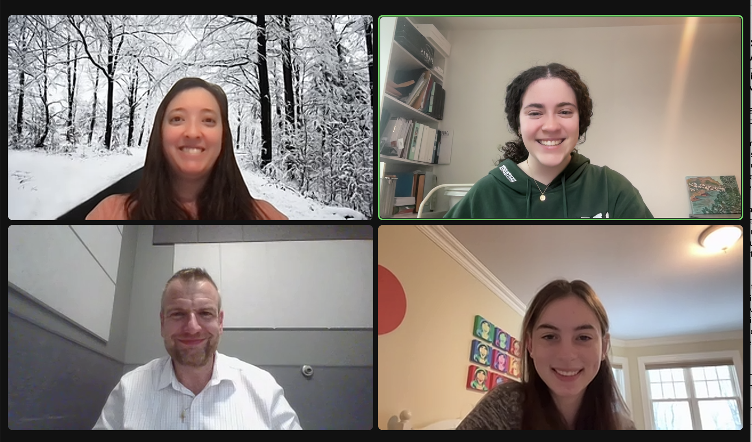
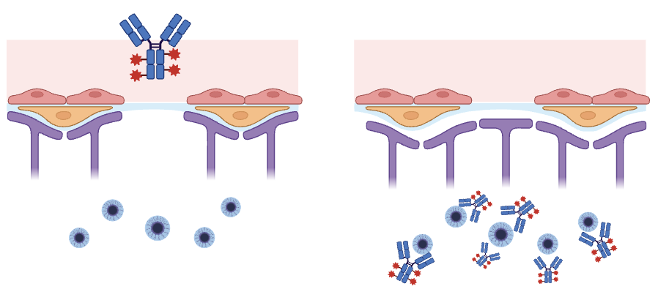
Slowing Parkinson’s Disease Progression With Biomimicry-Inspired Therapeutics
Ellie Tillman-Schwartz, Eva Odio, Mary Liu, Peter Horanyi, Ph.D. (UCB)
Weston High School, Weston, MA, USA
Abstract
Many current Parkinson’s Disease therapies target the dopamine regulation. However, we plan to develop a therapeutic that instead targets the aggregation of Lewy body formation. We will slow Parkinson’s disease progression through antibody-driven immune clearance of aggregates.
Science Content
Tumor Paint Venom:
Pediatric drug fast-tracked by FDA, so very safe
Composed of two chemicals– 1) a chlorotoxin to target chloride receptors on surface of tumor cells 2) fluorescent protein
Experiment details:
Instead of a fluorescent protein, we will use the venom chlorotoxin and add an antibody that targets alpha-synuclein.
Leqembi drug for Alzheimer’s proved to successfully target amyloid beta through peripheral administration so we expect enhanced performance with BBB shuttle
Immune system will clear aggregates through opsonization: antibodies mark aggregates for clearance by microglia that recognize Fc receptors, and will therefore remove antibody-antigen complex
Figure: antibody-venom complex passing through BBB and binding protein aggregates in brain. Blue circles are lewy bodies. Red and blue Y-shaped compounds are antibodies/chlorotoxins. The gate is the BBB.
Team Introduction
We are a small team of a junior and a senior! We meet each week to research topics that fascinate us.
Next steps:
Carry out experiment to determine whether antibody is too large to pass through blood-brain barrier.
Determine whether antibody tagging is sufficient to lead to immune clearance of protein aggregates
Introduction/Background
Background information: We took inspiration from the biomimicry-inspired Drug BLZ-100 (“Tumor Paint”), which is derived from scorpion venom and injected into patient veins; the chlorotoxin protein derived from the venom tags the targeted chloride receptors.
Objective: Develop an antibody-tagged venom that can degrade alpha-synuclein aggregates to slow the development of Parkinson’s Disease.
About our design: to enhance clearance across the blood-brain-barrier (BBB), we will take inspiration from a natural penetrant– venom! This venom will allow brain penetration and therefore clearance by the immune system.
References and acknowledgements
We’d like to thank Dr. Horanyi and Ms. Liu for their fantastic advising.
Works referenced:
Montemiglio, Linda Celeste, et al. “Cryo-EM Structure of the Human Ferritin–Transferrin Receptor 1 Complex.” Nature News, Nature Publishing Group, 8 Mar. 2019, www.nature.com/articles/s41467-019-09098-w.
Advanced Neurosurgery Associates “Glowing ‘Tumor Paint’ Innovation in Brain Tumor Identification.” Advanced Neurosurgery Associates, 10 May 2021.

