Slide 1
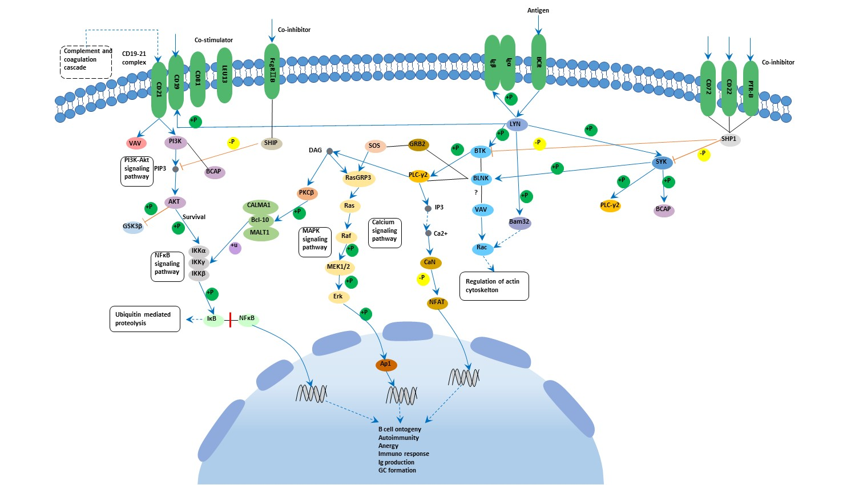
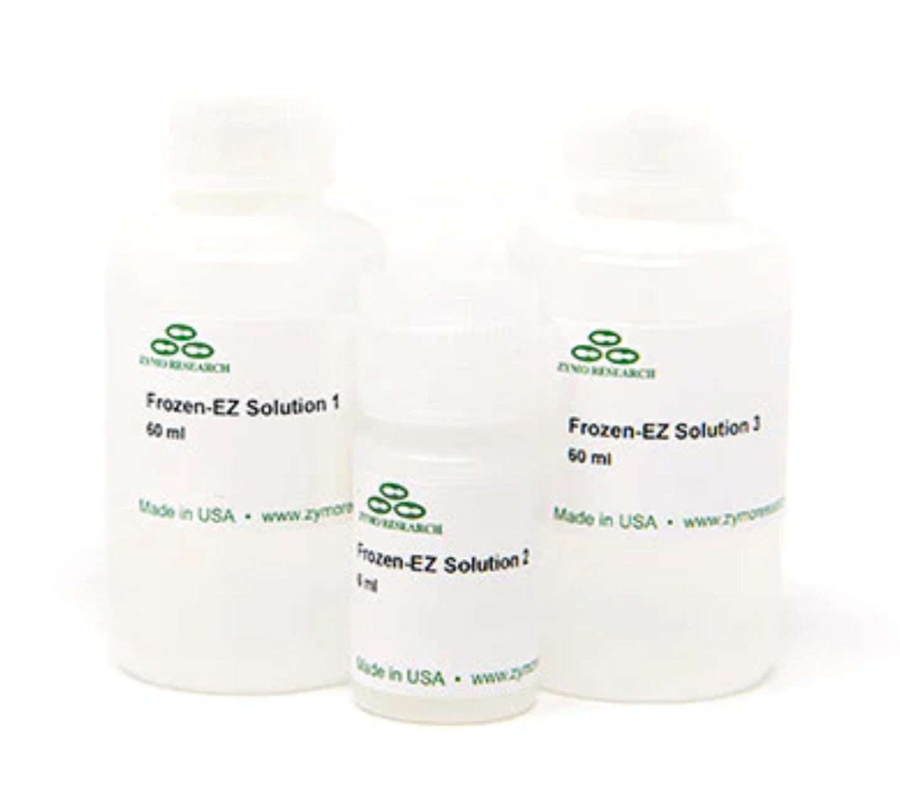
Sensor-Yeast: Creating a Widely Accessible Yeast Biosensor
JoAnn Tu, Jessica Wu, Aishwarya Viswanathan, Akshara Palanisamy, Anaïs Ndione,
Angelina Kodudhula, Ella Rahimo, Jons Jaison, Rishi Rao, Samiksha Saravanan
Mrs. Rebecca Brewer, Dr. Ben Steil (Arbor Biosciences)
Troy High School, Troy, MI, USA
Abstract
The presence of harmful bacteria in drinking water suggests that water often contains pathogens that can lead to disease. It is important to be able to identify unsafe drinking water to determine particular substances that may lead to illness. Our purpose is to create a functional and self-renewing biosensor that can be made to become accessible and cost-effective. We plan to transform yeast to express an antibody that binds to E. coli. To analyze its results, we will perform an ELISA assay to determine its effectiveness. Understanding the capability of producing a biosensor is essential to ensure safe drinking water and effective water filtration methods. This critical first step is also needed to better understand waterborne pathogens.
Science Content
Regarding colorimetric analysis, we would be using a pH indicator such as bromothymol blue (BTB) mixed into the yeast solution. The pH changes when the antigen binds to the yeast, triggering a signal transduction pathway ending with a proton pump that lowers extracellular pH. This signal would be easy to detect and interpret. Due to our limited resources at this level of biology, however, we are not able to research the transduction pathway experimentally and are only visiting this part of the lab as a potential idea.
The primary difficulty in this project lies in the construction of a functional link between antigen detection and proton pump activation. Similar pathways have been constructed (references A and C), but they may be difficult to implement.
Team Content
We are a first-year team from Troy High School in Troy, Michigan. All 10 members of this team are studying AP Biology, and are passionate about science and innovation in the STEM world today. We have been working hard after school to research and develop our project.
Next steps
The next step would be to link the detection to a proton pump and implement it experimentally in yeast cells.
Once a successful transduction pathway is implemented, testing and calibration of the sensor can be done to determine the optimal conditions, such as concentration and temperature, under which the sensor operates.
It is also important to determine stability and optimal methods of storage to increase accessibility to populations without equipment like incubators.
For this experiment, our main goal is to find a way to indicate an antigen’s presence (E. coli) through the use of yeast cells. While we have not currently carried out this experiment, we are making the necessary decisions to do so soon. To begin, we ordered a yeast transformation kit, selective agar plates, yeast plasmids and linear DNA. After receiving all materials, we will begin yeast transformation to express the antibody in the yeast. Finally, to ensure success in the process, we will use an enzyme-linked immunosorbent assay (ELISA). ELISA is commonly used to detect antibodies, making it an excellent tool to use to test for effective binding, which is necessary in a biosensor.
Introduction/Background
Biosensors are useful in determining the presence of select substances and have a lot of flexibility and potential in being more accessible than traditional forms of testing, which typically need several reagents and expensive equipment.
Bacteria such as E. coli and other biological contaminants are a primary concern, especially in areas with poor water treatment. Offering accessible detection methods can improve water sanitation and lessen preventable diseases.
We are continuing a project design from a previous year. This yeast biosensor project plan is outlined in a previous BioBuilder and BioTreks team (reference B). We plan to demonstrate the first step of this process.
To outline our experiment, we plan to transform yeast to express an antibody that recognizes and binds to E. coli. Then, we will perform an assay (ELISA) to demonstrate the ability of the yeast to bind to the antigen E. coli.
References and acknowledgements
Al-Awssi, A., et al. (2020). CIDosis - A Monitoring Tool for Chronic Inflammatory Diseases. iGem, https://2020.igem.org/Team:UCopenhagen/.
Baker, L., et al. (2023). Improving food safety and security: Detecting Salmonella typhimurium with yeast solution, BioTreks, https://biotreks.org/e202316/.
Dong, J., et al. (2023). The Patrol Yeast: A new biosensor armed with antibody-receptor chimera detecting a range of toxic substances associated with food poisoning. Biosensors and Bioelectronics, 219. Elsevier. https://doi.org/10.1016/j.bios.2022.114793.
We are so grateful to our mentors, Dr. Steil and Mrs. Brewer. Thank you to Dr. Steil, for his guidance on research and aid in scientific resources. Thank you to Mrs. Brewer, our AP Biology teacher, who has provided her classroom and tools such as incubators and micropipettes, has overseen our meetings, and given us helpful input in our project. We appreciate Carolina Biological
Supply, who generously donated $100 for supplies, which
allowedus to obtain many supplies. A special thank you to
Zymo for sponsoring our transformation kit and enabling us
to perform our experiment.
(Figure. This is a model of the signal transduction pathway of a B cell and is not representative of the pathway that might be implemented in Sensor-Yeast. However, it is a good depiction of the relative complexity of many cell communication pathways.)

