Slide 1
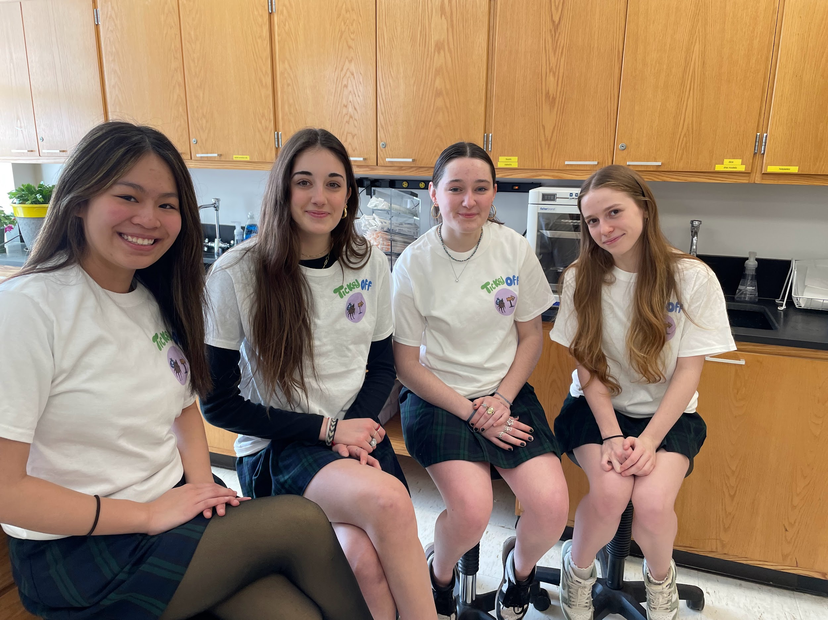
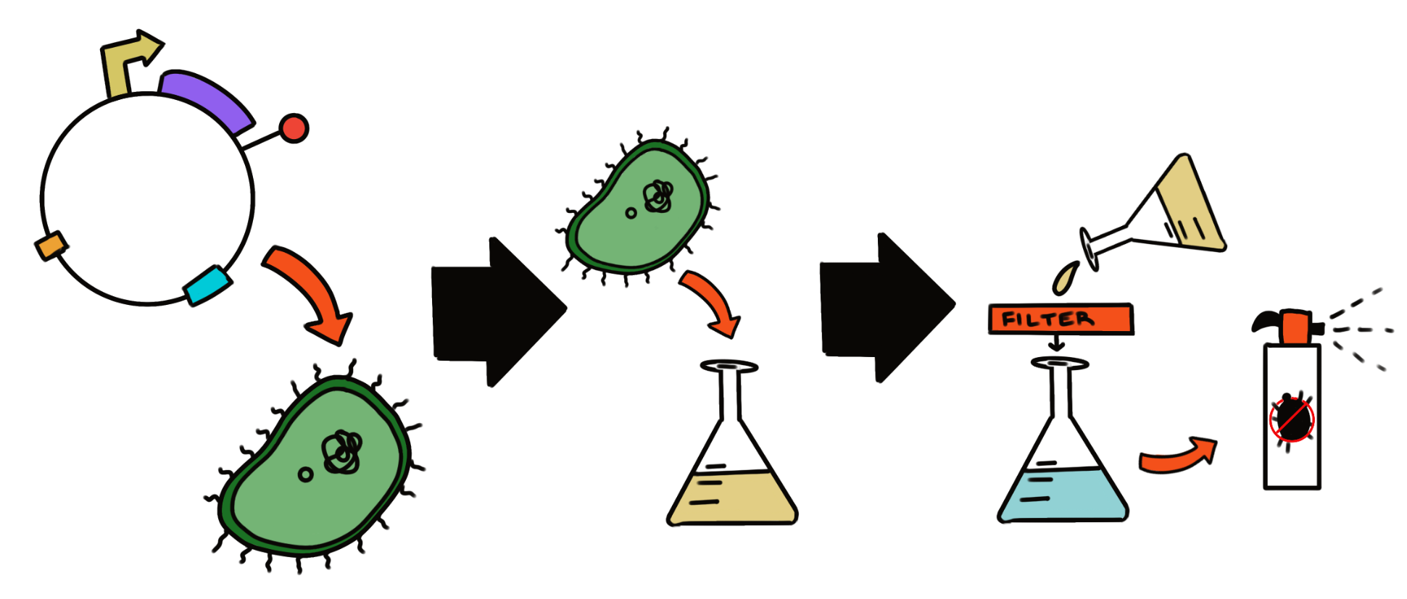
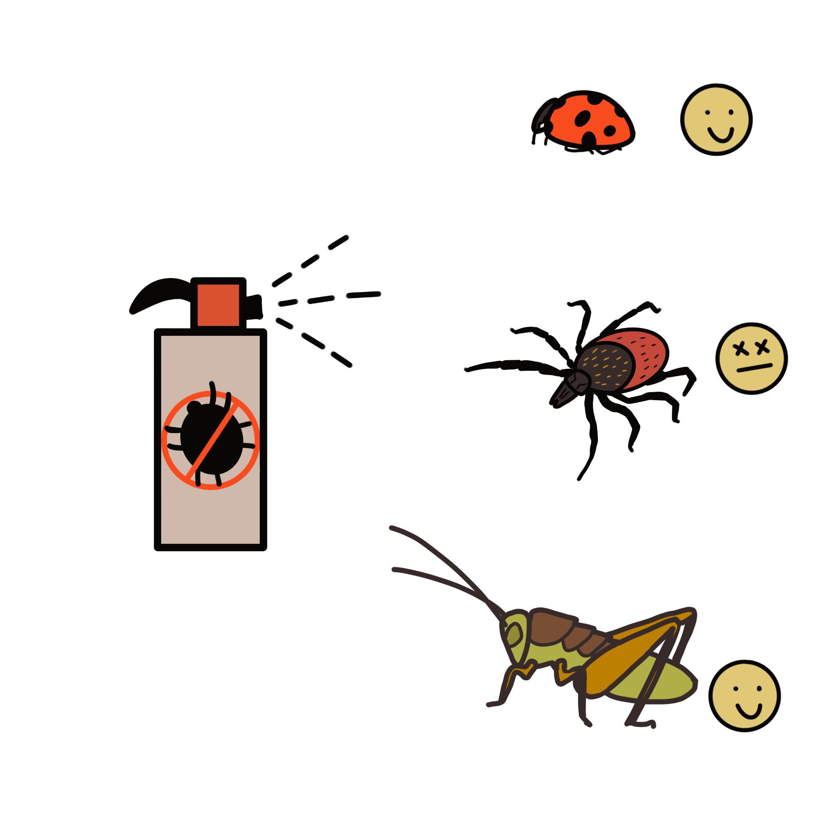
A fungal-derived enzymatic anti-tick spray: Targeting the Ixodes scapularis population
Evangeline Campbell, Anna Childs, Celine Omega, Natalia Ortiz, Dr. Beth Pethel, Maegan Plank (Union Chimique Belge)
Western Reserve Academy, Hudson, Ohio, United States of America
Abstract
There are over 800 species of ticks worldwide, but only a few of those species are capable of transmitting disease to humans. One of those species is Ixodes scapularis, the black-legged tick. The species is responsible for the transmission of several severe illnesses, including Lyme disease. The Centers for Disease Control (CDC) estimates that over 400,000 people are diagnosed and treated for Lyme disease each year in the United States. Our goal for this project is to create a bio-friendly super-spray that utilizes enzymes from the fungus Beauveria bassiana. The fungal enzymes allow a breakdown of the I. scapularis cuticle that increase the tick’s mortality rate. (what is the cuticle goal for the tick, if we break that down how is it more susceptible to higher mortality? Include sentence) People can then spray their clothes or other areas that are susceptible to ticks to control the I. scapularis population and reduce the spread of tick-borne diseases.
Design Process
Team Information
We are a new team of four from Western Reserve Academy!
(Left to Right) Celine Omega, Natalia Ortiz, Anna Childs, and Evangeline Campbell
Future Plan:
Our team needs to find the appropriate plasmids to clone our enzyme and natural repellant into E.coli
Another step is to conduct more testing for effectiveness and safety and determine what specific enzymes and natural repellents are the most compatible within our parameters.
Afterward, we use the transformation of E.coli extractions of enzymes and test them on species to ensure we are lowering the tick population rather than benign insects.
We must test various essential oils to compare the most effective repellent and whether it has available information on its biochemical pathway.
Introduction
Due to climate change, the tick population has significantly increased. As a result, the number of cases of Lyme Disease has more than doubled within the past two decades. Current solutions are helpful, but they do not keep up with the rapid reproduction of the I. scapularis and their invasive behavior. Our solution uses the fungal organism B. bassiana and its entomopathogenic properties, as well as tick-repellent essential oils, to create an improved tick repellant spray that not
only helps with repelling I. scapularis
ticks but also directly kills and controls
its population. Our team uses the
genetic genes of the B. bassiana
chitinase and lipase enzymes: Bbchit1,
Bbchit2, and BBL351 (Fig. 1). We
clone the genes into Escherichia coli
(Fig. 2) and will test their safety and
effectiveness, with a compatible natural
repellant such as citronella. This spray
will repel and kill the I. scapularis, lowering the
susceptibility of tick-borne illnesses.
Figure 1: Isolate the genes for enzymes from the B. bassiana and place them in
to a plasmid.
References and Acknowledgements
We’d also like to thank Dr. Pethel for helping us find leads to resources and our mentor Maegen Plank for providing access to research journals and suggesting ways to develop our project.
Figure 2: Clone the enzymes into E. coli and a compatible antibiotic-selectable marker and add natural repellant to turn into a spray.

