Slide 1
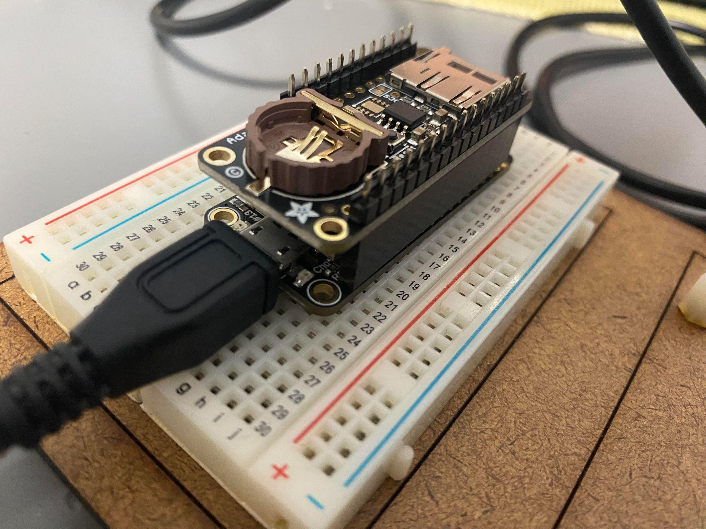
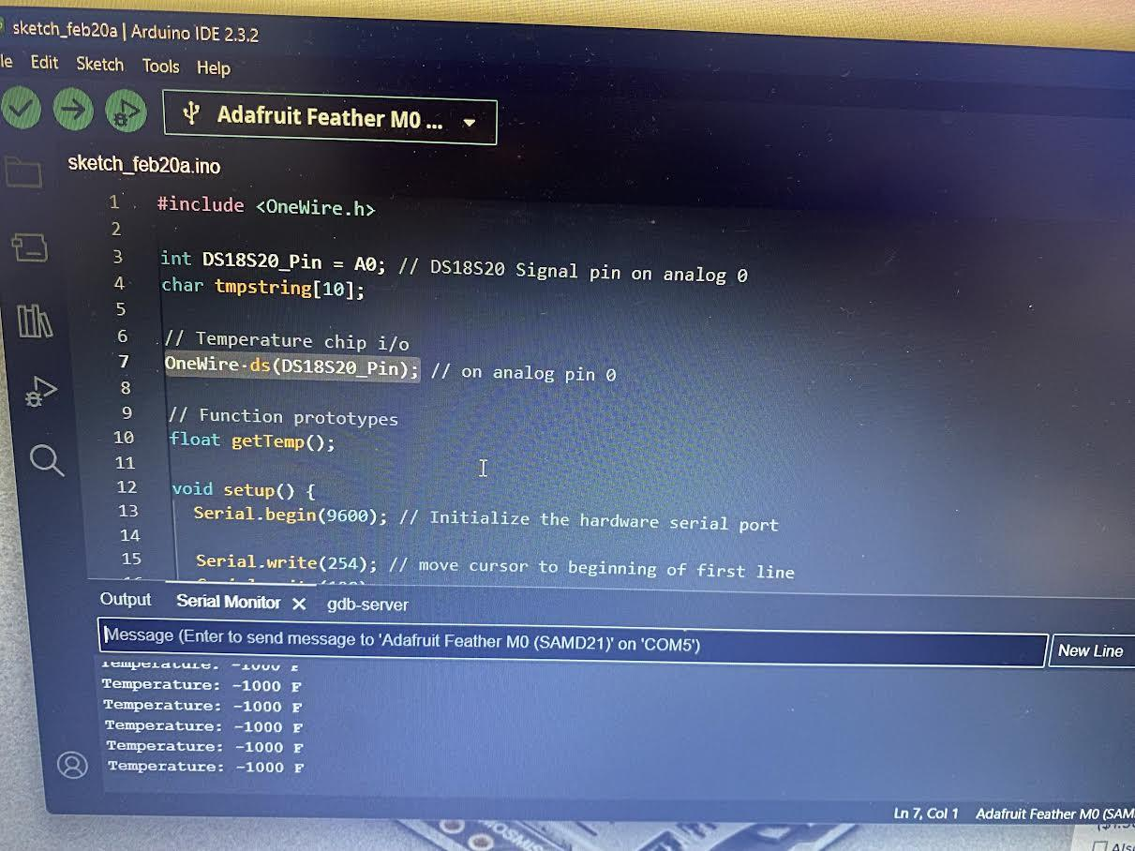
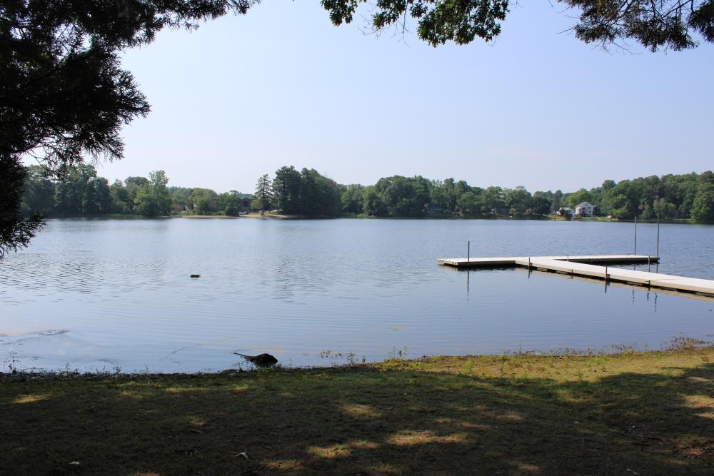
Pond Data Collection Device
Tyler Karp, Christopher Kim, Chelsea Yan, Evan Canty,
Stewart Pierson (Teacher Leader), Thomas Hyde (Mentor)
The Rivers School, Weston, Massachusetts, USA
Abstract
Our group started off by thinking of different ways that we could collect data and how that would impact how our device is built, such as a net of sensors or just a buoy that would sit out on the lake. Going off our general idea, we then had to figure out how to not only make our device float but also make sure none of the tech gets damaged. We also needed to conduct some research on our own pond to decide what data to collect using our device. Then, all that was left was to program.
Science Content
With an M0 Adalogger, we plan to collect various data from the pond, including temperature, pH, and turbidity. Currently, we are working on the temperature sensor. After that, we plan to build a floating device that periodically takes data from the pond throughout the day.
The parts of our project that we struggled with the most were getting Arduino, the M0 Adalogger, and the temperature sensor to communicate with each other. We also faced challenges in designing a waterproof system to ensure that the electronics remain dry and safe.
While our team was unable to complete this device, we had intended to address problems with the water quality of the pond after collecting the water data. We investigated how factors such as algae and E. coli can harm pond ecosystems.
Team Content
This is the 3rd year of the Rivers BioBuilder team. Our team consists of two returning members, Tyler Karp and Christopher Kim, and two new members, Evan Canty and Chelsea Yan. We also have Mr. Stewart Pierson as our returning advisor and Thomas Hyde as our BioBuilder mentor.
And maybe some next steps:
Something that we learned from this project is that electronics, especially sensors are more complicated than we thought
We think that adding more sensors would be a worthwhile future step in the project. Something like Ph or salinity in order to gather more informative data about the water ecosystem
Introduction/Background
Behind our school, we have a pond, which is a key feature of the campus. In addition to adding beauty to our campus, the pond is used in a plethora of different ways all year round, such as our school's fishing club during the year, pond hockey during the winter, and the camp over the summer. With how important this pond is to our school, our club wanted to make sure that not only is our pond healthy to use, but it will maintain its beauty for years to come. Our club wanted to develop a device that would automatically collect and store water health data. By collecting samples, we could easily see how things like swimming, fishing, or other biological factors impact our pond. We wanted to create something that would inform others in a clear way and incentivize them to help our environment or just be conscientious of their impact on the environment.
References and acknowledgements
We’d like to thank our Biobuilder mentor, Thomas Hyde, for meeting with and assisting us throughout this project. We would also like the thank our faculty advisor Mr. Pierson for all of his help in these past few months. Lastly, We would like to thank The Rivers School for providing us the opportunity and resources used for this project.

