Slide 1
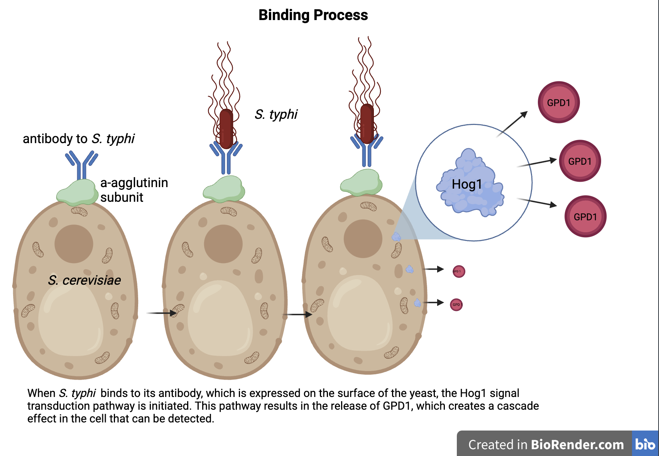
Detecting S. typhi with Engineered Yeast
Hana Shinzawa, Cate Lynch, Leslie Baker, Rosalia Reale, Sarah Hanna (teacher), Isabelle Ortiz (teacher), Dr. Natalie Kuldell (BioBuilder)
Montrose School, Medfield, MA, USA
Abstract
Salmonella typhimurium (S. typhi) is a prevalent bacterial species, and is estimated to cause around 33% of food-borne illness in Sub-Saharan Africa, South Asia, East Asia, and Pacific regions. To decrease food contamination in these areas, a portable and self-regenerating detection system is needed. To fulfill these needs, we designed a yeast-based detection system using synthetic biology. Our system will express an antibody to S. typhi via a-agglutinin complex subunits (Aga1p and Aga2p) on the surface of Saccharomyces cerevisiae (S. cerevisiae), a yeast that is both engineerable in the lab and safe to provide to households in affected areas. When the antibody presented on the surface of these engineered yeast binds to a lipopolysaccharide (LPS) of S. typhi, it will activate the Hog1 pathway. This pathway is naturally present in S. cerevisiae and will be engineered to generate a detectable signal that will provide an early warning for food contamination. Our system, if successful, will create a low-cost, self-regenerating detector for S. typhi, reducing disease in third-world countries by making food and water safer to consume.
Team Content
Our team is composed of 4 returning seniors. We recently conducted an experiment at the BioBuilders Learning Lab in Boston.
Experiment and Findings
Our team attended the BioBuilders Learning Lab on 2/16 and ran an experiment to test how bacterial LPS impacts Saccharomyces cerevisiae (S. cerevisiae) viability.
After preparing five 1:10 dilutions of yeast with LPS, glucose, NaCl, and bleach, we plated 5μl of each solution and dilution on a petri dish.
Above these drops, we plated our control of five 1:10 dilutions of yeast and water.
After 48 hours, the LPS and control groups seemed to have comparable viabilities. LPS had some negative impact on viability, but the yeast still seemed to grow well. If the LPS had drastically decreased yeast viability, this effect would cause a problem in our system, since the yeast must be able to survive in the presence of LPS.
Based on our experiment, since LPS did not prove toxic to the yeast, our system appears to still be a viable solution for detecting bacterial LPS.
Introduction/Background
S. typhi can contaminate food and water, causing typhoid fever, which can be deadly if left untreated. Instances of S. typhi contamination are more common in areas in Africa and South Asia. Although S. typhi contamination can be prevented by treating water and safely disposing of human waste, populations in third-world countries are more vulnerable to infection because of limited resources.
We created our yeast solution to help those vulnerable populations, so we had to ensure that our solution would be low-cost, easily accessible, and simple to use. We chose to create a yeast solution because yeast is self-generating and can safely be grown in a household environment. Because it is self-generating, it would be a one-time purchase for a family looking to test their food and water for S. typhi contamination. A small sample of the solution could be removed, and the food or water to be tested would be placed in the solution for testing. A positive result would be the release GPD1, which creates a signaling cascade. The rest of the yeast solution would be saved for future use.
Control
LPS
Glucose
References and acknowledgements
We’d like to especially thank our BioBuilders mentor Dr. Natalie Kuldell for all of her help, and BioBuilders and Ginkgo Bioworks for sponsoring our lab.
NaCl
Increasing dilution from left to right. Images taken after three days of incubation
Glucose and NaCl had a nearly identical impact on S. cerevisiae growth, as seen in comparison to the control. LPS slightly decreased S. cerevisiae viability, but yeast growth was not significantly impeded. This preliminary experiment indicates that S. cerevisiae will survive contact with LPS during detection and that S. cerevisiae is a suitable chassis for out detector.

