Slide 1
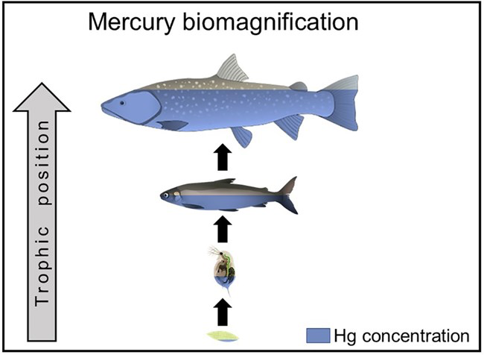
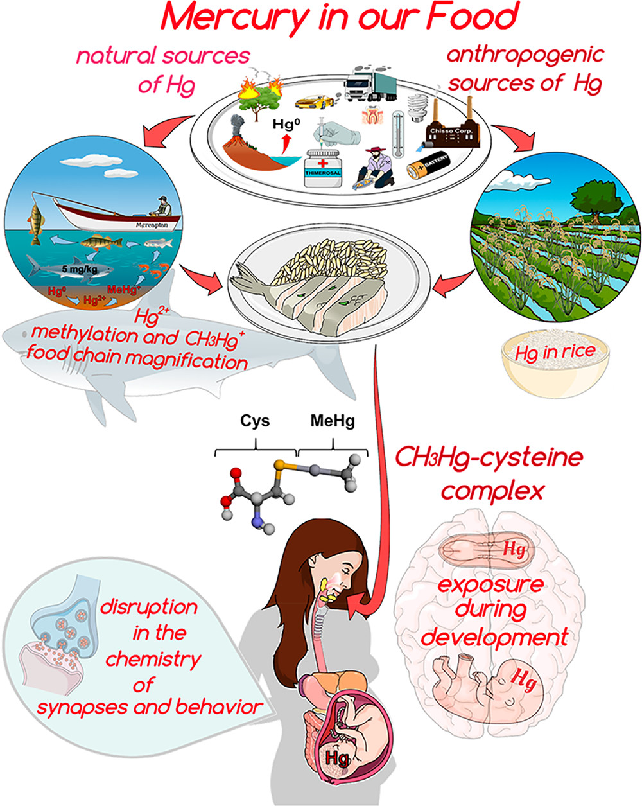
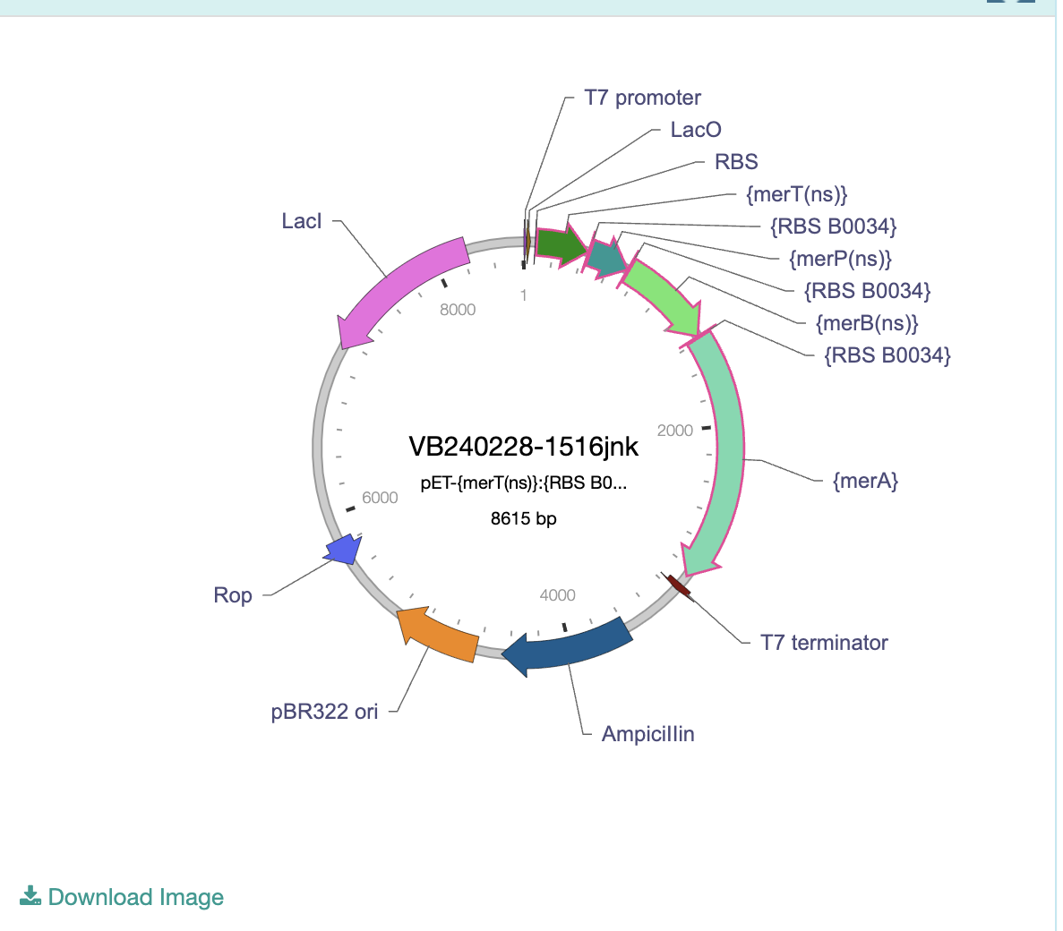
DETOX-I-FISH
Tessica Selvaganesan, Aditya Mukker, Ayan Ragunathan, Aditi Pabidi, Daksh Reddy, David Park, Keerthana Anumukonda, Julia Crossen, and Kensley Burke, supervised by Catherine Sharer, Pam Seeley, and Dr. Kristin Jenkins (BioMADE)
Lambert High School, Suwanee, Georgia, United States
We are working on developing an E. coli that uses different Mer proteins to break down the methylmercury found in fish into a less toxic form of mercury. Fish are soaked in this E. coli solution in order to break down the methylmercury and then cooked to remove all the E. coli, as the bacteria are unable to survive in higher temperatures. Our project is used to prevent mercury contamination and mercury poisoning in food. Mercury poisoning is a lethal condition when it isn't addressed, especially in shoreline and fish reliant countries. This plan is an efficient treatment process to ensure food safety.
Science Content
Experiment details / plans
We plan to genetically modify E. Coli to produce MerA and MerB using the IGEM Biobuilder part BBa_K2123202. This bacteria would be grown in a suspension so tuna and other fish can be soaked in it. The bacteria would then break down Methylmercury into Elemental Mercury, a less toxic substance.
We would like to run a proof of concept for the rate of dye penetration in fish meat. This would prove that the bacteria can be circulated through the fish by demonstrating the spread of the dye through the fish meat.
We would like to modify E. coli to produce the operon and suspend it. Then we would soak the fish in the suspension for varying periods of time. After time passes, test the concentration of Hg in the fish. This would determine how long the fish would have to soak and prove the effectiveness of the operon.
Problem
Biomagnification of materials-specifically mercury in fish
69 studies of 129 food webs confirm that mercury biomagnification in marine ecosystems is steadily worsening.
Issue for people because mercury is toxic and jeopardizes brain development.
Solution
Bioengineer E. coli and place it in a suspension that fish can be soaked in as they thaw.
This occurs before the fish are sterilized and canned, so it would not affect the safety or quality of the food.
Makes seafood a safer and more sustainable option for consumption.
The process can be replicated for detoxification of other heavy metals in a plethora of meats.

Slide 2
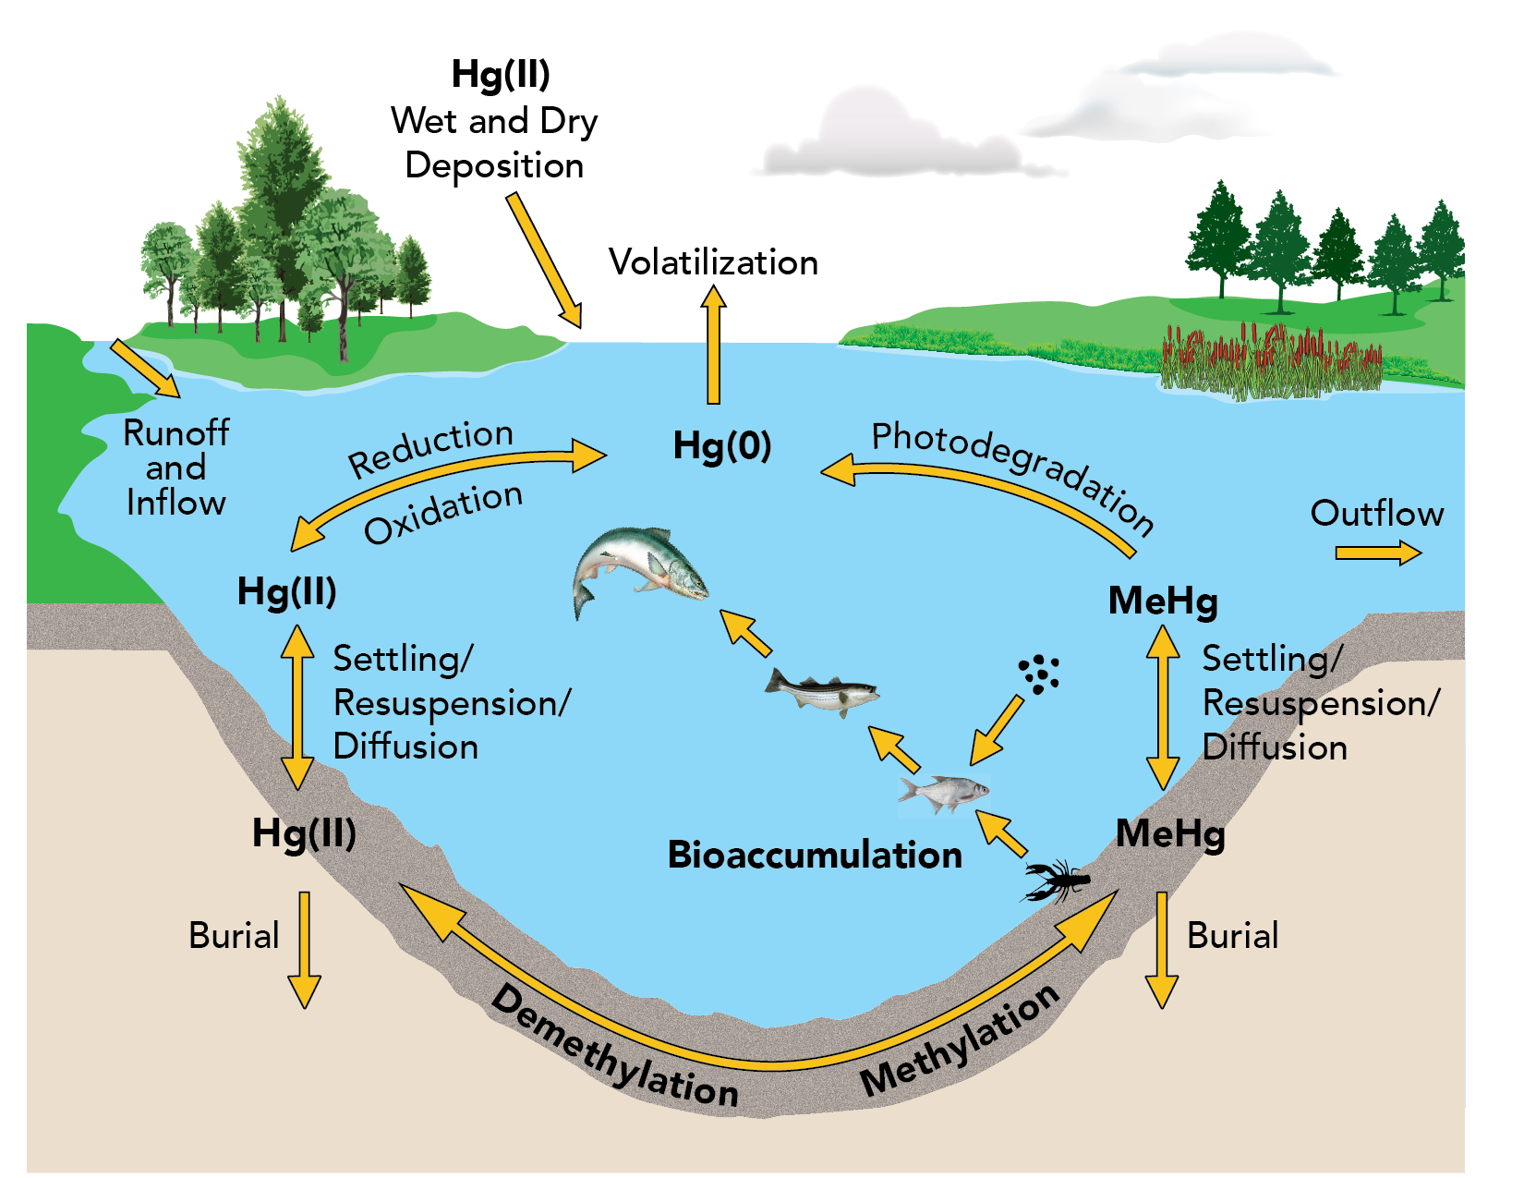
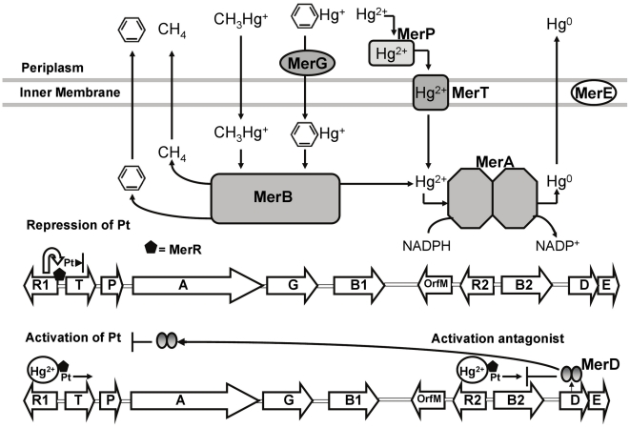
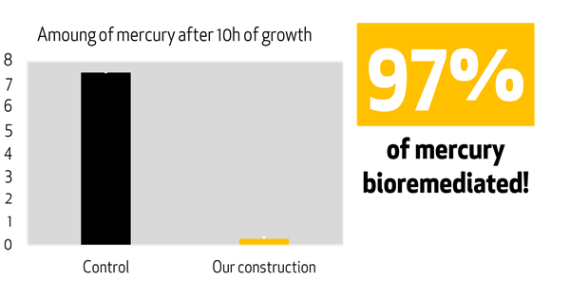
DETOX-I-FISH
Tessica Selvaganesan, Aditya Mukker, Ayan Ragunathan, Aditi Pabidi, Daksh Reddy, David Park, Keerthana Anumukonda, Julia Crossen, and Kensley Burke, supervised by Catherine Sharer, Pam Seeley, and Dr. Kristin Jenkins (BioMADE)
Lambert High School, Suwanee, Georgia, United States
Team Content
We are a new team with nine members, one of whom is returning from last year. Our experience with iGEM and BioBuilder has been very inspiring, and we have enjoyed working together to find new solutions.
Next steps:
We have located a part (BBa_K3470017) that contains the GFP molecule. It can be attached on to our current promoter sequence, so when we test for penetration we will be able to tell the effects. This promoter sequence also is able to delete merA and merB to show changes between different test groups. We can create multiple groups to show the effectiveness of the Mer proteins by measuring the amount of methylmercury and non volatile mercury in the plasmid with the merA and merB present, one where only MerB is deleted, and a control with MerA and MerB are deleted.
We would like to try our proof of concept to test the penetration and effect of the bacteria. The first step would be to have three bacteria cultures. Transform one of the bacteria cultures to contain E. coli with the plasmid containing part BBa_K2123202 with an attached GFP molecule, one with the plasmid containing part BBa_K3470017, and one E. coli with no changes. Prepare fish samples containing methylmercury at different depths into the skin. Place the fish into each of the E. coli solutions and check for the presence of methylmercury in each of the fish and record to see what level the penetration stops at.
From here, we want to contact companies that make canned fish, and talk to them about how we can actually implement this idea.
References and acknowledgements
Li, R., Wu, H., Ding, J., Li, N., Fu, W., Gan, L., & Li, Y. (2020, July 25). Transgenic Mera and Merb expression reduces mercury contamination in vegetables and grains grown in mercury-contaminated soil - plant cell reports. SpringerLink. https://link.springer.com/article/10.1007/s00299-020-02570-8
Lavoie, R. A., Jardine, T. D., Chumchal, M. M., Kidd, K. A., & Campbell,L. M. (2013, October 23).Biomagnification of Mercury in Aquatic Food Webs: A Worldwide Meta-Analysis. ACS Publications. Retrieved January 8, 2024, from https://pubs.acs.org/doi/10.1021/es403103t
We’d like to thank our club teachers Mrs. Seeley and Ms. Sharer as well as our mentor Dr. Jenkins. Their assistance has been invaluable and we would not have been able to research this project without them.

