Slide 1

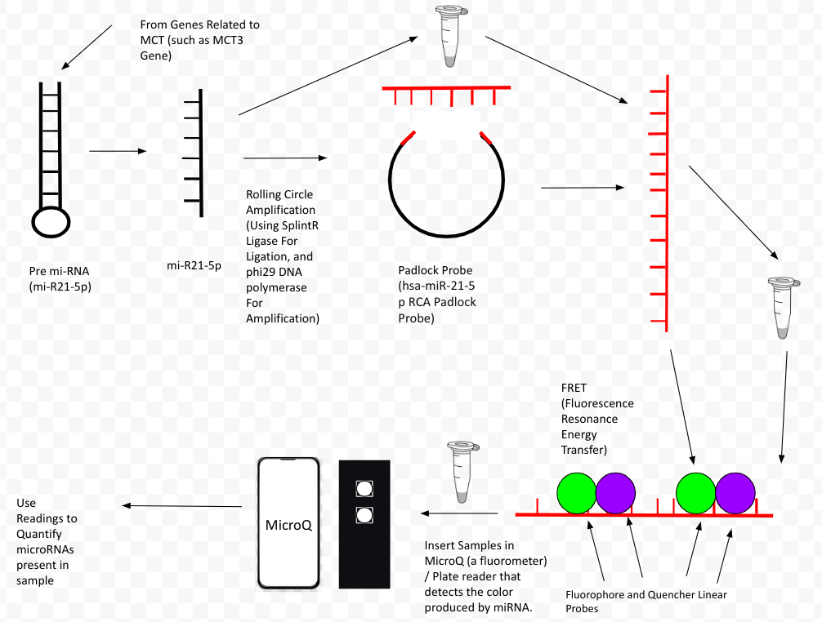






How miRNA biomarkers can be used to detect / quantify Mast Cell Tumors in Canids
Members: Reva Badkundri, Skanda Bharadwaj, Varsha Chennam, Eshawnvie Kallu, Sarvesh Krishnamoorthy, Matthew Murad, Naga Sahithi Rajuladevi, Arav Raghunathan, Yeryn Song, Swadha Surange
Advisers / Mentors: Mrs. Catherine Sharer, Ms. Caroline Matarrese, Mr. Sussmit Chowdhury (GT), and Mr. Maxwell Kazman (GT)
Lambert High School, Suwanee, GA, USA
Abstract
The focus of our project is to develop a fast and efficient process to detect the presence of mast cells in dogs. Mast cells promote tumor growth and histamine development, which are known as Mast Cell Tumors (MCTs). Our solution is to create a cost-effective, fluorescence biosensor to detect the target miRNA-21, found in saliva, which increases inflammation of mast cells. We will apply Lambert iGEM’s Rolling Circle Amplification (RCA) technique to amplify the miRNA-21. The RCA technique utilizes Padlock Probes to target and amplify the miRNA-21 sequence.
Science Content / Experimental Design
Learn: Our team researched a potential mast cell inducing biomarker present in the saliva of dogs, miRNA-21.
Design: Develop a biosensor for miRNA-21 using Lambert iGEM miRNA Detection System. Use Probe Builder software to help design successful padlock probe and obtain miRNA-21 samples for our test. As well as fluorophores and quenchers.
Build: Using materials from the BioBricks parts registry, the team hopes to build a biosensor for our biomarker (mi-RNA-21) and test it using procedures from Lambert iGEM. This includes adding our selected padlock probe and mRNA-21 / Saliva to test tubes and inserting it into a thermocycler to match optimum temperatures for what the project, then inserting fluorophores and quencher probes.
Test: Run tests and analyze the quantitative results produced from the MicroQ tests to show the frequency of certain miRNAs in MCTs. Using plate-readers / MicroQ, we can see how decreased fluorescence correlates with increased concentrations of miRNA-21.
Team Content
We are Team Red from Lambert High School in Suwanee, GA. Our team consists of 10 members (listed above), made up of high school freshman, sophomores, and juniors. We enjoyed developing this project and learning more about your project, and hope other schools continue this research and run real experiments.
Some next steps:
Contact: We hope our team (or future teams) will continue this research by contacting local and global oncologists and veterinarians to understand more about the application and experimental design for this project.
Conduct: We hope for other teams to conduct this experiment by looking into biosensor research to develop a novel sensor that they can use to detect their own specific miRNAs for their disorders / conditions (also study Lambert iGEM’s system).
Introduction/Background.
MCTs, otherwise known as Mast Cell Tumors,
are cancerous cells that grow from a type of white blood cell known as Mast Cells. These tumors have a major effect on a variety of animals, especially canids, as studies show that one out of every five canids obtain MCTs at some point in their life.
Research also shows that there are small, non-coding nucleotides, known as miRNAs, that are related to the presence of MCTs in the canids, such as miR-21-5p, miR-92a-3p, miR-338, miR-379 and miR-885. These miRNAs are involved in cell proliferation as well as metastasis pathways and can be used as a biomarker to identify increased risk of MCTS.
In RCA, target miRNA is amplified using rolling circle amplification, the Padlock Probe is designed to hybridize to the amplified product, and linear probes tagged with quenchers and fluorophores are used as a reporter. The flourophore emissions decrease when they are close to the quencher, and that decrease can be detected and used to quantify the amount of miRNA present. This novel biosensor system came from the Lamber iGEM CADlock project.
References and acknowledgements
Zamarian V;Stefanello D;Ferrari R;Chiti LE;Grieco V;Dalla Costa E;Ceciliani F;Lecchi C; (n.d.). Salivary Mir-21 is a potential biomarker for canine mast cell tumors. Veterinary pathology. Retrieved March 1, 2023, from https://pubmed.ncbi.nlm.nih.gov/36286075/
Lambert IGEM (2022). CADlock. iGEM. Retrieved March 1, 2023, from https://2022.igem.wiki/lambert-ga/
We’d like to thank our mentors Mr. Sussmit Chowdhury and Maxwell Kazman as well as the club’s sponsors Mrs. Catherine Sharer and Ms. Caroline Matarrese for their unconditional support in the development of this project!
Model

