Slide 1
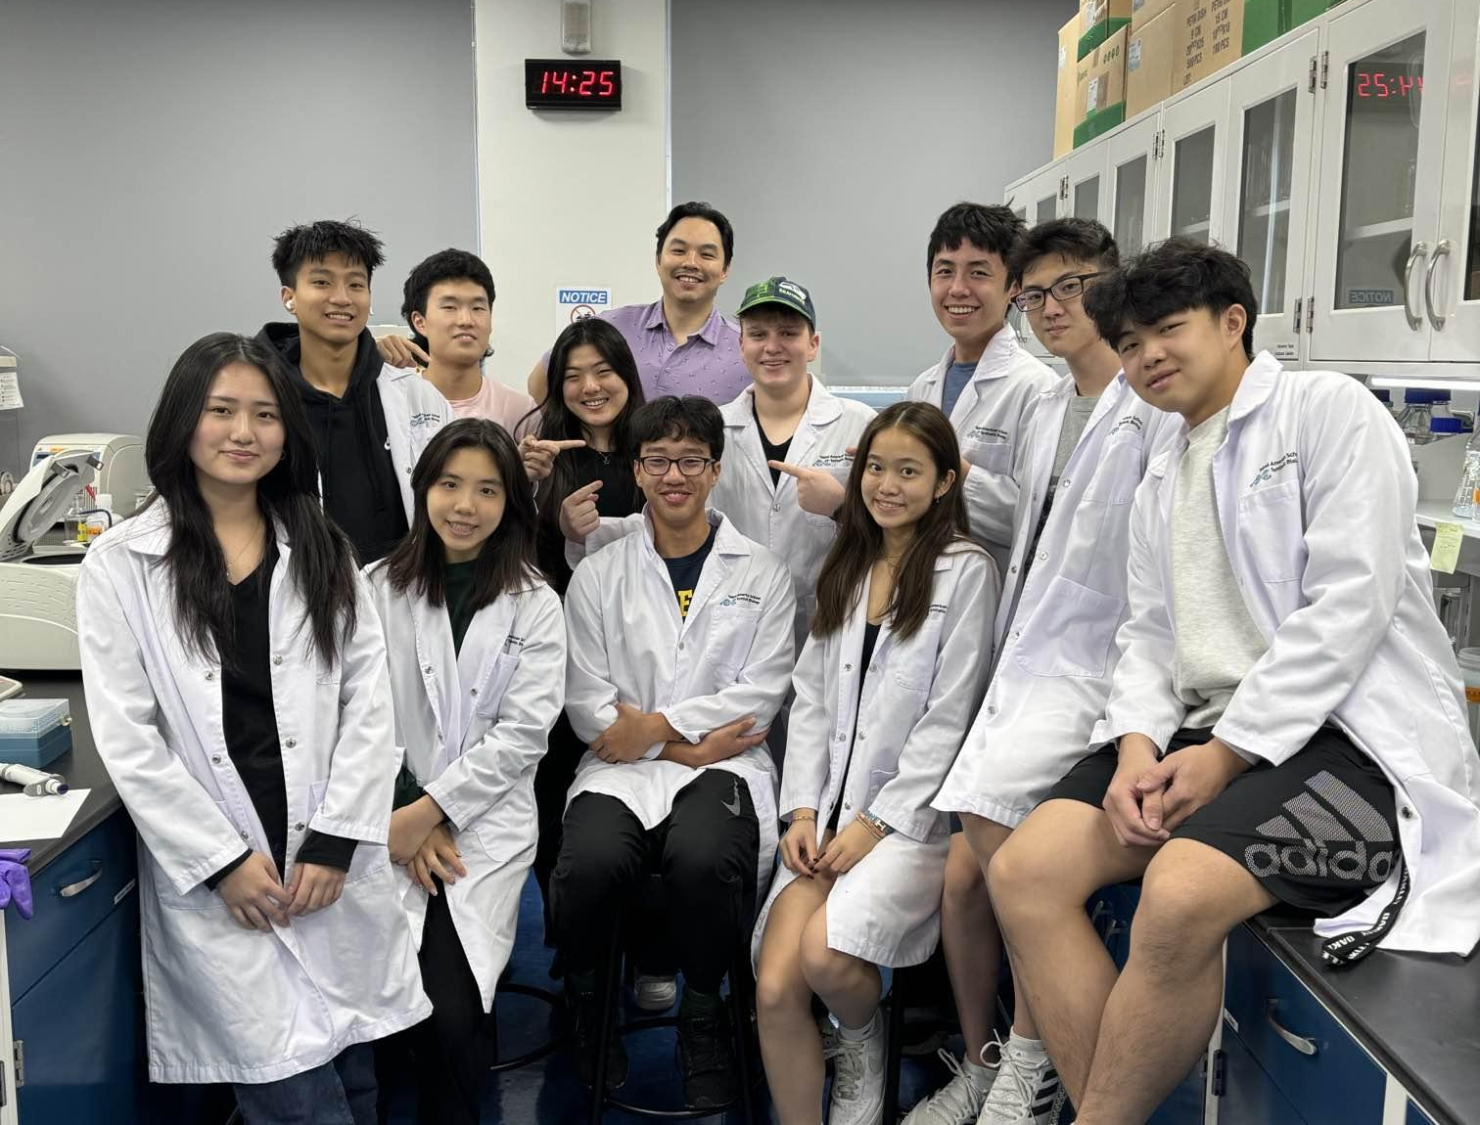
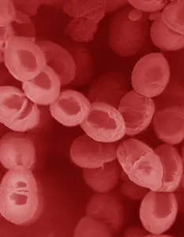
Lack-Tis Acid: Engineering a Lactic Acid-Free Oral Bacteria
Nikki Huang, Annie Chang, Audrey Leu, Steven Kuo, Elliot Brennan, Kenneth Miao, Ethan Lin, Tinsley Wu, Aaron Liu, Junui Song, Emma Shih, Dr. Jonathan Hsu
Taipei American School, Taipei City, Taiwan
Abstract
Introduction
Lactic acid, the cause of dental caries, is largely produced by Streptococcus mutans, a strain of lactic acid (LA) bacteria in the mouth. Using Lactococcus lactis as a model for S. mutans, we aim to remove the gene, ldh, that directs LA production from its genome, resulting in a strain of mutant bacteria with hindered lactic-acid production. We plan on utilizing molecular cloning techniques like cross recombination for gene deletion, and have found a preliminary method for testing the pH of bacteria. In the future, we plan on researching possible implementation methods of our bacterial strain.
Team Photo
Figure 1: Schematic flow of our project
Problem
90% of adults suffer from tooth decay
Cause: lactic acid produced by S. mutans
Goal
Delete ldh gene to create a L. lactis strain that replaces existing strains and does not produce lactic acid
Lactococcus lactis
Largely studied lactic acid bacteria
BSL1 bacteria, as opposed to S. mutans’ BSL of 2
We use L. lactis as a model for S. mutans to model the process of deleting ldh
We are a team of 3 high school juniors, 4 seniors, and our mentor, Dr. Hsu
Figure 2: L. lactis (University of Wisconsin-Madison)

Slide 2
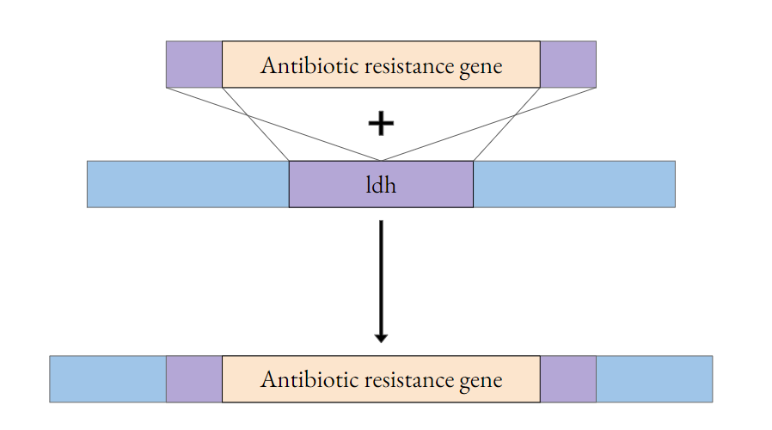
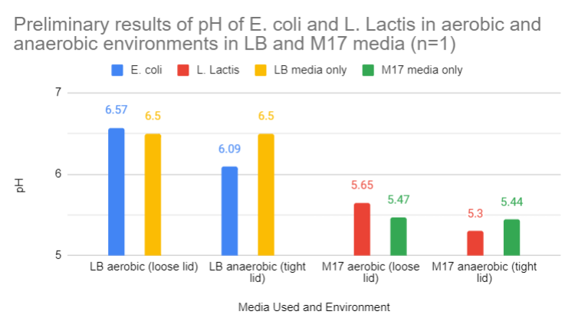
Lack-Tis Acid: Engineering a Lactic Acid-Free Oral Bacteria
Nikki Huang, Annie Chang, Audrey Leu, Steven Kuo, Elliot Brennan, Kenneth Miao, Ethan Lin, Tinsley Wu, Aaron Liu, Junui Song, Emma Shih, Dr. Jonathan Hsu
Taipei American School, Taipei City, Taiwan
Preliminary Design and Results
Next Steps
Complete cross recombination experiment
Test the effectiveness of our strain through pH and PCR
Research possible ways of implementation
Acknowledgements and References
RHoefnagel, Marcel H N et al. “Metabolic engineering of lactic acid bacteria, the combined approach: kinetic modelling, metabolic control and experimental analysis.” Microbiology (Reading, England) vol. 148,Pt 4 (2002): 1003-1013. doi:10.1099/00221287-148-4-1003
Hillman, J D et al. “Construction and characterization of an effector strain of Streptococcus mutans for replacement therapy of dental caries.” Infection and immunity vol. 68,2 (2000): 543-9. doi:10.1128/IAI.68.2.543-549.2000
Llanos, R M et al. “Cloning, nucleotide sequence, expression, and chromosomal location of ldh, the gene encoding L-(+)-lactate dehydrogenase, from Lactococcus lactis.” Journal of bacteriology vol. 174,21 (1992): 6956-64. doi:10.1128/jb.174.21.6956-6964.1992
Special thanks to Dr. Hsu, Mr. Tsao, Dr. Fagen, Dr. Chen, and the science department for their unwavering support. Thank you to members of the University of Chicago iGEM team for their mentorship.
Figure 3: Model of Cross Recombination Technique
Delete the ldh gene responsible for lactic acid production by substitution of antibiotic resistance gene
Antibiotic resistance gene cross recombination with ldh gene → new antibiotic resistance gene that does not produce lactic acid.
Figure 4: Graph of Preliminary pH results *pH of LB taken separately
L. lactis grown in M17 under anaerobic conditions show a decrease in pH, likely from the production of lactic acid
E.coli was used to compare our results from L.lactis to bacteria that produces little produce lactic acid
More trials and data are needed to better model a change in pH caused by lactic acid production

