Slide 1
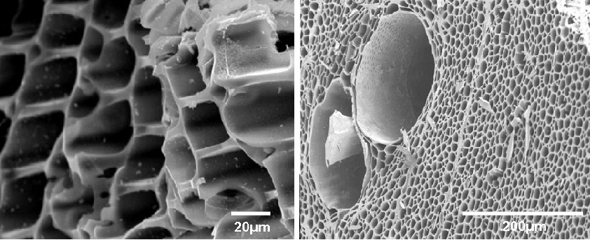
Bio-Char(ming) New England’s Soil Fertilizer
Shrewsbury High School, Shrewsbury, MA, USA
By: Aadrishma Dahal, Aashi Gupta, Aleena Shaikh, Amal Nadaf, Ayesha Naveed, and Rachael Laikangbam
Special Thanks to our mentor Susana Donkor (Aurion Biotech) and teacher advisor Dr.Duggan!
Science Content
Abstract
This study researches the impact of PGPB (Plant Growth-Promoting Bacteria) and nutrient-infused biochar on plant growth in New England soil. New England’s soil is notorious for its lack of certain nutrients, rocky structure, among other problems. If carried out, biochar will be soaked in water and infused with nutrient rich substances and PGPB. Then, it will be mixed in soil to grow plants, compared against a control group grown in regular soil. Over five months, growth metrics—height, stem diameter, root length, and leaf count— are expected to be significantly better in plants grown in the biochar-amended soil. The results will highlight biochar and PGPB’s potential as a sustainable amendment for improving agricultural productivity through enhanced nutrient availability. This underscores the importance of further exploring biochar and PGPB benefits and applications in sustainable agriculture.
Experiment details:
Infusing substances into biochar in order to deliver key nutrients to New England Soil
Soak biochar in water for 1-3 days
Add bone meal, nutrient-rich fertilizers, and PGPB strains (Pseudomonas aeruginosa, Klebsiella pneumoniae, Bacillus thurigiensis, Bacillus pumilus, Rhodococcus hoagii) to the mixture
Pseudomonas aeruginosa enhances plant growth through phytohormone production, nutrient mobilization, siderophore-mediated pathogen competition for iron, and pollutant degradation.
Klebsiella pneumoniae promotes plant growth by nitrogen fixation, producing antimicrobial substances, and aiding in pollutant breakdown, enhancing soil health and reducing chemical pesticide reliance.
Bacillus thuringiensis is a soil-dwelling bacterium that produces toxins harmful to insects, making it a natural pesticide, while also being safe for plants, animals, and humans, thus supporting sustainable agricultural practices.
Rhodococcus hoagii aids in breaking down environmental pollutants, especially hydrocarbons, facilitating soil clean-up and supporting eco-friendly remediation projects.
Let the mixture settle for 2 days
Combine the mixture with soil in a 1:4 ratio (biochar:soil)
Prepare a control group with just New England soil
Grow plants for 5 months
Collect data on measure height, stem diameter, root length, leaf count, etc
Team Content
We are a group of 7 hailing from Shrewsbury High School. Our team is completely rookie and student-led, however we still have persevered through our circumstances! WIth the aid of our teacher advisor, Dr.Duggan, and assigned team mentor, Susana Donkor, we have put many hours into this project. Whether it be hours in our local library, evening zoom calls, or early morning FaceTimes, we made it our goal to finish this project while still having fun!
And maybe some next steps:
Whether it be families gardening at home, local farmers planting crops, or large corporations mass producing, New England’s soil gives everyone a problem. It’s rocky conditions, unpredictable weather, and lack of certain nutrients prove that BioChar should be a widely accessible resource to be used by all!
If a future team (or us) were to carry out the experiment, then we would hope they follow our outlined experiment. Although it takes several months, most of the experiment is the BioChar sitting and waiting for nutrients and bacteria to be absorbed.
Experiment with different PGPB strains to find one best compatible with New England Soil/different crops grown in New England.
Introduction/Background
Problem: New England soil is known to be rocky and uneven, which leaves it lacking in nutrients for growing plants. In a world that is changing due to global warming, it is vital that we preserve crop growing in the U.S.
Solution: Biochar has been used throughout history by to enrich the soil.
What is BioChar: Biochar is made from organic material that has been combusted in the presence of limited oxygen which changes the structure of the carbon atoms to create a compound that is sponge-like and absorbs nutrients well. When placed in the soil, the spongy carbon releases these nutrients into the soil, supplying it, and enabling it to grow.
What is PGPB: Plant Growth-Promoting Bacteria promote plant growth through nitrogen fixation, phosphate solubilization, and the production of plant hormones.
Application: New England soil lacks calcium, potassium, magnesium, and is also high in acidity. This project utilizes Biochar by infusing it with these nutrients and PGPB (plant growth promoting bacteria) strains and doubles as a buffer for soil which will help increase the pH.
Expected results:
Plants grown in the biochar with PGPB treatment will perform significantly better in all measured areas than our control group, plants grown in regular soil
References and acknowledgements
Works Cited:
Thanks again to our mentor Susanna Donkor and our teacher advisor Dr. Duggan!

