Slide 1
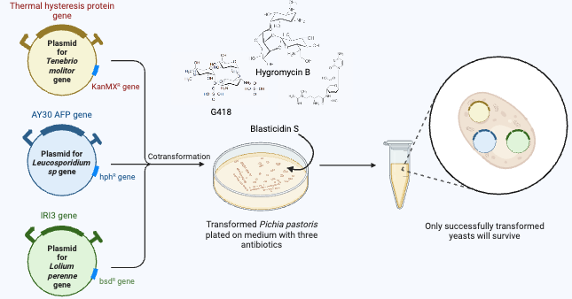
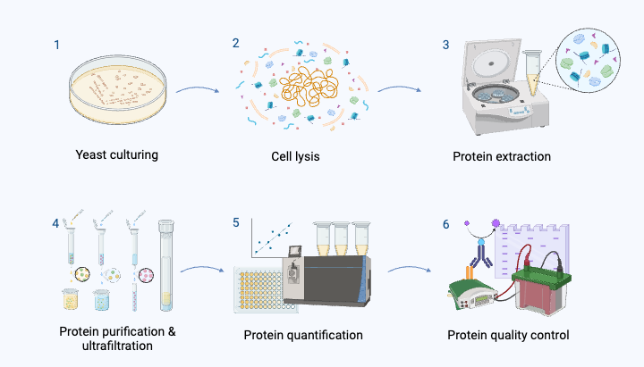
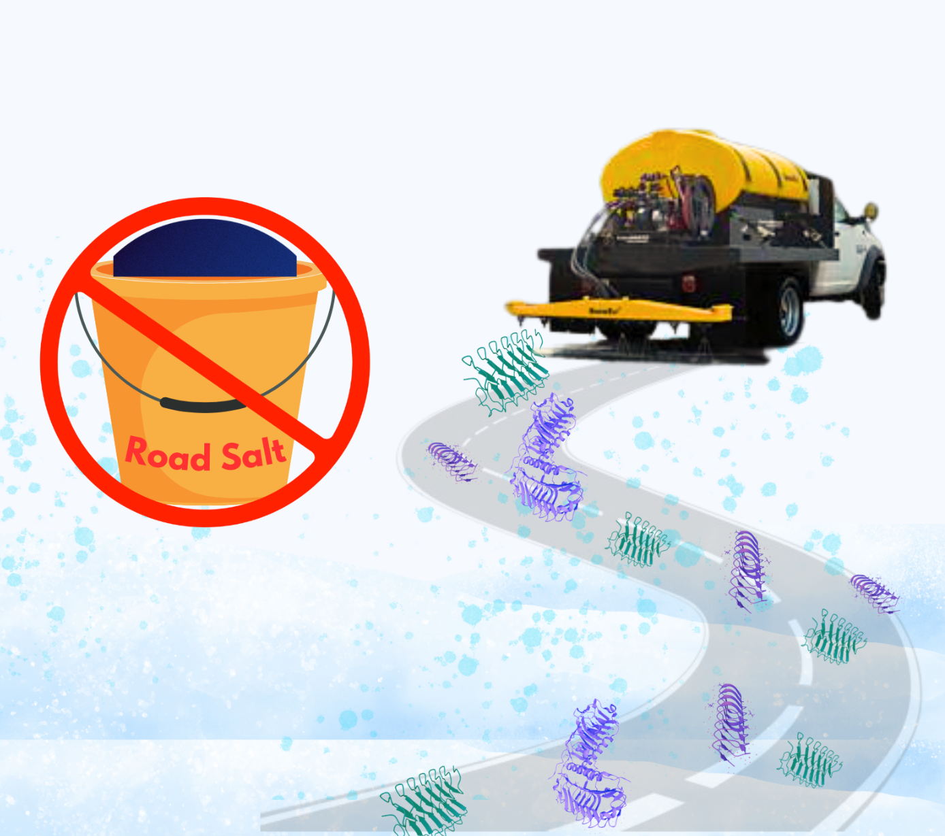
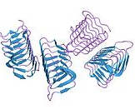
Road Salt Alternative Using AFPs
Loretta Wang, Paige Dix, Nicole Pae, Taylor Strilesky, Min Roh,
Dr. Beth Pethel, Vicki Liu (Lanza Tech) Western Reserve Academy, Hudson, OH, USA
Abstract
Every winter, drivers are threatened by hazardous icy roads. Among methods to prevent snow-related traffic accidents, the most common measure is road salt. However, the application of road salt causes many problems, such as its corrosion, as well as its harmful impacts on the environment. The negative effects of road salt necessitate an alternative solution to treating winter roads. Our plan involves inserting three AFP gene sequences into plasmids, transforming the plasmids into Pichia pastoris, and harvesting three AFPs from mealworms, plants, and arctic yeast genes. These AFPs adhere to the surface of newly formed ice crystals, inhibiting ice crystal formation in sub-zero temperatures. By harvesting the AFPs from yeast, we can apply the product as a cost-effective road salt alternative. This innovative solution addresses environmental concerns and uses a more eco-friendly approach. Testing this design's efficacy and safety will prove its feasibility as a replacement for road salt.
In order : Min Roh, Nicole Pae, Paige Dix, Loretta Wang, Taylor Strilesky
Meet the Team
Workflow of Genetic Engineering to Application of AFPs
Three Components for Super AFP
Tenebrio molitor is a freeze-susceptible mealworm that survives the cold winter by producing AFPs. We can introduce a thermal hysteresis gene from this species to enable the production of AFP in yeast.
Leucosporidium sp. strain 30 is a yeast strain known for producing a glycosylated ice-binding protein (LeIBP).
Perennial ryegrass (Lolium perenne) produces antifreeze proteins to protect itself against the cold. Its gene encoding an ice recrystallization inhibition protein-like protein can be incorporated alongside the other genes to produce super AFPs.
Chassis - P. pastoris - for its demonstrated efficiency in the pilot-scale production of AFP in several publications.
Our team has constructed this super AFP design with a passion for synthetic biology. We hope our design can be employed to address the prevailing challenges associated with road salts.
Background
Road Salt's Negative Impact: Due to the harmful effects of road salt, including the corrosion of vehicles and infrastructure as well as the infiltration of salt in ecosystems and well water, we are creating an environmentally safe alternative road salt.
Limitations of Sand: Sand is utilized on icy roads as it mitigates the negative environmental impacts associated with road salts. However, this approach has several limitations. Sand is employed solely to enhance traction; it does not possess the capacity to melt ice or snow.
Mechanism of AFPs: AFPs adhere to the surface of forming ice crystals, as depicted in the figure 2, preventing water molecules from joining the ice nucleus at the attachment sites. This interaction alters ice crystal growth and shape, creating a convex surface on the liquid-facing side where AFPs bind, thus modifying the ice's growth pattern.
Next Steps
Confirm the functionality of the newly created plasmids.
Isolate the target proteins from the yeast cell lysate.
Proceed with protein quality assessments to ensure integrity and purity.
Perform functionality tests to verify the effectiveness of the AFPs.
Gather performance data from samples in simulated icy road conditions.
Identify cost-efficient methods for the bioengineered P. pastoris production.
Figure 1.The negative effects of road salts to human health, environments, and infrastructures.
Cotransformation of Three Plasmids for AFP Production in P. pastoris
Acknowledgements
We extend our gratitude to Dr. Beth Pethel for her support and guidance throughout our project and to our mentor Vicki Liu for sharing her valuable knowledge and experiences.
ice nucleus
AFPs
AFPs
AFPs
Figure 2. AFPs bind to the ice nucleus, inhibiting ice crystal growth, and increasing the curvature of the ice surface which creates an unfavorable shape for the accumulation of additional water molecules
References
Protein Harvesting Procedure
Application of AFPs on road surfaces to prevent ice formation

