Slide 1
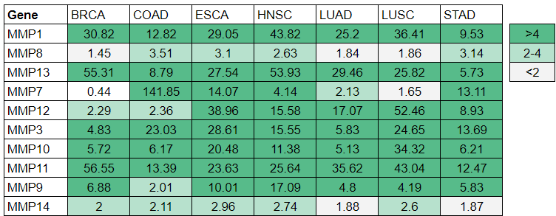
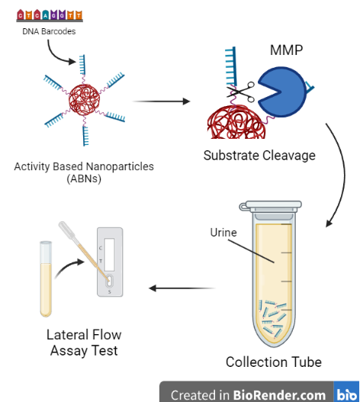
Pan-Cancer Diagnostic Using Activity-Based Nanoparticles
Harriet Lai, Jayla Chan, Sarah Huang, Nancy Sun
Derek Shapiro, Dr. Peter Horanyi (UCB)
Sage Hill School, Newport Coast, California, United States
Abstract
Science Content
Team Content
We are a new team of four students (1 junior and 3 sophomores). One of our favorite experiences is spending time after school together meeting with our mentor, Dr. Horanyi, breaking down the original design from the paper we found and discussing how we could create a similar design for our project.
Next Steps:
For our next steps, we plan on running tests to identify the common combinations of dysregulated MMPs in each cancer, as well as expanding our data to include other forms of proteases, such as ADAM and Cathepsins. This will help us more precisely determine the specific type of cancer that can be tested for and what combinations of proteases the test will detect. Then, the next step would be to test the efficiency and accuracy of the PATROL nanosensors and the lateral flow assay test, creating a point of care diagnostic platform that makes diagnosing cancer more accessible. In addition, a test kit would need to be developed and widely distributed to make this method of testing for cancers more efficient and accessible. The hope is that this test can act as a cheap, easy-to-use, accessible yearly screening tool for cancer.
THrough research, many cancers have been associated with the dysregulation of extracellular proteases^{[2]}.One such family of proteases is Matrix metalloproteinases, or MMPs, which have shown similar patterns of upregulation across various cancers^{[2]}. This project aims to create a method of detecting upregulated matrix metalloproteinases using inhalable nanosensors with PATROL (point-of-care aerosolizable nanosensors with tumor-responsive oligonucleotide barcodes) technology. Using reporter DNA barcodes bound to 8-arm PEG nanoparticles by MMP substrates, upregulation of MMPs can be indicated when arms are cleaved, releasing barcodes into the bloodstream and eventually the urine, which can be detected with a lateral flow assay urine test. This method, which requires a simple urine strip to test, can be a cheaper and more accessible alternative to scans and other costly cancer screening methods requiring heavy equipment/technology within low-income or developing areas.
Abbreviations: BRCA (Breast), COAD (Colon adenocarcinoma), ESCA (Esophageal cancer), HNSC (Head and neck squamous cell carcinomas), LUAD (Lung adenocarcinoma), LUSC (Lung squamous cell carcinomas), STAD (Stomach adenocarcinoma)
Introduction/Background
Table 1. This table shows the median expression values of several MMP genes in seven different cancers, in which a similar pattern of up-regulation can be seen across the board. Similar expression levels in a patient, as indicated through the concentration of barcodes in urine samples can be used as a general indicator of one of the listed conditions above.
Most cancers can be diagnosed using CT scans, liquid biopsies and other methods. However, in many low-income areas, there is little to no access to this technology nor the medical personnel to perform it, making early diagnosis difficult. In 2018, studies showed that low income countries/areas had an approximately 20% higher mortality rate by cancer per 100,000 people than that of high income areas^{[3]} . There are five classes of proteases: serine, cysteine, aspartate, threonine and matrix metalloproteinases (MMPs), which are responsible for cleaving proteins and play direct functional roles in the progression of tumors, with a positive correlation between the aggressiveness of the tumor and the secretion of select proteases^{[2]} . MMPs in particular are involved in the breakdown of extracellular matrix components, angiogenesis, and tumor metastasis. Our design is inspired by a similar design for diagnosing lung cancer using Activity Based Nanoparticles (ABNs) and DNA Barcodes^{[1]}, which can be inhaled and cleaved by overexpressed proteases and measured to reach a tentative diagnosis. We are taking a similar design and using it to create a pan-cancer diagnostic tool that can bring early tumor diagnosis to low income, or far-from-hospital settings. This can then act as an easy-to-administer, annual screening test—the general results of which can narrow the scope of potential conditions while identifying the need for further, more specialized follow-ups without having to go through unnecessary, often costly and time-consuming hospital visits/screenings.
References and acknowledgements
Figure 1. The diagram shows the different steps of the proposed test, from (A) the release of ABNs into the body, (B) the cleavage of the bar codes by MMPs, (C) the collection of barcodes from the urine, and (D) the testing of the presence of bar codes using a lateral flow assay test.
Zhong, Q., Edward, Martin-Alonso, C., Parisi, T., Hao, L., Kirkpatrick, J. D., Fadel, T. R., Fleming, H. E., Jacks, T., & Bhatia, S. N. (2024). Inhalable point-of-care urinary diagnostic platform. Science Advances, 10(1). https://doi.org/10.1126/sciadv.adj9591
Rakash, S. (2012). Role of proteases in cancer: A review. Biotechnology and Molecular Biology Reviews, 7(4), 90–101. https://doi.org/10.5897/bmbr11.027

Slide 2
Detecting Cancer Using Activity-Based Nanoparticles
Harriet Lai, Jayla Chan, Sarah Huang, Nancy Sun
Derek Shapiro, Dr. Peter Horanyi (UCB)
Sage Hill School, Newport Coast, California, United States
References and acknowledgements
3. O’Connor, J. M., Sedghi, T., Dhodapkar, M., Kane, M. J., & Gross, C. P. (2018). Factors associated with cancer disparities among low-, medium-, and high-income US counties. JAMA Network Open, 1(6). https://doi.org/10.1001 jamanetworkopen.2018.3146
We’d like to thank Dr. Horanyi and Mr. Shapiro for their support throughout the project.

