Slide 1
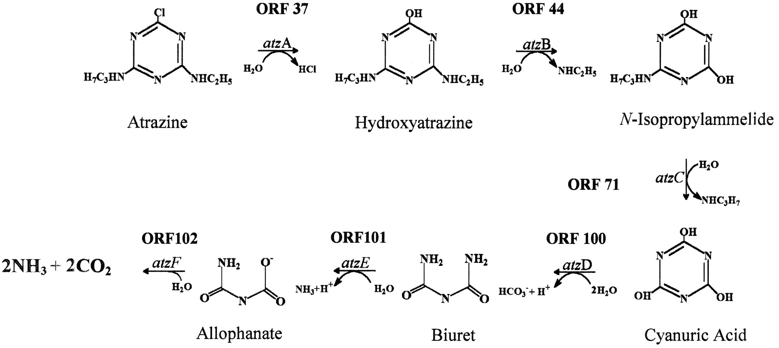
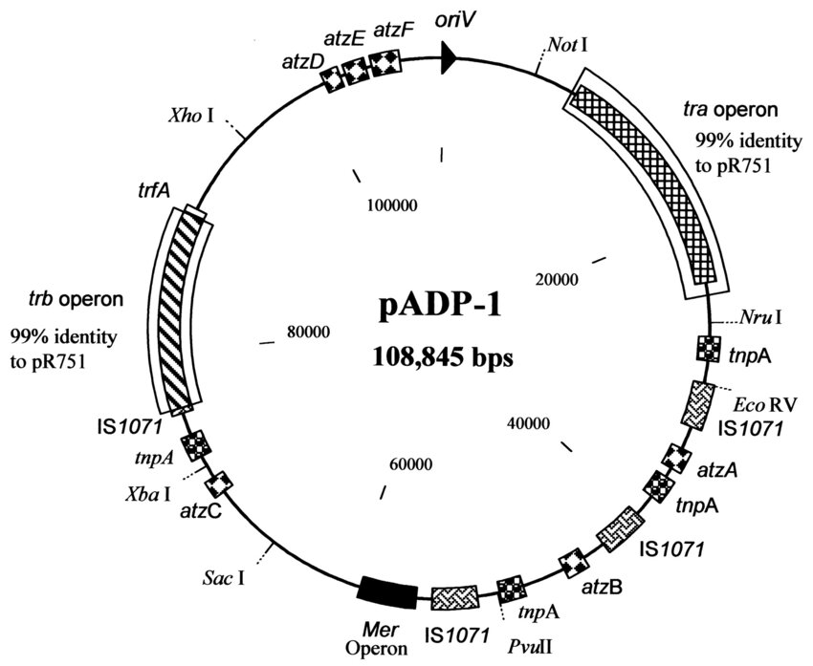
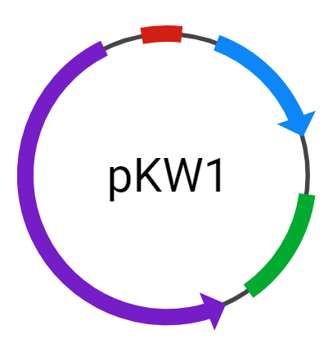
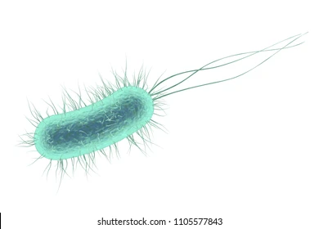
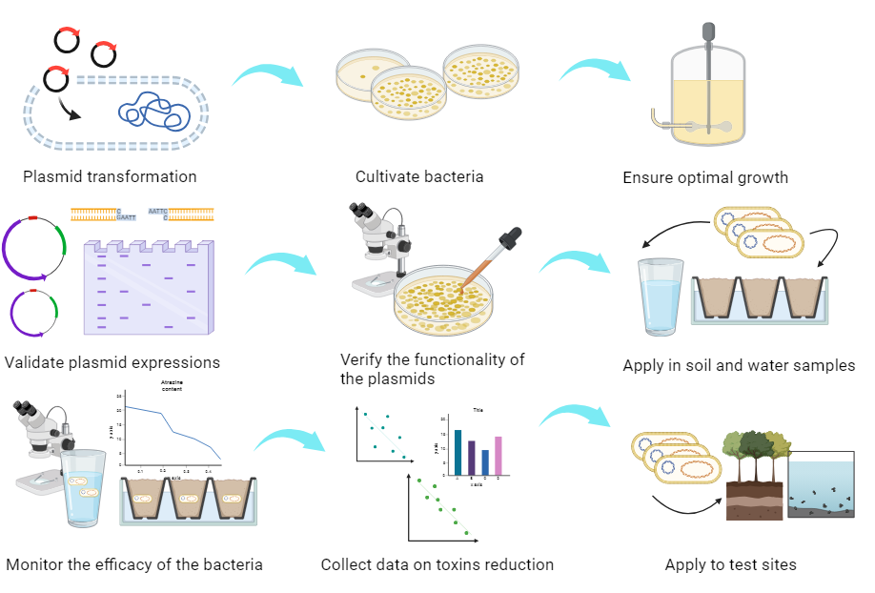
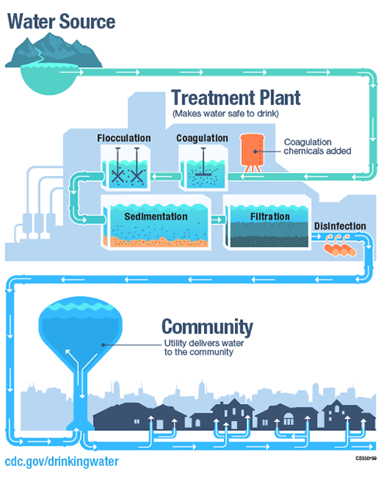
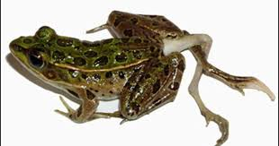
Runoff Remediation of Atrazine and Chlorobenzene via a Novel Pseudomonas putida Construct
Zhongchen Cai, Nana Kyei, Chongming Liu, Anya Mathur, Lingzhen Wang, Dr. Beth Pethel, Scott Gaines (Boston University)
Western Reserve Academy, Hudson, OH, USA
Abstract
Atrazine and chlorobenzene are chemicals commonly found in pesticides and herbicides that pose a threat to both humans and the environment as endocrine-disrupting pollutants. Our Biobuilder design targets the challenge of chemical contamination in water and soil by implementing an innovative and sustainable bacteria-based remediator of these two chemicals. Utilizing Pseudomonas aeruginosa strain ADP's exceptional ability to consume atrazine as its nitrogen source, we intend to integrate atzA, atzB, and atzC and DEF genes into a Pseudomonas putida strain, a compatible early colonizer in water and soil sources. P. putida strain GJ31 has been identified to possess a chlorobenzene degradation pathway, with genes encoded on plasmid pKW1’s clusters and chromosome. By introducing atrazine catabolic plasmid pADP-1 into P. putida GJ31, we can apply a cost-effective and environmentally friendly approach to alleviate the hazards of two common toxins. Evaluating the effectiveness and safety of this design will demonstrate the design’s potential for atrazine and chlorobenzene degradation.
Science Content
Current solutions, such as a water treatment plant, have the capability of reducing atrazine below 3 ppb but it is a big investment, in both materials and capital. There is currently no one treatment option that can completely remove all water contaminants. Our design presents a more affordable and long-term solution by introducing our engineered P. putida to environments with the ability to detect and remediate both atrazine and chlorobenzene from water and soil. Our plan involves transforming the two plasmids pADP-1 and pKW1 into the Pseudomonas putida strain GJ31, constructing a super remediator bacteria strain that breaks down the two toxins.
Remediation Pathways
Remediation Pathway of Chlorobenzene
Building and Testing Procedures
Remediation Pathway of Atrazine
Team Content
We are a new team made up of 5 members from Western Reserve Academy. All of us have a love for biology and creative minds connecting us to synthetic biology, which is why we are excited to create novel designs. Eleven new students will join us this spring.
Next Steps
Validate the viability of the newly constructed plasmid.
Ensure the actual reliability of the remediator in various soil and liquid environments.
Commercialize the product and find a cost-effective way to manufacture the bacteria through ways such as bacterial vats.
Identify the locations that suffer from atrazine and chlorobenzene contamination and analyze the actual distribution of the remediator in reality.
Background
Atrazine is a lab-made herbicide used to kill weeds that is commonly used in the United States, as the second most popular herbicide, but is banned in Europe. Atrazine has been found to cause
castration and feminization within frogs,
increase risk of ovarian cancer
in humans, and influence other
environmental defects. The herbicide
was recognized as a reproductive toxin
by California in 2016.
Chlorobenzene is another commonly
used herbicide in the United States
that poses serious risks to human
and environmental health. Animals
and people exposed to chlorobenzene
experience damage to the liver and
kidney as well as effects to the nervous
system such as spasms and drowsiness.
References and Acknowledgements
.
We’d like to thank
Dr. Beth Pethel
for guiding our project and
team and our mentor
Mr. Scott Gaines
for his expertise and advice.
Notes:
Remember to send the email to the German professor and get the plasmid map for chlorobenzene to put in science construct

