Slide 1
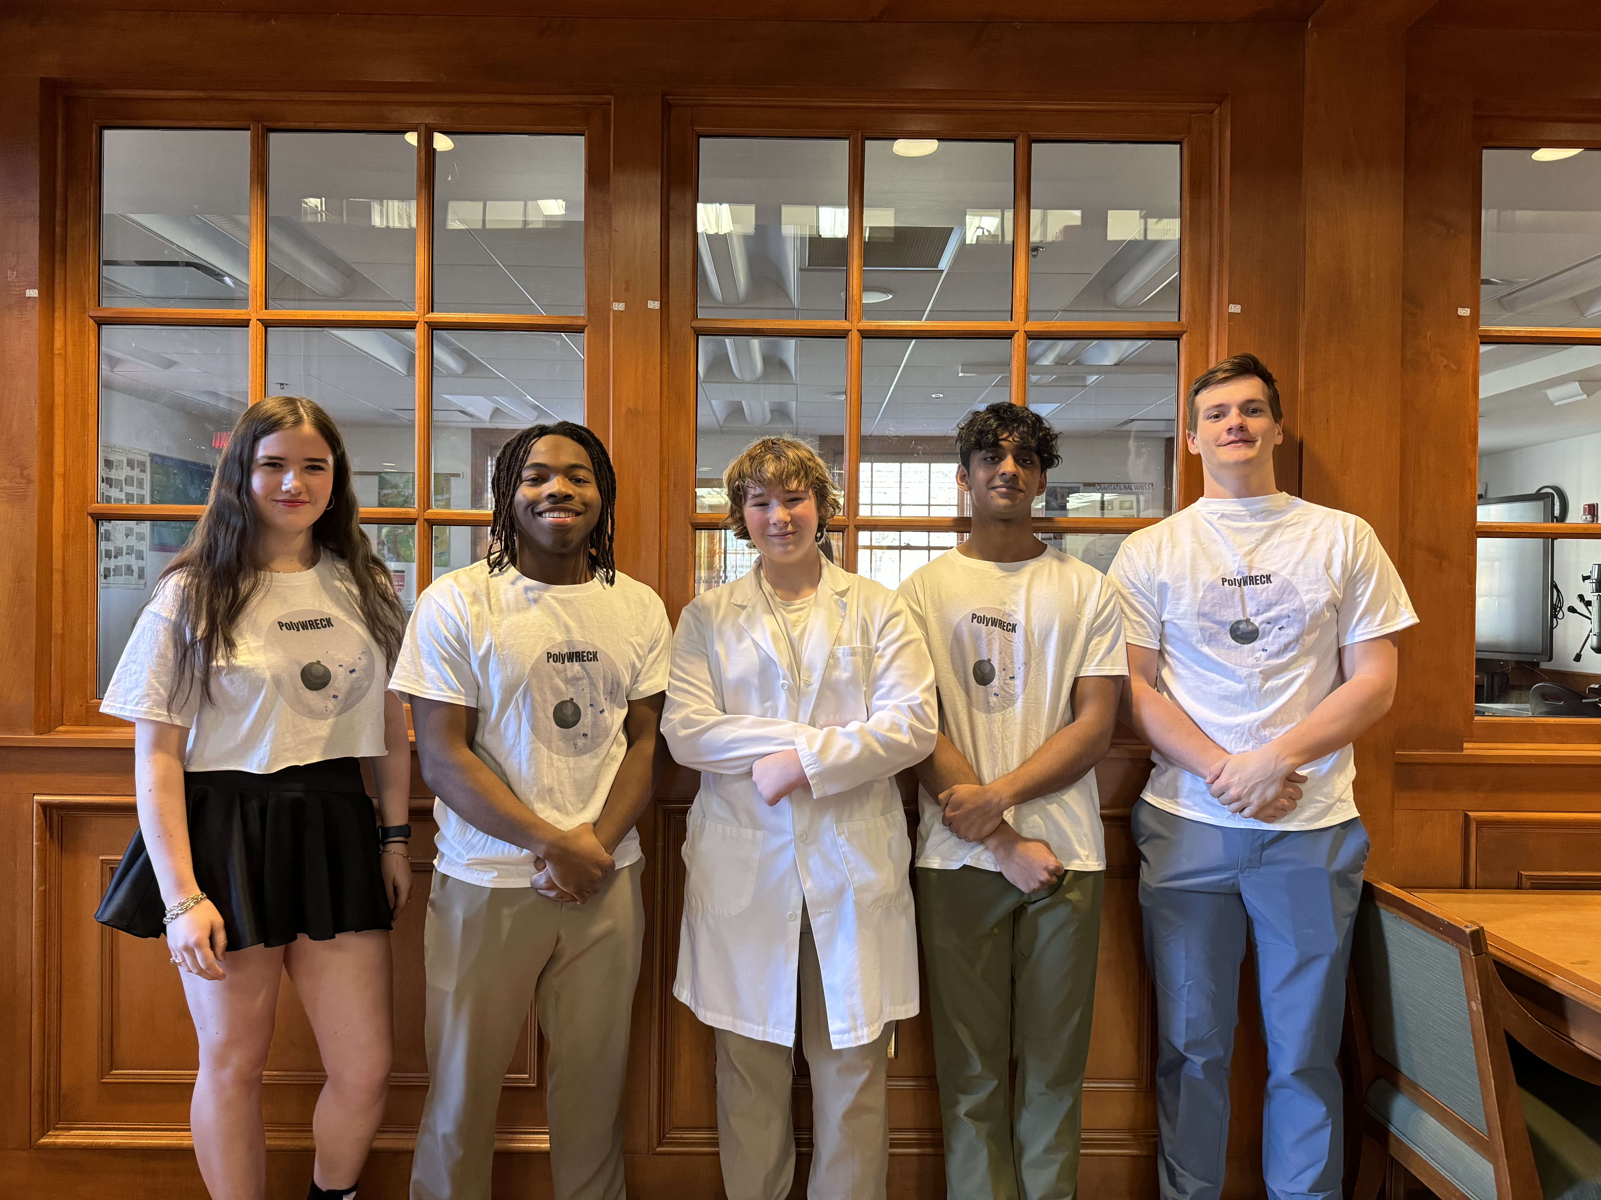
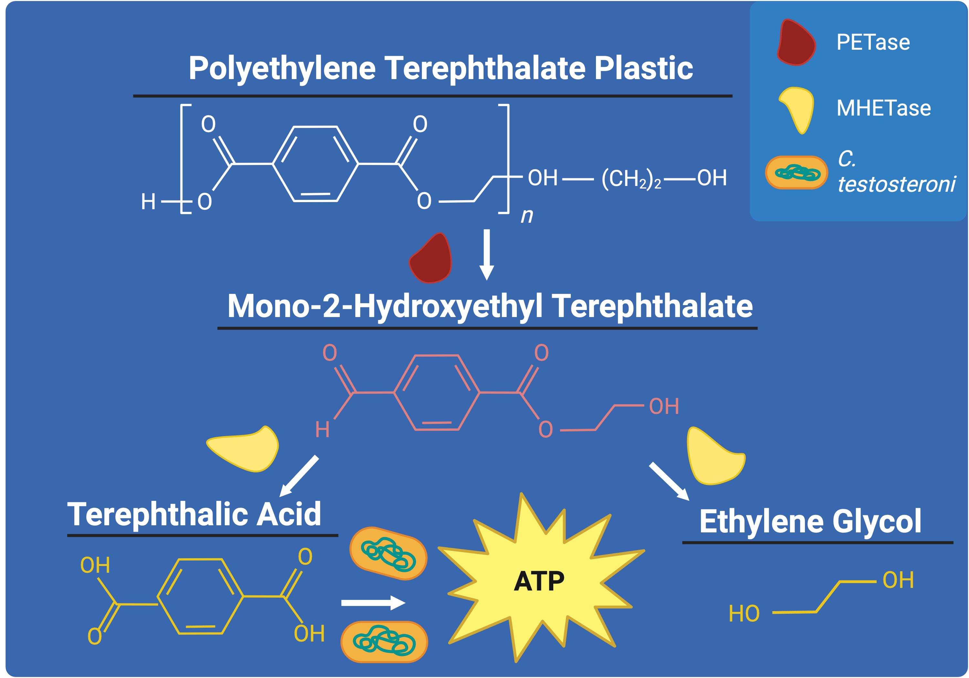
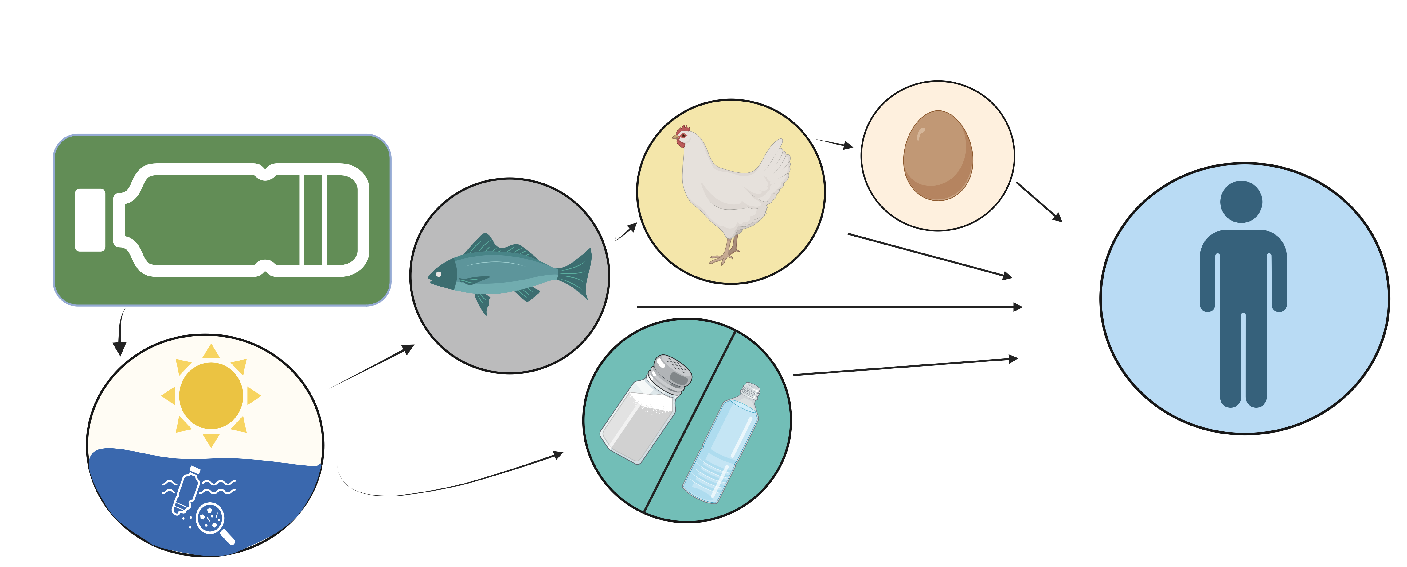
PolyWreck - Degrading Polymers by Inserting Enzymes
Amanda Blasberg, Jacob Wells, James Vacca, Brennan Christian,
Arsh Goyal,
Dr. Beth Pethel, Maegan Plank (UCB)
Western Reserve Academy, Hudson, OH, USA
Abstract
Plastic pollution plagues the world, lacking a sustainable and practical solution. Current solutions such as recycling and incineration can be effective. However, they often pose problems that either threaten the environment’s health or are generally inefficient. This project aims to develop an efficient way to degrade polyethylene terephthalate (PET), one of the most common single-use thermoplastic polymers. We propose using Comamonas testosteroni as a chassis for genes from Ideonella sakaiensis to produce a bacteria with enhanced ability to degrade plastics. The design aims to utilize C. testosteroni’s ability to target and break down benzene rings that hold PET together, which will be aided by enzymes PETase and MHETase, which I. sakaiensis produces. These enzymes, which help in plastic degradation, leave monomers that pose no environmental harm. Since C. testosteroni can be grown in standard laboratory conditions, we propose PETase and MHETase genes from I. sakaiensis be transformed into chassis C. testosteroni. The development of a new, more efficient, plastic degrading microbe can be helpful in creating a new waste management process for PET and can positively impact the environment and the world humans inhabit.
x
Our Team
Our team has five members, all of whom are new to BioBuilder and this project. We have three seniors, Amanda, Jacob, and Brennan. Junior and sophomore, Arsh and James, plan to continue working on Synthetic biology next year
From left to right, Amanda, Brennan, James, Arsh, Jacob.
Some Next Steps
Some significant next steps in our project are learning how to culture C. testosteroni and documenting its plastic degrading process.
Establish baseline degradation rates for C. testosteroni and I. sakaiensis.
We would like to clone MHETase and PETase into the appropriate plasmid and transform C. testosteroni with the plasmid.
We would then like to test the construct and compare it to the baseline plastic degradation of C. testosteroni and I. sakaiensis
Figure 2: PET plastic degraded by enzymes PETase and MHETase, and C. testosteroni.
The Science
I. sakaiensis is a type of bacteria that produces two enzymes, PETase and MHETase, to degrade plastic waste in a multistage process. First, PETase breaks down the structure of PET, which produces Mono-2-Hydroxyethyl Terephthalate (MHET) as a byproduct. In the next stage, MHETase further breaks down MHET and separates the segmented polymer into its monomers, Terephthalic Acid (TPA) and Ethylene Glycol (EG) (Figure 2). TPA contains a benzene ring, an aromatic and cyclic ring made of carbon and hydrogen atoms. These rings are what allows plastic to maintain its ridged transparent form. Not all bacteria can break down the benzene ring, but C. testosteroni can. It can later process the carbon found inside the rings for energy. C. testosteroni’s innate ability to degrade these aromatic compounds makes it an optimal chassis. By cloning genes from I. sakaiensis into a plasmid compatible with C. testosteroni we hope to accelerate the current rate of plastic decomposition available in treatment facilities by a large margin (Figure 3).
Figure 1: Flow chart of microplastic into humans through food products.
Introduction/Background
PolyWreck was created as a solution to the global plastic waste crisis that the world faces. Plastic waste is often disposed of via one of three methods: recycling, landfills, or incineration. However, each method has drawbacks that deem them unsustainable in the long term, and call for a new way to deal with plastic waste. These current solutions keep sizeable plastic waste minimal. However, they do not address waste at a microscopic level, and oftentimes contribute to microplastic contamination via the water cycle. Microplastics pose health and safety risks that our team plans to resolve with this alternate way of breaking down plastics. Microplastics have been found to have adverse effects on lung health, the digestive system, and hormones. PET plastic specifically is an issue due to its abundance and sturdy molecular structure. PET plastic's strong chemical bonds decrease the rate of decomposition, and their common usage in single-use products makes them a significant pollutant issue. PET makes up a sizeable 10.2% of all plastic produced, with a portion of 29.1% recycled. This is leaving millions of tons of plastic waste still wreaking havoc on the environment.
Sources here!
Figure 3: The cloning of I. sakaiensis genes into C. testosteroni.
References and Acknowledgements
We want to thank our teacher, Dr. Beth Pethel, for her guidance and help throughout this process and for lending her scientific knowledge to help us navigate this project. We would also like to thank our mentor, Maegan Plank, for her wise feedback and help throughout our writing process.
Notes:
Some next steps
Own box
This project not paper
period after UCB
P and T capitlized?
Take PAPER out
We propose using C.t as chassis
Change figure three to figure 1 and reference it in intro / background
Make figure 1 bigger
Not liking ending the intro, background with for
Leaving millions of tons of plastic still in the enviroment (going to watse, going into enviroment)
color PETase and MHETase more cause they get lost (bold red/yellow) (same color as LT)
loose arrows in dark blue
look up capitalization for the acids and that stuffsy
look the o on the ethelyne glycol
Labels in different color
MHET as a byproduct where is it (one in middle)(same label)
flip TPA and EG
Current and currently twice in The Science
Take the last sentence out and put into next steps (reference figure two in science)
BioBuilder is one word
Continuing to work on sythetic biology next year
Refecences down below and expand next steps and mopve up
Reference figure three in the science
Fix the colors for Figure three
Flip Flop referneces and next steps
Capitalize Acknowledgements and Next Steps
C. testestorni under figure three capitalized
bullet point some next steps
Next Steps: learning how to culutrue C.T
testing the PET degregation rate
Establish baseline degregation rates for C.T and I.S independently
Culutre C.T in general
Clone MHETase and PETase into approporiate plasmid and transform C.T with plasmid
TEst construct compared to the baselines for the other two

