Slide 1
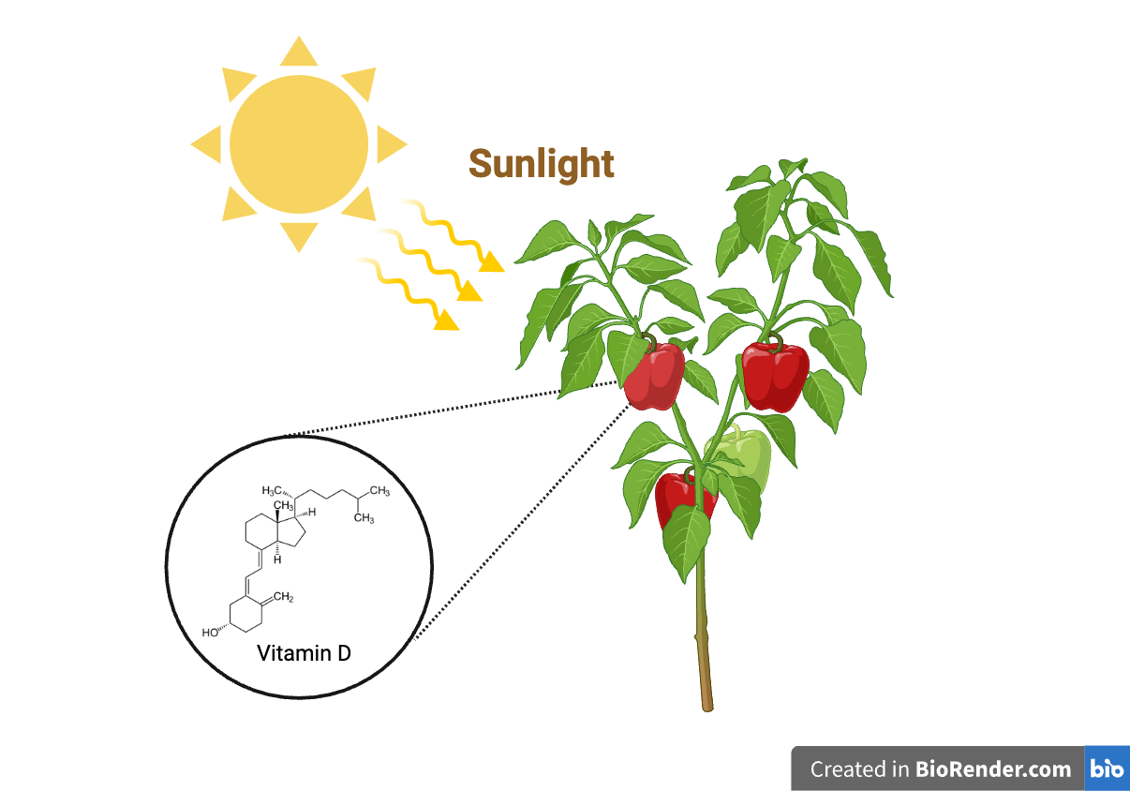
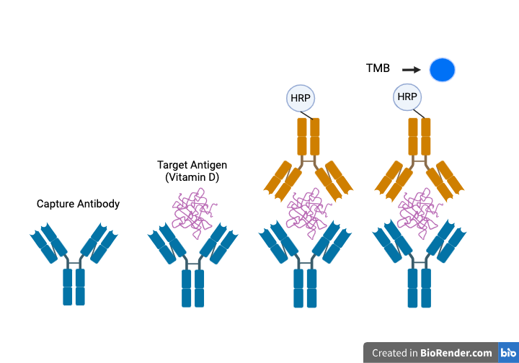
Nature's Dose of Sunshine: Engineering Vitamin D in Peppers
Junning Hu, Fernando Bermudez, Beth Pethel, Michael Stark
Western Reserve Academy, Hudson, OH, USA
Abstract
Background Information
Vitamin D deficiency affected more than 15% of the worldwide population from 2000 to 2022. Vitamin D deficiency is often linked to a wide range of chronic conditions such as osteoporosis, muscle weakness, and fatigue. Hardly any foods naturally produce adequate vitamin D concentrations and vitamin D supplements do not fully alleviate the symptoms of the deficiency. In recent years, scientists have used biofortification to enhance vitamin D levels in various vegetables such as tomatoes. Last year a team of WRA students proposed a CRISPR-based knockout method to produce vitamin D in Bell Peppers emulating a similar study done in tomatoes, which belong to the same Solanaceae family. Our team now has focused on the experimentation of the mentioned methods. We began by extracting the plasmid pHEE401E from the E. coli bacteria through the Qiagen plasmid minipreP. Our team also designed the gRNA targeting the 7-DR2 gene of bell peppers. Using Golden-gate cloning, the gRNA sequence is inserted into the pHEE401E plasmid. Three different bell pepper cultivars are used and grown in the lab to determine the vitamin D level before the CRISPR knockout experiment. Finally, a Vitamin D ELISA kit is used to quantify vitamin D levels in the fruit of bell peppers.
One billion people worldwide directly suffer from vitamin D deficiency, leading to conditions such as osteoporosis and muscle weakness.
Despite widespread use, vitamin D supplements have shown little effectiveness in preventing deficiency symptoms.
Scientists turned to biofortification, and have successfully increased vitamin D levels in tomatoes using CRISPR-Cas9 technology in order to modify the 7-DHC precursor.
The design utilizes the previously mentioned technique to insert the CRISPR-Cas9 and sgRNA expressing plasmid into bell peppers, which aims to accumulate 7-DHC by downregulating the 7-DR2 enzyme. This will potentially increase the vitamin D concentrations in the pepper.
Three different bell pepper cultivars have been chosen to assess the CRISPR knockout efficiency on vitamin D levels using an ELISA kit.
Bell peppers, being widely produced and consumed and part of the same family as tomatoes, offer a promising candidate for biofortification to combat vitamin D deficiency.
The steroidal glycoalkaloid synthesis pathway in bell peppers can be used to increase vitamin D levels through CRISPR-Cas9 technology by knocking out the 7-DR2 gene.
Figure 1. Sunlight turns Vitamin D precursor 7-DHC into Vitamin D
Figure 2. Sandwich Elisa Schematic

Slide 2
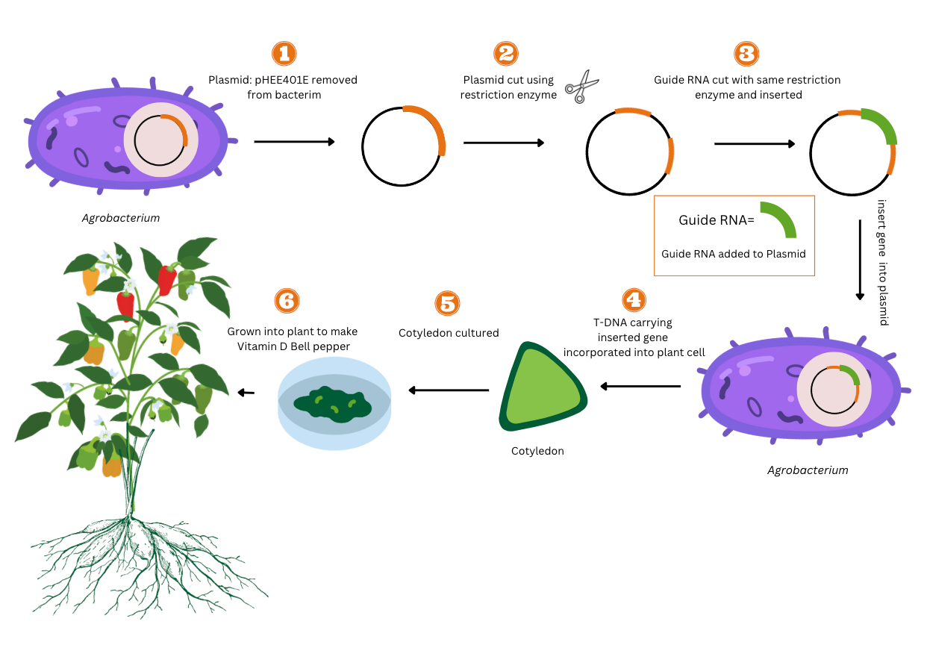
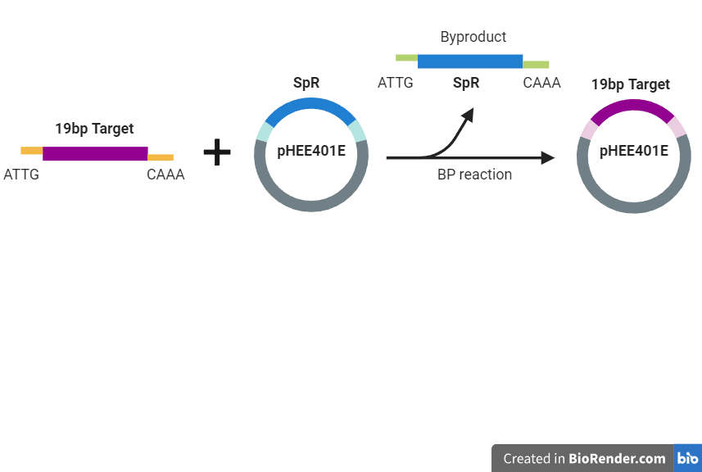
Nature's Dose of Sunshine: Engineering Vitamin D in Peppers
Junning Hu, Fernando Bermudez, Beth Pethel, Michael Stark
Western Reserve Academy, Hudson, OH, USA
Experiment Details
Future Development
Perform Ethanol Precipitation to concentrate plasmid for future DNA cloning experiments
Extract Control sample of Bell Pepper plant to measure regular 7-DHC cholesterol concentration in the Bell Pepper.
Acknowledgement
Figure 2. DNA cloning refers to the insertion of DNA sequence into the vector. In our study, we design the sgRNA that targets on the 7-DR2 gene of the bell pepper. Two 23bp-long complementary oligonucleotides are synthesized and combined with cutting side of BsaI enzyme on one end. Golden Gate Assembly is employed to insert the DNA sequence of sgRNA into the pHEE401E plasmid.
We’d like to thank our mentor Dr. Pethel, Mr. Stark, team members from last year: Jordanne Nichols, Marianna Jocas, Tanushree Patil, and Dylan Wu, Western Reserve Academy Department of Biology, and Biobuilder Foundation for making this project possible.
Reference
Figure 1. An overview of the Agrobacterium-mediated transformation we are planning to perform. First, we will insert the predesigned gRNA and gene of CRISPR-Cas 9 into the plasmid. Then we will insert the plasmid into the Agrobacterium. The transformed bacteria will incorporate the plasmid into the bell pepper gene. Once the plasmid is expressed by the bell pepper the 7-DR2 gene will be knocked out.
Team Content
Figure 3. Photo of Western Reserve Academy Pepper Alchemists
Fernando Bermudez (Left) and Junning(David) Hu (right)

