Slide 1
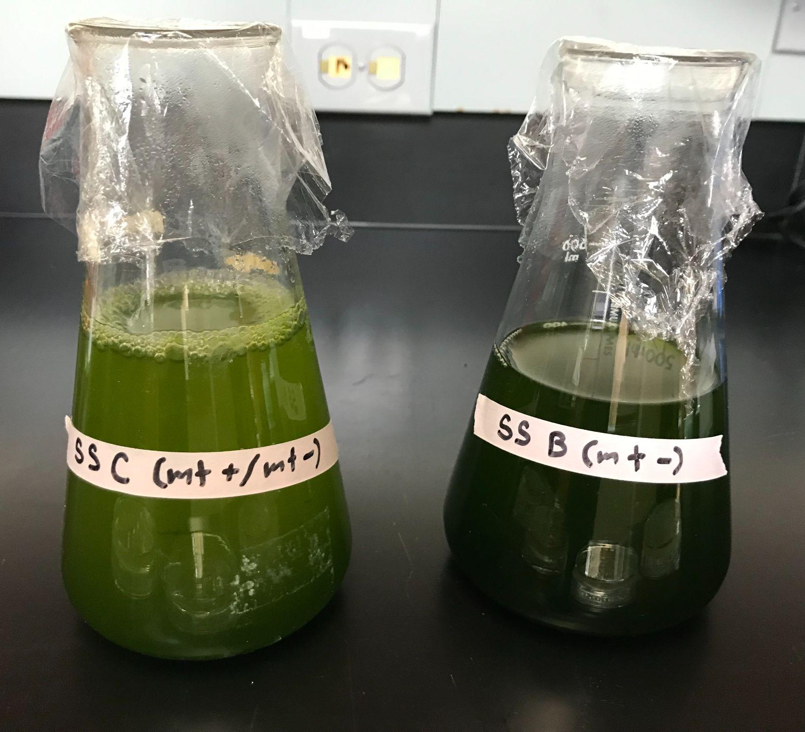
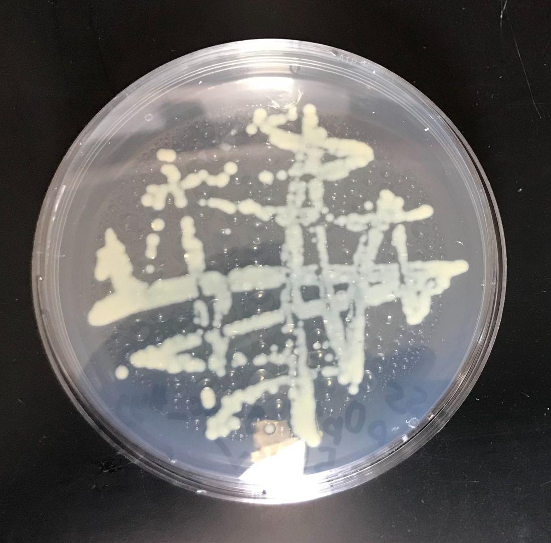
Engineering Goal
Transforming Luciferase Reporter into Chlamydomonas reinhardtii Using Glass Bead Method
Discussion
Consistent growth of C. reinhardtii on plates with hygromycin B may suggest successful transformation and expression of hygromycin B resistance from plasmid
Negative control luminosity readings are inconclusive
  Algal control data seems to support null hypothesis (that the plasmids were not successfully transformed into the algae)
  Lysis buffer control data is contradictory to algal control data
  WIld-type C. reinhardtii is not known to produce luciferase, a necessary component in the light producing luciferin-luciferase reaction induced by the assay
    It is therefore unclear the cause of the light measured by the microplate reader in the algal control wells
Potential sources of error:
  Though cultures were never in contact, and new micropipette tips were used for every transfer, contamination is still possible
  It was in some places not possible to follow the procedure exactly
    For example, transparent microplates were used while the procedure called for opaque
Extensions:
  Optimizing the glass bead transformation procedure
  Testing transformation efficiency in other algal species
To successfully transform a plasmid with a luciferase reporter and hygromycin B selection marker into wild type C. reinhardtii
Methods
Abstract
C. reinhardtii (mt + and -), pOpt2_gLuc_Hyg plasmids*, luciferase assay, and tris-acetate-phosphate medium (TAP) were acquired
C. reinhardtii were grown in TAP to prepare for transformation
E. coli transformed with plasmids were grown on ampicillin plates
E. coli colony was grown in liquid medium
Plasmids were harvested from E. coli
50 mL of C. reinhardtii were spun down and resuspended in 1.2mL TAP
300 µg 0.5 mm diameter glass beads, 300 µL cells, 100 µL 20% polyethylene glycol, and 2 µL plasmids were vortexed in a microcentrifuge tube for 20 s
Cells were immediately plated on hygromycin B/TAP agar with non-hygromycin B plates as control
A colony from each plate was resuspended, transferred onto a microplate and lysed
A luciferin was added to the lysate and luminosity measured
A promising source of renewable energy is biofuel produced by microalgae. However growing such algae commercially poses its own problems, including but not limited to: contamination, energy efficiency, strain improvement, and resource allocation. A potential solution to these issues is bioengineering microalgae to have higher lipid content, higher crop production, etc. One method of transforming the microalga species Chlamydomonas reinhardtii is the glass bead method. While not as efficient as electroporation or bombardment, this procedure is more accessible to smaller labs with less resources. This study aimed to successfully transform wild type C. reinhardtii with a luciferase marker using the glass bead method. Cells that underwent transformation protocol were successfully grown on hygromycin B plates, however luminosity readings were inconclusive. The algal control recorded similar levels of luminescence as the transformed cells (~1000 μlm), however the lysis buffer control did not (~30 μlm). It is therefore unclear whether or not the transformation was successful, although the results suggest a possible potential or transformation of wild-type C. reinhardtii by the glass bead method.
Conclusion
Figure 1: (above) Wild type C. reinhardtii growing in TAP, with mating type - on the right and mating types +/- crossed on the left..
The results suggest a possible potential for transformation of wild-type C. reinhardtii by the glass bead method.
Data
Figure 2: (right) A plate of the transformed algae growing on a hygromycin B plate.
Background/ Introduction
 | 1 | 2 | 3 | 4 | 5 | 6 | 7 | 8 | 9 | 10 | 11 | 12
A |  | 1542 |  |  | 1439 |  | 1119 |  | 1564 |  | 1197
B |  | 1587 |  |  | 1602 |  | 1058 |  | 1360 |  | 1217
C |  | 1601 |  |  | 1167 |  | 789 |  | 579 |  | 584
D |  | 996 |  |  | 1096 |  | 737 |  | 686 |  | 737
E
F
G |  | 19 | 39
H
Table 1: The top chart is a microplate reading showing the luminosity of cell staples treated with luciferin.
Biofuels are fuels involving a living system which are being developed as an alternative to fossil fuels
Algae is a candidate for biofuel due to its quick growth rate, high lipid content, and economy of space
Genetically engineering algae to be more desirable for commercial growth has been proposed, such as boosting lipid content, energy efficiency and utilization, and reproduction
The common of genetically transforming microalgae (electroporation and bombardment) are expensive and require special equipment
However, C. reinhardtii mutants (cell wall deficiency) have been successfully transformed using glass beads
While less efficient, the glass bead method is a cheap way to transform microalgae accessible to smaller labs
Table 2: The bottom chart is a data summary for the luminosity readings of each plate and the two controls.
 | Transformed algae |  |  |  |  |  |  |  | Control
 | Plate 1a | Plate 1b | Plate 2a | Plate 2b | Plate 3a | Plate 3b | Plate 4a | Plate 4b | Stock algae | Lysis buffer
Min (μlm) | 1416 | 908 | 1376 | 944 | 1029 | 609 | 1274 | 348 | 573 | 19
Max (μlm) | 1588 | 1601 | 1649 | 1167 | 1229 | 789 | 1564 | 686 | 1217 | 41
Avg (μlm) | 1533.25 | 1234.75 | 1516.5 | 1041.25 | 1108.75 | 688 | 1380.75 | 517.5 | 856.75 | 30
References
Hannon, M., Gimpel, J., Tran, M., Rasala, B., & Mayfield, S. (2010). Biofuels from algae: Challenges and
potential. Biofuels, 1(5), 763-784. https://doi.org/10.4155/bfs.10.44
Heitzer, M., & Zschoernig, B. (2007). Construction of modular tandem expression vectors for the green alga
<i>Chlamydomonas reinhardtii</i> using the cre/lox-system. BioTechniques, 43(3), 324-332.
https://doi.org/10.2144/000112556
Kindle, K. (n.d.). Transformation of Chlamydomonas with glass beads. Chlamydomonas Resource Center.
https://www.chlamycollection.org/methods/transformation-of-chlamydomonas-with-glass-beads/
Kindle, K. L. (n.d.). Nuclear transformation: Technology and applications. The Molecular Biology of
Chloroplasts and Mitochondria in Chlamydomonas, 41-61. https://doi.org/10.1007/0-306-48204-5_4
Kindle, K. L. (1990). High-frequency nuclear transformation of chlamydomonas reinhardtii. Proceedings of
the National Academy of Sciences, 87(3), 1228-1232. https://doi.org/10.1073/pnas.87.3.1228
Neupert, J., Shao, N., Lu, Y., & Bock, R. (2012). Genetic transformation of the model green alga
chlamydomonas reinhardtii. Methods in Molecular Biology, 35-47.
https://doi.org/10.1007/978-1-61779-558-9_4
Rattanachaikunsopon, P., & Phumkhachorn, P. (2009). Glass bead transformation method for gram-positive
bacteria. Brazilian Journal of Microbiology, 40(4), 923-926.
All photos taken by presenter
Plate 1 corresponds with microplate readings 2A:2D, plate 2 with 5A:5D, plate 3 with 7A:7D, and plate 4 with 9A:9B. The stock algae readings are 11A:11D and the lysis buffer 2G:3G. The a and b denominations within plates indicates whether the cultures were tested after resuspension in liquid medium or taken directly from plates.
*Developed by Kyle Lauersen, Olaf Kruse lab, Bielefeld University-Germany

