Slide 1
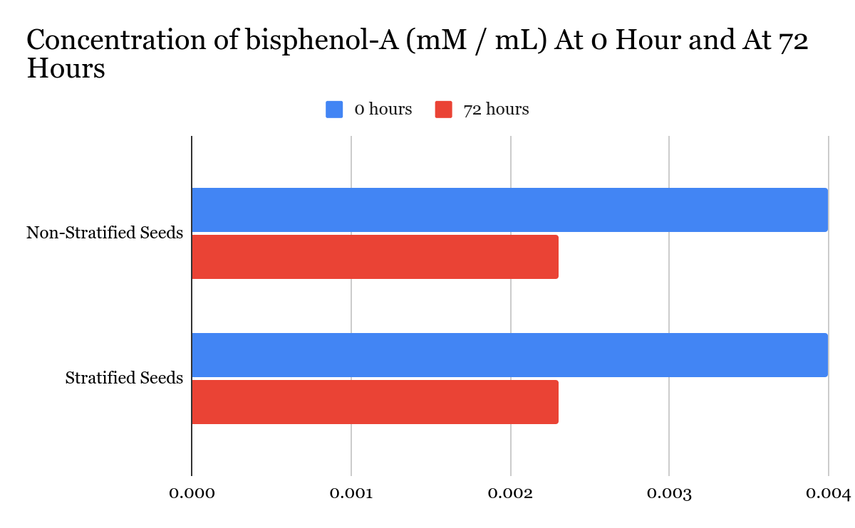
Degradation of Bisphenol-A Using Germinating Schizachyrium scoparium Seeds
Nancy Chieu, Aakanksha Deshmukh, Diana Dang, Tabitha Lee, Christine Yan Lin, Isabelle Ng, Huy Nguyen, Kimy Ong, Irena Shi, Chloe Wu, Julia Buben (Teacher), Dr. SitaRam Meena (UCB)
North Quincy High School, Quincy, MA, United States
Abstract
Bisphenol A (BPA) is a common material used in plastic manufacturing. Plastic products, such as water bottles made with BPA can leach BPA into drinking water and food products, which can cause physiological disruptions in the body once ingested. To counter this problem, our team modified a procedure performed by Putnam and her team (2017) to decrease BPA concentrations in sources of water using germinating Schizachyrium scoparium seeds. This research supports that germinating S.scoparium seeds decrease the concentration of BPA present in a solution. Further trials and an improved procedure would be necessary to validate these results.
Method
Pre-Stratification Seed Preparation
S. scoparium seeds were stratified by wrapping them in a damp paper towel and placing them in a plastic bag at 4 ℃ for 10 days. Additional S. scoparium seeds were left in dry room temperature storage conditions.
Solution Preparation
A 1% iron (III) chloride indicator solution was prepared by dissolving 0.54g of iron (III) chloride solution in 100 g of distilled water. 10 mM / mL analytical grade bisphenol A was added to 1% FeCl₃ solution at a 1:1 ratio to produce a standard BPA solution with a known concentration of 5 mM / mL. The solution was mixed by pipetting up and down then allowed to stand for two minutes before absorbance values were collected at 580 nm and 975 nm.
Experimentation:
Ten non-stratified S. scoparium seeds were added to one microcentrifuge tube along with 300 μL of 10 mM / mL bisphenol A and 100 μL of water. Ten stratified S. scoparium seeds were added to one microcentrifuge tube along with 300 μL of 10 mM / mL bisphenol A and 100 μL of water. Both tubes were incubated at 27 ℃ for 72 hours. After 72 hours, the tubes were centrifuged at 10,000 rpm for 20 seconds to separate the seeds from the supernatant. The supernatants were extracted from the seed-bisphenol A mixture and combined with FeCl₃ at a 1:1 ratio. The solutions were then mixed by pipetting up and down then allowed to stand for two minutes before absorbance values were collected at 580 nm and 975 nm.
Team Content
Our BioBuilders team is an enthusiastic group of 10 juniors and seniors who are interested in making contributions to science that will improve human health. Through many setbacks, our project team was able to persevere through many different creative challenges and ideas.We learned to not rush our learning process, and the most important thing was to avoid rushing to the solution for our problem and questions. In addition, we learned to cope with creative blocks and learned to work better as a team. If another school were to continue our experiment next year, we would like them to be able to do more trials of our experiment, and to stratify the seeds for two months instead of ten days to get a true understanding of whether stratification would have increased the amount of BPA broken down by increasing the germination rate.
Introduction/Background
Bisphenol A (BPA) is used in the manufacturing of polycarbonates and epoxy resins that are used to create products essential to modern life (Putman et al., 2017). However, BPA is a Endocrine Disrupting Chemical (EDC) due to its role as a xenoestrogen, whose structure resembles that of estrogen. It can stop natural hormones from binding to their receptors and act as a hormone, thus increasing the impact of endogenous hormones. Evidence has shown that BPA has negative effects on organisms. BPA seeps into food or beverages from containers that are made with BPA. The contamination of food causes possible health effects on the brain and prostate gland of humans, even affecting behavior (Hafezi & Abdel-Rahman, 2019). Commonly known as little bluestem, Schizachyrium scoparium is a species of prairie grass that grows throughout North America. According to an experiment conducted by Putman and her team (2017), little bluestem seeds can remove BPA from water during its germination process. Seed stratification for 10 days - 1 month has been found to speed up germination (Swainston, 2023).
Iron (III) chloride reacts with Bisphenol A (BPA) to produce a byproduct with a carboxyl group, which can be detected at a wavelength of 975 nm. See Figure 1 for a visual representation of this reaction. According to Beer’s law, since the absorbance level has a direct relationship with concentration, a solution with an absorbance at 975 nm indicates a greater concentration of byproduct, indicating a lower concentration of bisphenol A. A solution with an absorbance at 580 nm indicates a lesser concentration of byproduct, indicating a greater concentration of bisphenol A.
Analysis
Figure 2: Change in concentration of bisphenol A byproduct and BPA after before and after exposure to germinating S. stratified and non-stratified scoparium seeds for 72 hours.
Results:
The data presented in Table 1 and Figure 2 supports prior research on this topic, suggesting that germinated seeds can break down BPA; however, it is inconclusive in regards to the extent to which stratification would optimize BPA degradation.
Data
Table 1: Absorbance at 580 nm and 975 nm of solutions containing bisphenol A before and after exposure to germinating S. stratified and non-stratified scoparium seeds for 72 hours.
Figure 1: Visual Representation of the bisphenol A - iron (III) chloride reaction
 | Absorbance (A) at 580 nm |  | Absorbance at 975 nm
 | 0 hours | 72 hours | 0 hours | 72 hours
Non-Stratified Seeds | 0.040 | 0.066 | 0.109 | 0.063
Stratified Seeds | 0.040 | 0.060 | 0.109 | 0.063
References and acknowledgements (scan QR code)

