Slide 1

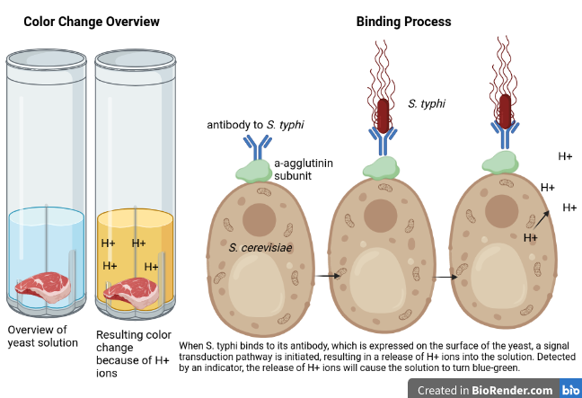
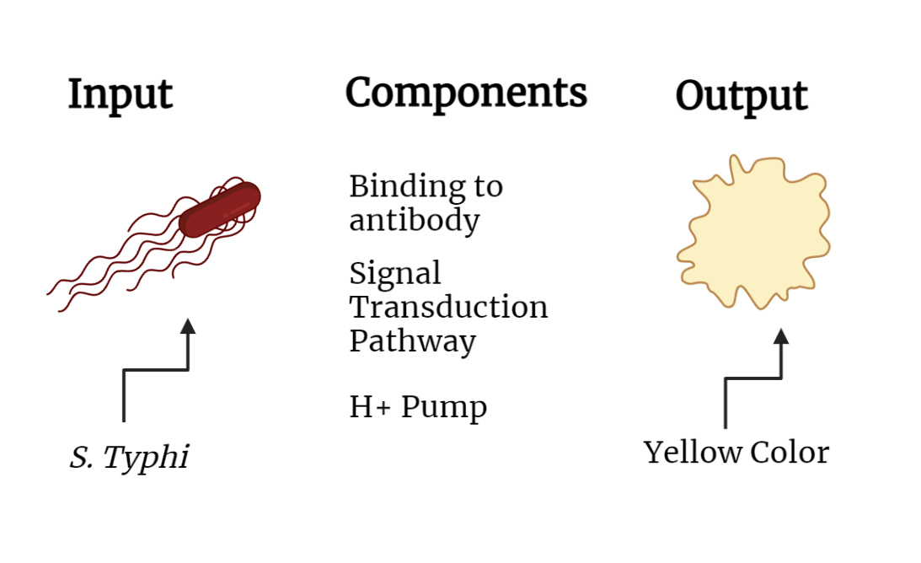






DETECTING S. TYPHI WITH YEAST SOLUTION
Hana Shinzawa, Leslie Baker, Cate Lynch, & Rosie Reale with Mrs. Dimitriou, Sarah Hanna, and Natalie Kuldell (BioBuilders)
Montrose School, Medfield, MA, USA
Abstract:
Salmonella typhimurium (S. typhi) is a bacterial species that is prevalent and causes disease in Sub-Saharan Africa, South Asia, East Asia, and Pacific regions. Better detection of the microbe would improve food safety and security in these regions. Because S. typhi is mainly present in the food and water of third-world countries, an effective detector must be portable and self-regenerating. To achieve these characteristics, we designed a detection system using synthetic biology.
Our system expresses the a-agglutinin complex subunits (Aga1p and Aga2p) on the surface of Saccharomyces cerevisiae (S. cerevisiae), a yeast that is both engineerable in the lab and safe to provide to households in affected areas. The antibodies presented on these engineered yeast will bind to S. typhi, stimulating a proton pump in the yeast and adding H+ ions to the yeast growth solution by means of a signal transduction pathway not yet defined.
A pH indicator, such as Bromophenol blue, in the solution will be used to detect the increase in H+ ions, and if the pH of the solution drops significantly below 5.75, the typical pH of S. cerevisiae, to about 4.5, the solution will turn yellow, indicating the presence of S. typhi. Our solution, if successful, will create a low-cost, self-regenerating system for the detection of S. typhi. Its low cost and its capacity to reproduce will ensure greater access to our system, making food and water in third-world countries safer to consume and reducing disease.
Science Content:
Team Content:
We are a returning group of four juniors. We realized we loved biology after taking AP Biology together in our sophomore year, and BioBuilders was a way for us to continue studying biology.
Next steps:
Our system depends on the ability of S. cerevisiae to express an antibody to S. typhi and then present that antibody on the surface of the yeast. While the techniques for yeast surface display have been known for decades, we are still investigating the precise antibody sequences needed for the a-agglutinin complex to recognize S. typhi. We plan to investigate the Golden Gate Cloning approach to construct our yeast surface display. Because of its modular approach, DNA fragments can be easily removed, allowing us to more easily experiment with creating our system. Using this approach, we hope to successfully engineer our yeast to express the antibody to S. typhi.
We will also continue to investigate the signal transduction elements within the yeast. These elements are needed to connect the binding of S. typhi to the yeast's surface and subsequent changes in proton pump activity that will acidify the yeast solution.
Introduction/Background:
S. typhi can contaminate food and water, causing typhoid fever, which can be deadly if left untreated. Instances of S. typhi contamination are much more common in areas in Africa and South Asia. Although S. typhi contamination can be prevented by treating water and safely disposing of human waste, populations in third-world countries are more vulnerable to infection because of limited resources.
We created our yeast solution to help those vulnerable populations, so we had to ensure that our solution would be low-cost, easily accessible, and simple to use. We chose to create a yeast solution because yeast is self-generating and can safely be grown in a household environment. Because it is self-generating, it would be a one-time purchase for a family looking to test their food and water for S. typhi contamination. A small sample of the solution could be removed, and the food or water to be tested would be placed in the solution for testing. A positive result would be the color change to yellow, which is observable with the human eye. The rest of the solution would be saved for future use.
References and acknowledgements
We referred to these sources in our work:
Valldorf, B., Hinz, S. C., Russo, G., Pekar, L., Mohr, L., Klemm, J., Doerner,
A., Krah, S., Hust, M., & Zielonka, S. (2021). Antibody display
technologies: Selecting the cream of the crop. Biological Chemistry,
403(5-6), 455-477. https://doi.org/10.1515/hsz-2020-0377
Als, D., Radhakrishnan, A., Arora, P., Gaffey, M. F., Campisi, S., Velummailum, R., Zareef, F., & Bhutta, Z. A. (2018). Global Trends in Typhoidal Salmonellosis: A Systematic Review. The American journal of tropical medicine and hygiene, 99(3_Suppl), 10–19. https://doi.org/10.4269/ajtmh.18-0034
Rosowski, S., Becker, S., Toleikis, L., Valldorf, B., Grzeschik, J., Demir, D.,
Willenbücher, I., Gaa, R., Kolmar, H., Zielonka, S., & Krah, S. (2018). A
novel one-step approach for the construction of yeast surface display fab
antibody libraries. Microbial Cell Factories, 17(1). https://doi.org/
10.1186/s12934-017-0853-z
We’d like to thank our mentor, Natalie Kuldell, and our advisors Mrs. Dimitriou and Ms. Hanna. Thank you to the organizers of the Idea Accelerator, which we participated in.

