Slide 1
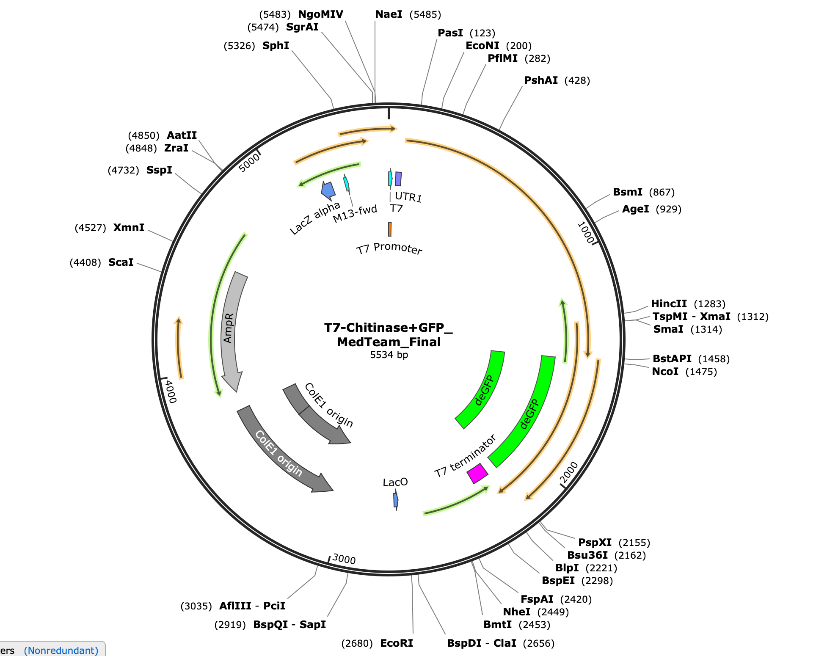
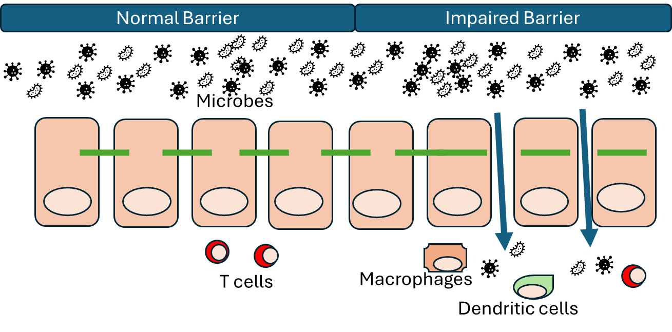
Utilization of Chitinase for Digestion of Indigestible fibers like Chitin to Alleviate Symptoms and Inflammation in Irritable Bowel Disease
Dee Epshtein, Charlie Scott, River Scott, Juliette Bezaire, Rafi Butt, Jordan Alioto, Jeremy Miere, Gabe Shaye Almanzar, Evan O'Brien, and Kavi Whyte.
Mr. Eric Jorgenson (East Tennessee State University), Mr. Matthew Kirkpatrick (OPRFHS), and Dr. Jennifer Watson (Chief Executive Officer of Limuless)
Oak Park and River Forest High School, Oak Park, Illinois, United States
Abstract
Irritable Bowel Diseases (IBD), such as Irritable Bowel Syndrome (IBS), are chronic health conditions that cause disruptive and challenging symptoms. Chitin, a type of indigestible fiber, often exacerbates IBD symptoms. Studies suggest that the ability to digest chitin could lessen IBD symptoms. This experiment will utilize chitinase to break down chitin, thus alleviating symptoms of IBD. This project aims to generate a probiotic bacteria that is able to digest chitin.
Engineering Design
Limitations/Further Research/Positive Impact:
Currently, this work is only an engineering design for chitinase to be translated in a cell-free system. We have not yet tested whether this device can be transformed into a probiotic bacterial strain and successfully delivered to the intestinal lumen to alleviate the symptoms of IBD. Given additional time and resources, our research would continue by conducting further tests with this plasmid. Initially, this plasmid would be tested in E. coli, as it is easy to modify and test with. This would be followed by tests in lactobacillus, a bacteria already found in gut probiotics. Finally, there needs to be a way to encapsulate it in order to ensure its survival through the digestive system until it reaches the gut. This project lays the groundwork for further research in evaluating the use of chitinase to digest indigestible fibers, which will hopefully lead to better treatments for IBD.
Team Content:
Our team has 10 members, 3 of which have done BioBuilder projects before. Our team is located in suburban Chicago, Illinois.
Overview:
In order to create a chitinase-producing system, we needed to insert a chitinase gene into a cloning vector—we chose the T7-P14 vector, as we could use the expression of its preexisting GFP protein as evidence of chitinase expression (Figure 5). We inserted the start codon of chitinase downstream of the T7 promoter—which ensures that chitinase is expressed alongside GFP, as the GFP gene precedes the T7 terminator.
Testing this system will involve inserting the cloning vector into a dish with the cell-free system and a chitin sample, which is insoluble in water. The efficacy of our chitinase-producing cloning vector can be shown quantitatively through measuring the amount of light emitted from the GFP, as well as qualitatively by adding the produced enzyme to a mixture of chitin and water, and observing changes in solubility.
Figure 2. Vector T7-P14 With Human Chitinase Genome (Cell-Free- System)
Background Information
Irritable Bowel Disease (IBD) is a common gastrointestinal disease which affects millions of people worldwide, often causing gastric discomfort and inflammation. Chitin is a type of indigestible fiber which can exacerbate IBD symptoms (Figure 1). Additionally, chitin has been shown to benefit harmful bacteria, resulting in an increased concentration of harmful microbes. Over time, the enlarged population of these bacteria directly worsen IBD symptoms, as well as causing systemic autoimmunity. Recent studies suggest that chitinase, the enzyme that breaks down chitin, may have evolved for various protective functions associated with inflammatory pathologies, such as IBD. Chitinases directly diminish the unwanted presence of chitin, thus resulting in a decreased occupancy of harmful microbes in the gut microbiome. More beneficial microbes will surface in the absence of chitin and their adversive counterparts, relieving the symptoms of IBD and its other associated effects on the human body as a whole.
Figure 1. Molecular Mechanisms of IBD
1,2,3,4
1,2,3
2
1,3
Acknowledgements
We like to thank…
BioBuilders, for donating their time to contribute to youth STEM.
Arbor Scientific, for providing the cell-free expression kits for our tests.
K2 Scientific, for donating a sub-zero freezer for our tests
Our mentors:
Mr. Eric Jorgenson, Vice President of Biomanufacturing Development, East Tennessee State University
Dr. Jennifer Watson, PhD, Chief Executive Officer of Limuless, Nashville, Tennessee, United States
Mr. Matthew Kirkpatrick, Teacher (OPRFHS)
For their tremendous support in research for youth in STEM & BioBuilders
1,2,3
Figure 3. Possible Procedure Flowchart
Input: Chitin
Chitinase + GFP Generator: Will confirm that chitinase is being expressed
Output: N-acetylglucosamine (metabolised as a carbohydrate)
1,3
References
Ziatabar, S., Zepf, J., Rich, S., Danielson, B. T., Bollyky, P. I., & Stern, R. (2018). Chitin, chitinases, and chitin lectins: Emerging roles in human pathophysiology. Pathophysiology, 25(4), 253–262. https://doi.org/10.1016/j.pathophys.2018.02.005
Horvath-Szanics, E., Perjéssy, J., Klupács, A., Takács, K., Nagy, A., Koppány-Szabó, E., Hegyi, F., Németh-Szerdahelyi, E., Du, M. Y., Wang, Z. R., Kan, J. Q., & Zalán, Zs. (2020). STUDY OF CHITINASE AND CHITINOLYTIC ACTIVITY OF LACTOBACILLUS STRAINS. Acta Alimentaria, 49(2), 214–224. https://doi.org/10.1556/066.2020.49.2.11
Mazur, M., Zielińska, A., Grzybowski, M. M., Olczak, J., & Fichna, J. (2021). Chitinases and Chitinase-Like Proteins as Therapeutic Targets in Inflammatory Diseases, with a Special Focus on Inflammatory Bowel Diseases. International Journal of Molecular Sciences, 22(13), 6966. https://doi.org/10.3390/ijms22136966
Patel, N., & Shackelford, K. B. (2022, October 30). Irritable Bowel Syndrome - StatPearls - NCBI Bookshelf. StatPearls Publishing. www.ncbi.nlm.nih.gov/books/NBK534810/
Normal Barrier Impaired Barrier
T-7 Promoter UTR1 RBS Chitinase ORF GFP ORF T-7 Terminator
Notes:
Precipitation -
Cut figure 1 Molecular Mechanisms, unless we are invested in it. If we were to keep it, we could cut some of the Backround Info. Find a better image
Add the main decision we made
EXPAND ON THE DECISION WE MADE
Summarize background info into less than a paragraph
Design the poster on the things we are most knowledgeable about
Fluorescent - Yes or No
Bioluminescing precipitation test.

