Slide 1
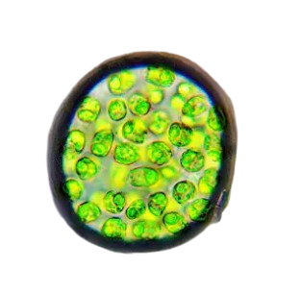
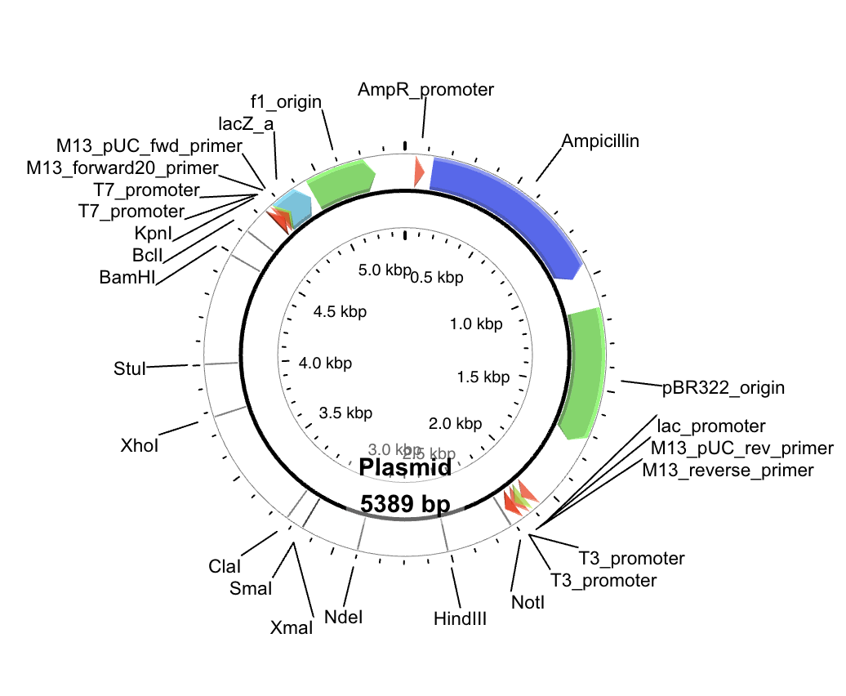
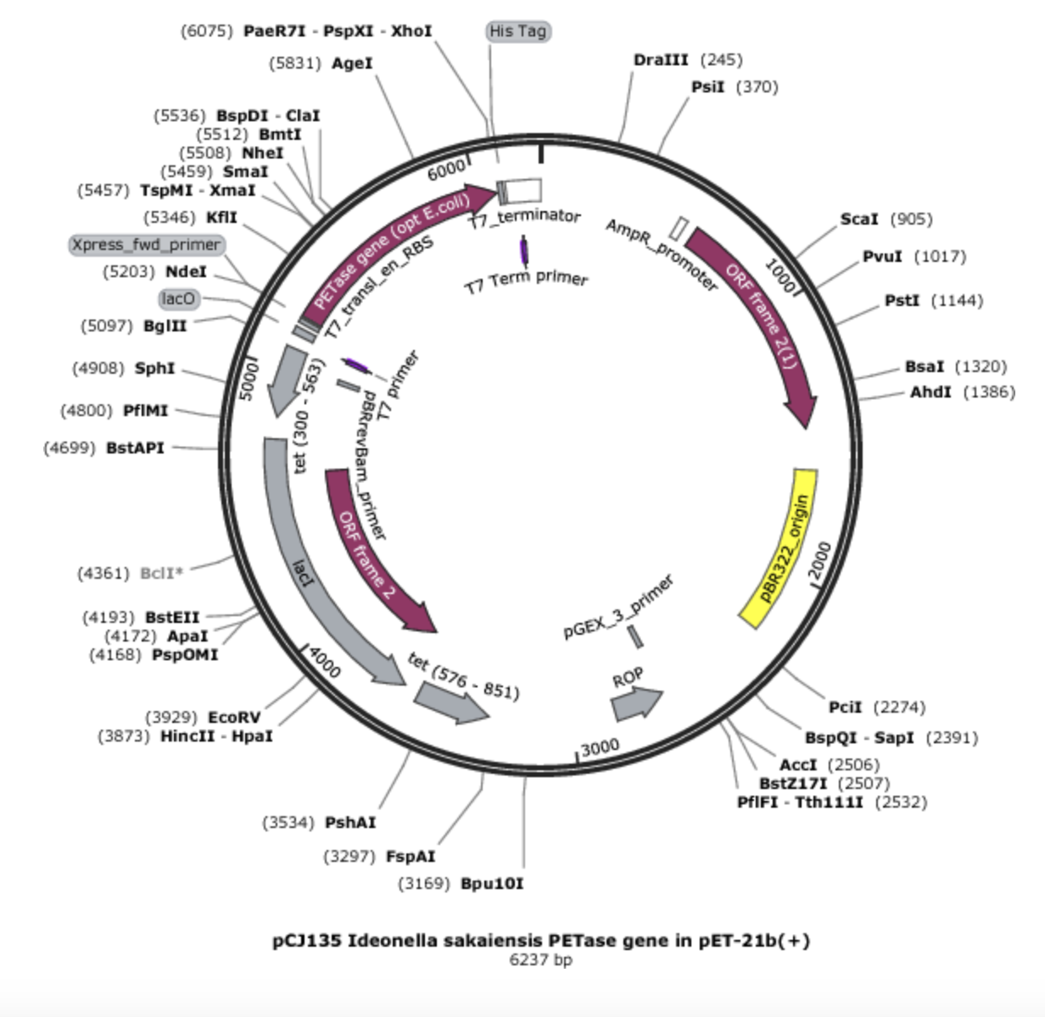
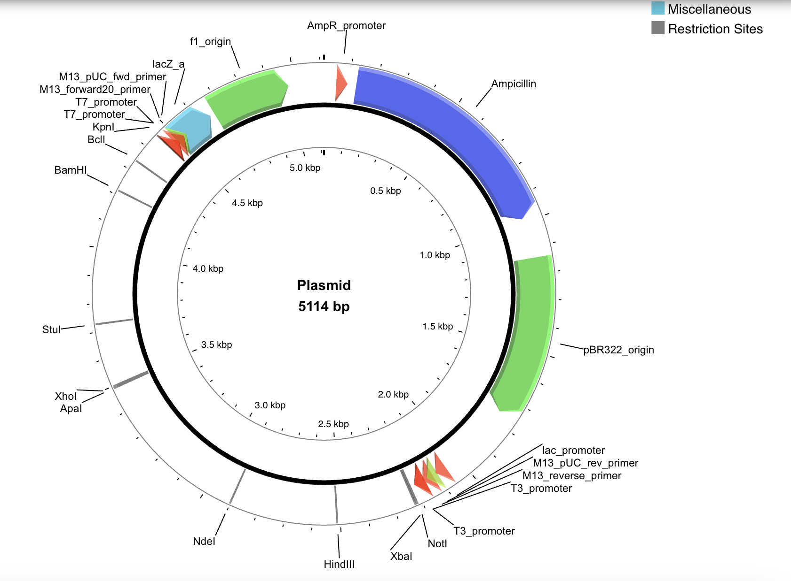
Plastic-Eating Algae, brought to you by the GENEIES!
Josh Beresford, Oliver Beresford, Elizabeth Hossack, Samantha Botti, Nina Minsky, Nyla Tait, Roma Hatton-Rueda, Arezu Kabuli, Jasmine Rancourt, Shreya Desai
Teacher: Karin Schinkmann, Mentor: Mark Cherepashensky (Boston University)
School: International School of Boston, Cambridge, MA, USA
Abstract
Plastic pollution is a pressing environmental issue especially affecting the health of marine animals. There are ongoing efforts to mitigate the impact of this marine debris by developing novel organisms that have enhanced abilities to degrade plastics. In particular a study by Cell Factory Research has described experiments to insert a PETase gene into the pBR9_mCherry_Cre plasmid and introduce it into a cell wall deficient strain of Chlamydomonas reinhardtii.
Our research goals are to integrate a PETase gene containing plasmid into a strain of Chlamydomonas reinhardtii that has a naturally occurring cell wall. In order to do this we will adapt our methods to integrate the plasmid into the target organism using a glass bead method. This experiment will allows us to explore the potential of plastic eating algae’s ability to reduce polyethylene waste in the ocean.
Science Content
Experiment details:
Finding a fitting alga: correct pH (3.4 - 8.4), thrives in cold (4 degrees C), salt water, is unicellular, does photosynthesis, is BSL1, and been used for transformation before (= mapped out).
The point of interest being chlamydomonas reinhardtii, this algae is unicellular, easy to transform, and viable at the correct temperature and pH. As chlamydomonas reinhardtii is not cell wall deficient this will affect the transformation process
Finding the right plasmid:
To be the correct size for its host
PCR
DNA assembly
Transformation
Finding procedures and means to test them
Team Content
We’re a new team of ten high-school students (grades ten through twelve) led by Joshua Beresford.
Next Steps
Key needs for advancing the project:
Follow the following procedures: E coli Genomic DNA Isolation, Polymerase Chain Reaction, DNA Assembly and Transformation, Sequence Verification, and Protein Expression and SDS PAGE
Access to lab-grade equipment over multiple days in order to complete our procedure
Lessons learned from this experience:
It took us some time to come up with our design, so throughout the project we did not only learn about the biology behind but steps to get to the biology. Our team consist of students who are eager to learn and support the process of thought.
Researching what a plasmid is, how to create placid maps and how to look for a plasmid that expresses our interests.
We also learned procedures of transformation and methods to do research.
Introduction/Background
Goal: Placing the PETase gene in the MCherry plasmid, and inserting the latter in the Chlamydomonas Reinhardtii algae so that it digests plastic and breaks it down.
About our topic:
There is currently a crisis of PET plastic being carelessly dumped in our oceans, posing a threat to wildlife and humans alike.
We picked our topic through a general consensus of the group regarding our will to address this critical environmental issue.
About our design:
Our project will be based off of a study that used an enzyme called PET-ase to break down plastic. They genetically engineered a plasmid and injected it into an algae. We plan to create a similar plasmid to create an even more efficient PET digestion protein.
Our new plasmid would be a combination of the PET-ase plasmid and the mCherry plasmid which would allow us to see the amount of algae which are successfully transformed.
References and acknowledgements
https://microbialcellfactories.biomedcentral.com/articles/10.1186/s12934-020-01355-8
https://earth.org/plastic-eating-enzyme/
We’d like to thank Mark Cherepashensky, Karin Schinkmann, and the Biobuilder team for helping us throughout the program.

