Slide 1

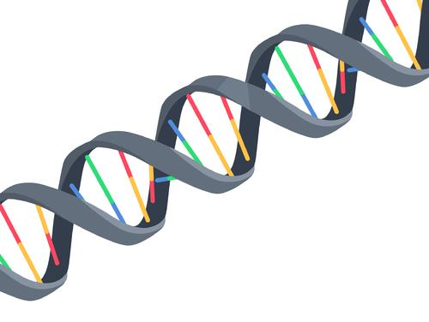
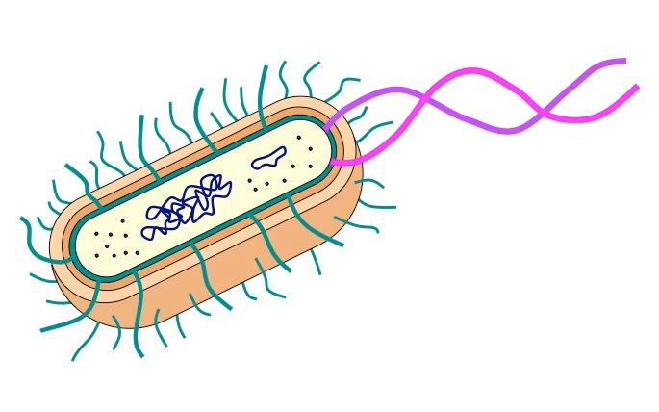






An Organic Approach to Crude Oil Degradation
Gabe Wolter, Trevor Wilson, Eli Landsman, Charles Yang, Alex Hymson, Ian Kelley
Mr. Kirkpatrick, Mr. Ben French (Mentor)
Oak Park and River Forest High School, Oak Park, IL, USA
Abstract & Introduction/Background
Abstract
Our study aims to find an effective, eco-friendly, and business-lucrative way to tackle crude oil spills in the ocean using proteins Alkane Monooxygenase (AlkB) and Alcohol Dehydrogenase (ADH) synthesized from E.coli.
Background research based on improving a study that created a plasmid containing only one oil degrading protein.
Team Content
6-person team that is new to BioBuilders and bio-engineering.
  Learning the ins and outs of plasmid design for our project has been an enlightening process that has made us feel like true scientists; that was satisfying for all of us.
Our members have experience in AP sciences and several of us seek to pursue a major in a biology-related field
Introduction/Background
Our group wanted to focus on finding an environmental improvement for aquatic life.
  Identified the human induced issue: oil spills
Created a design modeled off of a lab¹ we found from the Brazilian Journal of Microbiology titled “GPo1 alkB Gene Expression for Improvement of the Degradation of Diesel Oil by a Bacterial Consortium”
Used the findings of this lab along with outside research to conclude that alkB was an appropriate oil degrading enzyme
Took a two pronged approach in order to use alkB in conjunction with another enzyme
  alkB: breaks down alkanes, or single bonded fatty acid chains, in the hydrocarbon
  ADH: degrades oil into fatty alcohols that can be repurposed, providing an economic incentive/benefit for oil companies to not only use our product, but work harder to clean up their oil spills.
    In its pure form, crude oil can barely be reclaimed and repurposed. However, fatty alcohols can easily be distilled from water and repurposed
Enzyme insertion process in future experiment:
Inserted as a DNA sequence
Into E. Coli cell
Target Gene(s) in plasmid
Notes:
Abstract
Our study aims to find an effective, eco-friendly, and business-lucrative way to tackle crude oil spills in the ocean using proteins Alkane Monooxygenase (AlkB) and Alcohol Dehydrogenase (ADH) synthesized from E.coli.
Research based on improving a study that created a plasmid containing only one oil degrading protein.
INTRO/Background
As a team, our group wanted to focus on finding an environmental improvement for aquatic life. We arrived here with the increasingly disheartening statistics about the decrease in water quality and how it has impacted the Great Barrier Reef. This information served as a catalyst and had us thinking about improving water quality. So, we began our research on a human induced water quality problem, oil spills.
Our design was modeled off of a lab1 we found from the Brazilian Journal of Microbiology titled “GPo1 alkB Gene Expression for Improvement of the Degradation of Diesel Oil by a Bacterial Consortium”. For our project we took a two pronged approach.
We used the findings of this lab along with outside research to conclude that alkB was an appropriate oil degrading enzyme for us to use in our plasmid.
In addition we chose ADH, another protein, for its degradation along with economic incentive/benefit.

Slide 2
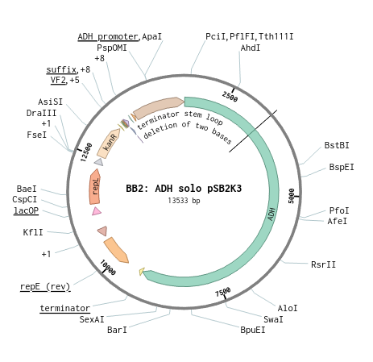
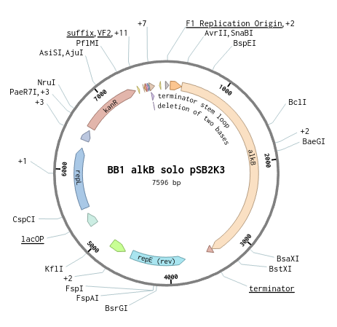
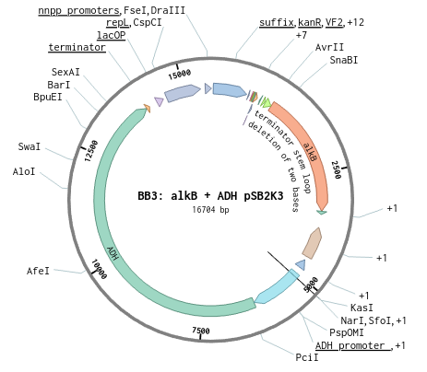
An Organic Approach to Crude Oil Degradation
Gabe Wolter, Trevor Wilson, Eli Landsman, Charles Yang, Alex Hymson, Ian Kelley
Mr. Kirkpatrick, Mr. Ben French (Mentor)
Oak Park and River Forest High School, Oak Park, IL, USA
Science Content
Started with research on current clean up methods of oil spills.
  Oil clean-up methods:
    Use booms to contain marine spills
      Then vacuums, aka skimmers, to suck up all the oil
    Burn top layer oil for quick oil extraction
      Nonrenewable process due to combustion
    Chemical dispersion: our chosen method,where water covered in oil is collected and treated with chemicals or biological agents
GOAL: Break down the oil into smaller pieces so that it will be able to degrade quicker in its natural state. In addition, the ADH protein will make the products of hydrocarbon breakdown usable for oil companies looking to minimize their losses.
alkB + ADH
ADH Solo
alkB solo
Next steps:
We plan to continue working past the assembly to get into testing the functionality of our 3 plasmids in a lab-induced crude oil and solution.
We would want to figure out a way to have an inducible backbone that would become induced by the contents of crude oil, e.g. alkanes.
Drawbacks
One of our major drawbacks of our project involve the ADH gene. Ideally, we would have liked to find a gene sequence of ADH that was shorter so it didn’t run the risk of over-working the cell.
References and acknowledgements
¹Luo, Qun, et al. “GPo1 alkB gene expression for improvement of the degradation of diesel oil by a bacterial consortium.” Brazilian Journal of Microbiology, 46. Jul 2015, pp. 649-657.
Registry of Standard Biological Parts. http://parts.igem.org/Main_Page
Adlin Nur Aina, et al. “Microbial Biodegradation of Paraffin Wax in Malaysian Crude Oil Mediated by Degradative Enzymes.” Frontiers in Microbiology, vol. 11, Sec. Microbiotechnology, 08 Sep. 2020.
Sui, Yu-An, et al. “Utilizing Alcohol for Alkane Biosynthesis by Introducing a Fatty Alcohol Dehydrogenase.” Applied and Environmental Microbiology. 13 Dec. 2022.
Smith CB, et al. “Alkane hydroxylase gene (alkB) phylotype composition and diversity in northern Gulf of Mexico bacterioplankton”. Frontiers in Microbiology. 4: 370. 12 Dec. 2013.
Dinamarca M. Alejandro, et al. “Expression of the Pseudomonas putida OCT plasmid alkane degradation pathway is modulated by two different global control signals: evidence from continuous cultures.” Journal of Bacteriology. 185(16), Aug 2003.
Kosuri, Sri. “Inducible copy number BioBrick plasmid Part:pSB2K3.” iGem. 04 May 2004.
Notes:
Identify key needs for advancing the project or lessons learned from this experience
If your team doesn’t continue the project next year, but it was picked up by another school’s team, what experiment would you want them to do? (Be specific so they can actually try it!)
Science Content
Our team started attacking our idea with research on current clean up methods. When an oil spill happens, the typical cleanup method is to simply use booms to stop the spread and then vacuums called skimmers to suck up all the oil. The diluted oil is then stored to potentially be sold to another company that needs it. With our method, water covered in oil would be collected and treated with a plasmid with the two protein gene sequences along with many other parts. The goal would be to break down the oil into smaller pieces so that it would be able to degrade quicker in its natural state. ADH LUCRATIVE because the ADH protein is able to reuse the products of hydrocarbon breakdown; meaning that ADH breaks down fatty-acid chains into fatty-alcohol which can than be reused.

